Slide 1
Cloudy With a Chance of Integration - Come and Learn About Oracle Integration Cloud Services
SESSION #5019
10/11/2017

Slide 2
presenters
James Imgraben
Senior Information Technologist
University of South Australia
James.Imgraben@unisa.edu.au

Slide 3
University of South Australia (UniSA)
6 Campuses
4 Metropolitan, 2 Regional
35,000+ Students

Slide 4
UniSA & Oracle
Oracle CX Cloud
Service Cloud – November 2016
Marketing Cloud – Release 492
Integration Cloud Services – 17.3.3
Sales Cloud – Release 12
Social Cloud
Content Marketing Cloud
Oracle PeopleSoft
Campus Solutions (PT8.56, v9.2)
CRM for Higher Education

Slide 5
Presentation Overview
1
2
3
Overview of ICS – Connections, Integrations and more
In Practice – Step through example uses cases of ICS for CX Integration
Introduction to UniSA and ICS

Slide 6
Introduction to oracle integration cloud service & uniSA
Brief overview of Integration Cloud Service and its usage at UniSA

Slide 7
UniSA & ICS
Throughout 2017 UniSA has been implementing the CX Cloud, ICS was acquired as part of that project as primary integration medium.
ICS is being used for:
Service Cloud (RightNow) to Marketing Cloud (Eloqua)
Marketing Cloud to Service Cloud
PeopleSoft Campus Solutions to Service Cloud
Service Cloud to PeopleSoft Campus Solutions
External to Service Cloud – various on premise systems as well as external (to UniSA) admissions systems

Slide 8
UniSA & ICS by the numbers
As of this presentation, we have 3 instances (dev, test, production)
6 Connections (4 distinct), 36 Integrations where:
18 manage Service Cloud to Marketing Cloud
2 manage Marketing Cloud to Service Cloud
3 ICS exposed Campus Solutions REST Services
3 manage PeopleSoft to Service Cloud
10 manage external systems to Service Cloud
40-60k messages flow through on average day across integrations

Slide 9
Overview of ICS & base components
Connections, Integrations, Libraries, Lookups & more.

Slide 10
What is Integration Cloud Service?
Oracle Cloud based integration platform that supports both cloud to cloud and on premise to cloud integrations
User-friendly, web based interface/designer
Drag-n-drop design for integrations between platforms using library of pre-built adapters
Depending on systems, integrations can be quickly developed without any code

Slide 11
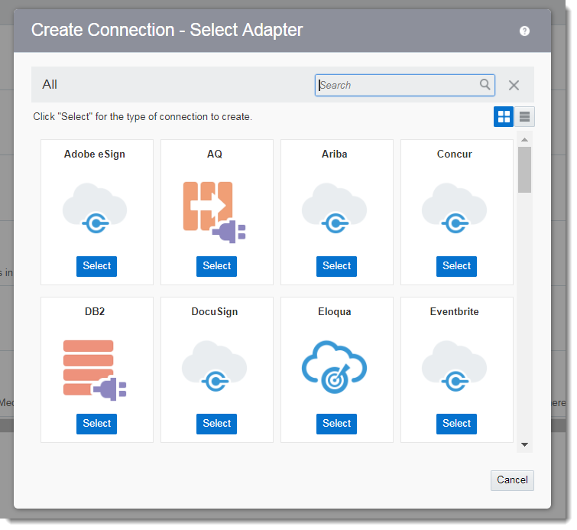
Connections in ICS
Represent a connection to another system, each using an adapter that provides system specific functionality
Can utilise adapters available from built-in library (49 and counting)
Adapters utilise system APIs to abstract complexities and simplify development

Slide 12
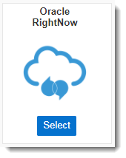
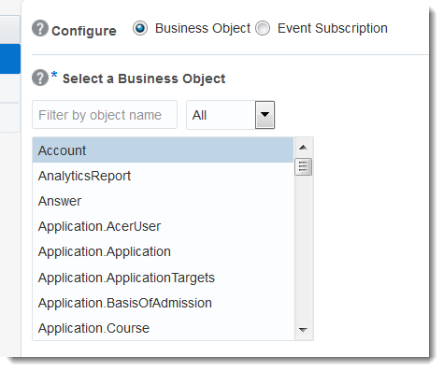
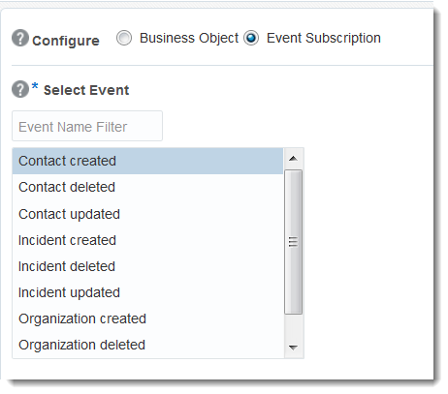
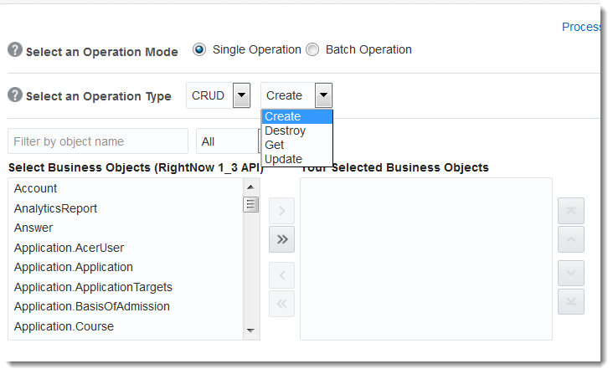
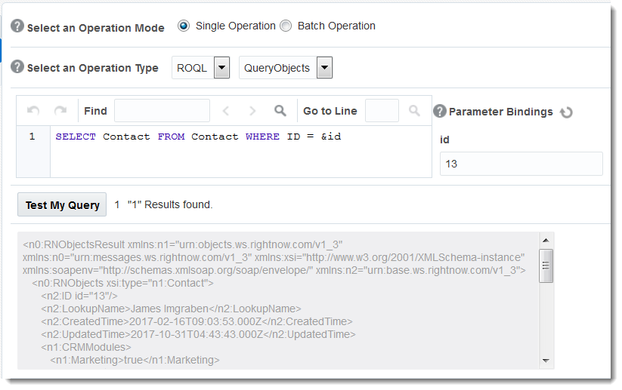
rightnow adapter
Expose base objects (Contacts, Incidents and Organisations) as well as custom objects
CRUD (Create, Read Update, Delete) operations for all objects or ROQL (by object or csv) based integrations
Subscribe to RightNow events for Contacts, Incidents and Organisations
Notes:
Setup using RightNow SOAP WSDL

Slide 13
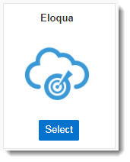
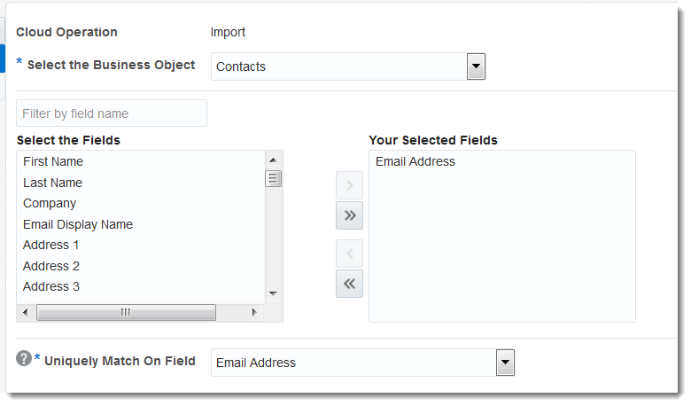
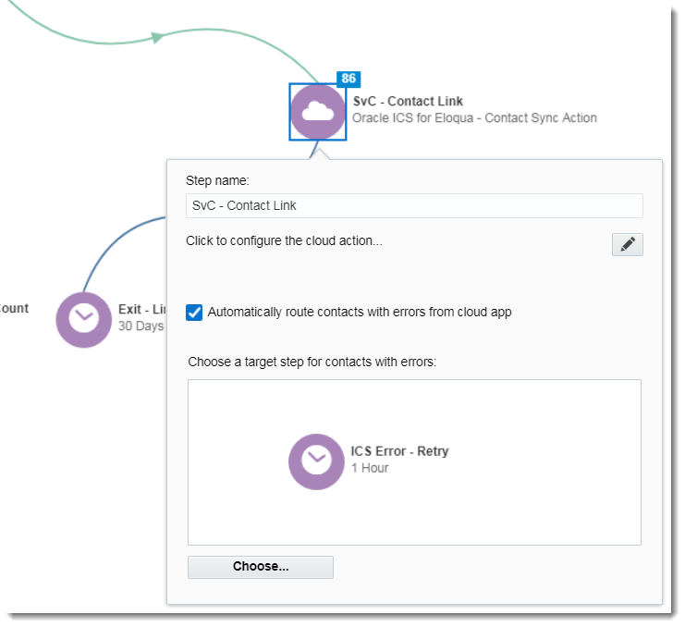
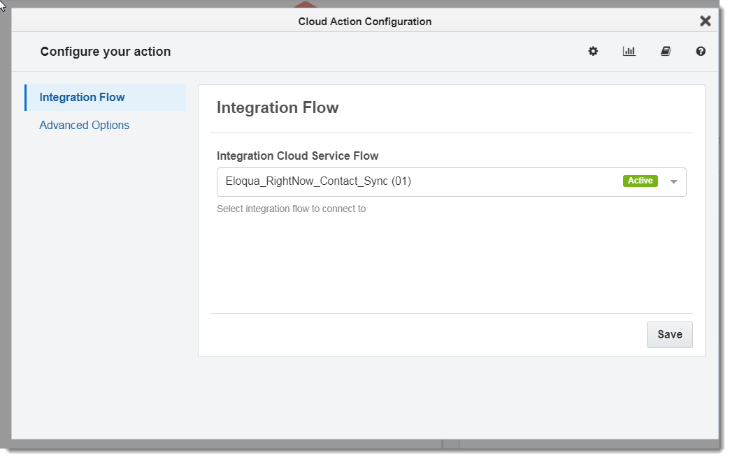
Eloqua adapter
Expose base objects (Contacts, Accounts) as well as custom objects
Uses Eloqua Bulk API 2.0 for importing data
Allows use of ICS App within Eloqua to trigger calls from program or campaign flows
Notes:
Bulk API – asynchronous, when importing to Eloqua you will not get immediate response for data integrity issues

Slide 14
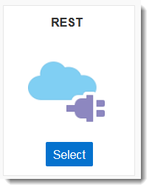
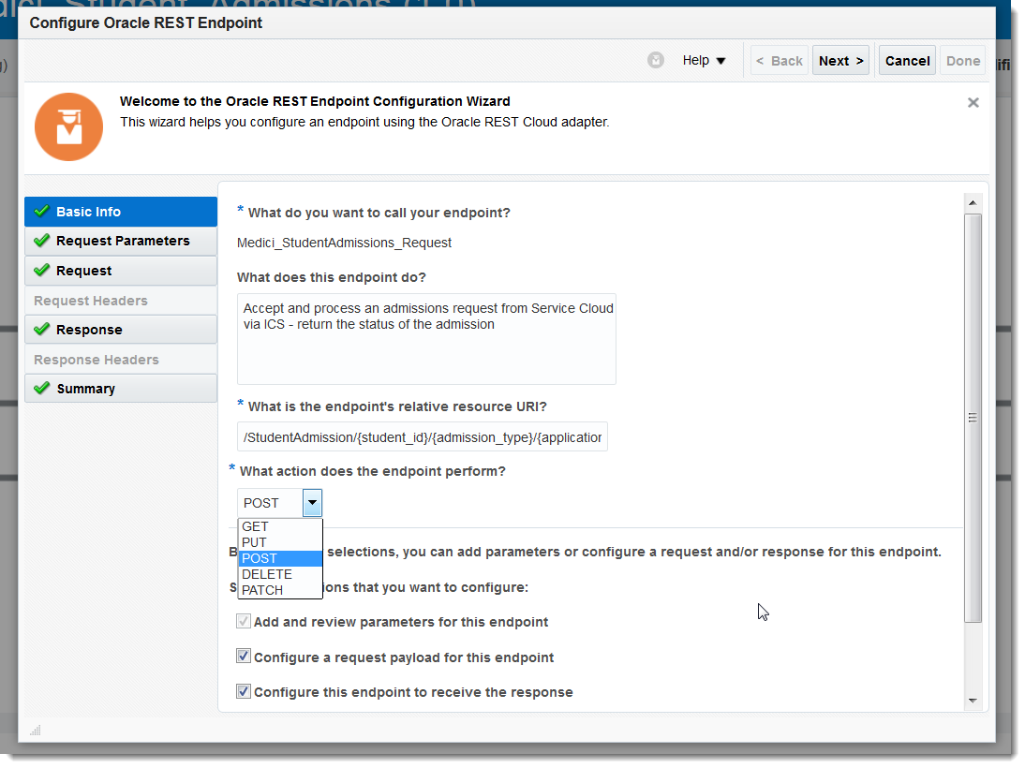
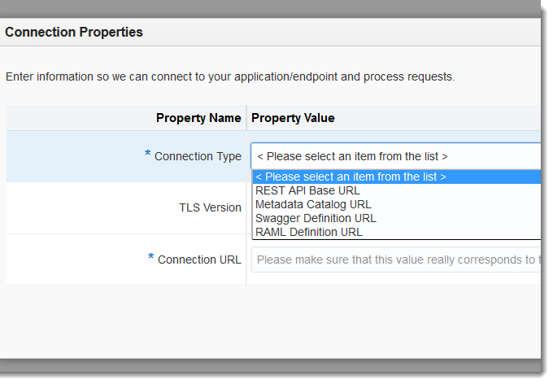
rest Adapter
Generic REST adapter for any application that exposes a REST API
Multiple connection types available base URL, WADL, swagger , RAML
When used with Trigger only, allows ICS to expose endpoints to other adapters
https://ics/integration/contact/
{
"first_name":"",
"last_name":"",
"email_address":""
}
REST Adapter
RightNow Adapter
RightNow
Notes:
Can use both RightNow and Eloqua REST APIs manually (no RightNow/Eloqua adapter) using the REST adapter

Slide 15
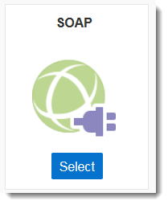
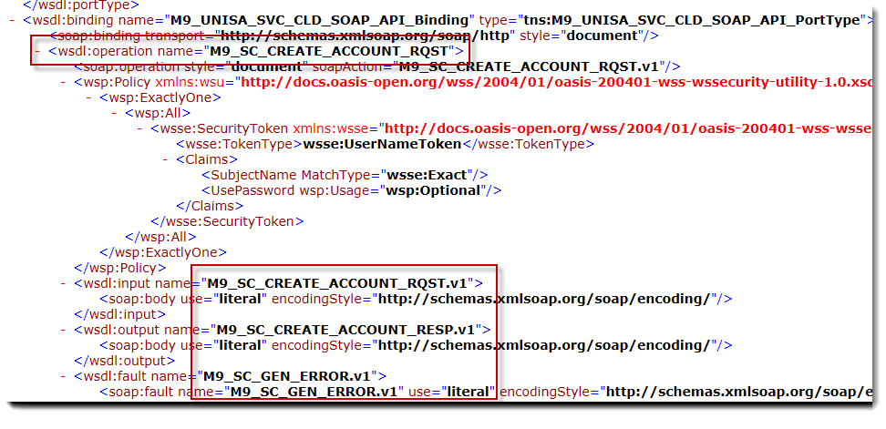
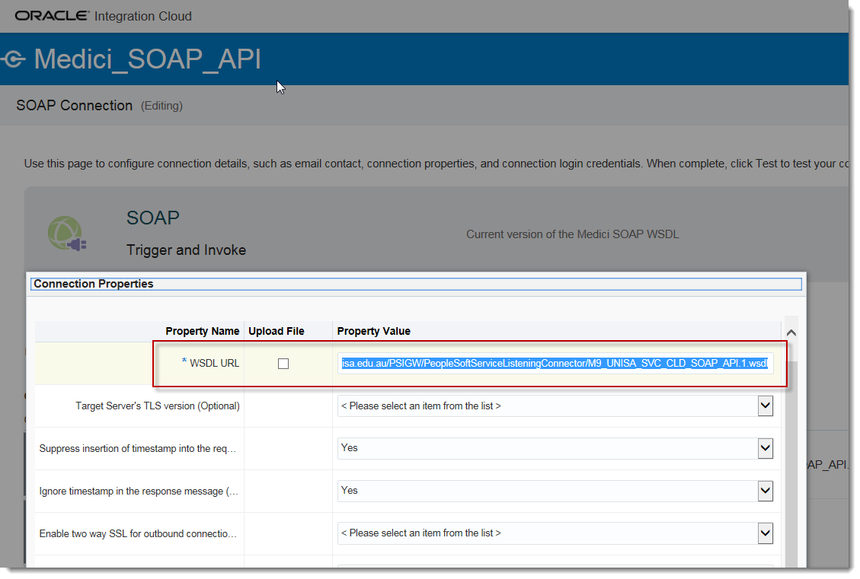
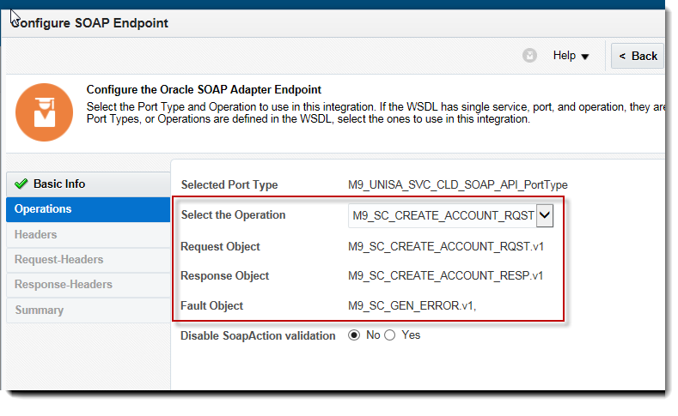
soap adapter
Generic REST adapter for any application that exposes a SOAP WSDL
Import WSDL file or via URL (needs to be externally available)
Connection compiles metadata for WSDL – service operations and message definitions

Slide 16
PeopleSoft Adapter
No pre-built PeopleSoft adapter available
UniSA have setup both a SOAP and REST adapters for both inbound and outbound integrations
Services need to be manually built in PeopleSoft

Slide 17
PeopleSoft Adapter Cont.
As both the REST & SOAP use same base WSDL they count as connection (physically more) e.g.
https://api.unisa.edu.au/PSIGW/PeopleSoftServiceListeningConnector/XYZ.1.wsdl
https://api.unisa.edu.au/PSIGW/PeopleSoftServiceListeningConnector/ABC.1.wsdl
https://api.unisa.edu.au/PSIGW/RESTListeningConnector/
https://api.unisa.edu.au/ is the base URL for the system = 1 licensed connection

Slide 18
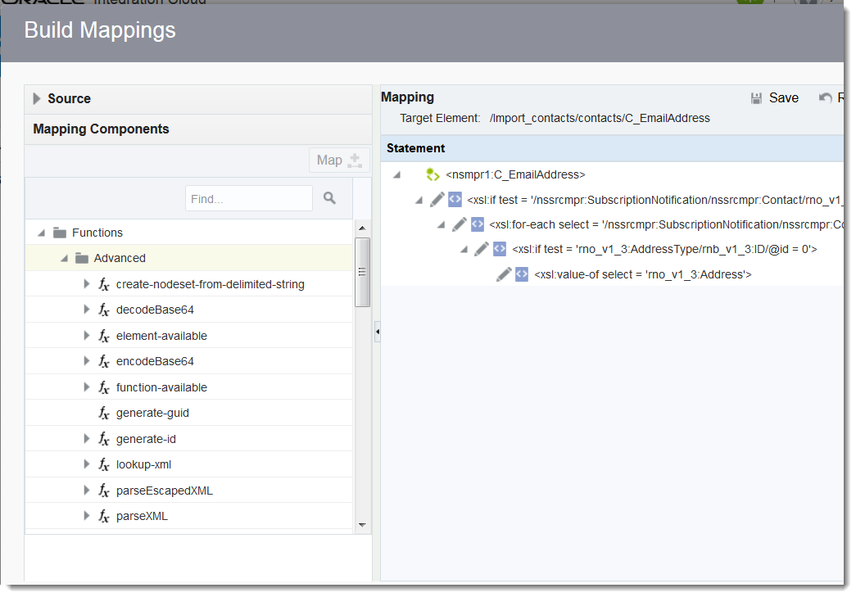
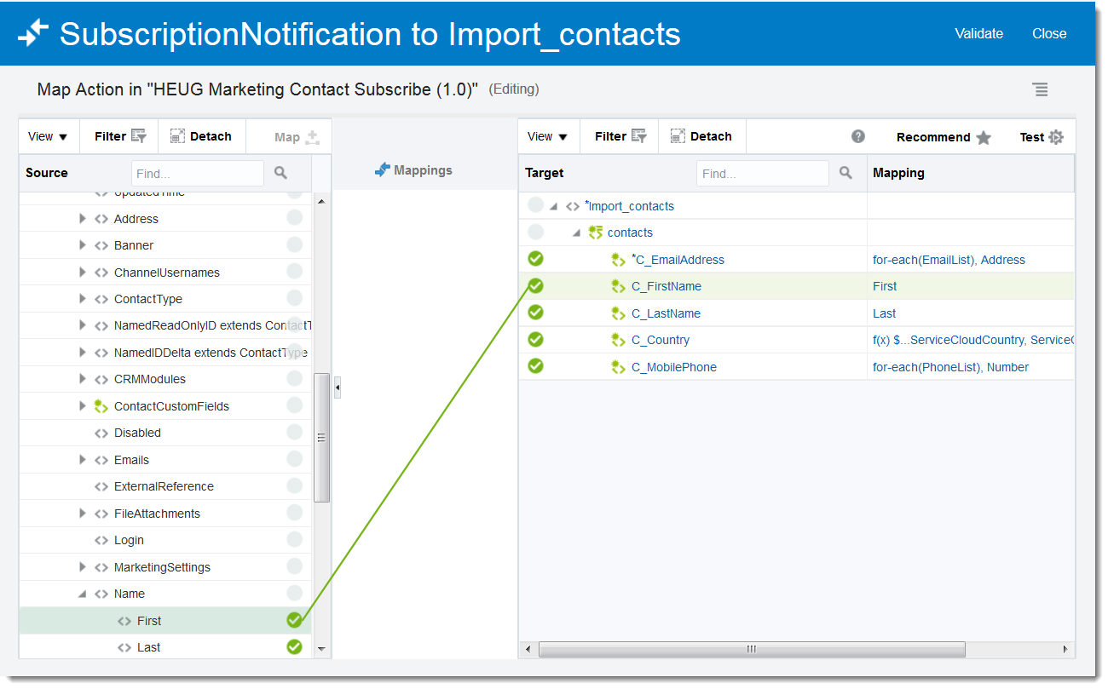
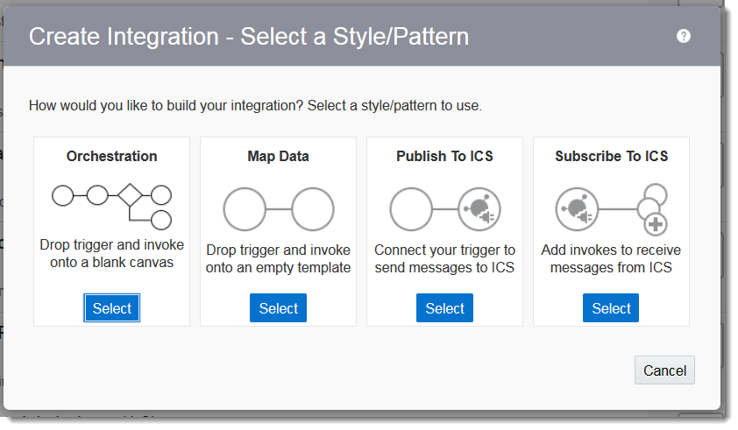
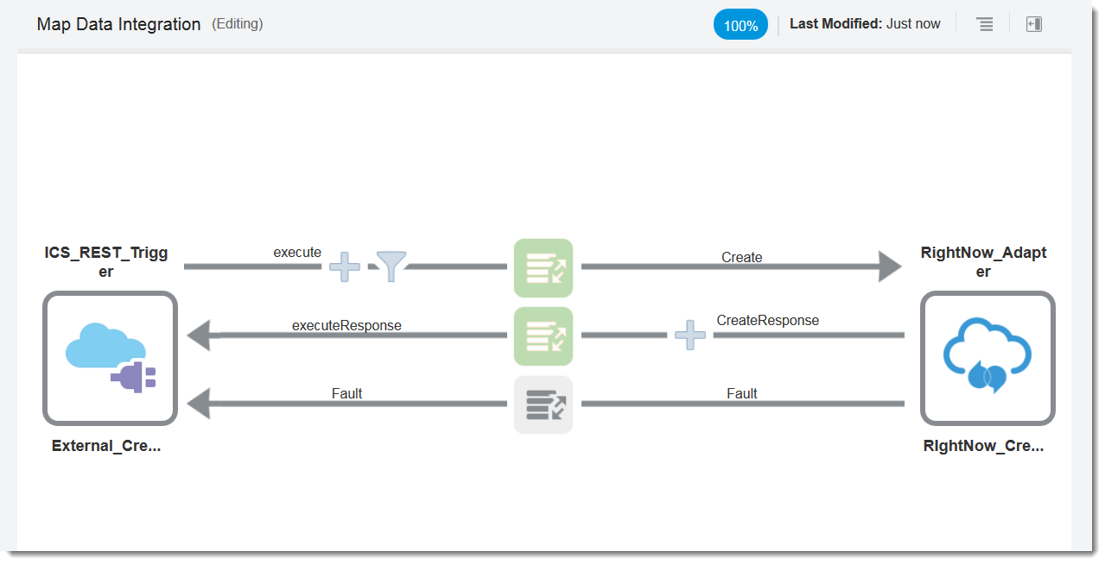
Integrations
Connect two adapters to create integrations; a trigger and invoke
Multiple styles/patterns allow simple or complex design
XSLT mapping tool maps data between adapters
XPath/BPEL XPath functions allow data transformation during mapping

Slide 19
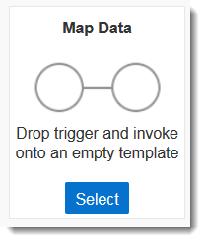
map data
Standard integration style – request, response, fault mapping supported
Requires a trigger and invoke connection
Depending on connections used, can operate as asynchronous or synchronous
Mapping available for request, response and fault messages

Slide 20
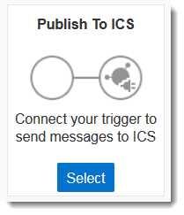
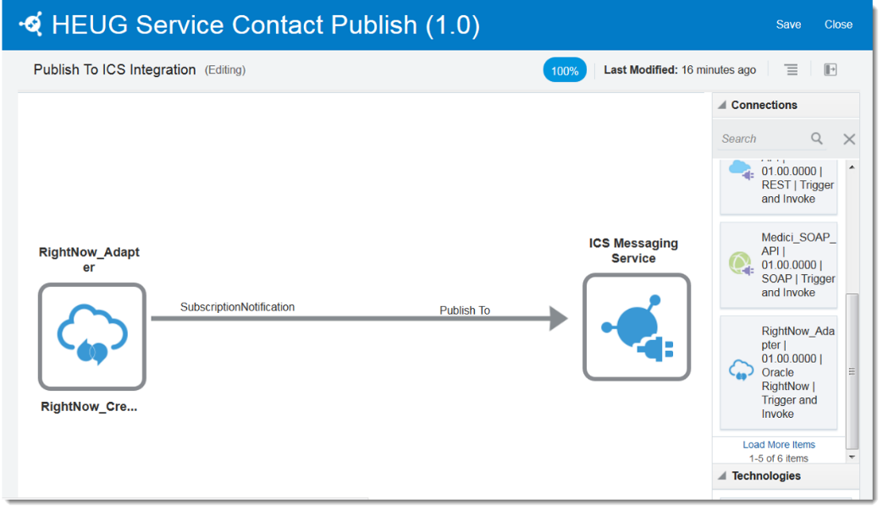
publish to ICS
Publish messages from trigger connection to ICS Messaging Service
Any number of Subscriber integrations can subscribe and be triggered by a message being published
Uses map canvas (not orchestration) and operate as one way integration (asynchronous)
No mapping required for Publish – message is sent as is with no transformation

Slide 21
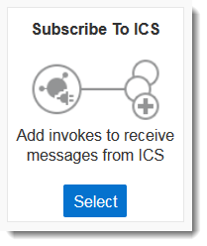
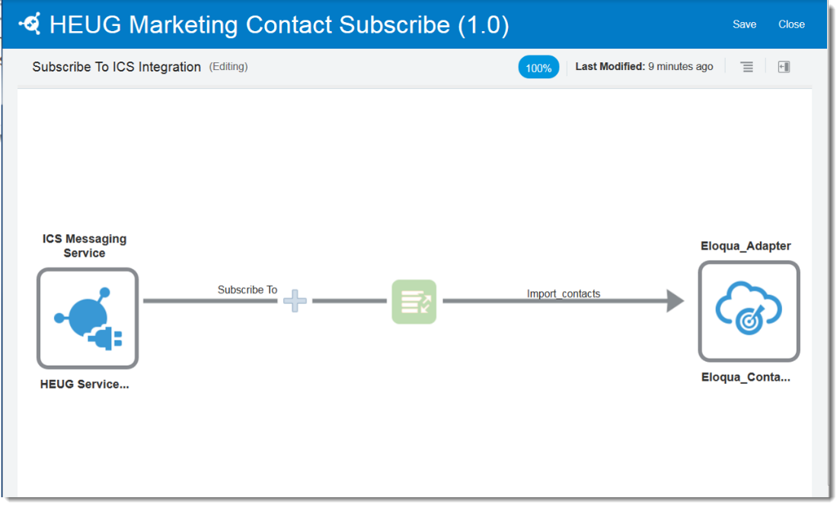
subscribe to ICS
Subscribe to messages published to ICS Messaging Service and send on to invoke connection
Requires an active Publish Service to Setup
As with Publish, Subscribe integrations use map canvas and operate as asynchronous messages (one way)
Mapping available when processing the message

Slide 22
Publish & subscribe
Contact Subscribe
Sales Cloud
Contact Publish
Service Cloud
Contact Subscribe
Marketing Cloud

Slide 23
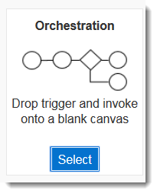
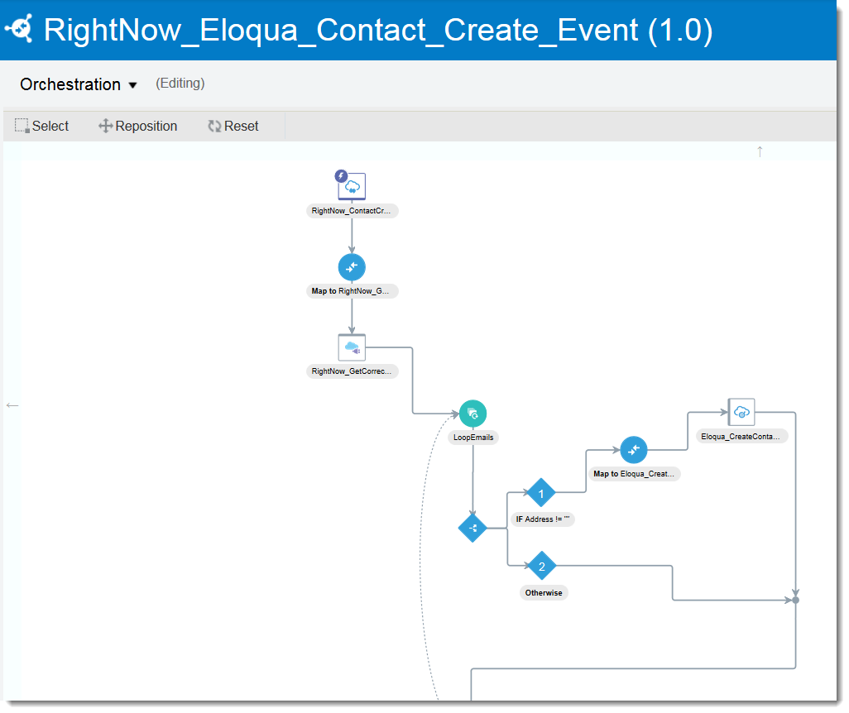
orchestrations
Uses workflow style canvas to build integrations
Allows for complex conditions, functions and actions to build logic
Orchestration trigger can be event or object or on a schedule
Scheduled Orchestrations have no connection based trigger

Slide 24
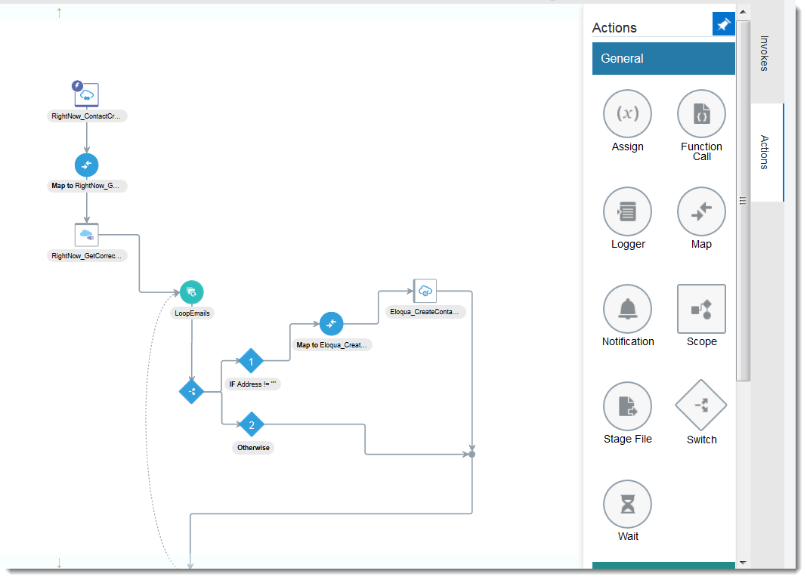
orchestrations actions

Slide 25
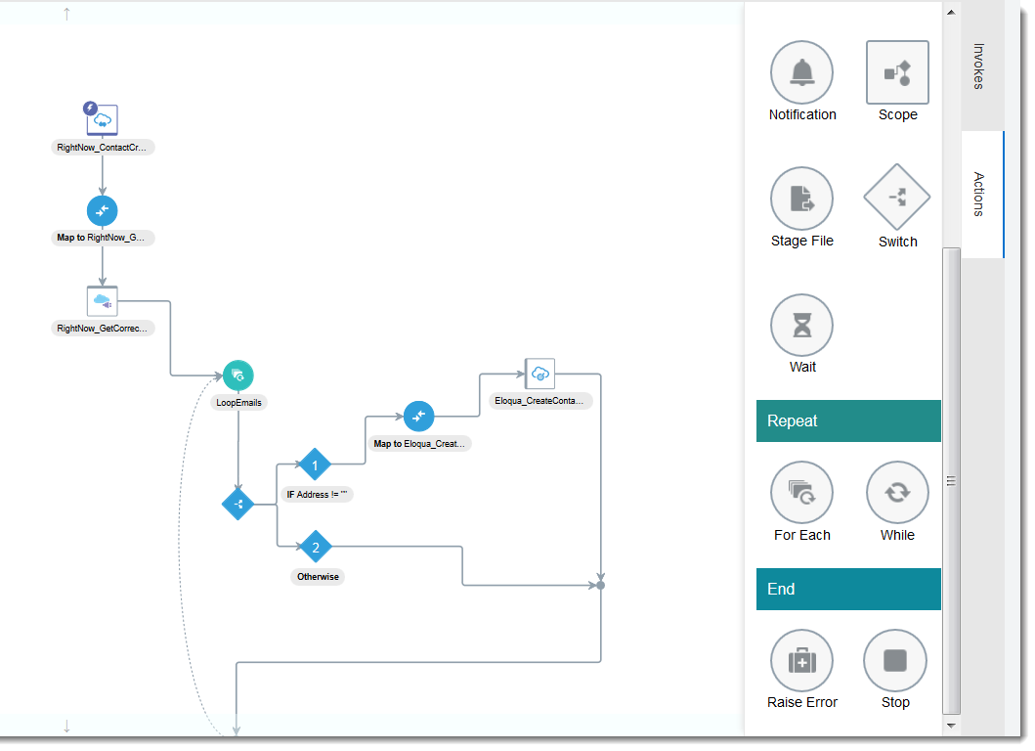
orchestrations actions

Slide 26
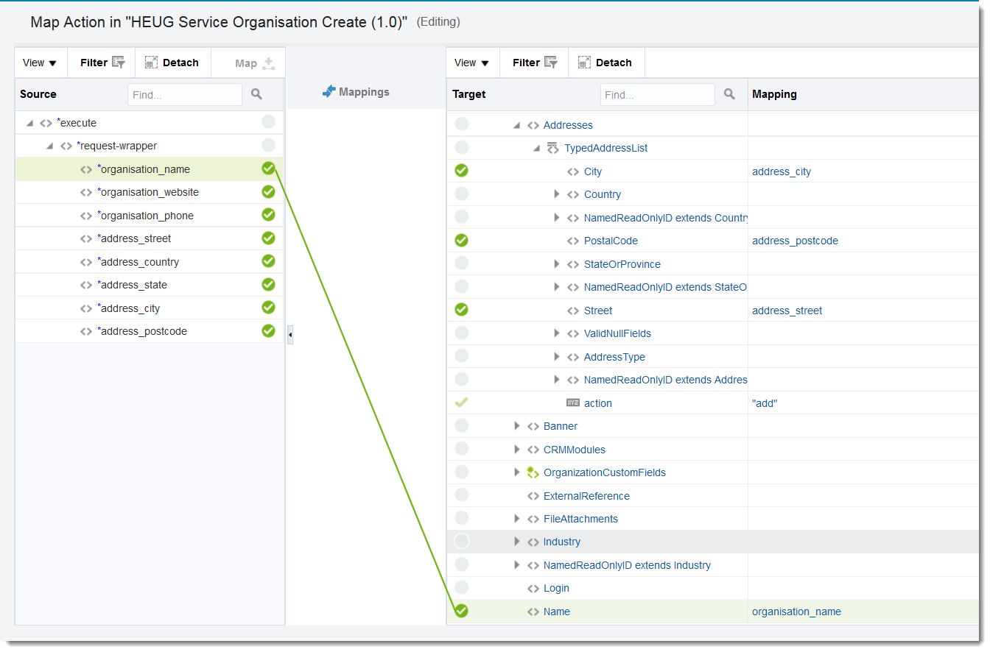
Integrations – mapping

Slide 27
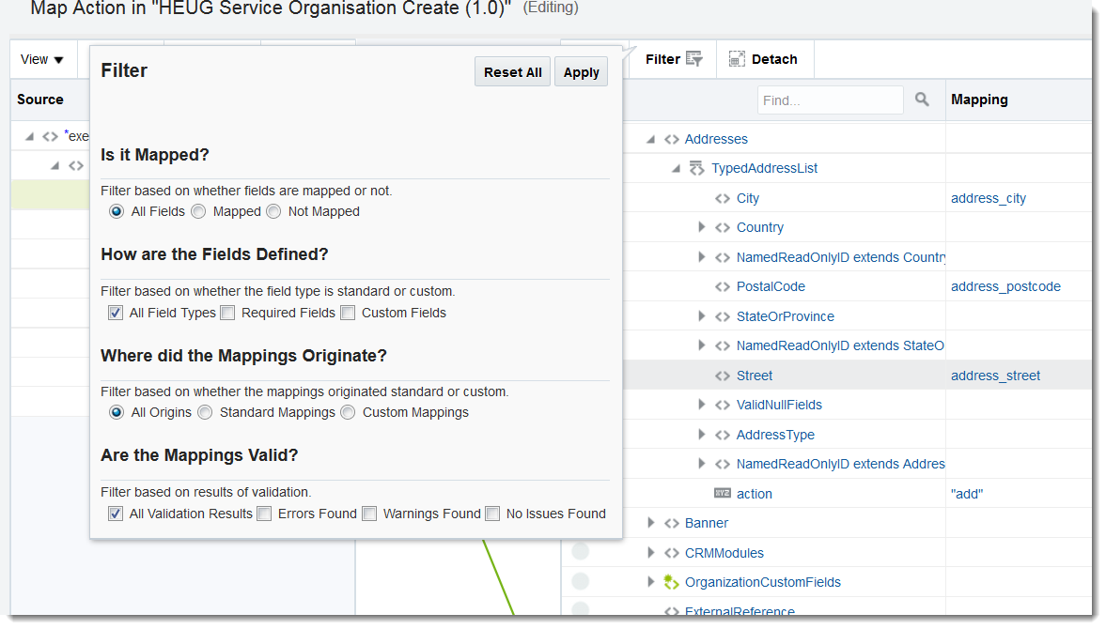
Integrations – mapping

Slide 28
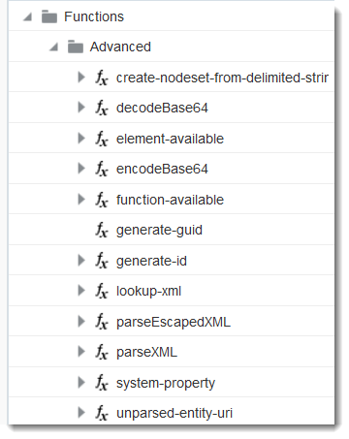
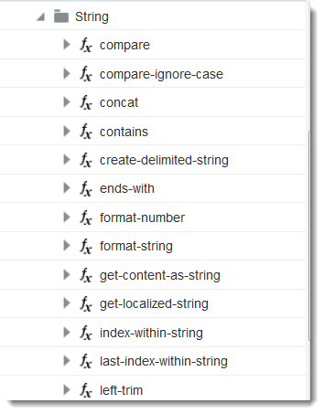
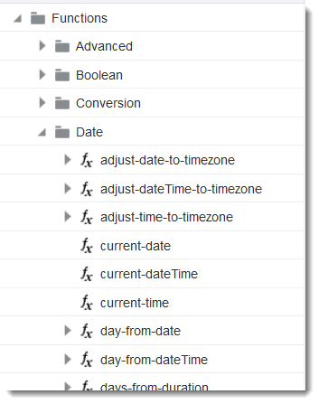
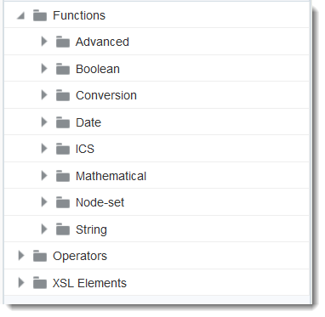
Integrations – functions

Slide 29
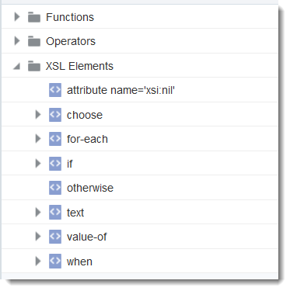
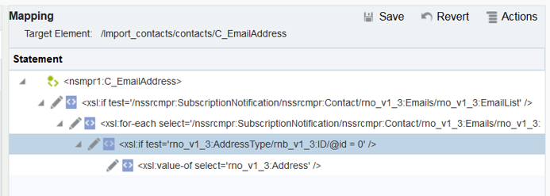
Integrations – XSL elements
If email object is populated
For each email in EmailList
If Address Type ID = 0
Set C_EmailAddress = Address

Slide 30
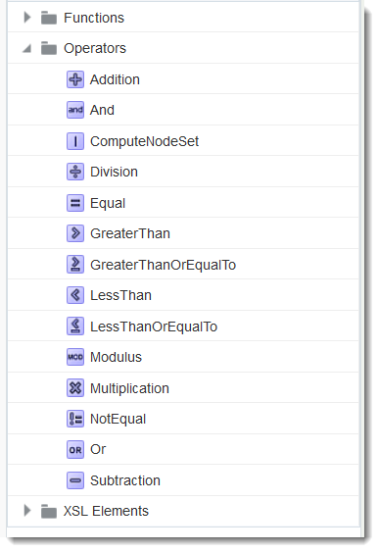
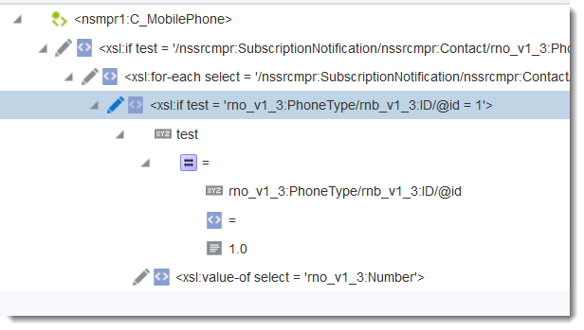
Integrations – Operators
If Phone Type ID = X

Slide 31
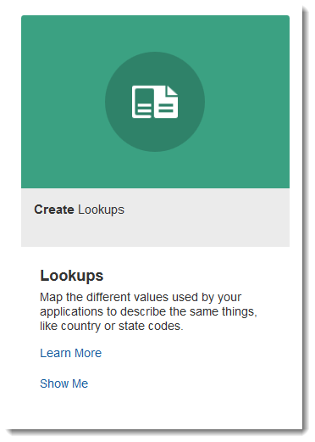
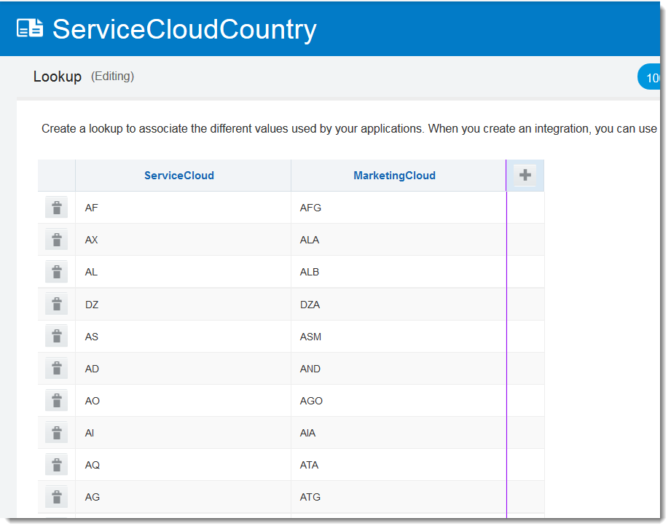
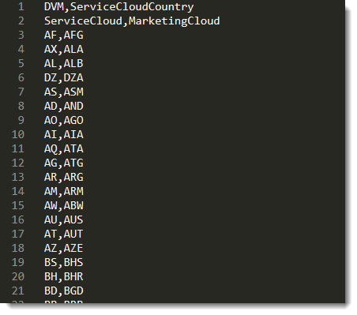
lookups
e.g. trigger sends AU, invoke expects AUS
Lookup can be setup to map AU = AUS, NZ = NZL, US = USA, etc.
Upload as csv or maintain manually
Lookups allow for dynamic conversion of values between source to target systems

Slide 32
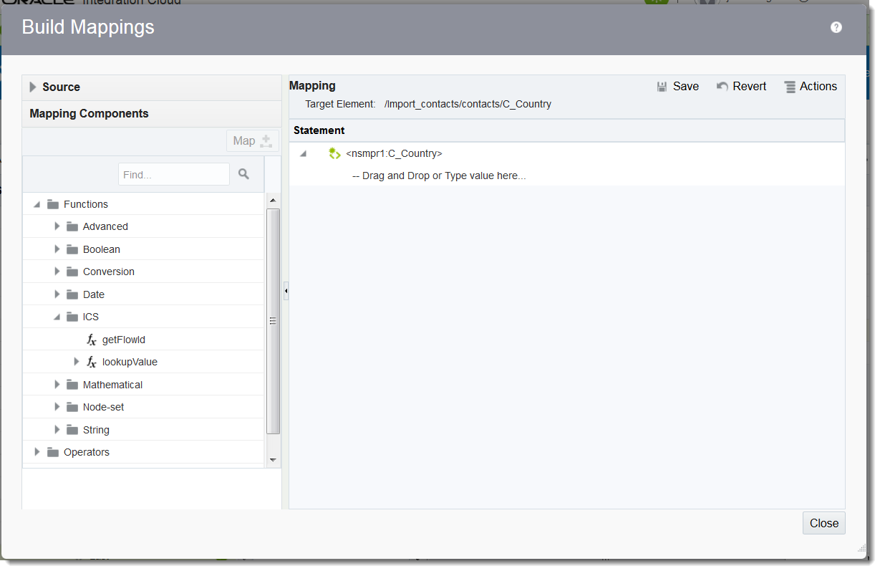
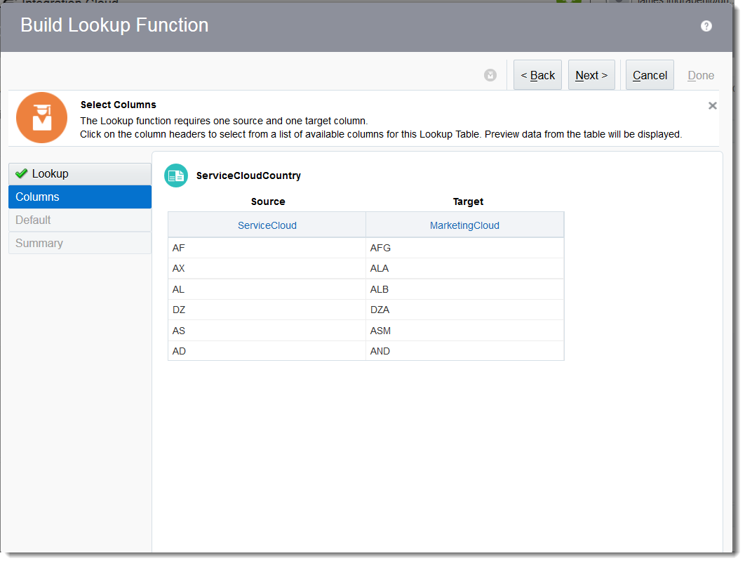
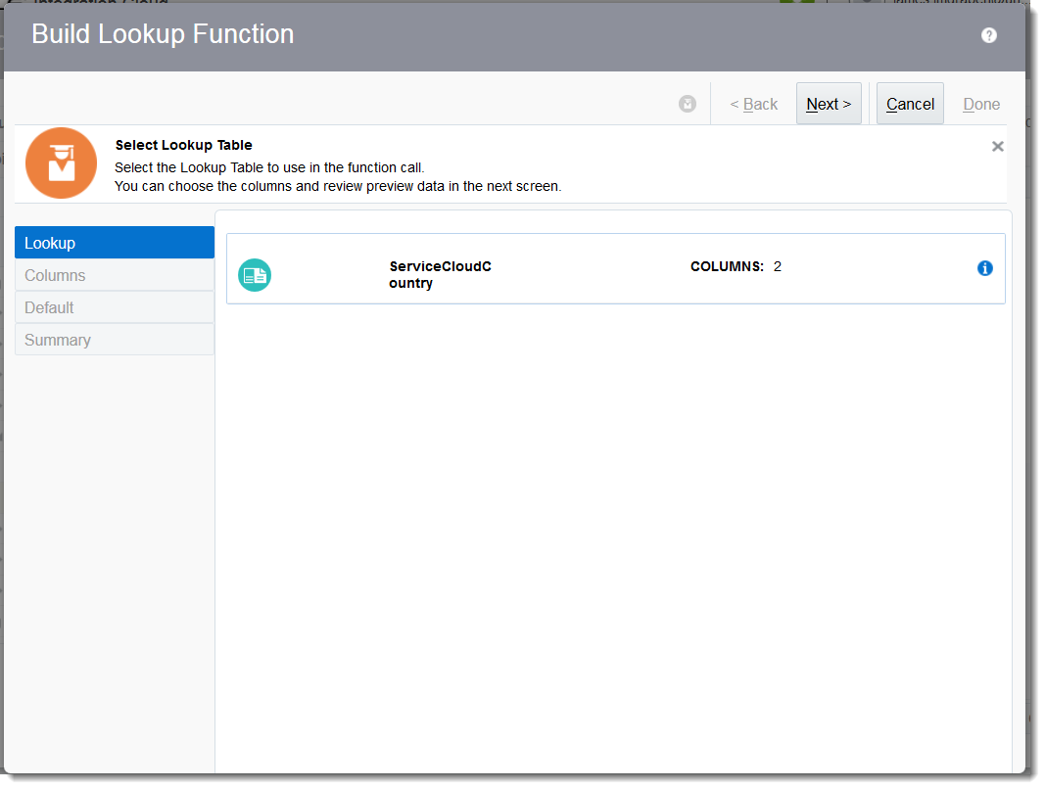
Using lookups when mapping
Notes:
Used when mapping any integration type; basic, orchestration, subscribe, etc.

Slide 33
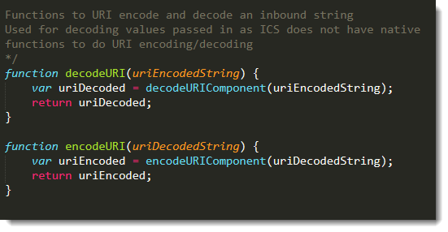
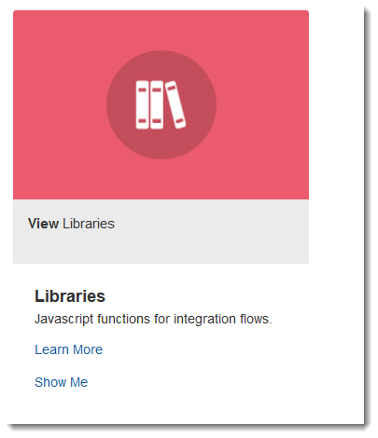
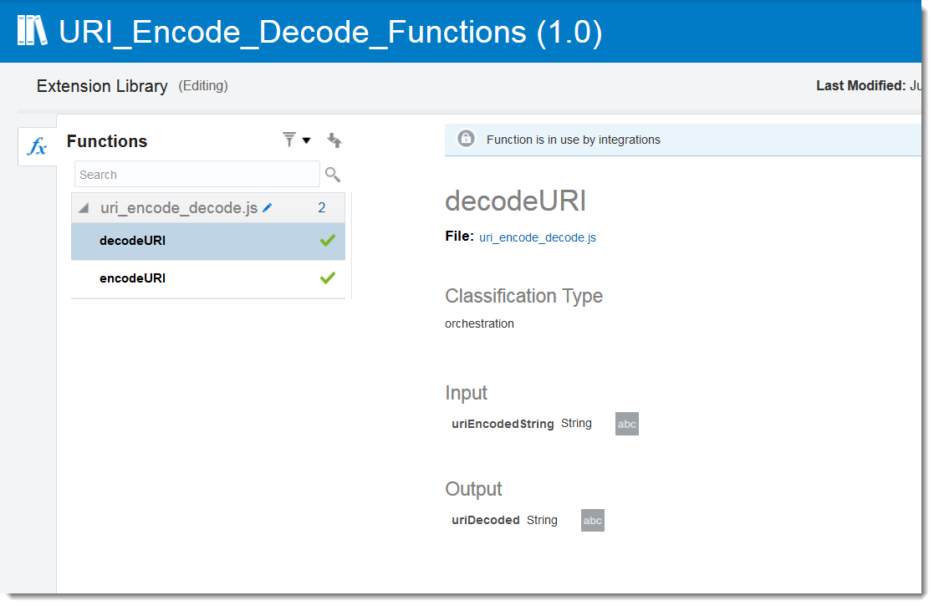
libraries
Javascript libraries to extend integration capabilities
Add values, compare dates on Orchestration canvas using JavaScript functions
Mapping functions don’t support URI decoding by default – can use a library to decode and use result in mapping

Slide 34
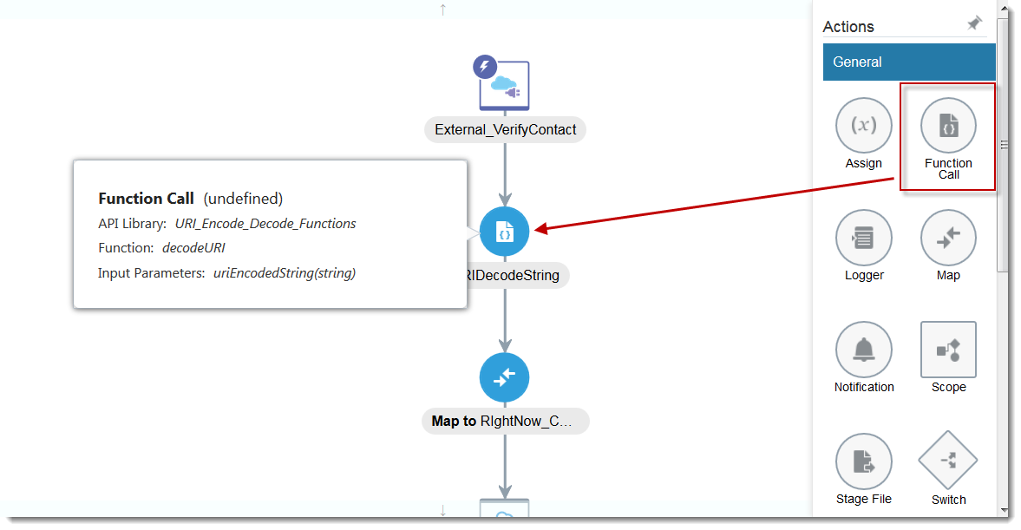
Using libraries in an orchestration

Slide 35
Packages
Allow for logical grouping of integrations
Assigned at the time of creating an integration
Export and import packages into environments

Slide 36
Migrating between environments
Individual integrations can be exported (.iar) as well as packages (.par)
Export files take all artifacts – connections, integrations, lookups, libraries, etc.
Connections imported lose all configuration
Notes:
Import connections means you can import into live instance and not be concerned about existing integrations breaking – new connection information is only picked up on re-activating an integration

Slide 37
monitoring

Slide 38
Monitoring - Notifications

Slide 39
ICS in practice – example use cases
All of the following are available to download on HEUG Site (.par file for import) + instruction document

Slide 40
Use cases
Externally exposed ICS REST endpoint to Service Cloud Organisation
POST REST request to ICS to create an organisation in Service Cloud from request body
Demonstrate basic map – request/response
Demonstrate mapping data for creating objects in Service Cloud
Demonstrate how to call/test resulting endpoint

Slide 41
Exposing adapter as ics endpoint

Slide 42
Exposing adapter as ics endpoint

Slide 43
Exposing adapter as ics endpoint

Slide 44
Exposing adapter as ics endpoint

Slide 45
Exposing adapter as ics endpoint

Slide 46
Exposing adapter as ics endpoint

Slide 47
Exposing adapter as ics endpoint

Slide 48
Exposing adapter as ics endpoint

Slide 49
Exposing adapter as ics endpoint

Slide 50
Exposing adapter as ics endpoint

Slide 51
Exposing adapter as ics endpoint

Slide 52
Exposing adapter as ics endpoint

Slide 53
Exposing adapter as ics endpoint

Slide 54
Exposing adapter as ics endpoint
00

Slide 55
Exposing adapter as ics endpoint

Slide 56
Exposing adapter as ics endpoint

Slide 57
Exposing adapter as ics endpoint

Slide 58
Exposing adapter as ics endpoint

Slide 59
Exposing adapter as ics endpoint

Slide 60
Exposing adapter as ics endpoint

Slide 61
Exposing adapter as ics endpoint

Slide 62
Exposing adapter as ics endpoint

Slide 63
Exposing adapter as ics endpoint

Slide 64
Exposing adapter as ics endpoint

Slide 65
Exposing adapter as ics endpoint

Slide 66
Exposing adapter as ics endpoint

Slide 67
Exposing adapter as ics endpoint

Slide 68
Exposing adapter as ics endpoint

Slide 69
Exposing adapter as ics endpoint

Slide 70
Exposing adapter as ics endpoint

Slide 71
Use cases
Orchestration to send all emails for a Service Cloud contact to Marketing Cloud as separate contacts
Contact with 3 emails should result in 3 Eloqua contacts
Demonstrate orchestration type
Demonstrate how to loop a collection in an orchestration
Demonstrate mapping data for complex scenarios
Demonstrate how to use lookups when mapping
Demonstrate event notification framework in RightNow

Slide 72
Contact sync with orchestration

Slide 73
Contact sync with orchestration

Slide 74
Contact sync with orchestration

Slide 75
Contact sync with orchestration

Slide 76
Contact sync with orchestration

Slide 77
Contact sync with orchestration

Slide 78
Contact sync with orchestration

Slide 79
Contact sync with orchestration

Slide 80
Contact sync with orchestration

Slide 81
Contact sync with orchestration

Slide 82
Contact sync with orchestration

Slide 83
Contact sync with orchestration

Slide 84
Contact sync with orchestration

Slide 85
Contact sync with orchestration

Slide 86
Contact sync with orchestration

Slide 87
Contact sync with orchestration

Slide 88
Contact sync with orchestration

Slide 89
Contact sync with orchestration

Slide 90
Contact sync with orchestration

Slide 91
Contact sync with orchestration

Slide 92
Contact sync with orchestration

Slide 93
Contact sync with orchestration

Slide 94
Contact sync with orchestration

Slide 95
Contact sync with orchestration

Slide 96
Contact sync with orchestration

Slide 97
Contact sync with orchestration

Slide 98
Contact sync with orchestration

Slide 99
Contact sync with orchestration

Slide 100
Contact sync with orchestration

Slide 101
Contact sync with orchestration

Slide 102
Contact sync with orchestration

Slide 103
Contact sync with orchestration
Service Cloud exports 2 character ISO code e.g. AU, NZ
Marketing Cloud corresponding field has lookup that expects 3 character ISO code e.g. AUS, NZL
Need to use an ICS lookup function to assess and convert
Requires lookup is setup already

Slide 104
Contact sync with orchestration

Slide 105
Contact sync with orchestration

Slide 106
Contact sync with orchestration

Slide 107
Contact sync with orchestration

Slide 108
Contact sync with orchestration

Slide 109
Contact sync with orchestration

Slide 110
Contact sync with orchestration

Slide 111
Contact sync with orchestration

Slide 112
Contact sync with orchestration

Slide 113
Contact sync with orchestration

Slide 114
Contact sync with orchestration

Slide 115
Contact sync with orchestration

Slide 116
Contact sync with orchestration
Phone is a List/Object from Service Cloud
If phone object is populated
For each phone in PhoneList
If Phone Type ID = 1
Set C_MobilePhone = number
0
1
2
3
4

Slide 117
Contact sync with orchestration

Slide 118
Contact sync with orchestration

Slide 119
Contact sync with orchestration

Slide 120
Contact sync with orchestration

Slide 121
Contact sync with orchestration

Slide 122
Contact sync with orchestration

Slide 123
Contact sync with orchestration

Slide 124
Contact sync with orchestration

Slide 125
Contact sync with orchestration

Slide 126
Contact sync with orchestration

Slide 127
Contact sync with orchestration

Slide 128
Contact sync with orchestration

Slide 129
Contact sync with orchestration

Slide 130
Contact sync with orchestration

Slide 131
Contact sync with orchestration

Slide 132
Contact sync with orchestration

Slide 133
Contact sync with orchestration

Slide 134
Contact sync with orchestration

Slide 135
Contact sync with orchestration

Slide 136
Contact sync with orchestration

Slide 137
Contact sync with orchestration

Slide 138
Contact sync with orchestration
https://{interface}.custhelp.com/services/rest/connect/v1.3/eventSubscriptions/

Slide 139
Contact sync with orchestration
https://{interface}.custhelp.com/services/rest/connect/v1.3/eventSubscriptions/
Contact Create
Update
Delete
Event Notification Process/CPM
ICS
Event Subscriptions
HEUG_SVC_CLOUD_CONTACT_SYNC/v01/

Slide 140
Contact sync with orchestration

Slide 141
Contact sync with orchestration

Slide 142
Contact sync with orchestration

Slide 143
Contact sync with orchestration

Slide 144
Contact sync with orchestration

Slide 145
Contact sync with orchestration
ICS import files attached on presentation files.
As well as 2 demonstrated, there are also:
Example of publish/subscribe using event notification framework to send contact create from Service Cloud to Marketing Cloud
Orchestration for ICS exposed integration to verify a Service Cloud contact – uses a library for decoding

Slide 146
Concluding thoughts
ANY QUESTIONS?

Slide 147
presenters
James Imgraben
Senior Information Technologist
University of South Australia
James.Imgraben@unisa.edu.au
all Alliance presentations will be available for download from the Conference Site

Slide 148
THANK YOU!

