Slide 1
Managing Enrolment Issues in a Multi-campus Environment
SESSION 2026
November 14, 2016

Slide 2
presenter
Stephen Ko
Team Leader / Systems Analyst – Student Academic Information System
eUP Project – University of the Philippines Diliman
stko@up.edu.ph

Slide 3
University of the Philippines
8 Constituent Universities: UP Manila, Baguio, Cebu, Los Baños, Open University, Visayas, Mindanao, Diliman

Slide 4
ORGANIZATION & ORACLE
Campus Solutions 9.0 Peopletools 8.52

Slide 5
OVerview
Here are the topics to be discussed:
ISSUES ENCOUNTERED DURING IMPLEMENTATION Discussion of issues encountered with the delivered functionalities of Campus Solutions
SOLUTIONS TO THE ISSUES ENCOUNTERED Presentation of the configurations and customizations done to resolve issues encountered
CONCLUSION

Slide 6
ISSUES encountered during implementation and its Solutions

Slide 7
ISSUES encountered during implementation
Each constituent universities has different enrolment processes and requirements
Maximum Credited Units allowed per semester
Grading Scheme issue
Online Advisement
Student Evaluation for Teaching
Blocking of Payments
Slow Invoice Printing

Slide 8
Each constituent Universities have different enrolment processes and requirements
Each CUs has different legacy systems. Each CUs has different enrolment workflows (Standardization)
Resistance to Change
User Errors

Slide 9
Maximum Credited Units allowed per Semester
Definition: Credited courses – these are either majors or electives that can be taken by a student. Grades taken from these courses are included in the computation of the general weighted average of the student.
Non credited courses – these are PE or NSTP courses which are graded but not included in the computation of the general weighted average of the students Scenario:
A computer science student is allowed to take 19 units of graded units per semester and up to 5 units of non credited courses
In the delivered functionality, there is no way to restrict students to only take 19 units of graded units and 5 units of non credited courses

Slide 10
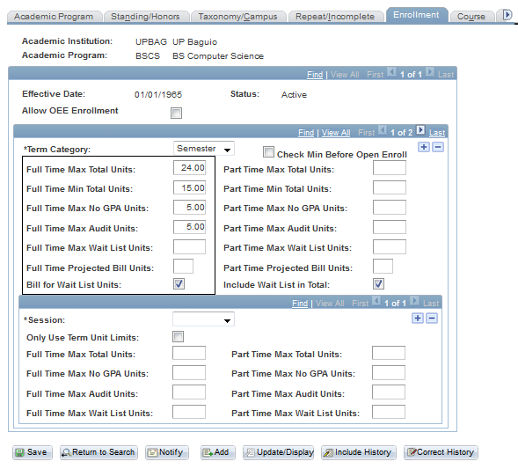

Slide 11
Maximum Credited Units allowed per Semester
Customization: Peoplecode
Fields involved: Full time max units, Full time max no gpa units (field was replaced with full time max non credit units) Formula used: Credited units = Full time max units – Full time max non credit units

Slide 12
Maximum Credited Units allowed per Semester
Example: A computer science student is allowed to take 19 units of graded units per semester and up to 5 units of non credited courses Full time max units = 24 Full time non credit units = 5 Credited units = Full Time max units – Full time non credit units
Credited units = 24 – 5 Credited units = 19 units

Slide 13
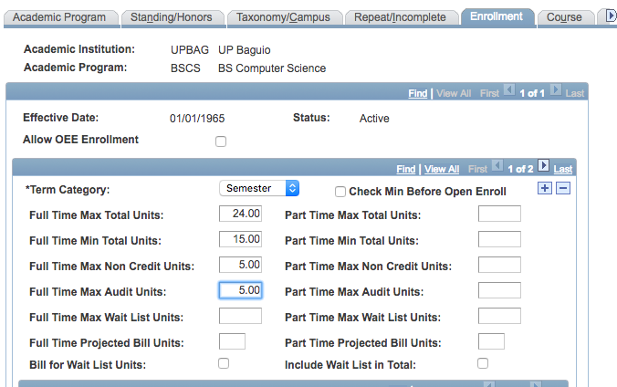
Maximum Credited Units allowed per Semester

Slide 14
Grading Scheme Issue
Grading Scheme of UP: 1.00, 1.25, 1.5, 1.75, 2.00, 2.25, 2.50, 2.75, 3.00, 4.00, 5.00, INC, DRP Problem: Grade input field only contains 3 characters and is being displayed in several components

Slide 15
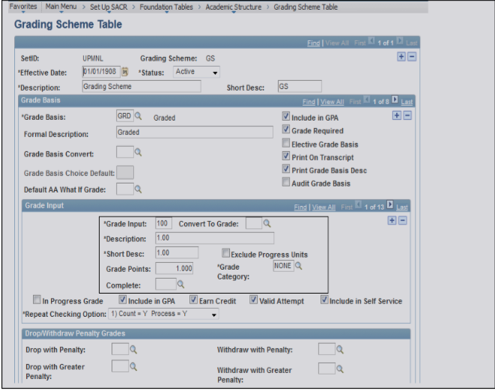
Grading Scheme Issue

Slide 16
Grading Scheme Issue
Solution: Made the grade input field invisible and used the description field to appear instead.

Slide 17
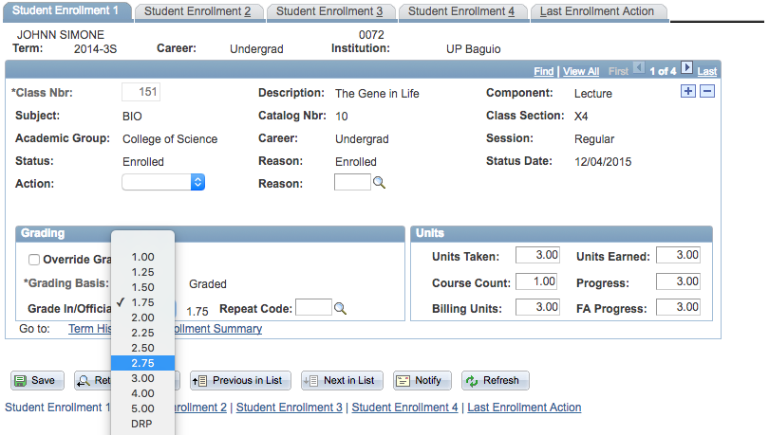
Grading Scheme Issue

Slide 18
Online Advisement
Problem:
In the enrolment process of UP, the advisers must approve the subjects taken by the students before they can proceed with the enrolment. Students pre-enlist their subjects 2 weeks before the actual enrolment. Using advisor center, advisers can view the subjects of the student but they cannot approve the subjects online.

Slide 19
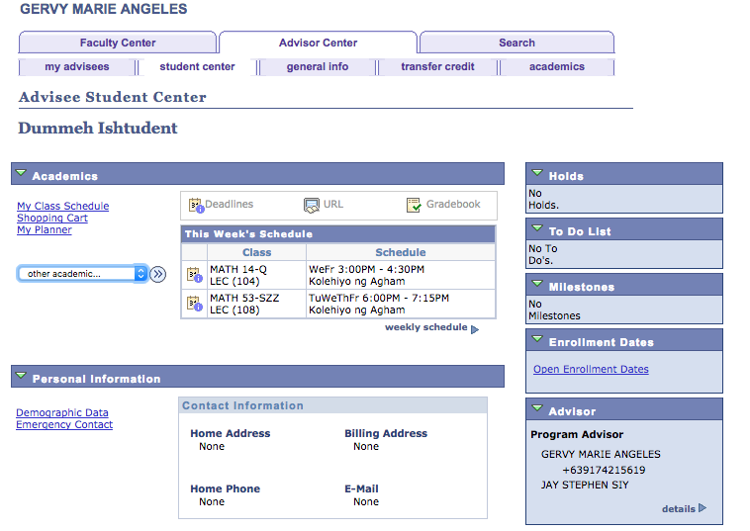
Online Advisement

Slide 20
Online Advisement
Solution: Used a service indicator “Advised” with a service impact that blocks enrolment. Advisers will tag students whose subjects were already approved. A service impact (Block enrollment) is attached to the student so that once approved by the adviser, he/she cannot change subjects anymore unless permitted by the department.

Slide 21
Student Evaluation for Teaching (SET)
SET is required for students to answer after they take their classes. This will help the university evaluate the performance of the instructors. It is currently not available in CS so our partners helped customize.

Slide 22
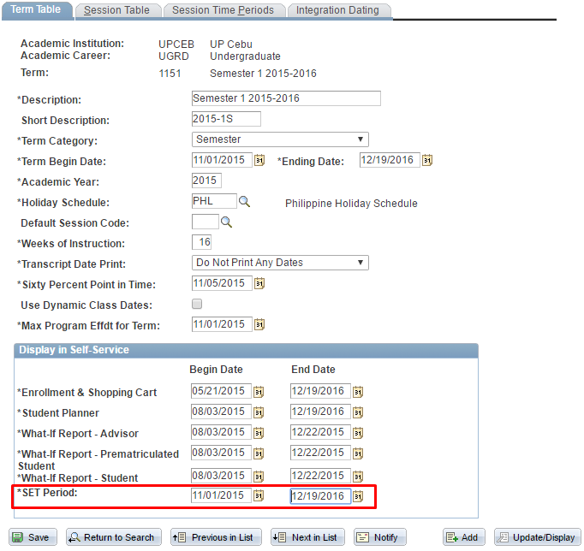
Student Evaluation for Teaching (SET)

Slide 23
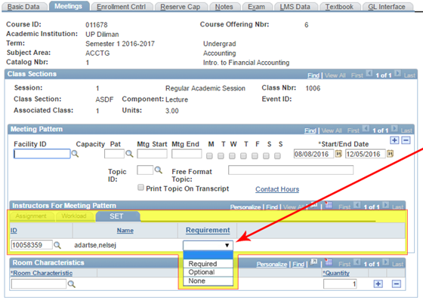
Student Evaluation for Teaching (SET)

Slide 24
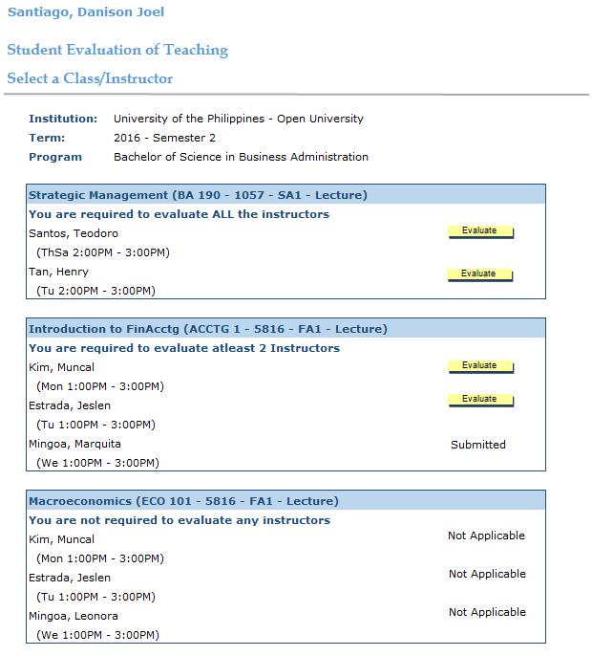
Student Evaluation for Teaching (SET)

Slide 25
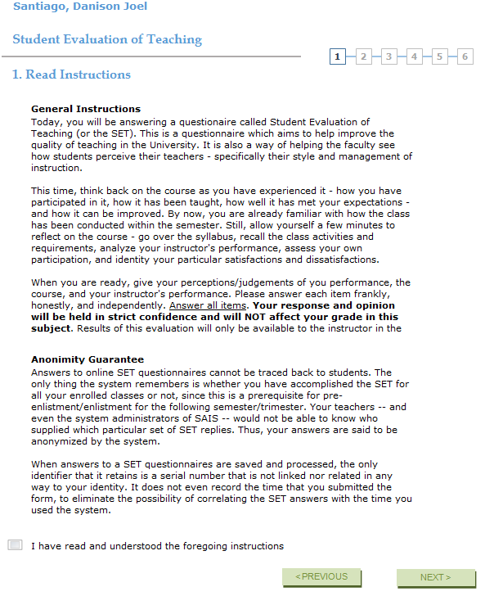
Student Evaluation for Teaching (SET)

Slide 26
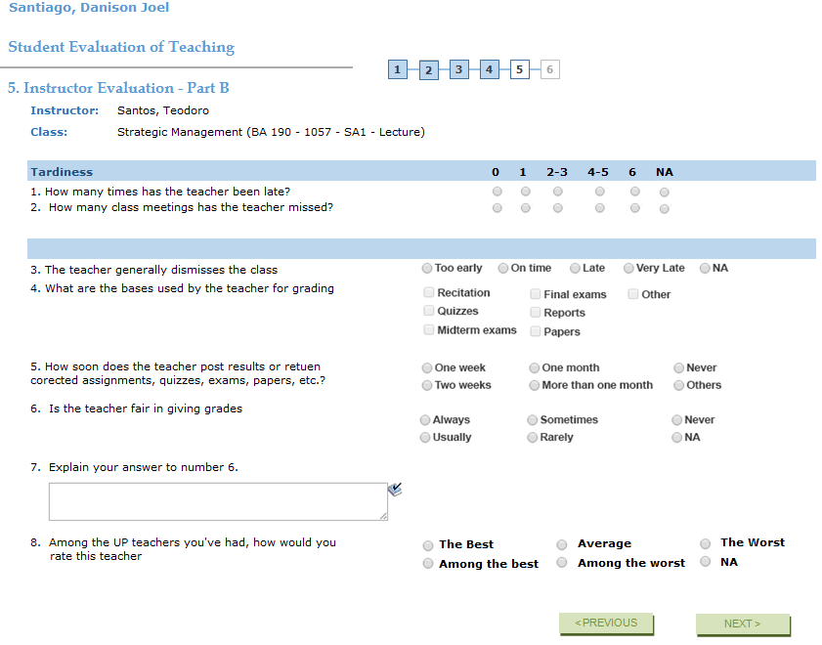
Student Evaluation for Teaching (SET)

Slide 27
Blocking of Payments
Some of the delivered impacts UP has been using was block enrollment and block viewing of grades. Most constituent universities do not accept blocking students from enrolling subjects even if they still have unsettled balances from previous semesters. Our team needs to find a way to block tuition calculation or payment for students tagged as unpaid from previous semesters.

Slide 28
Blocking of Payments
Some of the delivered impacts UP has been using was block enrollment and block viewing of grades. Most constituent universities do not accept blocking students from enrolling subjects even if they still have unsettled balances from previous semesters. Our team needs to find a way to block tuition calculation or payment for students tagged as unpaid from previous semesters.

Slide 29
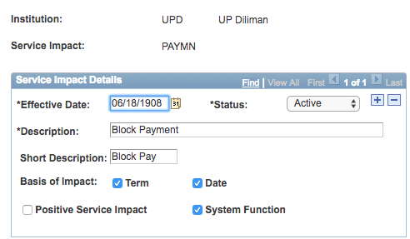
Blocking of Payments

Slide 30
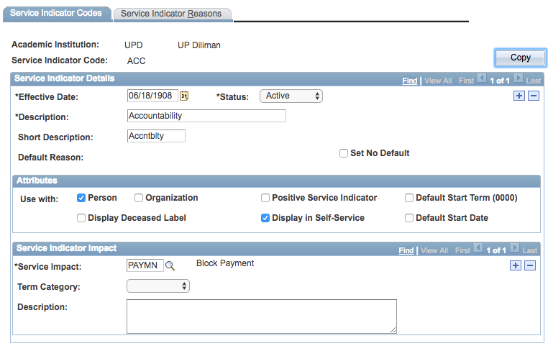
Blocking of Payments

Slide 31
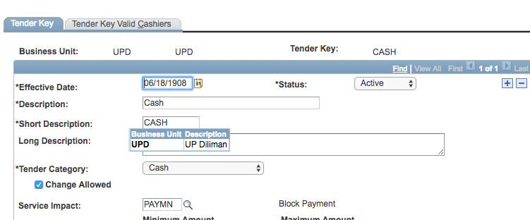
Blocking of Payments

Slide 32
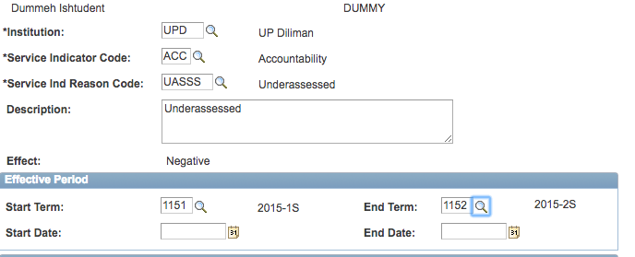
Blocking of Payments

Slide 33
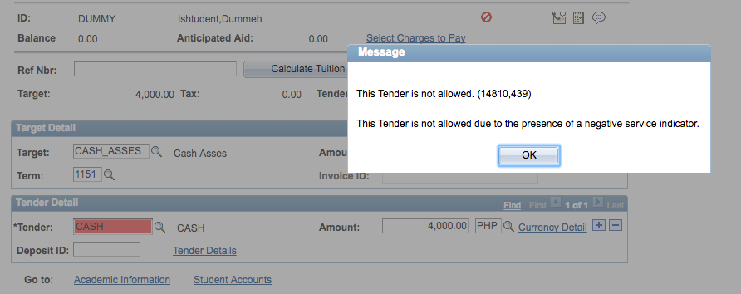
Blocking of Payments

Slide 34
Slow Printing of Invoice
Enrolment process in UP requires students to print a “Form 5”
It is a form with all the subjects taken by the student, the schedule of classes, details of the student, and the fees needed to be paid by the student. Before UP is using the invoice feature of CS with a customized output.

Slide 35
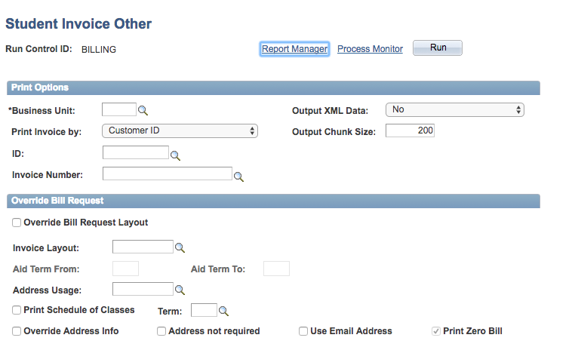
Slow Printing of Invoice

Slide 36
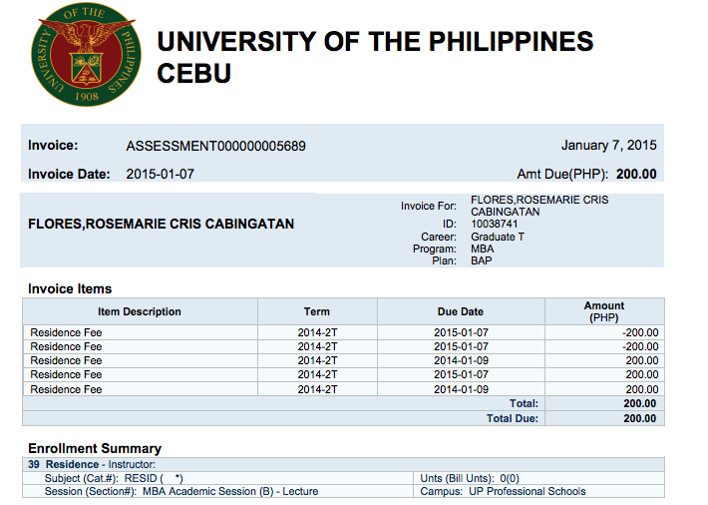
Slow Printing of Invoice

Slide 37
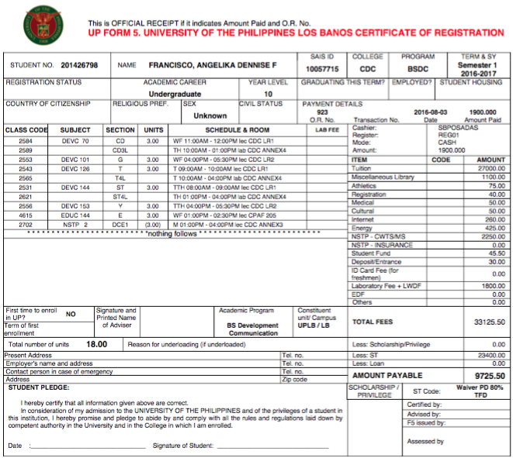
Slow Printing of Invoice

Slide 38
Concluding thoughts
ANY QUESTIONS?

Slide 39
THANK YOU!

