Slide 1
Casual Pay System (CAPS) A replacement
SESSION: 5008
8/11/2017

Slide 2
presenters
Jane Smart-Foster
Rahul Raju
Manager, HR Systems and Operations
University of Adelaide
jane.smart-foster@adelaide.edu.au
PeopleSoft HR Application Specialist
University of Adelaide
rahul.raju@adelaide.edu.au
Notes:
JSF

Slide 3
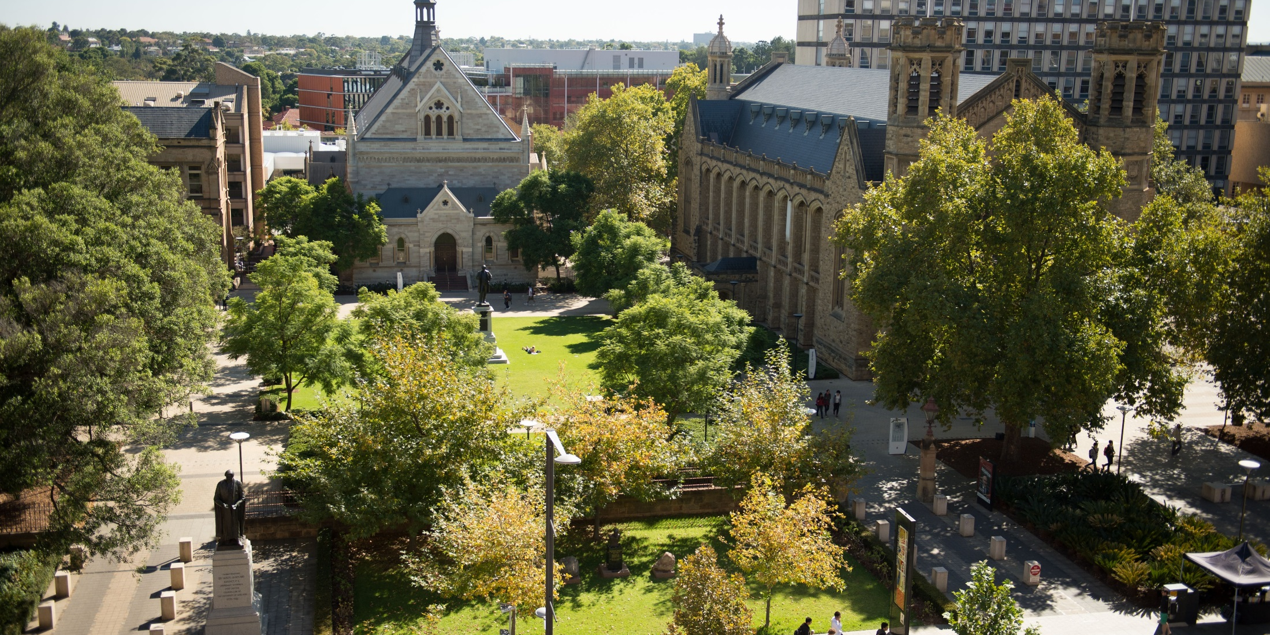
The University of adelaide
Established: 1874
Campuses: 3
Faculties: 5
Divisions: 3
Students: 25,000
Staff: 3,500 (exl casuals)
Notes:
JSF

Slide 4
ORGANIZATION & ORACLE
HCM, Campus & Finance
PeopleSoft HCM 9.2
PeopleTools 8.55, PUM #21
GP, Time and Labour, Profile Mgmt, Partial Position Mgmt, Contract Admin, Training Admin
Notes:
JSF

Slide 5
Overview
Our Casual Systems Journey
Casual Engagement
Casual Time Sheeting
Key Learnings
Notes:
JSF
Our Casual Systems Journey (10min)
Casual Engagement (25min)
Casual Time Sheeting (10min)
Key Learnings (5min)
Questions (10min)

Slide 6
SECTION 1: Our Casual Systems Journey
Oracle Fusion Middleware & Business Process Workspace to PeopleSoft eForm & AWE
Notes:
JSF

Slide 7
Our casual systems Journey
November 2012 - CASPA
October 2014 First GT form
August 2015 – 9.2 Upgrade
2016 – Replacement Feasibility Study
June 2017 – Tools 8.55 Upgrade
June 2018 – CAPS Go Live
Notes:
JSF
November 2013 – CASPA
Oracle Fusion Middleware implemented for Casual Contract Generation
Business Process Workspace for Process and Workflow Functionality
Oracle Service Bus (OSB) for common integration points
Application Development Framework (ADF) for Forms
PeopleSoft Time and Labour with a Middleware Front end used for casual Timesheets
October 2014 – First GT Form
Fixed Term Contract Renewals Implemented Using Gideon Taylor
June 2017
8.55 upgrade was one of the main reason PeopleSoft solution was chosen to leverage enhancements in the tool set

Slide 8
Key Drivers for change
OFM License Costs high, and CASPA the only University system remaining on this technology
Oracle support for OFM products will cease shortly
Ongoing BAU support high
Limited resources with the technical skill set to support OFM
Not a robust system due to it being over engineered and not following standard architecture design principles
Limited mobile and browser compatibility
30% issues through HRSC related to CASPA
Notes:
JSF
Performance issues

Slide 9
CAPS – primary Objectives
A solution option that reduces the complexity of business processes
User friendly
Has less complex design and code
Easy to maintain and support
Mantra: Simplification and Standardisation
Notes:
JSF

Slide 10
CAPS – options considered
Enhancing / Fixing CASPA
Kronos – Workforce Ready
PageUp – Contractor Management
Gideon Taylor
PeopleSoft HCM
Notes:
JSF

Slide 11
CAPS – the technology
Casual Engagements
Custom PeopleSoft Build
Casual On boarding
PeopleSoft Activity Guides
Casual Time sheeting
PeopleSoft Time and Labour
Notes:
JSF
WHY:
A native P/Soft solution will allow us to take advantage of future P/Soft enhancements and reduce dependency on Gideon Taylor
A PeopleSoft T&L solution allows us to re-use existing business rules already developed for CASPA
With the upgrade to PeopleSoft 9.2 and PeopleTools 8.55, additional features became available e.g.
Improved mobile enabled user interface (Fluid) for an enhanced and consistent user experience
Improved native workflow functionality
Activity Guides
Approvals Tile making use of a fluid approvals page constructed via PeopleSoft page composer
Discussions held with Griffiths University about their PeopleSoft solution
Decision made to re-engineer processes & remove complexity e.g.
Replace contract process with letter of appointment
Capture required personal information at start of casual engagement
Gideon Taylor 3.0 framework released – no upgrade path from 2.9 and not fluid-enabled.

Slide 12
CAPS – scope
Casual Engagements
Initiate
Approve
Generate Offer
Acceptance
Full Integration to PeopleSoft Core HCM Records
Casual On boarding
Timesheet and Academic Schedule Management
Cloning
Integration to HPRM
Reporting
Notes:
JSF

Slide 13
SECTION 2: Casual Engagement
Appointment of a casual staff member
Management of a casual engagement
Notes:
JSF

Slide 14
Casual engagement
Casual Coordinator
Identify Casual to be Hired
Delegated Authority
Approve (or decline) casual engagement
System
Initiate Engagement
Offer Sent to Casual
Job & Person Integration
Notes:
JSF
Initiation of offer can be done as a completely new task, cloning the person and the job or cloning just the job

Slide 15
Casual engagement
Casual
Review Offer
Casual
Complete On boarding tasks
System
Access to T & L
Accept / Decline
Integration of Personal Details, Bank / Tax, pay eligibility
Notes:
JSF
Existing Casuals accepts offer using their university log on details
New Casuals will received a guest log in and will required to authenticate via a token that is emailed via defined email address.

Slide 16
Casual Engagement – Live Demo
Core
Staff Services Online
Mail
Notes:
RR

Slide 17
Initiate Casual Engagement
Notes:
RR

Slide 18
Initiate Casual Engagement
Notes:
RR

Slide 19
Initiate Casual Engagement
Notes:
RR

Slide 20
Initiate Casual Engagement
Notes:
RR
Utilising the PeopleSoft search match, with the ability to use existing record or create a new person
Option to Initiate engagement use existing record if details match OR to Create a New Person, if person currently exists any details we store on them will be prepopulated in the engagement form

Slide 21
Initiate Casual Engagement
Notes:
RR
Depending on whether Academic, Professional or English Language Teacher is selected, will determine if what fields display

Slide 22
Initiate Casual Engagement – Academic
Notes:
RR
Academics are paid via payroll elements, hence don’t have a salary, grade, plan but do have an Academic Schedule which defines the courses and activities required to teach as part of the engagement
For new academic casuals required to collect qualification data OR qualification equivalence for compliance with ESOS

Slide 23
Initiate Casual Engagement – Academic
Notes:
RR
Multiple items can be added to the academic schedule, which is then used to restrict what can be entered into the timesheet

Slide 24
Initiate Casual Engagement - Professional
Notes:
RR
Professional Staff

Slide 25
Initiate Casual Engagement - ELT
Notes:
RR

Slide 26
Initiate Casual Engagement
Notes:
RR

Slide 27
Initiate Casual Engagement - Approval
Notes:
RR

Slide 28
Initiate Casual Engagement - Approval
Notes:
RR

Slide 29
Casual Engagement Acceptance
Notes:
RR

Slide 30
Casual Engagement - management
Resend Offer
Amend Supervisor / Timesheet Validator
Terminate Early
Amend Academic Schedules
Cloning
Notes:
RR

Slide 31
SECTION 3: Casual Time Sheeting
PeopleSoft Time and Labour Solution
Notes:
JSF

Slide 32
Casual Time Sheets
Casual
Submits Timesheet via Employee Self Service Time and Labour
System
Generate Payable time via Time Administration process
Timesheet Validator / Supervisor
Approve Payable Time
Notes:
JSF
Big change for Academics who are not used to submitting their own timesheets

Slide 33
Casual Time Sheets
System
Integration of approved time to Global Payroll for payment
Casual
Timesheet amendments only before timesheet is paid
Payroll
Paid Timesheet amendments into core Time and Labour
Notes:
JSF

Slide 34
Casual Timesheet
Notes:
JSF

Slide 35
Casual Timesheet
Notes:
JSF

Slide 36
Casual Timesheet - academic
Notes:
JSF

Slide 37
Casual Timesheet - Professional
Notes:
JSF

Slide 38
Casual Timesheet - ELT
Notes:
JSF

Slide 39
Time Administration
Generates Payable Time
Run’s all the rules to calculate the amount of overtime / penalties to be paid for Professional Staff
Generates timesheet approval tasks and emails
Notes:
JSF

Slide 40
SECTION 4: Lessons Learnt
Key Learnings
Concluding Thoughts
Questions
Notes:
JSF

Slide 41
Key learnings
Sprint Planning critical to avoid requirements changing mid sprint
Stories to be ‘ready’ before being bought into a sprint, and interdependencies defined
MVP to be defined and agreed to up front
Focus group to be representative of the entire University, with the right people who are able to make / influence decisions within the Faculties / Divisions
Vanilla, Vanilla, Vanilla – avoid customisations where possible
Standardise and Simplify
Notes:
JSF

Slide 42
Questions
Notes:
JSF

Slide 43
presenters
Jane Smart-Foster
Rahul Raju
Manager, HR Systems and Operations
University of Adelaide
jane.smart-foster@adelaide.edu.au
PeopleSoft HR Application Specialist
University of Adelaide
rahul.raju@adelaide.edu.au
Notes:
JSF

Slide 44
THANK YOU!

