Slide 1
Flexible interface tool
SESSION 37005
11 October 2016
FIT for Cloud

Slide 2
presenters
Clemens de Vos
Michel Jonkman
Managing Consultant
Epicenter
clemens.de.vos@epicenter.eu
Managing Consultant
Epicenter
michel.jonkman@epicenter.eu
Founding father and shareholder of Epicenter. Clemens is the main functional architect of the Flexible Interface Tool.
Consultant, manager and shareholder of Epicenter. Michel is responsible for the cloud infrastructure of the Flexible Interface Tool.

Slide 3
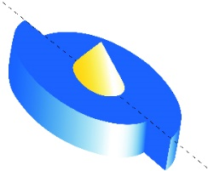
Epicenter
Dutch Oracle Consulting Firm, specialized in PeopleSoft and Oracle HCM Cloud
WWW.EPICENTER.EU

Slide 4
1.
2.
Product glance: Flexible Interface Tool for
3.
Product glance: Flexible Interface Tool for
4.
Common integration challenges and pitfalls
5.
Architecture, functionality and added value of the FIT
EMEA Alliance 11-12 October 2016
Notes:
AGENDA: ABOUT US AND INTERFACES

Slide 5
INTERFACES IN A CLOUD ARCHITECTURE
EMEA Alliance 11-12 October 2016
Notes:
MAIN TOPIC OF TODAY

Slide 7
FIT FOR PEOPLESOFT
Flexible Interface Tool PeopleSoft HCM
Various target systems
Payroll systems
Active Directory
Other ERP system

Slide 8
FIT FOR PEOPLESOFT
5
Payroll Systems
12
Clients
40
Interfaces

Slide 9
FIT FOR PEOPLESOFT
Mature, proven, robust and future proof
Configuration above development
Standard PeopleSoft Payroll Configuration screens
Built on standard PeopleSoft tooling (SQR, App engine PeopleCode)
Utilises PeopleSoft Process Scheduler
Pre-packaged PeopleSoft Bolt-on

Slide 10
WHAT-IF

Slide 11
MOVE TO HCMCLOUD

Slide 12
MOVE TO HCM CLOUD
Various target systems
Payroll systems
x
x
Active Directory
x
x
Other ERP System

Slide 13
PEOPLESOFT versus hcm cloud
PEOPLESOFT HCM
PeopleTools
Extension datamodel via Tools
Process Scheduler
Application Engine / SQR
Acces to database
Limited Configuration options
Simple Datamodel
Payroll Interface
ORACLE HCM CLOUD
No Development tools available
FlexFields
Process Scheduler unavailable
Java and PL/SQL
No Access to database
Multiple Configuration options
Complex datamodel
HCM Extract

Slide 14
challenge
No Standard Interfaces
No Access DBMS

Slide 15
Which way to go?
EMEA Alliance 11-12 October 2016

Slide 16
solution
FIT for Cloud
Flexible
Interface
Tooling
EMEA Alliance 11-12 October 2016

Slide 17
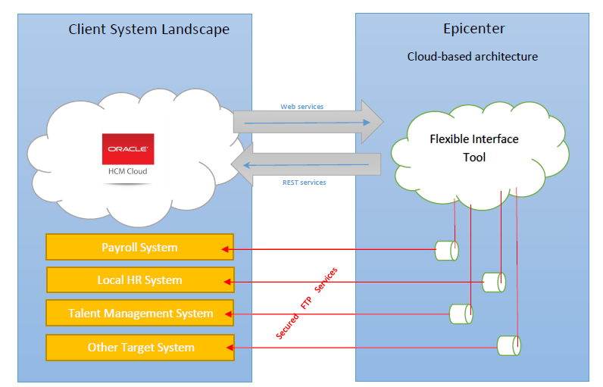
Infrastructure at a glance
EMEA Alliance 11-12 October 2016

Slide 18
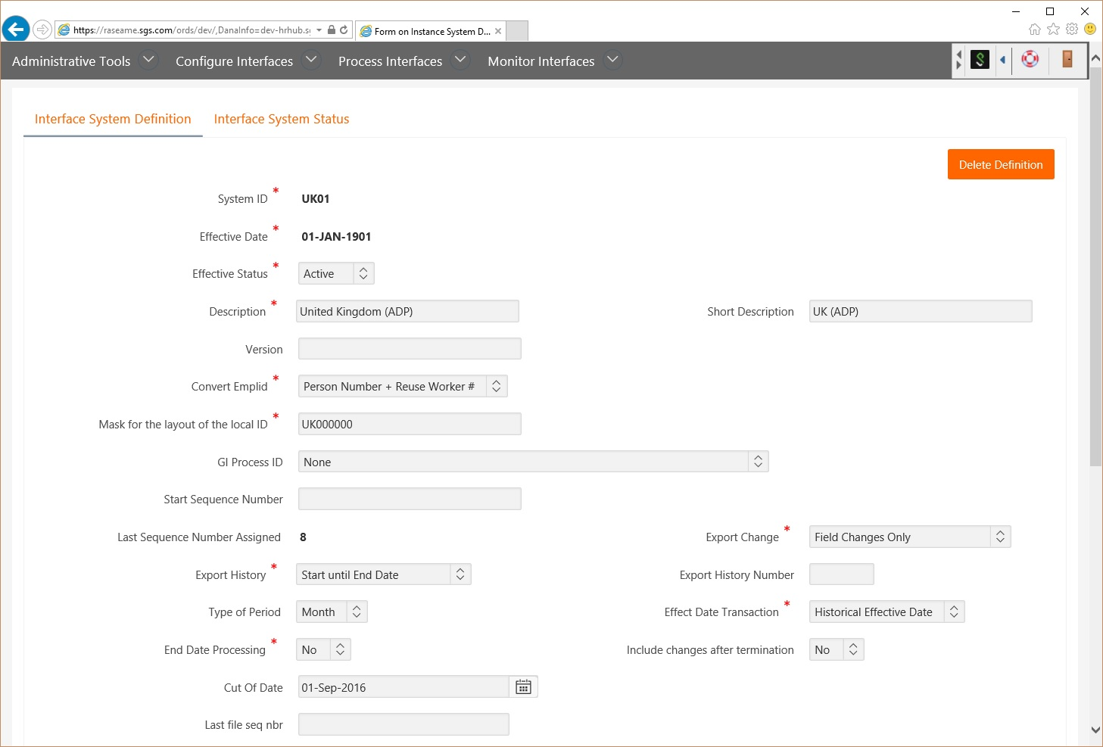
CONFIGURE YOUR INTERFACE
EMEA Alliance 11-12 October 2016

Slide 19
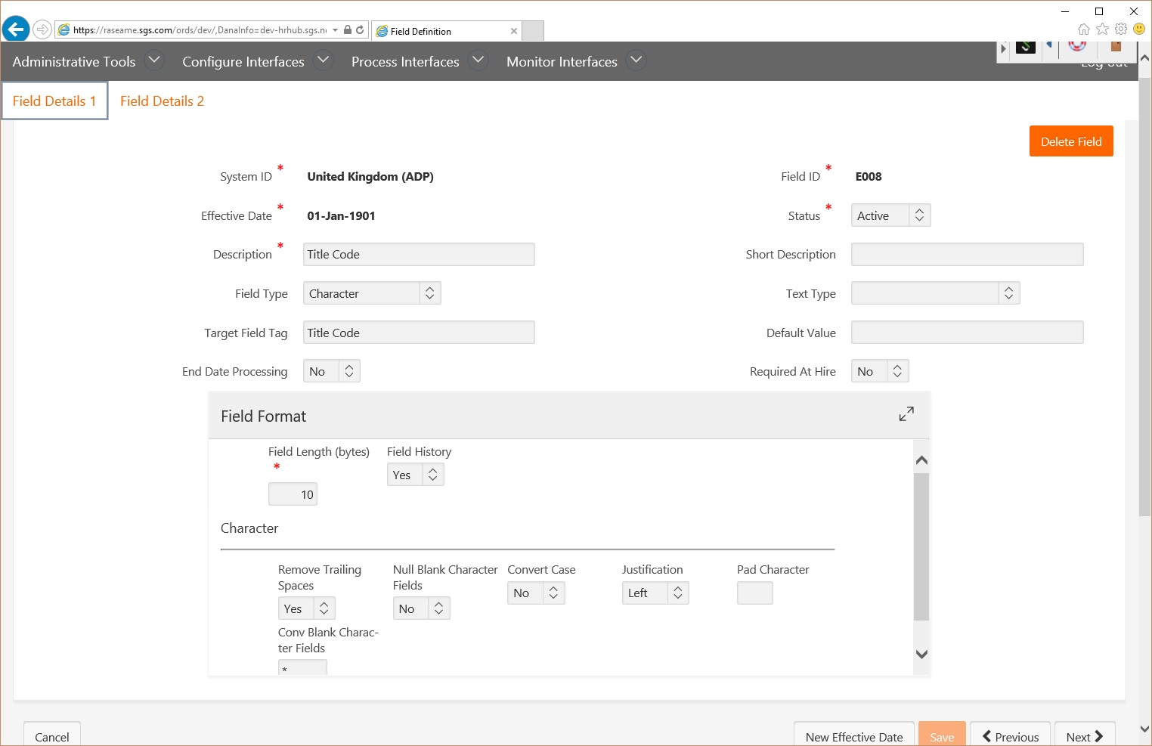
CONFIGURE YOUR INTERFACE
EMEA Alliance 11-12 October 2016

Slide 20
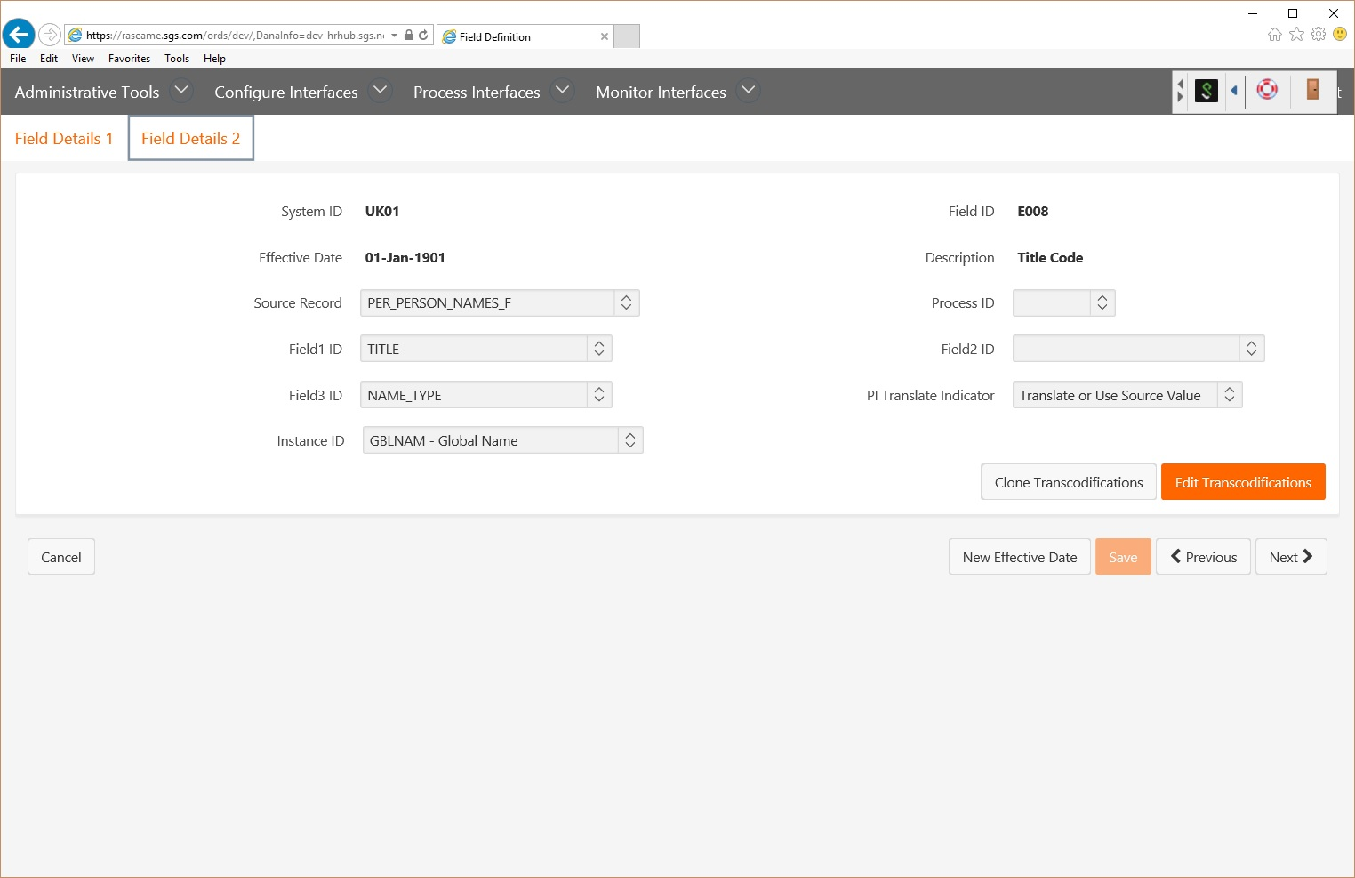
CONFIGURE YOUR INTERFACE
EMEA Alliance 11-12 October 2016

Slide 21
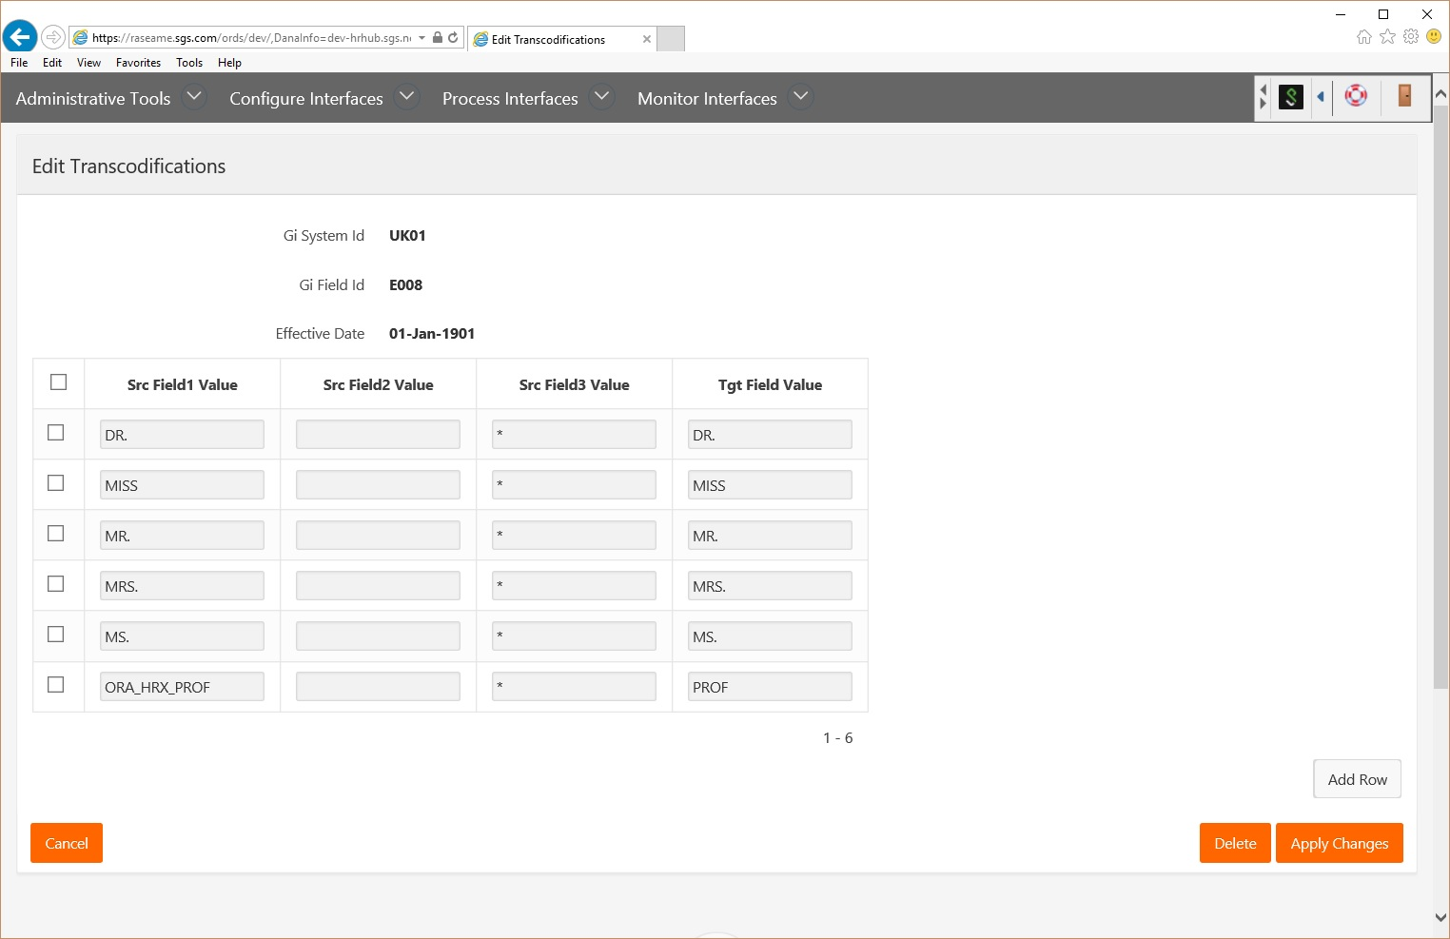
CONFIGURE YOUR INTERFACE
EMEA Alliance 11-12 October 2016

Slide 22
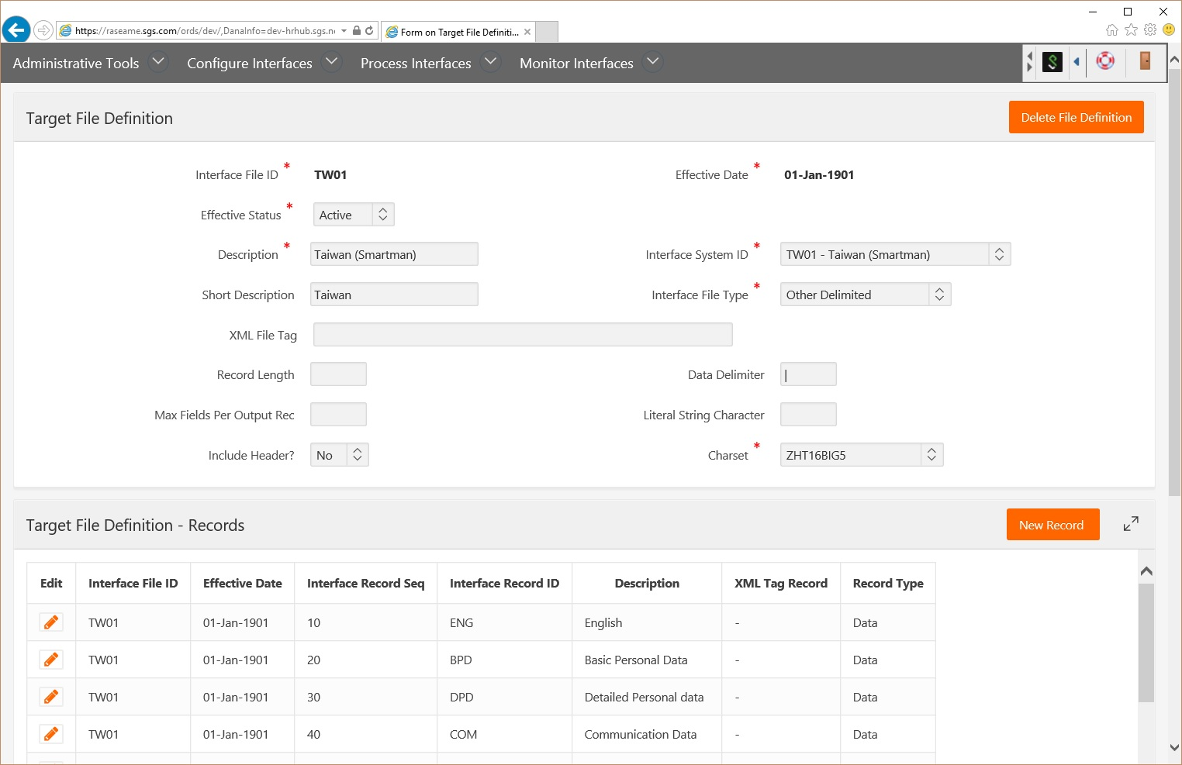
CONFIGURE YOUR INTERFACE
Comma delimited file
Tab delimited file
Other delimited file
Fixed File format
Logical file format
XML file
EMEA Alliance 11-12 October 2016

Slide 23
File formats in a click, logical file
Header lines
XM0068091001241108PSOD TRANS 02~
PX1968091 0622 1 08509 V 01063006 X~
PK6809 077019 01082015 9600 0101082005 ~
PK6809 077019 01082015 V720 000000001 ~
PK6809 077069 01082015 S001 0019240 ~
ZS000000000000000000000248002480~
Employee ID
Effective Date
Field Code
Field Value
Trailer record with control totals

Slide 24
Other Separated File, in a click
Header lines
TABLE=S1ADR
SEPARATOR=;_
COLUMNS=MMAT;DATE_DEBUT;RUE;COMPTE;CODE_POSTAL;ADR_VILLE;CANTON;PAYS;TELEPHONE;MOB_PHONE
002563;2016-09-01;Dorfstrasse 20;;9306;Freidorf TG;$TG;$CH;0041 71 860 03 79;0041 78 708 25 46
002567;2016-09-01;Hauptstrass 14;;5742;Kölliken;$AG;$CH;;0041 1711250761
Employee ID
Effective Date
Street
Postal Code

Slide 25
XML file, in a click
<?xml version="1.0" encoding="UTF-8" standalone="no"?><EmployeeImport>
<Employee>
<XRefCode>001103791</XRefCode>
<EmployeeNumber>001103791</EmployeeNumber>
<FirstName>Mohsen</FirstName>
<MiddleName/>
<LastName>Barkh</LastName>
<Gender>M</Gender>
<SocialSecurityNumber>742 392 582</SocialSecurityNumber>
<BirthDate>1967-08-24</BirthDate>
<StartDate>2011-08-29</StartDate>
<WorkAssignment>
<JobXrefCode>763037</JobXrefCode>
<DeptXrefCode>F406201.020.002900.2155.10.211</DeptXrefCode>
<EffectiveStart>2016-02-01</EffectiveStart>
<FTE>1.00</FTE>
</WorkAssignment>
</Employee>

Slide 26
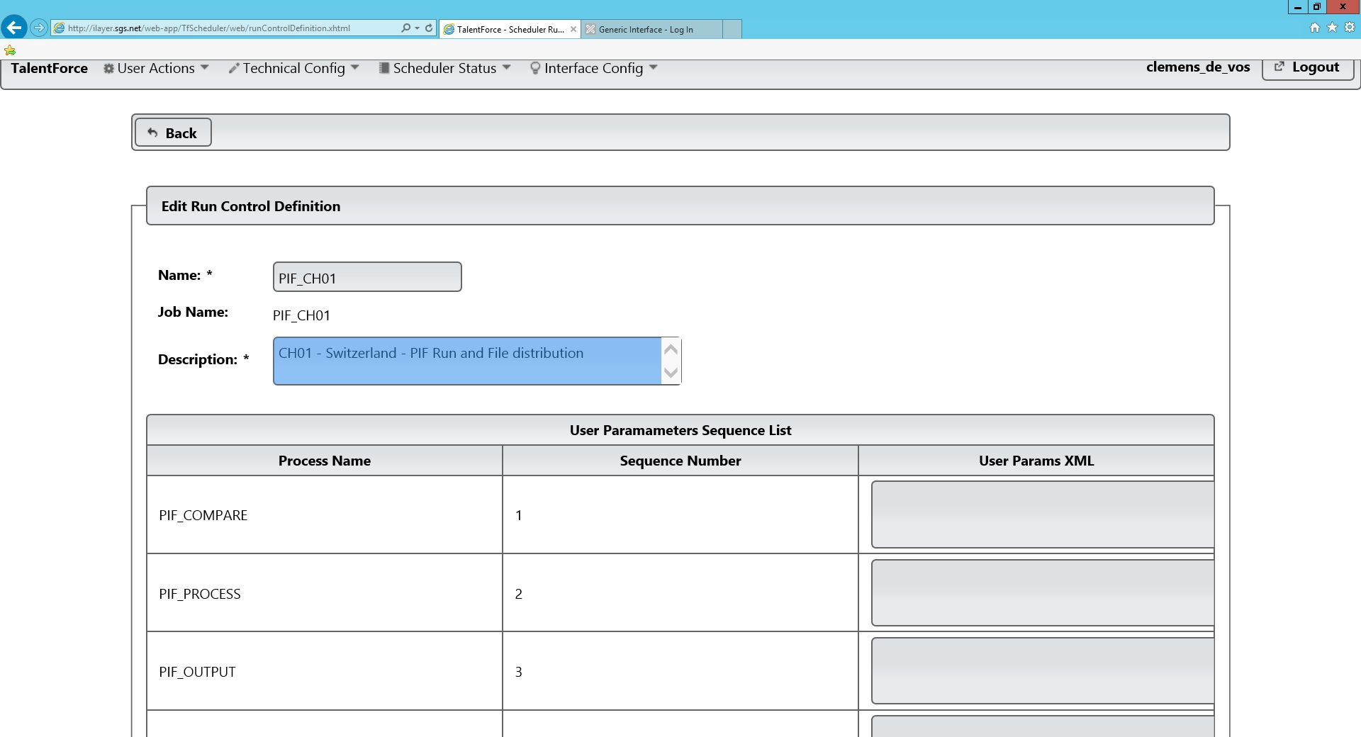
RUN YOUR INTERFACE
EMEA Alliance 11-12 October 2016

Slide 27
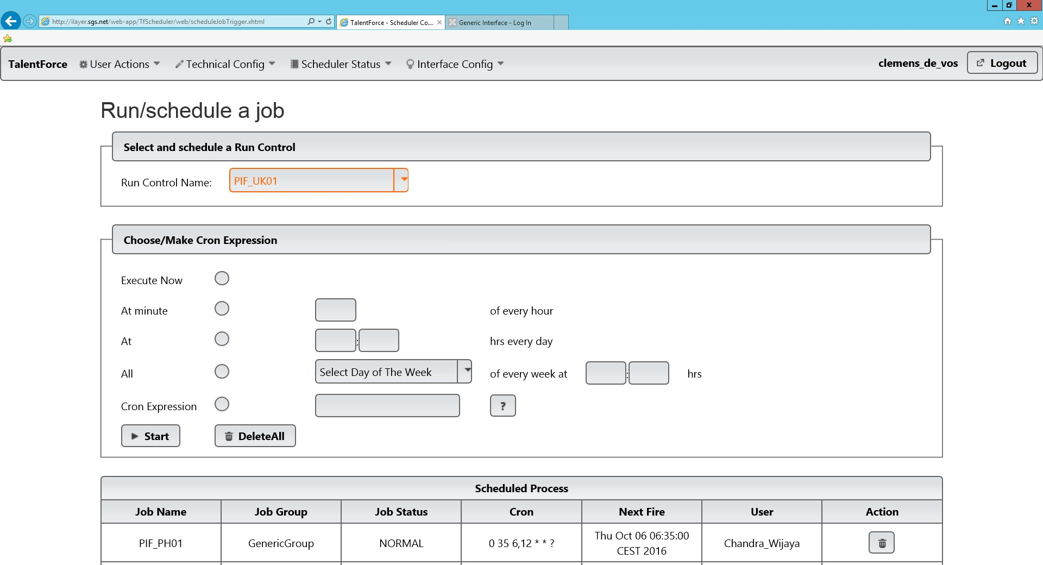
RUN YOUR INTERFACE
EMEA Alliance 11-12 October 2016

Slide 28
Functionality at a glance
Building interfaces thru configuration (vs development)
Retro-active change, deletions and effective date change
Sophisticated period selection and effective date control (historical & future)
Delta at Field, Record or Employee level and…Full Export
File types: Separated, Fixed, Logical, XML, Header/Footers
Supports all possible Local Employee ID algorithms
Common algorithms: end date processing, adding personal data upon hire, send complete array if a single item changes, and much more!
Simple configurable transcodifications and layout transformations
Dynamically configurable file lay-out
All charactersets (languages) supported
EMEA Alliance 11-12 October 2016

Slide 29
Fit architecture
Oracle Cloud
Epicenter FIT Cloud
Process Scheduler
Change detection
Oracle HCM Cloud
FIT Database
File generation
replicator
Configuration
Local ID
File distribution

Slide 30
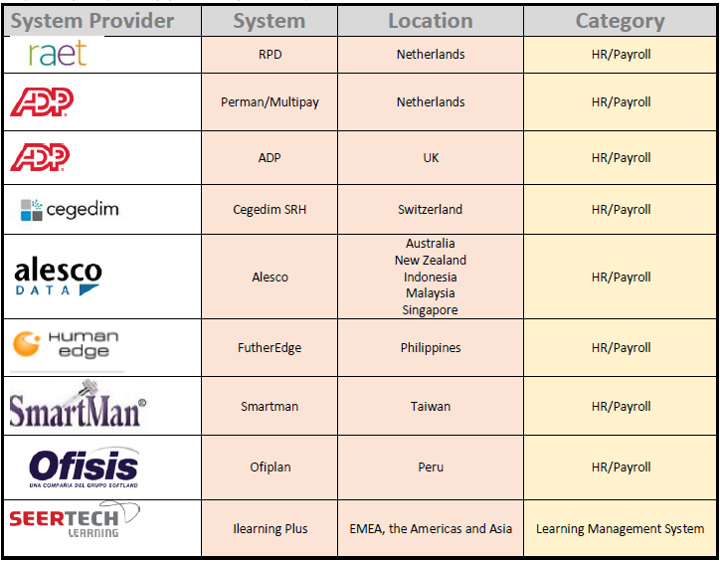
Pre-configured interfaces

Slide 31
Implementation of fit interface
activities
activities
activities
activities
Interface workshops
Design document
Prep test cases
Prep Regression
Define prod manual
Support Import Prog(o)
Repl program Data to HUB
New views
Configure new interface
Special processes
Scheduling
Import program (o)
Regression
Unit
System
SIT
UAT
Train 1st line
Migration to Prod
Initialize interface
Production Manual
Build/Prep Team
Interface plan
Plan
Define
Configure / Build
Test
Deploy

Slide 32
Business VALUE of the fit
Rapid deployment of new interfaces
Relatively low maintenance
Highly Configurable
Flexible (by applying Special Processes)
Proven Solution & References
Developed on the latest Oracle technology
Robustness & Performance
Readiness for Global deployment
Multiple interface specifications ready to use
Low investment: pay per use

Slide 33
WWW.EPICENTER.EU

Slide 34
presenters
Clemens de Vos
Michel Jonkman
Managing Consultant
Epicenter
clemens.de.vos@epicenter.eu
Managing Consultant
Epicenter
michel.jonkman@epicenter.eu
Founding father and shareholder of Epicenter. Clemens is the main functional architect of the Flexible Interface Tool.
Consultant, manager and shareholder of Epicenter. Michel is responsible for the cloud infrastructure of the Flexible Interface Tool.
all Alliance presentations will be available for download from the Conference Site

Slide 35
THANK YOU!

