Slide 1
Switching File Attachment Storage
SESSION 4
Thursday, July 4th, 2019

Slide 2
presenters
Marieta Bester
Gysbertus Janse van Rensburg
PeoplesSoft Application Specialist
University of the Free State
bestermm@ufs.ac.za
ERP Specialist
University of the Free State
jansevanrensburgg@ufs.ac.za
Andrew Jusjong
Senior Specialist: ERP: Campus Solutions
University of the Free State
jusjongae@ufs.ac.za

Slide 3
From a humble start in 1904, the UFS became a well-known institution, boasting 164 NRF-accredited researchers and 2 521 staff members. Our ever-expanding facilities and knowledge base present many opportunities for scholars to impact locally and globally.

Slide 4
ORGANIZATION & ORACLE
HRMS 9.20.00.000
Tools Release 8.55.25

Slide 5
Switching File Attachment Storage
UFS initially went with Database, but we recently moved to FTPS. Requirement was to move not only future file attachments, but attachments from the past as well. Allowing users to upload file attachments to multiple types of transactions within PeopleSoft is a very important People-Tools feature. Adding files like resumes, expense receipts and other types of documents can be a huge win for organizations looking to move away from paper and fully leverage their ERP system. Giving users the option to upload a file into your system has risks. Storage Locations There are three delivered storage locations for file attachments in People Tools. All three options have their own pros and cons, so you will have to decide which to use depending on your needs. There will be a few things to consider with each approach to make sure each protocol is used safely. Will further discuss the reason why and how we have managed to do the switching and also our final outcome.

Slide 6
Switching File Attachment Storage
File Attachments in PeopleSoft HCM and keeping it vanilla.
In this presentation we will cover the reasons for handling specific attachments a specific way.
There exists three delivered ways to store file attachments in PeopleSoft:
Database
FTP/SFTP
HTTP/HTTPS
We are going to focus on DB and FTP/SFTP today.

Slide 7
Database Storage
This is probably the most secure option.

Slide 8
Database Storage
Storing in a DB would be of course the easiest of all methods to store your attachments. However, it does have some drawbacks.
You will quickly note that without size limits and what users upload you are going to have a bad day with your DBA. Especially when it comes to Backups, refreshes and performance. This being true when the database was not initially setup to handle BLOBS/CLOBS efficiently.
The upside of using the DB is that it is in an environment which is readily available and already secured (given that the DB is set up correctly).
This is probably the most secure option. Generally, the database is already very locked down, since the majority of other application data is stored there. No extra controls are really needed to make sure your files are safe. To be truly safe though, you really want to make sure this data is encrypted in flight and at rest. So, if you do your due diligence with the security of your app as a whole, storing with this method takes care of itself.
Without the proper data retention policies and a decent backup policy – your DB can become quite cumbersome to manage. When there are no decent policies in place to manage the amount of data in the DB it is a good idea to start looking at another way of managing the storage of file attachments namely FTP/SFTP in this case.

Slide 9
FTP/SFTP Storage
Take care to secure the attachments on the file system the FTP server is pointed to.

Slide 10
FTP/SFTP Storage
Storing your file attachments on storage as physical files has it’s pro and cons as well. The most important being security and storage space.
This protocol has been around forever, but really has fallen out of favor in most organizations. You should under no circumstances be using plain old unencrypted FTP. PeopleTools does however support both FTPS and SFTP, a more secure option. To use these protocols, you must use URL objects, not URL strings, in your PeopleCode. Take care to secure the attachments on the file system the FTP server is pointed to.
There are ways to secure access to the server which hosts these attachments, like restricting any access from any other server/system through firewalling or mac filtering.
The safest would be of course to use SFTP/FTPS.

Slide 11
FTP/SFTP Storage
This will ensure an encrypted channel of data transfer between the two points.
In terms of space, as with the database without a decent data retention policy the amount of data being stored can become a problem. Also note that on some operating systems there are a limit of the number of files that can be stored on the file system. This however is very high and it’s unlikely to easily reach this limit.
When storing your files on another server also be sure to have a backup policy in place. In our case our servers were being backup up nightly managed by our vSphere admin.

Slide 12
SET UP SFTP SERVER
most basic way of using this functionality

Slide 13
SET UP SFTP SERVER
Please note that we will cover the most basic way of using this functionality and that more configuration can be used to improve security.
What you will need to start configuration on testing environment:
1. The Record/Table where the attachments are being stored in the DB – In this case HRS_ATTACHMENTS
2. A File Server which will contain the future files – For example Windows Server 2016
3. A SFTP client – SolarWinds SFTP

Slide 14
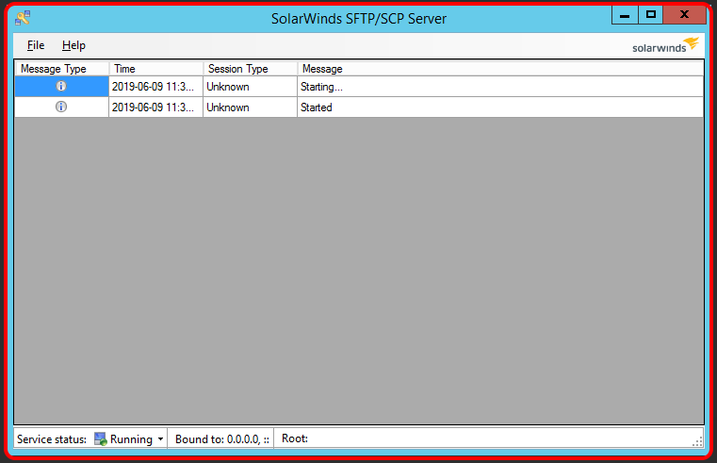
SET UP SFTP SERVER
The first step would be to set up your SFTP Server and create the directory structure on the server you wish to use.
Once you have completed the setup you will have the following window on startup of SolarWinds SFTP.

Slide 15
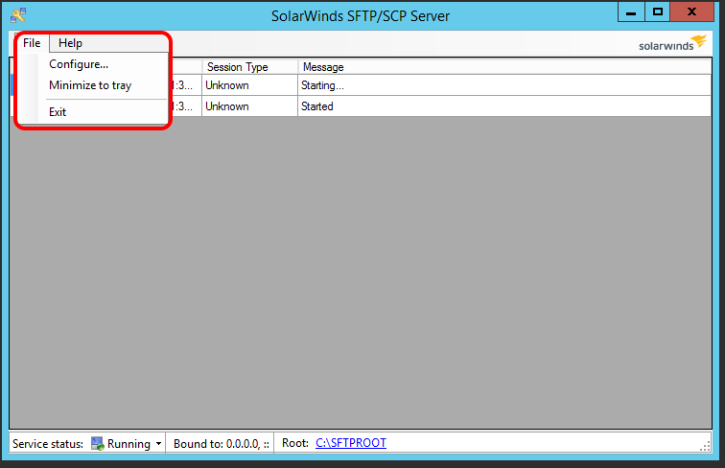
SET UP SFTP SERVER
Create the directory structure for the location where the files will be stored.
C:\ -> SFTPROOT -> HCM -> HRS_ATTACHMENTS
Now we may start with the configuration of SolarWinds SFTP.
To do so click File -> Configure

Slide 16
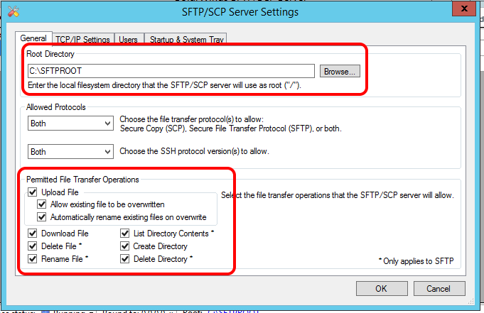
SET UP SFTP SERVER
You may click on the “Browse” to browse to the directory created previously or you may enter the location manually.
Select all the appropriate file permissions for the SFTP operations like Deleting, Creating Directories etc.

Slide 17
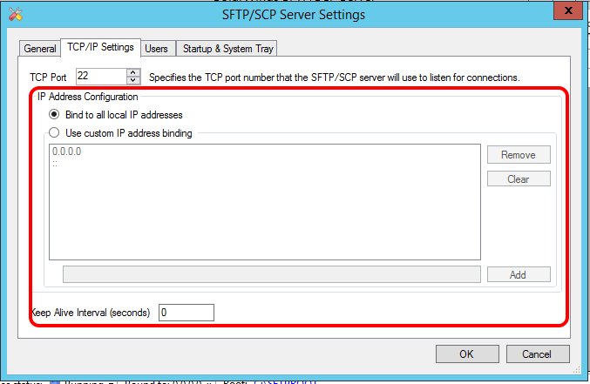
SET UP SFTP SERVER
Now click on TCP/IP Setting to configure the bind addresses.
This will allow you to configure to which IP address the SFTP service is bound.
This is useful when you have more than one IP address configured or more than one Network Card. Leave the port as default for the SFTP service.

Slide 18
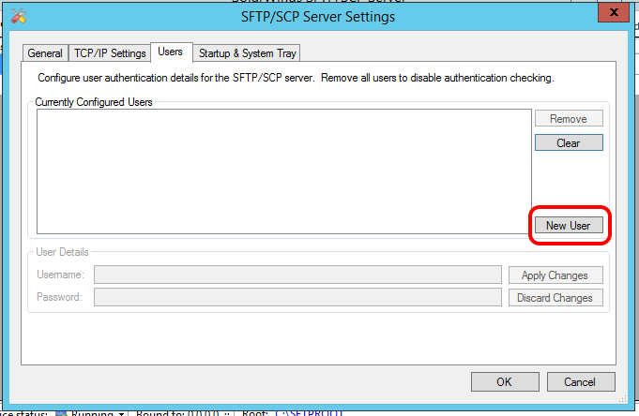
SET UP SFTP SERVER
After completing the TCP/IP Setup you may click on the “Users” tab.
Here we will setup the user/s account settings which will be able to access the SFTP service.

Slide 19
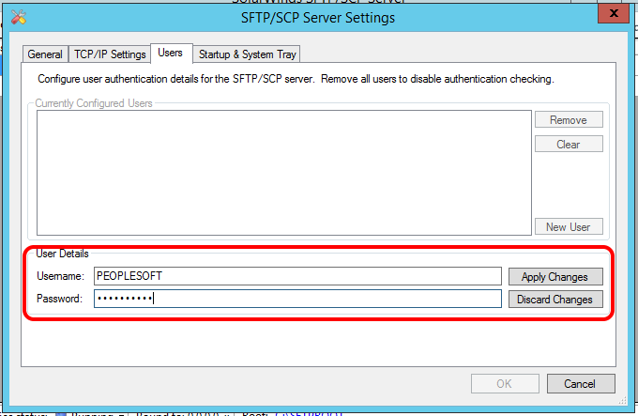
SET UP SFTP SERVER
For this exercise we will configure the user as PEOPLESOFT with the password PEOPLESOFT.

Slide 20
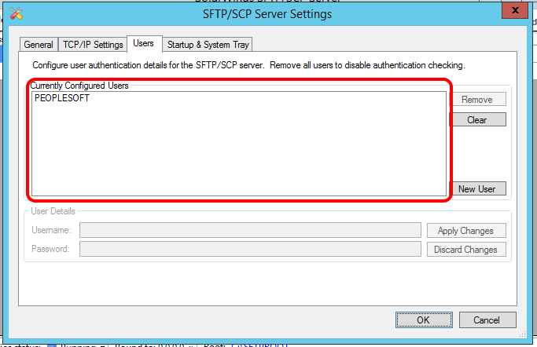
SET UP SFTP SERVER
Once you have typed in the user details click “Apply Changes”
You will note that the user is now at the top where the list of allowed users is listed.

Slide 21
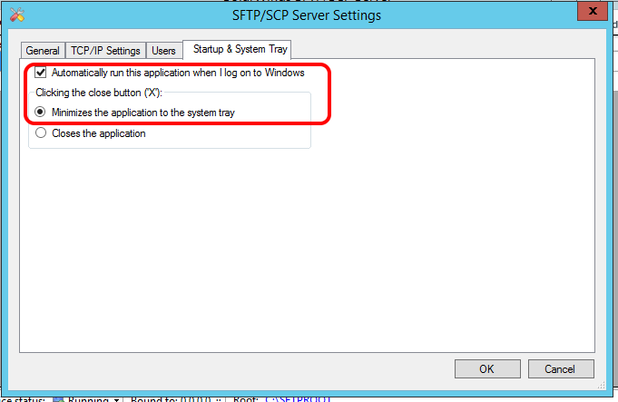
SET UP SFTP SERVER
Finally, you may click on the “Startup & System Tray” tab.
For good practice we want to start the service whenever the system starts up and we don’t want it to stop the service when the it is closed. Tick the boxes and click “Ok”

Slide 22
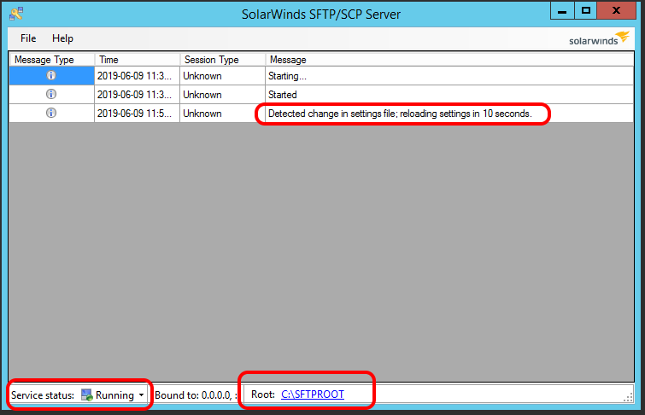
SET UP SFTP SERVER
Now we have configured SolarWinds and created the directory to store the files in. Note that the “ROOT” has been set and that the service is running.

Slide 23
PeopleSoft hcm - url setup
URL’s Set Up

Slide 24
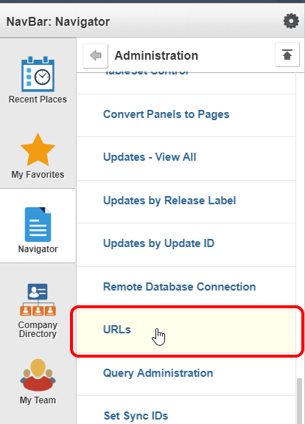
PeopleSoft hcm - url setup
For PeopleSoft HCM to be able to use this new service we need to set it up as well.
To do so login to PeopleSoft HCM and navigate to:
PeopleTools -> Utilities -> Administration -> URLs

Slide 25
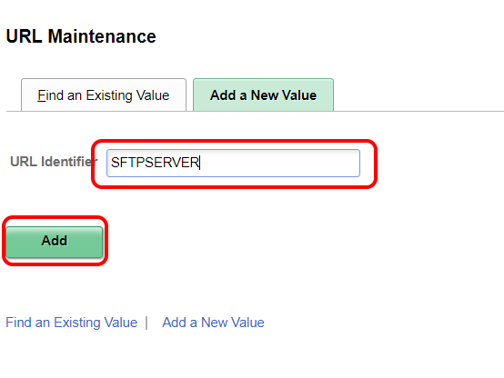
PeopleSoft hcm - url setup
Once you’re on the URL Maintenance Search Page click “Add New Value”
Type in the new URL name eg: SFTPSERVER and click “Add”

Slide 26
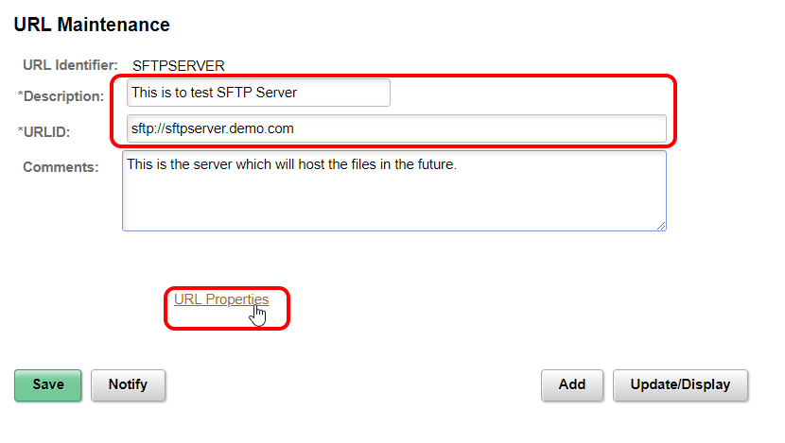
PeopleSoft hcm - url setup
Type in a relevant description for the URL just created eg: “This is to test the SFTP Server”
And also type in the SFTP Address for the server eg: sftp://sftpserver.demo.com
You may add some comments (Optional)

Slide 27
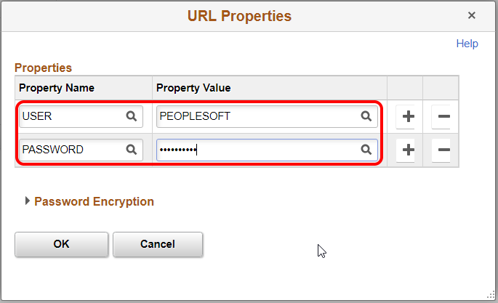
PeopleSoft hcm - url setup
Now, we have to configure the username and password for the SFTP server.
Click on “URL Properties and type “USER” as the first property and the “PEOPLESOFT” username which was defined in SolarWinds.
Add another property and type “PASSWORD” as the second property.
You will note that the moment you click in another box the “Property Value” will be filled with 3 dots …

Slide 28
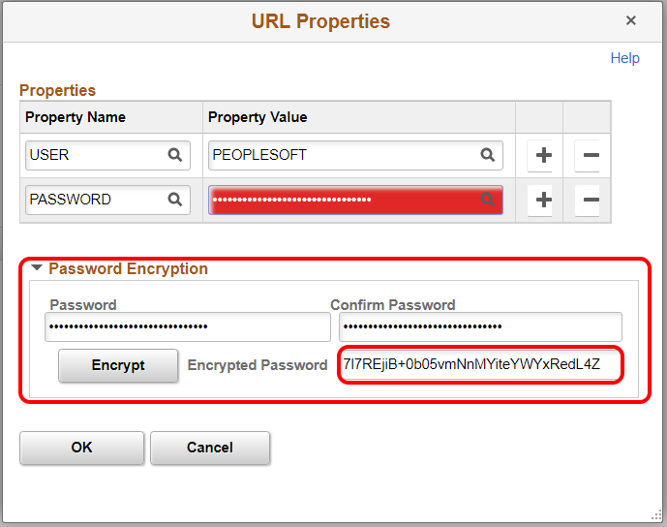
PeopleSoft hcm - url setup
This is the password masking and you will remove this with the correct value.
Also, very important – DO NOT TYPE IN THE PASSWORD IN THIS FIELD, PeopleSoft will not accept this and will give an error and show the field red.
Type the password in the “Password Encryption” area and use the “Encrypted Password” output as the password for the “Property Value” field.

Slide 29
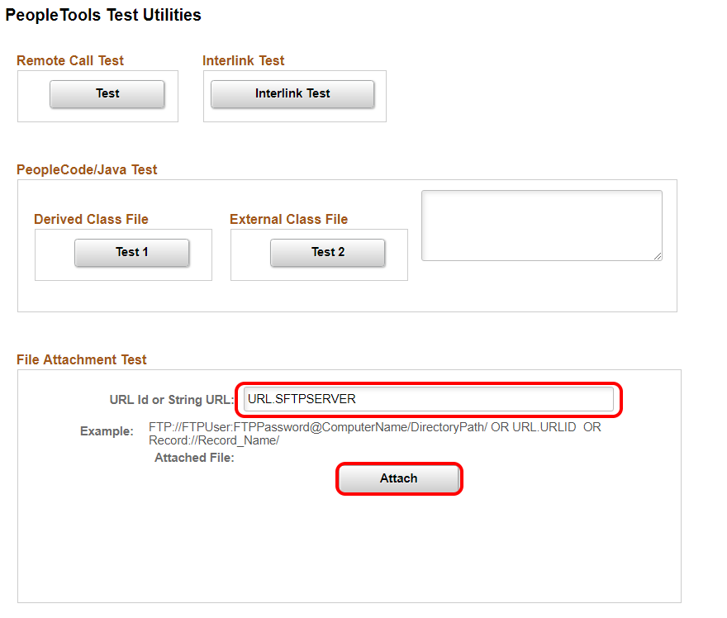
PeopleSoft hcm - url setup
Now we will test this URL and confirm that everything has been set up correctly.
Navigate to PeopleTools -> Utilities -> Debug -> PeopleTools Test Utilities
On the PeopleTools Test Utilities page enter the newly created URL in the field starting with URL .(DOT) and then the URL name which was given eg: SFTPSERVER. Click “Attach”

Slide 30
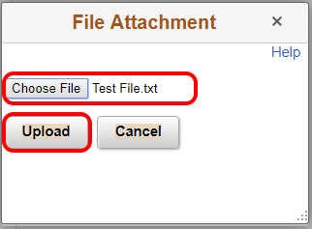
PeopleSoft hcm - url setup
Select file for testing eg: Test File.txt
And Click “Upload”

Slide 31
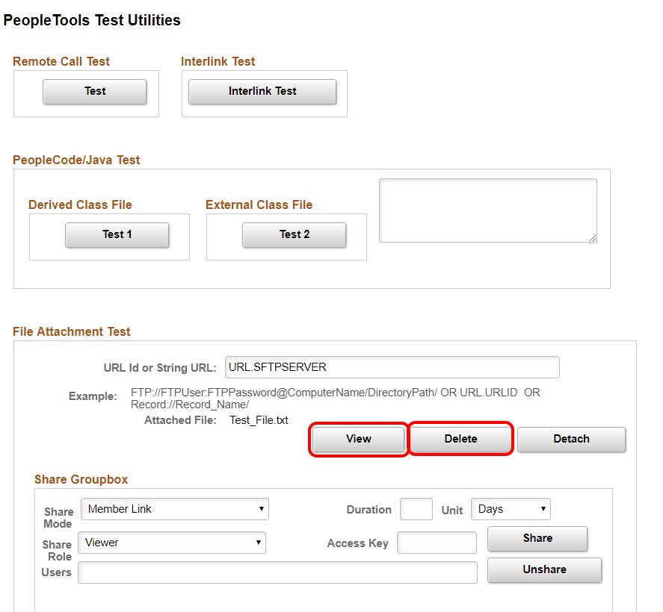
PeopleSoft hcm - url setup
Click “View” to confirm the file has been uploaded.

Slide 32
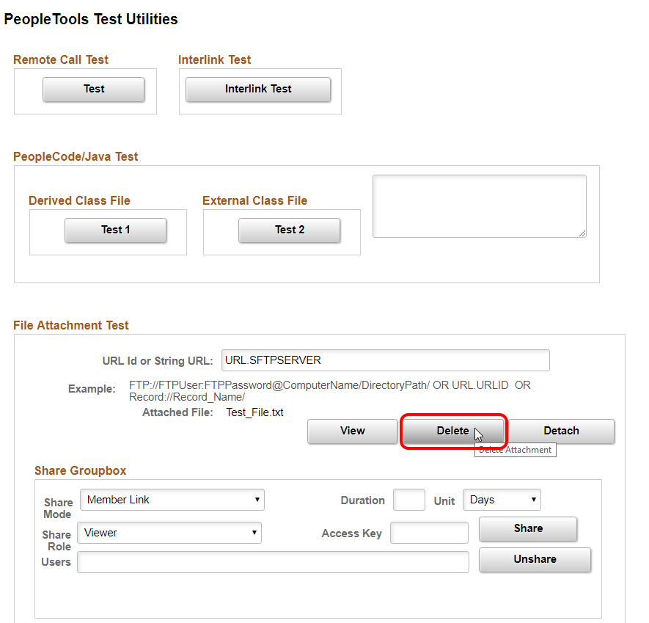
PeopleSoft hcm - url setup
Now you may click “Delete” and confirm that the file has been removed on the SFTP server.

Slide 33
PeopleSoft hcm - url setup

Slide 34
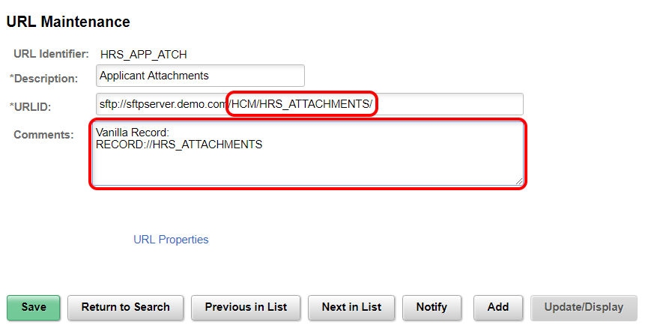
PeopleSoft hcm - url setup
Note that it’s always a good idea to note the previous configuration in the comments. This will help future administrators.

Slide 35
PeopleSoft hcm - url setup
Also note that the address to be used will be the directory structure created eg:
HCM/HRS_ATTACMENTS/

Slide 36
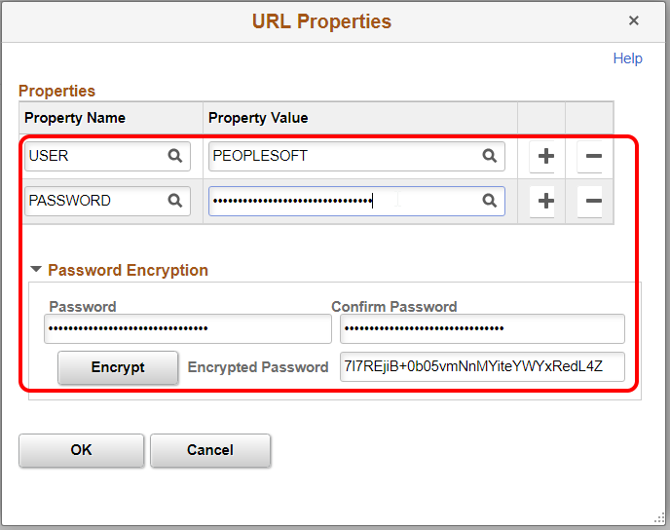
PeopleSoft hcm - url setup
Set the URL Properties like before and save your changes

Slide 37
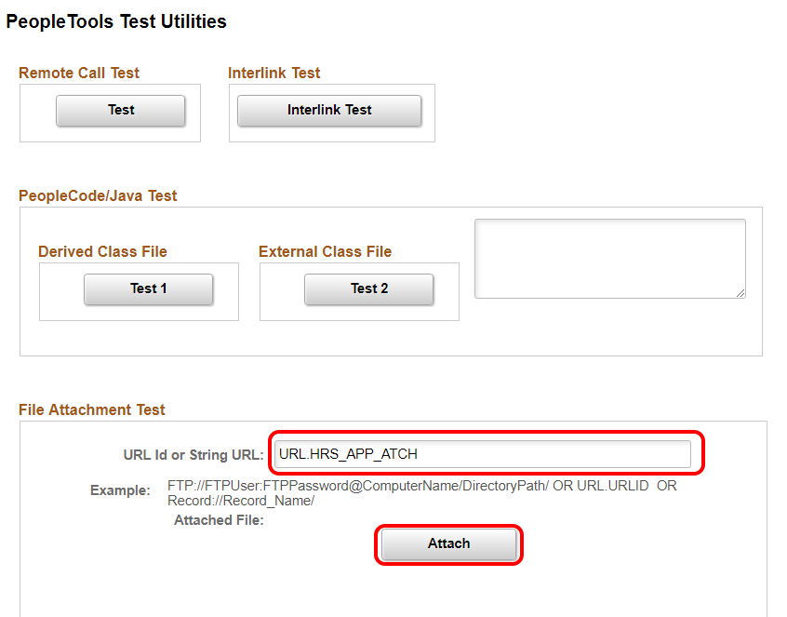
PeopleSoft hcm - url setup
Test your configuration and confirm that the upload is working to the correct directory. Enter the relevant URL Id and click “Attach”.

Slide 38
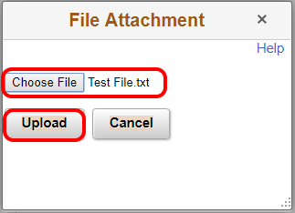
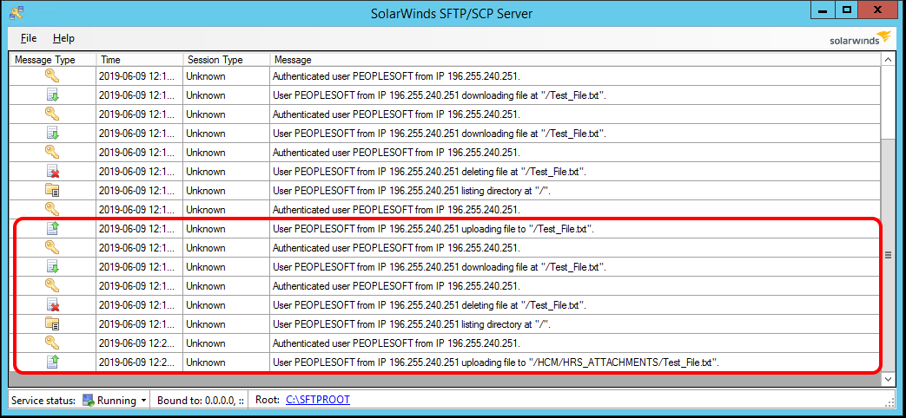
PeopleSoft hcm - url setup
Select your test file for upload and confirm that file is on SFTP server.

Slide 39
PeopleSoft hcm - url setup
Confirm that the file is in correct directory.

Slide 40
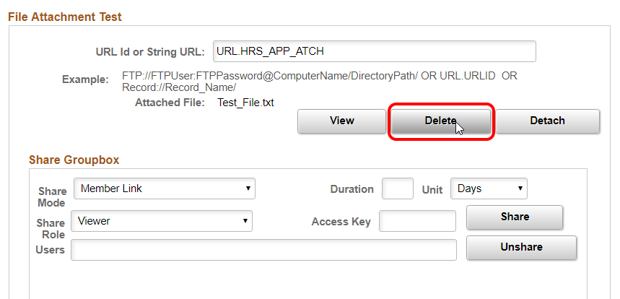
PeopleSoft hcm - url setup
Once confirmation is completed click “Delete” on HCM.

Slide 41
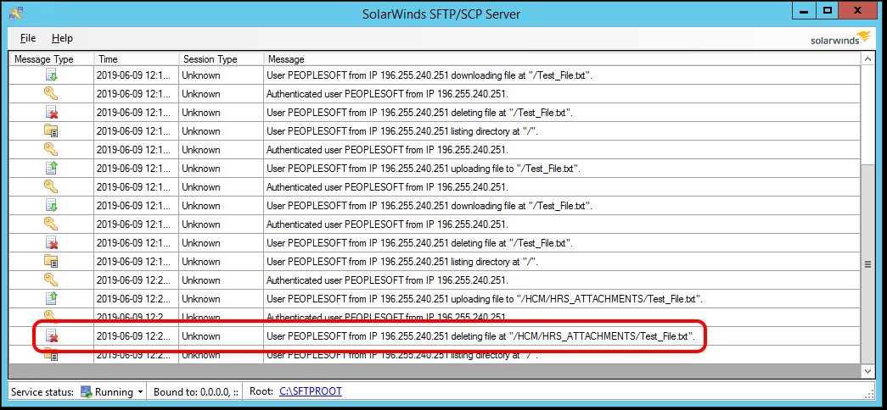
PeopleSoft hcm - url setup
And finally confirm that the file was removed.

Slide 42
Concluding thoughts
Note that this is just a basic setup and can be managed in different ways. For more information about this see the Oracle Support site and documentation.

Slide 43
Concluding thoughts
What we have learned through moving our attachments to a file server.
We have had database performance increases which in turn delivers better end-user experience.
We have reduced the database size and thus reducing the time and space required for database backups
In the event of a database failure we will have a quicker recovery time as a result.
File server storage is much cheaper than ODA (Oracle Database Appliance) storage.
Note that this is just a basic setup and can be managed in different ways. For more information about this see the Oracle Support site and documentation.

Slide 44
SUMMARY

Slide 45
SUMMARY

Slide 46
THANK YOU!

