Slide 2
Business and Technology Challenges of Upgrading Oracle EBS to Release 12.2.4

Slide 3
presenters
Alaa Ibrahim
Mohamed Yousri
Project Manager (PMO)-IT
Head of HR Systems -HR
Joined QU six years back appointed as a project Manager. Experienced in ERP Projects Implementations with focus on Finance & SCM while possessing both business and IT expertise. Having ERP implementations' references in different businesses like telecom, Education, Oil & Gas, Automotive industries and utilities in both public and private sectors with over than 12 years of experience. Had a career progressing in Applications Consultancy till team leader level and is currently leading and managing the new Oracle Applications related projects to QU
Joined QU three years back appointed as the Head of HR Systems. Experienced in ERP Projects Implementations with focus on HCM while possessing both business and IT expertise. Having ERP implementations' references in different businesses like telecom, Education, Oil & Gas and utilities in both public and private sectors. Over 11 years of experience in project management, applications consultancy, business & systems analysis and customer support. Had a career progressing in Applications Consultancy till seniority level and is currently leading and managing the HCM Applications related projects and operations support in QU.

Slide 4
Agenda/ Content
Brief about Qatar University (QU).
The Reasons for upgrade the Oracle EBS to release 12.2.4
The Scope of work.
The key success factors.
The project plan & the timeline.
The upgrade challenges & Execution approach.

Slide 5
About Qatar University
The National University in Qatar.
QU presents a wealth of opportunities to interact with other respected scholars, students, and cultures.
QU began as a single college in 1973.

Slide 6
About Qatar University
Now QU comprises 8 colleges, 60 academic programs with the highest international accreditations.
Serves a competitive body of almost 17,000 students and 1,100 faculty members.

Slide 7
About Qatar University
Qatar university has recently been ranked as one of the most beautiful college campuses in the world, The Old Campus in the University ranked as 22nd out of total 23 universities.

Slide 8
The Reasons for upgrade the EBS to release 12.2.4
Life time support policy.
New features and Enhancement.
Online patching for business continuity.

Slide 9
Life time support policy
Release | Premier | Extended
11i | 2010 | 2013
12.0 | 2011 | 2014
 | 2016 | 2019
 | 2018 | 2021
12.1
12.2

Slide 10
New Features and enhancement- Purchasing
Automatic update to encumbrance (GL) date
Behavior of release 12.1:
Buyer can specify an encumbrance date for each distribution line against a line at the time of creating a purchase order. If this date is in closed period and is hence invalid then the application gives an error message.
Enhanced functionality 12.2 :
Introduce a new value “Redefault” of the PO: validate GL Period profile option . If this profile option is set to redefault Value, application automatically update the date as the system date.

Slide 11
New Features and enhancement- HR
Create and Update Multiple Retro Assignments Using Web ADI Spreadsheet
Prior to this release, Mass Creation or Update of Retro Assignments was not available. Payroll administrator had to create or update retro assignments by individual employee. With this release, a Web ADI integrator for the mass upload or modification of retro assignments is delivered.

Slide 12
New Features and enhancement- HR
Use Star Ratings to Rate Performance and Proficiency Levels
Managers and workers can now use star ratings to rate performance and proficiency levels in competencies. The star rating component is now available for Competency Profile and Appraisals functions. In the Appraisals function, the star rating component is displayed in the Competency Profile region. This function enables you to display performance and proficiency rating scales as star ratings, instead of on conventional rating scale values. To use the star rating component, set the profile option HR: Enable Star Rating for Performance and Proficiency Levels in Competencies.

Slide 13
New Features and enhancement- HR
SSHR Transaction Monitor
Using the Transaction Monitor feature, employees, managers, and HR professionals can view and track the details of their self-service transactions that are in Pending Approval, Deferred, Completed, or Errored status. For self-service transactions that are in Pending approval or completed status, employees, managers, and HR professionals can use the transaction monitor to view the approval history, comments, and attachments for the transactions, if any. Employees can view all transactions that they initiate. However, managers can view only those transactions initiated by them on any worker within their hierarchy. HR professionals can view all transactions initiated by workers and managers based on their security profile.

Slide 14
New Features and enhancement- Receivables
Review and manage accounting exception during period close
Ability to review and sweep the accounting transactions. This new sweep invalid distributions report show the details of the accounting exceptions that are holding the period close for review and action.

Slide 15
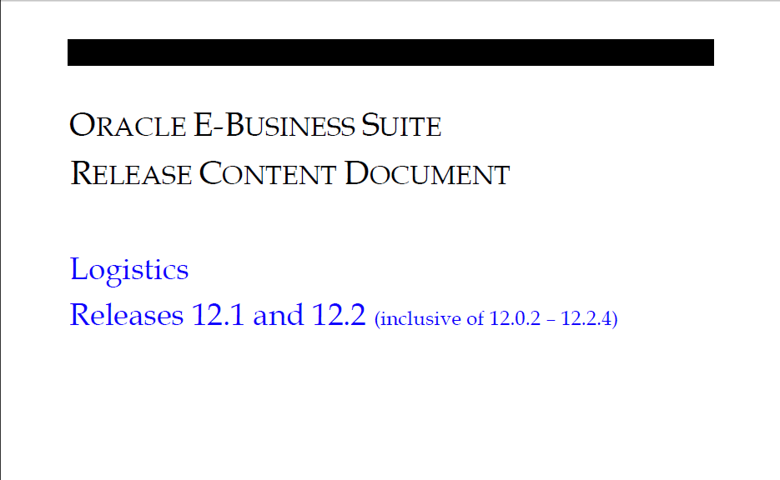
New Features and enhancement
Download Document 1302189.1- https://support.oracle.com

Slide 16
Reason-New Features and enhancement- Look & Feel

Slide 17
Online Patching for Business Continuity
Users remain online while patches are applied.
User downtime is limited to the time required to restart the system.
Critical business operations are not interrupted.
Stop sending Broadcast to announce that the system will be down for patching.

Slide 18
THE Scope of work
Upgrade the Oracle EBS from release 12.1.3 to
release 12.2.4.
Migrate the middle tier from HP to LINUX.
Migrate the Database to the EXADATA.

Slide 19
The key success factors
To Specify the following:
The right project team.
The prerequisites of the upgrade project.
The approach of addressing and fixing the Issues.

Slide 20
Specified the right project team
Include all the relevant stakeholders
Executive steering committee.
Project management office (PMO).
Project manager. (QU & Oracle)
Business process Owners.
DBA team. (QU & Oracle)
Functional team.
Technical team. (QU & Oracle).

Slide 21
Specified the Prerequisites of the upgrade project.
Identify the list of customizations on the EBS
Customized reports.
Alerts & Notifications.
Workflows &OAF Customizations.
Form Personalization’s.
List down all the Business scenarios.
Identify the list of Integrations.
Identify the new features of Release 12.2.4.

Slide 22
Specified the approach of Addressing and Fixing the issues.
Create an issue log to record all types of issues.
The fix for any standard functionality has to be through the oracle support.
Specify the approach to fix the customization issues.
Inform the third Party vendor about Upgrade.

Slide 23
The Project plan & the time line
2015 |  |  |  |  |  |  |  |  |  |  | 2016
FEB | MAR | APR | MAY | JUN | JUL | AUG | SEP | OCT | NOV | DEC | JAN | FEB | MAR
Trial Phase
UAT Phase
Dry Run Phase
PROD. & SUP.

Slide 24
The Project plan –UAT PHASE
UAT Tasks | JUN |  |  |  | JUL |  |  |  | AUG |  |  |  | SEP
 | W1 | W2 | W3 | W4 | W1 | W2 | W3 | W4 | W1 | W2 | W3 | W4 | W1 | W2 | W3
Pre-Upgrade
Upgrade
Deployment
Post-Upgrade
Users-UAT
UAT-Support

Slide 25
The Upgrade challenges & the execution approach
Addressing and resolving the issues within the timeline of the project.
The challenge to close the EBS project on time, in order to launch the other projects under the umbrella of the oracle program.
The functional and technical stakeholders were executing the project tasks in addition to running the business operations.
The approach that had been followed by QU to execute the project tasks.

Slide 26
The Upgrade challenges & the execution approach
The approach that QU follow in most of the projects under the Oracle program is to assigned some tasks to QU Resources.
Tasks | Oracle | QU
Upgrade- DBA tasks | xx
Customization deployment. | xx | xx
Integrations. |  | xx
Technical support. | xx | xx
Functional testing. |  | xx
Functional support | xx | xx

Slide 27
Questions?

Slide 28
presenters
Alaa Ibrahim
Project Manager
Qatar University
alaa.saied@qu.edu.qa

