Slide 1
ePerformance – An evolution of engagement
SESSION 7044
November 6, 2019

Slide 2
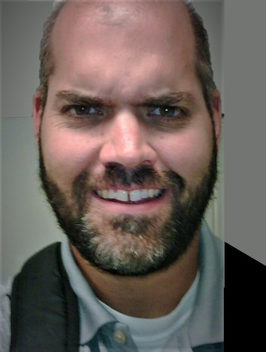
presenters
Brad Hurton
Patrick Ryan
Senior Systems Analyst
University of Calgary
bjhurton@ucalgary.ca
Talent Development Consultant
University of Calgary
paryan@ucalgary.ca

Slide 3
The University of Calgary
26,200 Undergrad Students
6,100 Grad Students
5,300 Staff
Recognized as one of Canada's Best Diversity Employers
Named one of top Alberta Employers for 5th year running
333 Sunny Days - Most in Canada!

Slide 4
UCALGARY & ORACLE
FSCM 9.2 PI 26
HCM 9.2 PI 29
ELM 9.2 PI 18
CS 9.2 PI 4
IH 9.1 PI 8 + IntraSee
PeopleTools 8.56
Oracle 12.2 database
Linux
We’re becoming old timers – original go-lives began in 2004. We’re now live with Campus Solutions, Finance, HCM, ELM and Integration Hub.

Slide 5
Eperformance - agenda
1
3
ePerformance at UCalgary
Connect to Perform
2
4
Creating new Administrative Tools
Streamlining the Process

Slide 6
Eperformance @ ucalgary
A brief history….

Slide 7
Eperformance @ ucalgary
Introduced in 2013 in HCM 9.0 for ~1000 non-union employees
Two of everything: templates, workflows, and training
Lengthy review template with 8 sections

Slide 8
Original SECTIONS
Vision
Mission
Strategy
Goals
Mid year Review
Accomplishments
Competencies
Summary

Slide 10
Original process
Define Goals (Manager/Employee)
Start Evaluation (Manager)
Employee completes self-evaluation
Manager completes evaluation
Manager submits for central approval
Approved by Central Approver
Share with Employee
Meet with Employee
Manager requests acknowledgement
Employee acknowledges
Manager completes document

Slide 11
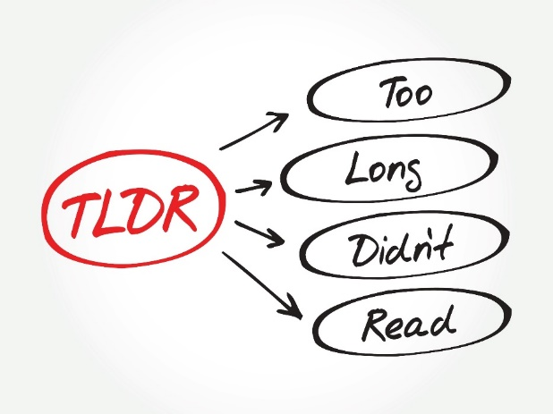
Lessons Learned
Perceived as too long and cumbersome
Managers didn’t start the evaluation on time
Users wanted:
Auto-save function for adding goals
Ability to re-open goals after starting their assessment

Slide 12
Streamlining the process
Baby steps

Slide 13
streamlining
Simplified the assessment workflow
Consolidated inputs to focus feedback
Merged templates
Tabbed view with fewer sections

Slide 14
Changes over time
 | 2013/14 | 2015/16 | 2019/20
Sections | 8 | 7 | 3
Comments | 6 | 6 | 6
Ratings | 17 | 5 | 1
Format | Long | Long | Tabbed
Workflow | Approval Before Review – 5 Steps | Approval Before Review – 3 Steps | No Approval with Review – 2 Steps

Slide 15
SECTION changes
Original Sections
Current Sections
Vision
Mission
Strategy
Goals
Mid year Review
Accomplishments
Competencies
Summary
Goals/Competencies
Development Plan
Accomplishments/Check-ins
Summary

Slide 16
Process Changes
Original Process
Current Process
Define Goals (Manager/Employee)
Start Evaluation (Manager)
Employee completes evaluation
Manager completes evaluation
Manager submits for central approval
Approved by Central Approver
Share with Employee
Manager requests Acknowledgement
Employee Acknowledges
Manager completes document
Define Goals (Manager/Employee)
Start Evaluation (Manager)
Employee completes evaluation
Manager completes evaluation
Share with Employee
Employee Acknowledges

Slide 17
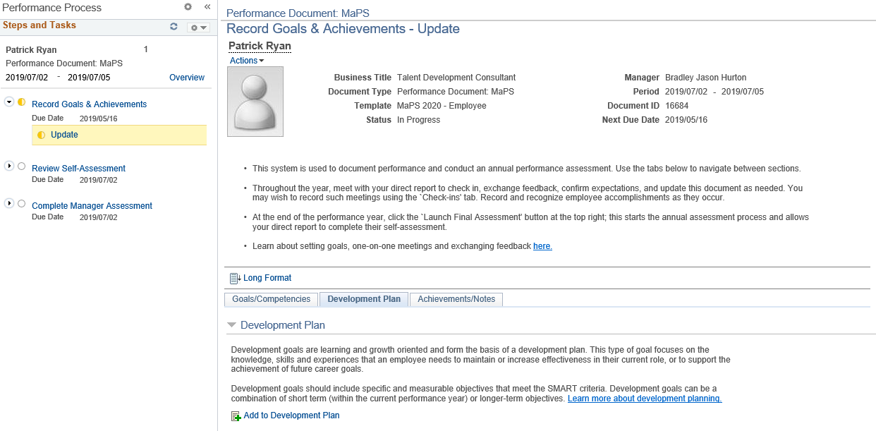
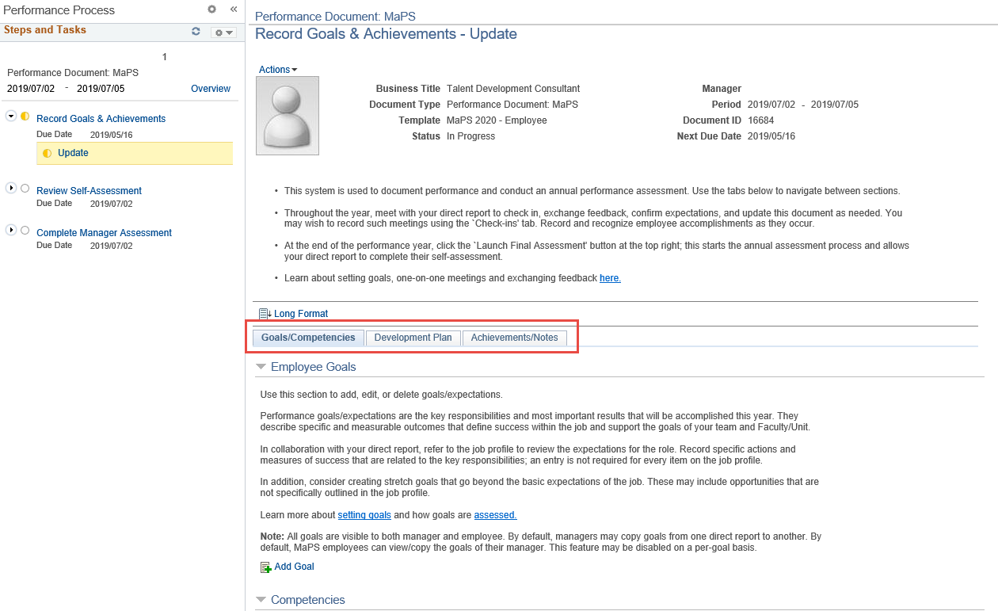
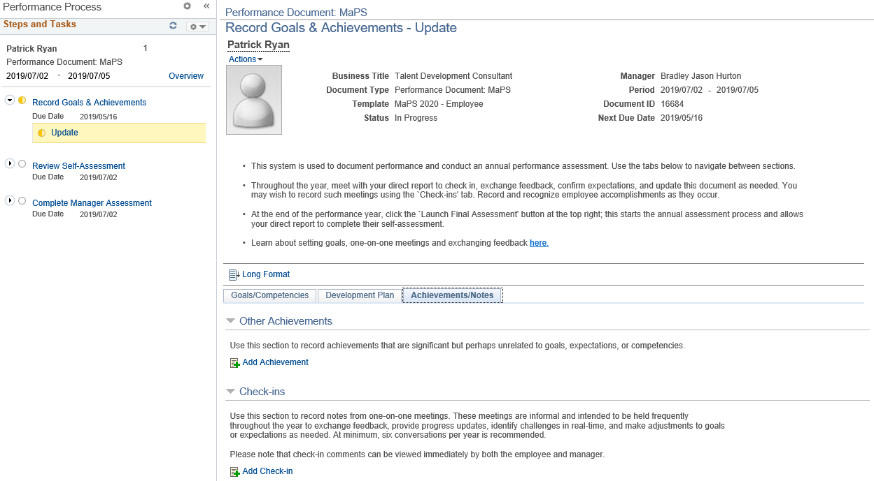
NEW TEMPLATE

Slide 18
Customizations
- Auto Save for goals
Automatically saved document once a goal was submitted
- Re-open goals
Move document back to Establish Criteria from Evaluation in Progress
- Business Title
Delivered Performance documents displays the job code description - our business titles are more accurate
- Auto-Cancellation Administration
We require a delay, and the option to prevent cancellation of a document

Slide 19
Connect to perform
Performance Management is evolving!

Slide 20
Connect to perform
The evolution of Performance Management at UCalgary
More focus on one-on-one conversations, timely feedback, and career development
Shifting the performance year for better alignment
Disconnecting performance ratings from compensation decisions

Slide 21
Expanded audience
Online annual reviews introduced to unionized staff group in 2018
Increased the audience by 2.5x (~2500)
More templates, more problems
Access to computers required a flexible process
89% review completion in the first year, with 88% self-assessment completion

Slide 22
Probation Reviews
Requirements:
Online and centrally managed
Two new templates
Auto-creation based on start-date
Managers completes the assessment, employee acknowledges
Notifications as reminders
Reporting

Slide 23
Probation Assessments in PeopleSOFt
Repurposed Development Documents
Consistent experience
Workflow and Notifications
Captured online and Report-able
Very configurable

Slide 24
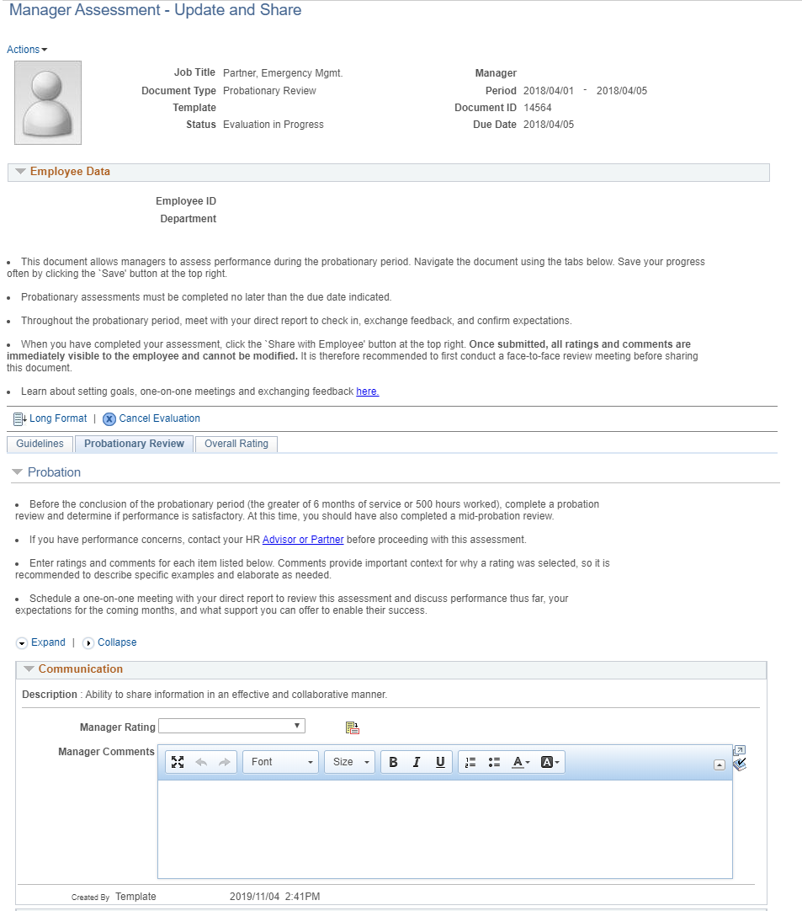
Probation Documents

Slide 25
Now we know…
Things to consider
Removed Define Criteria (Goals) step
Finding all the instances of “Development”
Notifications triggers tied to Performance Documents (Install Settings)
Employee has view only access after review (Historical)

Slide 26
Probation assessments IN REVIEW
It’s not all roses…
Not all employee types serve a probationary period
Not all probationary terms are served based on calendar days
Uptake has been slow: ~47% of reviews completed per month

Slide 27
Administrative tools
Cleaning up and moving forward

Slide 28
Clutter over time
We needed a way to manage old, incomplete reviews.
Incomplete reviews linger forever as a ‘current document’
Finalizing the document as an admin was manual and complicated
Unnecessary volume when transferring historical documents to new managers

Slide 29
Administrative tools
Customization process developed to centrally move documents through the workflow.
Incomplete reviews pushed forward or archived
Target step can be selected (not just the next one)
Move one or more employees at once
All current annual reviews can be moved to the Evaluation step.
Admin can control this centrally with one simple step to process all current documents

Slide 30
Status administration
Moving documents forward to a new status through search page
Selection page based on “Cancel Document” admin component for consistency
Required new field Template ID to be mandatory to relate to defined workflow steps
New config page to define the order of the document statuses by template

Slide 31
Status Admin demo

Slide 32
Status Configuration

Slide 33
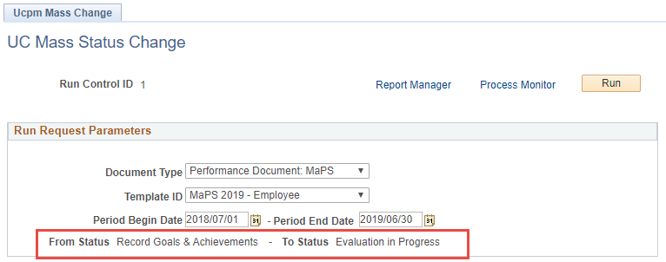
Mass Status Change
Moving all documents that match the run control parameters specifically from “Define Criteria” to “Evaluation in Progress”.

Slide 34
Outcomes
No news is good news…

Slide 35
outcomes
Streamlined documents
Improved user experience → higher-quality reviews
Fewer instances of calls to support centre or HR Partner
Process is still described as cumbersome
Connect to Perform
Focus groups suggest a shifting culture of feedback
Online probationary reviews close a labour relations gap
High completion rates among employee and managers of union staff
Decreasing review completion YOY from managers of non-union staff
Status Administration
Improved user experience for employees and managers
Fast-tracked workflow at the beginning of the review cycle

Slide 36
3 Tips for Optimizing your ePerformance Implementation
Learn from our mistakes

Slide 37
3 Tips
Start with why
What is the purpose of performance management in your organization?
Match system with purpose
Don’t make it painful
Look for the shortest workflow possible
Be purposeful: every comment box is a commitment
Be open-minded and engage your audience
Seek feedback from managers and employees
Consider repurposing delivered functionality to fill a business need
Don’t be shy about announcing your improvements

Slide 38
Concluding thoughts
ANY QUESTIONS?

Slide 39
Thank you!

