Slide 1
Payroll for North America, Eh?
SESSION 7038
November 5, 2019
10:00 AM – 11:00 AM

Slide 2
presenters
Sarah Hill
BSC, WKM, PCP
Jesse Wilson
BA, MBA, CHRL
Business Systems Analyst III
University Technology Services, McMaster University
hillsa@mcmaster.ca
Senior HR Payroll Analyst
Human Resources Services, McMaster University
huether@mcmaster.ca
Former McMaster Payroll Analyst who joined the original HCM Implementation Team as a Business Systems Implementation Specialist in Payroll; ROE; Year End; GL Interface; Labour Distribution & Salary Commitments; Payroll Actuals for Hyperion Planning; and Hyperion Salary Administration, and continue to support these functions, and others, in my current IT role.
Has worked in the HR Service Centre at McMaster University for 10 years in various capacities, including experience with high volume, front-end entry as an HR Advisor and payroll processing as a Payroll Analyst. Now leads a team of 6 responsible for full end-to-end processing of multiple payrolls, Pay to GL, statutory reporting, remittances and table updates.

Slide 3
1 monthly and 2 biweekly payrolls.
Employs more than 14,000 people in 11 employee groups.
Over 20 active benefit plans.

Slide 4
ORGANIZATION & ORACLE
PS HCM launch: October 2014
PS ERP includes: Financial Services, Human Resources, Campus Solutions, Data Warehouse (EPM), Business Intelligence, and Integration Hub
HCM Version: 9.2.23
PeopleTools: 8.55.22

Slide 5
Presentation outline
1
3
Non-Optional Employee General Deductions? There’s an App (Engine) for that!
Mass Uploads, Mass Uploads, Mass Uploads
2
4
Workman’s Compensation Board Premiums via Payroll
Additional Eh-fficiencies! ROE, Year End, Direct Deposit Entry

Slide 6
Automation of Employee General Deductions
How many non-optional deduction records need to be created per employee? Automate!

Slide 7
Automated General Deduction Enrollment
Context: A large portion of the McMaster University employee population is represented by varying unions.
Additionally, McMaster University has certain employer costs set up on the employee level to facilitate the allocation of business costs and to provide accurate remittance and regulatory reporting.
Challenge: Minimum of two and up to nine compulsory General Deductions to set up and maintain per employee.
Entering, updating, and expiring these deductions manually is labour-intensive and a significant administrative burden.

Slide 8
Automated General Deduction Enrollment
Outcome: Design a custom process to define, insert, and maintain Employee General Deductions.

Slide 9
Custom Process Specifications
PeopleSoft does not provide any delivered functionality which can be used for determining eligibility and setting up General Deduction records automatically.
Need for an Automated General Deduction (AGD) process which determines changes in an employee’s eligibility for Union Dues (Before-Tax), as well as certain employer cost deductions (Non-Taxable Benefit).
Use of the delivered deduction subset links General Deductions to our custom automated deduction setup table.

Slide 10
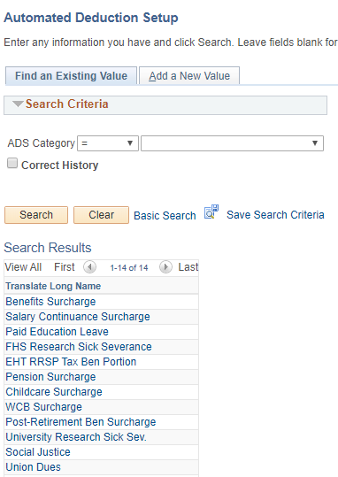
AGD Categories

Slide 11
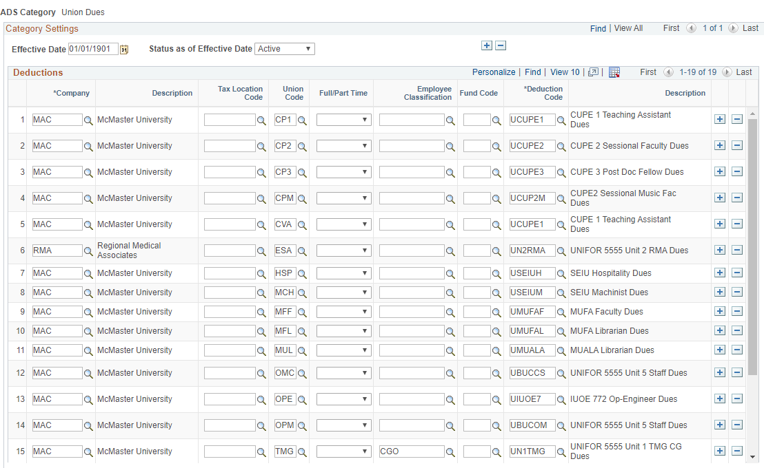
AGD category Referencing Job Attributes

Slide 12
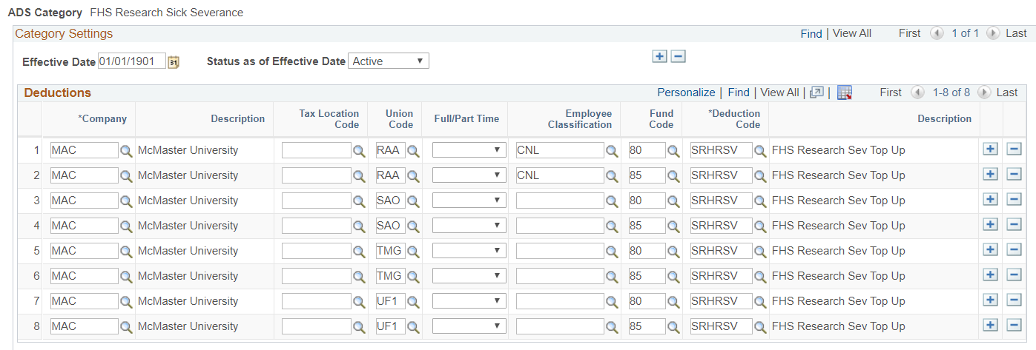
AGD Category referencing job and Department budget table Attributes

Slide 13
AGD Process
app-engine to be run ad-hoc
process is run through setting up a run-control, with pay run ID being the only required prompt
process scheduled to be run nightly

Slide 14
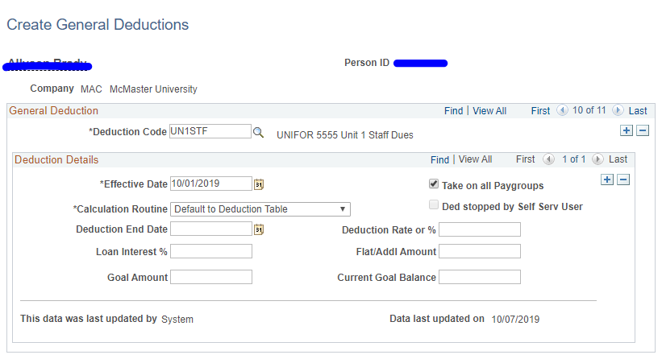
Create General Deductions
AGD Process audits employees in the pay and will insert any missing ‘Create General Deductions’ record(s) for eligible employee(s) as defined on the AGD setup table.

Slide 15
Process detail

Slide 16
AGD Output report
Company | Employee ID | Name | Depart | Empl Record | Deduction Code | Description
MAC | 000013871 | Doe, John | 10170 | 1 | UCUPE1 | Ineligible open deduction UCUPE1 exists from category U
MAC | 000112061 | Potter, Harry | 10473 | 0 | UN1STF | Ineligible open deduction UN1STF exists from category U
MAC | 000152306 | Pitt, Brad | 10346 | 3 | SRCACC | Ineligible open deduction SRCACC exists from category K

Slide 17
Workman’s Compensation Board premiums via payroll
Working with Multiple Companies, Provinces, and Rate Groups.
Can work for the new BC Employer Health Tax, too!

Slide 18
It’s complicated…
McMaster provides Payroll Services for numerous non-affiliated Companies at one time (currently six)
Multiple concurrent Provinces and/or Territories are possible for a single company (the number of employees and provinces fluctuates over time)
Multiple concurrent Rate Groups are possible within a single Province + Company combination

Slide 19
What peoplesoft delivers for wcb
Not Included in Payroll
No Actuals Distributed
Report Estimates; Remit Estimates

Slide 20
WCB: A Cost of doing business?
PeopleSoft treats provincial Workman’s Compensation premiums more like a ‘Cost of Doing Business’, rather than a true Payroll-related cost; this business approach assumes a central finance department will foot the bill for the whole company; may work in a private sector company
PeopleSoft has used a similarly styled approach for the new BC Employer Health Tax Report
This approach definitely does not fit the business needs of most Public Sector or Higher Education institutions, both of which tend towards using an extremely decentralized costing model
McMaster’s solution can be used for either WCB or the new BC EHT

Slide 21
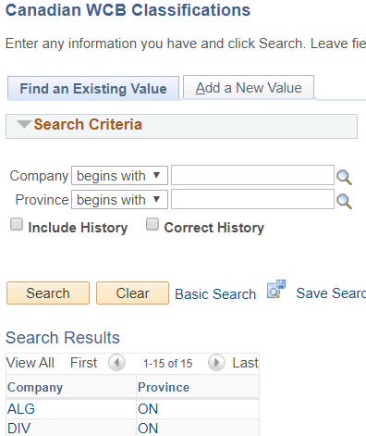
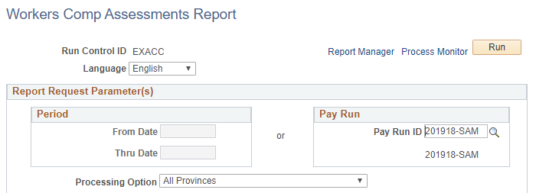
WCB: PeopleSoft Delivered
WCB Classifications – set up a record for each unique Company + Province combination required; add applicable Rate Groups
Workers Comp Assessments Report – Run after Pay is Confirmed to estimate remittances on a pay period, or a calendar period, basis

Slide 22
What mcmaster needed for wcb
Accurate Corporate Costs per Employee via Payroll
Distribute Payroll Actuals
Report Actuals & Remit Actuals

Slide 23
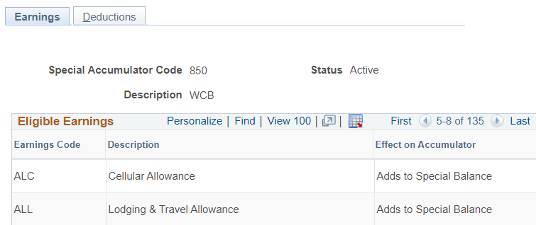
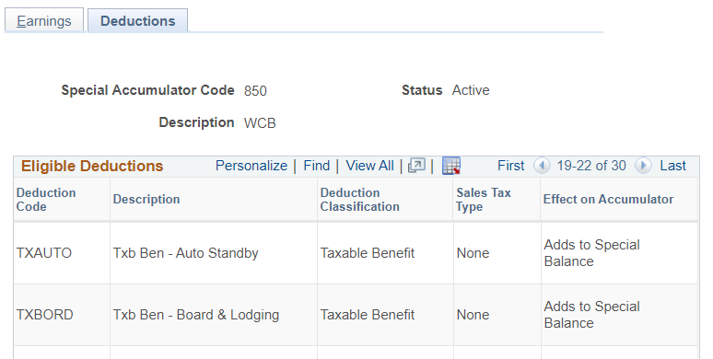
How we ‘Delivered’ it
Special Accumulator (SA) – Set up any Special Accumulator(s) required for the WCB Deductions to calculate; attach the SA to applicable Earnings / Deductions codes on the applicable tables

Slide 24
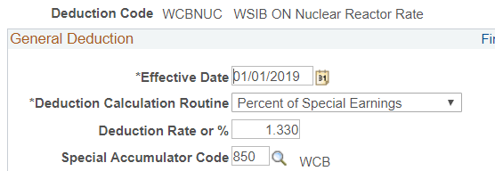
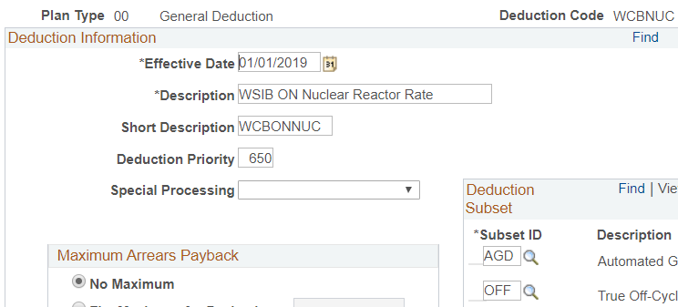
WCB general deductions
Deduction Table - create a separate General Deduction record for each unique Province + Rate combination required; set applicable Maximum Yearly Deduction (Insurable Earnings x Rate)
General Deduction Table – select Percent of Special Earnings, specify Deduction Percentage, link to the Special Accumulator

Slide 25
WCB Employee level deductions
Create General Deductions – set up an employee-level Deduction using the applicable Deduction Code and Default to Deduction Table

Slide 26
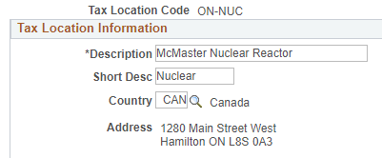
Optional setup to Support auditing
Tax Location Table – set up a separate Tax Location Code for each unique Province + Rate Group combination required
Job Data – Populate the applicable Tax Location Code

Slide 27
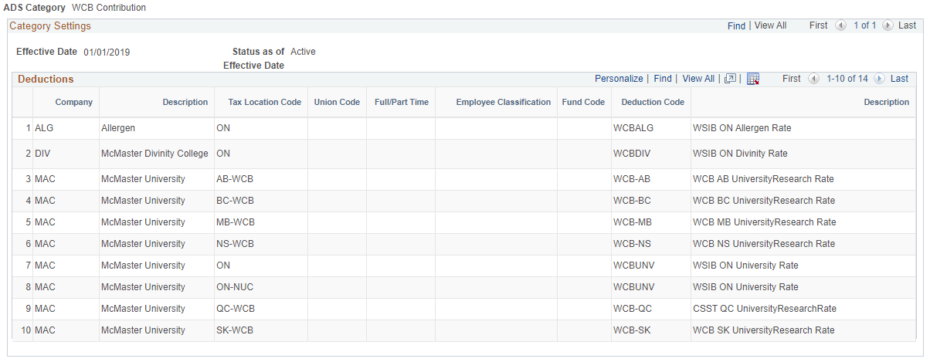
Of course, we automated this too
Automated General Deductions – we set up a separate Category for WCB in our custom AGD tables, so we could automate the Employee Deductions for WCB based on the Tax Local Code on Job Data

Slide 28
a summary of our wcb processes
Automated Employee Deductions; Corp Cost per Empl
Payroll Actuals Distributed to GL
Report Actuals & Remit Actuals

Slide 29
Mass Uploads, Mass Uploads, Mass Uploads
There’s an App (Engine) for that!
Load to Paylines; Load to Additional Pay; Load to Create General Deductions

Slide 30
Upload Processing For pay
Developed custom app-engine for front-end users
Initial report mode enables validation of the file and its’ contents prior to committing to loading (allows users to correct file and data errors)
Update mode inserts records on the tables using delivered excel to ci
Both report mode and update mode generate the following files:
log file summarizing results
exception report

Slide 31
One-Time Paysheets Load

Slide 32
Paysheet upload log file

Slide 33
One-time PAYsheet LOAD

Slide 34
Load additional pay

Slide 35
Additional Pay Uploads by Fiscal Year
May 1, 2015 – April 30, 2019
Notes:
May 2015 - April 2016 - 6255 Records
May 2016 - April 2017 - 9273 Records
May 2017 - April 2018 - 9254 Records
May 2018 - April 2019 - 9368 Records
Total of 34,150 records

Slide 36
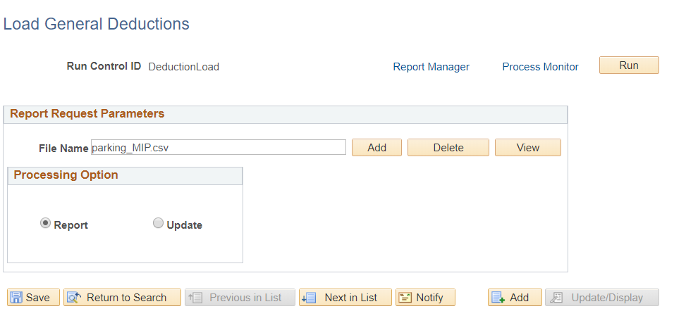
Load general deductions

Slide 37
General Deduction Uploads

Slide 38
Additional Eh-FFiciencies
Use Cases and Success Stories for Navigation Collections (Records of Employment, Tax Slips…)
Request Direct Deposit just got a whole lot easier

Slide 39
Leveraging system efficiencies to Reduce Administrative burden
How great is it when a new feature is implemented, which is instantly intuitive, and which makes your (work) life a little better?
Here is a brief showcase of some of the improvements we have made to reduce administrative burden for our business partners:
Navigation Collections: Use Cases and Success Stories
Repetitive, high volume, multi-step processes (ROE Processing)
Reducing the guesswork on periodic or complicated processes (Tax Slip Processing)
Leveraging our ERP to improve the User Experience (HR Reporting Hub)
Streamlining Direct Deposit Entry
Page and Field Configurator
Event Mapping

Slide 40
Using Navigation collections to simplify your workday
Most of the Tiles on our HR Work homepage link to Navigation Collections.
This homepage is accessible to McMaster’s Human Resources Services staff, who are dealing in high volumes of data entry and processing on behalf of the University.
These employees have access to a LOT of pages in the system, so relying on Menu Navigation or a Favorites List was not an optimal solution for them.

Slide 41
Navigation Collection use case: High Volume tasks
Use Case: Multi-Step, high volume tasks are great candidates for Navigation Collections, especially when there are multiple possible steps to completion
Examples: Record of Employment (ROE) Processing, Prior Period Adjustments

Slide 42
ROE processing

Slide 43
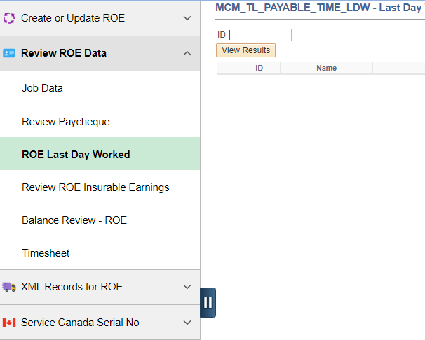
items are grouped by function for ease of use
Review ROE Data folder contains links to all the pages needed to review the data contained in the ROE report
A user-developed query has been included here, by request
The query download links will appear after the query has returned results

Slide 44
ROE volumes vary by month

Slide 45
Navigation Collection use case: Complicated, periodic process
Use Case: Highly complicated end to end jobs and/or those performed only periodically can also be simplified by using Navigation Collections
Examples: Pay to General Ledger (GL) Processing, Tax Slip Processing

Slide 46
Tax Slip Processing - navigation collection
Items are grouped according to function
Groupings also follow the basic flow of the work to be completed
All processes, reports, queries and data recon pages are included, for ease of workflow

Slide 47
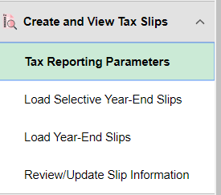
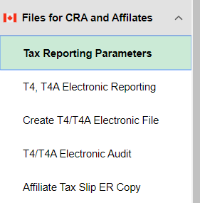
Tax Slip Processing - navigation collection
Links may be repeated in the list, if it makes more sense to the flow of the work
Notice each of the folders shown have a link to the Tax Reporting Parameters page

Slide 48
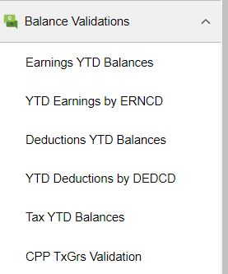
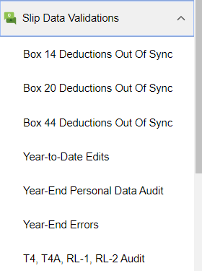
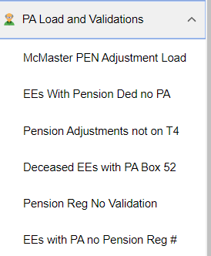
Tax Slip Processing – validations
Many validations are required to produce tax slips each year
All our validation reports, queries are included
Links to the associated data pages where corrections might be needed are provided in this Navigation Collection

Slide 49
our HCM tax slip annual volumes

Slide 50
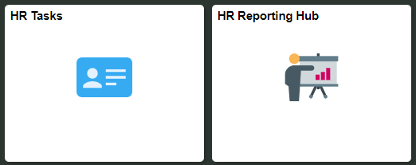
Navigation Collection use case: access to a variety of pages for similar users
Use Case: One of the most common uses for Navigation Collections is to give multiple similar users access to a variety of system pages from a single location
Examples: Pay to General Ledger (GL) Processing, Tax Slip Processing, HR Tasks, HR Reporting Hub

Slide 51
A homepage just For department administrators and financial managers
Users are able to access Campus, Finance, Human Resources, and Data Warehouse from a single homepage
Even with a Navigation Collection, users are able to access items from different databases

Slide 52
Hr reporting hub: access to HR reporting, and…

Slide 53
Hr reporting hub: …access to data warehouse reporting in one place

Slide 54
Request Direct Deposit just got a whole lot easier
The Challenge: an extremely high-volume data entry page, with over half the fields having easily defined defaults; an additional field on the same page is unwanted (DDP Advice Print)
Due to processing volumes, there is a huge amount of repetitive manual entry with no value added for the business when it comes to data entry on this one page

Slide 55
Request Direct Deposit just got a whole lot easier
The Solution: we used a combination of Page and Field Configurator and Event Mapping to achieve the desired results
Added Benefit: Our solution is Configured, not Customized!

Slide 56
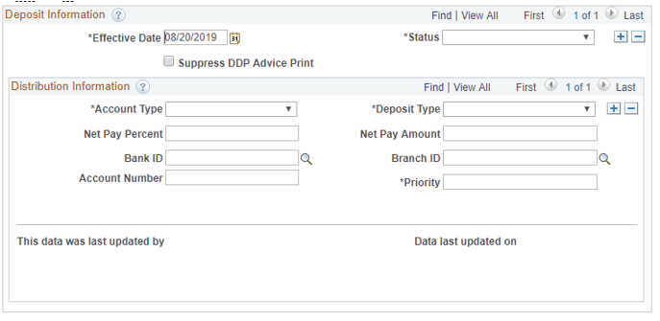
Request Direct deposit - delivered (blank record)

Slide 57
Request Direct deposit – newly configured (blank record)

Slide 58
How we did it
When user clicks the Add Button (prior record exists)
When User Accesses a Blank Record (no prior record)
Page and Field hides the unwanted field
Page and Field restricts Update Access for the never-changing fields
Page and Field enforces the default values when the new effective dated row is created, even when the prior field value does not match the default
Page and Field hides the unwanted field
Page and Field restricts Update Access for the never-changing fields
Event Mapping Rule loads the desired default values to the page (when a specified field is blank)

Slide 59
Small change, big impact: Hires and rehires at McMaster

Slide 60
Questions?

Slide 61
presenters
Sarah Hill
Jesse Wilson
Business Systems Analyst III
University Technology Services, McMaster University
hillsa@mcmaster.ca
Senior HR Payroll Analyst
Human Resources Services, McMaster University
huether@mcmaster.ca
all Alliance presentations will be available for download from the Conference Site

Slide 62
Thank you!

