Slide 1
Automated Oracle EBS R12.1 Cloning
Presented by
Andrew McGuiness
Notes:
Hello and welcome to this presentation on how we at LJMU clone an Oracle EBS R12.1 environment
Using the process I’m going to describe shortly, we have reduced the time to clone an environment from 3 hours to less than 1 hour and can duplicate the database in around 20 minutes. This is all without any user intervention
I have allowed time for any questions as we go along, so if there are none, we are likely to finish early and have time for a morning coffee.
Out of interest, how many of you clone your EBS environment using the
RMAN> DUPLICATE TARGET DATABASE FROM ACTIVE DATABASE command?

Slide 2
Short history of LJMU
1823 - originally founded as the Liverpool Mechanics' School of Arts
The institution grew over time by converging and amalgamating with
different colleges and eventually became the Liverpool Polytechnic.
- the Polytechnic became one of the UK's new generation of
universities and assumed the name Liverpool John Moores University.
Today - the university has over 22,000 students and approximately
2,500 staff
Notes:
1823 - originally founded as the Liverpool Mechanics' School of Arts
2. The institution grew over time by merging with different colleges
and eventually became the Liverpool Polytechnic.
3. 1992 - the Polytechnic became one of the UK's new generation of
universities and assumed the name Liverpool John Moores University.
The staff at the time were allowed to put forward suggestions including
Everton University
Liverpool Polytechnic University
Atlantic University
4. Today - the university has over 22,000 students and approximately
2,500 staff

Slide 3
Infrastructure
Data Centre A
Data Centre B
8Gb Dark Fibre link
16Gb Fibre Channel link
400Tb SAN datastore
400Tb SAN datastore
Notes:
We have 2 data centres physically separated by about 2km
Each centre runs vmware and each having a 400Tb datastore.
The Data Centres are connected via 8Gb Dark Fibre link.
Each Data Store is replicated between the two SANs over a 16Gb Fibre Channel link.

Slide 4
Infrastructure
All the EBS virtual machines are based on:
Redhat Enterprise Linux v6.8x86_64
Notes:
All the EBS virtual machines are based on
Redhat Enterprise Linux v6.8x86_64
We started on Solaris 2.6 many years ago when we commenced using EBS and have slowly migrated onto the current version of Linux about a year ago. Our first experience of EBS was 11.5.3 Oracle Student System, which some of you may remember, but now our student system runs PeopleSoft since Oracle stopped the support of OSS a few years ago.
The migration of OSS to Campus Solutions is a story for another day…

Slide 5
Infrastructure
VM Server | vCPU | vCORE | RAM
Production Db | 2 | 20 | 64G
Production App | 2 | 10 | 32G
Test Db/App | 2 | 4 | 16G
Notes:
All the VMs have 2 vCPU
The Prod db VM 20 vCORE and 64G memory
The Prod App VM has 10 vCORE and 32G memory
And the test/dev clone environments have 4 vCORE and 16G memory

Slide 6
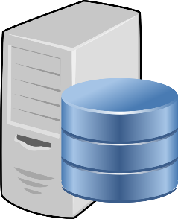
Our Environments
Production
Daily Clone
nfsadmin
ebsdbc
ebsdbp
nfsadmin:/nfsmount/EBSclone
nfsadmin:/nfsmount/EBSclone
EBSDLY
EBSPRD
Single Server
Database Server
Other environments
ebsapp
nfsadmin:/nfsmount/EBSclone
UAT
/nfsmount/EBSclone
nfsadmin:/nfsmount/EBSclone
ebsdbu
Application Server
EBSUAT
Single Server
Notes:
The Prod environment consists of a database server, ebsdbp – p for production
A database, EBSPRD
And an application server, ebsapp
The environment we now clone nightly and the one I will be talking about today resides on a single server, ebsdbc – c for clone, with a database called EBSDLY as it’s cloned on a nightly basis
We also have other environments, i.e. UAT, each residing on their own single VM
Underpinning this we have another Linux server, nfsadmin, which has a filesystem called /nfsmount/EBSclone
This filesystem is remotely mounted to all the EBS environments so that all the EBS clone servers see the same nfs filesystem with the same name.
This helps enormousely with standardising the cloning process.

Slide 7
nfsadmin server
Multi-purpose Linux server, which we DBA’s use for a:
Network File server – for our EBS backups
Web server – it hosts our environment reports
Notes:
nfsadmin server is a multi-purpose and we use it as a:
Network file server for our EBS backups
Web server for our environment reports – more about this later
General file store and “dump” for things we might need at a future date.

Slide 8
Background information
EBS Database
Oracle 11.2.0.4
Approx 550Gb
Between 500 - 600 concurrent connections
Separate software owners
Database – oraprd, oradly
Application – appprd, appdly
Notes:
EBS database
Oracle database software version 11.2.0.4
There is No RAC, no ASM. There is a Data-Guard standby for disaster recovery, but that doesn’t feature in our current cloning method.
approx. 550Gb so not large by any means but not trivial either
Has 500-600 concurrent connections and in theory at least, 2,500 active users. We use OAM/OID for our single sign-on methodology, linking back to our central Active Directory.
Has separate software owners for database and app

Slide 9
Previous Backup Strategy
On a Sunday evening we had the luxury of shutting down the
production application and database to perform a “cold”,
consistent backup of the complete environment
The backups were performed using Linux tar to a locally mounted
filesystem and then copied to a network filesystem
Daily full database backup using RMAN
Notes:
Every Sunday we had the luxury of shutting down the Prod app & db to perform a cold consistent backup of the Prod environment
The backups were performed using Linux tar to a locally mounted filesystem and then copied to a network filesystem
Both the local and network filesystem were backed up to tape overnight
Daily full database backup using RMAN for normal backup and disaster recovery.

Slide 10
Previous Cloning Strategy
Used the weekly “cold” backup of the database, dbTier and appsTier
The clone procedure took around 3 hours
This was acceptable to the business for cloning/testing purposes
But a new project required that the data be less than 24 hours old
Notes:
Used the weekly “cold” backup of the database, dbTier and appsTier.
Basically we took the complete “copy” or production and dropped it onto the clone target and there was a semi-automatic process for creating the cloned instance.
The clone procedure took around 3 hours to complete and every clone created that week was from the same source – i.e. the cold backup of the database files.
This was acceptable to the business for cloning/testing purposes
New project, a “proof of concept” for OBIEE required that the data be less than 24 hours old, and acting as a source for the OBIEE warehouse. The OBIEE drew the data from the clone every morning, so the clone needed to be refreshed prior to this every day.

Slide 11
New Backup Strategy
Daily “hot” backup dbTier using Linux tar
Daily “hot” backup of appsTier using Linux tar
Daily full database backup using RMAN
Notes:
The new Production backup strategy consists of a daily hot backup of dbTier and appsTier using Linux tar and we still run a daily full database backup using RMAN. Basically we don’t shut the production database or application down – it runs 24/7
We do not use the RMAN backup as part of the cloning process, it would only be used in the event of Prod db recovery, our cloning is done against the live production database. We had investigated cloning from the RMAN pieces, but found that cloning from the live database was simpler, and obviously gave more “up to date” data.

Slide 12
Production backup schedule
# Backup of ebsdbp Oracle software
00 19 * * * /scripts/oracle/backups/ebsdbp_backup.sh
> /scripts/oracle/logs/ebsdbp_backup.log 2>&1
# Backup of ebsapp Application software
00 19 * * * /scripts/oracle/backups/ebsapp_backup.sh
> /scripts/oracle/logs/ebsapp_backup.log 2>&1
Notes:
Both database and app server backups are scheduled through crontab to start at same time and both are run as the root user. They tar up various components of the $APP_HOME and the complete database $ORACLE_HOME.
Crontab is flexible and dependable and we use it for a lot of database/application jobs rather than the Oracle Scheduler – but that is slowly changing.

Slide 13
Production Backup Script
Before any backup files are created, a pre-clone of each Tier is performed
On ebsdbp, ebsdbp_backup.sh runs:
su - $DBOWN -c "${SCRIPT_DIR}/pre_clone.sh $APPSPASS"
On ebsapp, ebsapp_backup.sh runs:
su - $APPOWN -c "${SCRIPT_DIR}/pre_clone.sh $APPSPASS"
Notes:
In order to make sure that the cloning will complete we run the adpreclone perl script on both the apps and database server prior to the backup.
We do this via a custom script pre_clone.sh for the apps and db tiers.

Slide 14
Preclone dbTier
#!/bin/bash
appspass=$1
#
cd $ORACLE_HOME/appsutil/scripts/$CONTEXT_NAME
echo ${appspass} | perl adpreclone.pl dbTier
Notes:
It took us a while to work out how to pass the Apps password into the perl script as a parameter.
We tried many things using redirects and such-like, but eventually we found the simple echo command worked.

Slide 15
Preclone appsTier
#!/bin/bash
appspass=$1
#
cd $INST_TOP/admin/scripts
echo ${appspass} | perl adpreclone.pl appsTier
Notes:
And here we have the apps tier pre-clone script, again echoing in the apps password.
At this point it must be said that we, the DBA team, are not hugely proficient bash scripters, but we do find it easier to maintain scripts that we write, rather than get the Linux sysadmins to write them. Basically, their scripts are too clever for us to understand half the time.

Slide 16
List of backup files
ls -lh /nfsmount/EBSclone/backup
total 19G
-rw-r--r-- 1 root root 9.4G Nov 2 20:50 EBSPRD_ebsapp_Apps_Top.tgz
-rw-r--r-- 1 root root 6.7G Nov 2 22:13 EBSPRD_ebsapp_Inst_Top.tgz
-rw-r--r-- 1 root root 16M Nov 2 22:19 EBSPRD_ebsapp_Out_Top.tgz
-rw-r--r-- 1 root root 3.3G Nov 2 19:10 EBSPRD_ebsdbp_Oracle_Home.tgz
-rw-r--r-- 1 root root 64M Nov 2 19:13 EBSPRD_ebsdbp_Out_Top.tgz
Notes:
As you can see, we backup $APP_TOP, $INST_TOP and outbound files on the app server
And the Oracle home and outbound files on the db server
We will only be using the $APP_TOP and the Oracle Home backups for the clone, the other backups are for DR and file recovery – if needed.
The $INST_TOP will be automatically built from scratch on the clone server during the cloning process.

Slide 17
Network File System Directory Structure
/nfsmount/EBSclone/
app
backup
db
logs
script
EBSclone.sh
contextfile
clone_env
Logo
contextfile
scripts
init_ora
security
network_admin
sql
rman_policy
scripts
security
sql
Notes:
Fairly simple directory structure.
It logically separates the app and db scripts and pertinent information.
The backup directory contains the production backups the clone script will use e.g.. the $APP_TOP and $ORACLE_HOME
The logs directory contains the html output from the clone script (more of which later)
And the script directory contains the EBS clone master script

Slide 18
Summary
At this point we have a backup of the required software
files from the Production servers and we can now start
to look at the cloning process
Notes:
At this point we have a backup of the required software files from the Production servers.
We can now start to look at the cloning process itself

Slide 19
The EBSclone.sh script
Run as the root user (or sudo) on the clone server
This enables the script to switch user (su) as required
Accepts a single parameter - the database to be cloned
Notes:
This script can be run manually or scheduled to run via the crontab
Obviously if you have all the software installed under a single user then the scripts could all be run as that user, but since we have split the o/s users we need a way of switching between them.
Due to the way we have built the script – more accidental than design it must be said – we only need to pass in a single parameter – the name of the database to be cloned.

Slide 20
Crontab entry
# Hot clone for EBSDLY
30 00 * * 1-6 /nfsmount/EBSclone/script/EBSclone.sh EBSDLY
> /nfsmount/EBSclone/logs/EBSDLY_clone.log 2>&1
Notes:
Runs at half past midnight, Monday thru Saturday, and redirects any cron output and any errors to a log file, in this case EBSDLY_clone.log.
This obviously can be run manually at any time, which we do to either re-run the clone if it fails, or to build UAT, DEV, TEST etc. when requested.
Talking of failing, the cloning can sometimes crash out if it gets a SQL timeout error.
We have not got to the bottom of this yet, but imagine it is a problem with the network at some point.
Most of the problems we have we tend to blame on the network – it is easy to do, and since networks is such a black art no one points the finger back at us !

Slide 21
Sanity checks
Has the clone environment been cloned before?
/nfsmount/EBSclone/db/clone_env/${clndb}_clone.env
i.e:
/nfsmount/EBSclone/db/clone_env/EBSDLY_clone.env
Notes:
The EBSclone.sh script performs a couple of sanity checks.
First has the environment to be cloned, been cloned before?
If it has there will be a db instance_clone.env file in existence, basically a file containing all the information require to complete a cloning. We will have a look at one now.

Slide 22
export clndb=EBSDLY
export clnsvr=ebsdbc
export clnfs=/u01/oracle
export clnbase=${clnfs}/${clndb}
export clnoh=${dbloc}/db/tech_st/11.2.0.4
export clnapp=clone_apps_pw
export clnsystem=clone_system_pw
export clnasadmin=clone_asadmin_pw
export clnsysadmin=clone_sysadmin_pw
export appown=app$(echo ${clndb}|cut -c4-6|tr '[:upper:]' '[:lower:]')
export dbown=ora$(echo ${clndb}|cut -c4-6|tr '[:upper:]' '[:lower:]')
export cname=${clndb}_${clnsvr}
EBSDLY_clone.env
export srcdb=EBSPRD
export srcapp=prod_apps
export srcsys=prod_sys
export srcsystem=prod_system
export ssosystem=sso_system
export F5=Y
export SSL=Y
export SSO=Y
Notes:
Here is an example of the clone.env file
I appreciate that there is a lot of information to take in on this slide
Colour codes:
Blue – clone environment variables – stuff needed from the clone side
Purple – source environment variables – stuff needed from the production side
Black – optional - what we use at LJMU - obviously this will be different for every site, but we use SSO, F5 load balancers, SSL termination, etc.
Red – your relevant details with passwords in italics. We determine the o/s users by chopping up the name of the clone database. Ending up with ora<name> and app<name>

Slide 23
New clone environment
Create o/s user(s)
Create mount points
Create init.ora and password file
Create sqlnet/tnsnames files
$CONTEXT_FILE will not exist so configure manually first time
or copy one from another environment and edit carefully
Once the $CONTEXT_FILES have been created, copy them to
a central location (/nfsmount/EBSclone/db|app/contextfile)
Notes:
For a new clone environment:
If we find we haven’t clone this instance before, there are certain steps that need to be completed
For instance :
Create the operating system user or users
Create the mountpoints (/u01/oracle)
Create the init.ora and password file
Create network files, tnsnames.ora etc
Optionally create a CONTEXT_FILE or you will need to configure this manually at the prompts by running adcfgclone.pl

Slide 24
Sanity checks
Is the Production database available for cloning?
Notes:
The second check the script performs is, is to verify that the Prod db available for cloning the data?
There is no point trying to run the clone process if there is no source, or the source is not accessible

Slide 25
Testing if a database is available
1.
tnsping
2.
Notes:
How would you test to see if a database is available for use?
There are two obvious ways that immediately spring to mind.

Slide 26
Testing if a database is available
tnsping only reports on whether the database listener process is running and if it knows about the service you are connecting to
No + No
No + No
tnsping

Slide 27
Testing if a database is available
1.
tnsping
2.
ps –ef| grep pmon/smon

Slide 28
Testing if a database is available
This command can only be run on the
server where the database resides and
even then it does not display whether
the database is available for use
ps –ef| grep pmon/smon
Notes:
This command can only be run on the server where the database resides
And even then you cannot be certain that the database is available for use
It could be in nomount or mount state

Slide 29
Testing if a database is available
sqlplus -L <user>/<password>@<database>
Using the -L flag will attempt to log on just once instead of reprompting on error
Note: DO NOT use “/ as sysdba”, because SYS can always connect to an idle instance!!
Notes:
sqlplus –L <user>/<password>@<database>
Using the -L flag will attempt to log on just once instead of reprompting on error
Note: DO NOT use “/ as sysdba”, because SYS can always connect to an idle instance!!

Slide 30
ok_to_clone.sh
#!/bin/bash
srcsystem=$1
srcdb=$2
BASEPATH=$3
echo "exit" | sqlplus -L system/${srcsystem}@${srcdb} | grep Connected > /dev/null
if [ $? -eq 0 ]
then
touch ${BASEPATH}/db/scripts/ok_to_clone
fi
EBSPRD
<system password>
/nfsmount/EBSclone
Check the status code returned from the above command
Notes:
This is the script we use to check that the Prod db is available for cloning
As you can see we try to login from the clone server to the source database on the source server as the user SYSTEM
If the login is unsuccessful, the status code from the command will be 1
If it is successful then we create a flag file for the EBSclone.sh script to check.
At the time this script is run, the Prod db may be unavailable because it has crashed, be down for maintenance or there may be network issues etc which made the test connection fail

Slide 31
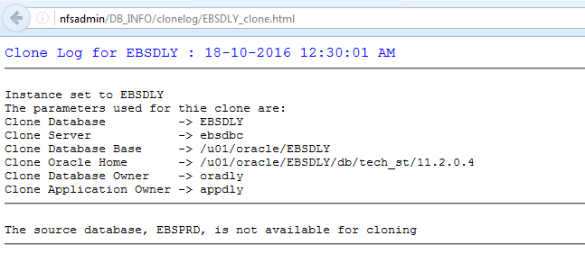
Source database is unavailable
Notes:
If it is unavailable for any of the these reasons, we see this clone log

Slide 32
Summary
At this point we have a backup of the required software
files, the Production database is available and we know
that the environment to be cloned has been cloned
previously
Notes:
At this point we have a backup of the required software files from the Production servers
The Prod db is ok and that the environment has been cloned before we can now start to look at the cloning process

Slide 33
1.
Restore dbTier software
2.
Duplicate database
3.
Clone dbTier
4.
Restore appsTier software
5.
Clone appsTier
Notes:
The environment clone can be broken down into 5 sections.
Restore the dbTier software files using Linux tar
Duplicate the database using Oracle RMAN
Clone the dbTier using adcfgclone.pl
Restore the appsTier software files using Linux tar
Clone the appTier using adcfgclone.pl
So lets look at step 1

Slide 34
Restore dbTier software
Shuts down the application and database to be cloned
Deletes the database files, dbTier software
Restores the dbTier from compressed backup tar file
Creates password file and copies init.ora
Creates CONTEXT_NAME.env
Notes:
If the application and database to be cloned are running, the processes are stopped the database files, dbTier software are deleted
The dbTier software is restored from compressed backup tar file
Once the restore is complete, the db password file is created and the init.ora copied from nfsmount/EBSclone/db/init_ora directory
All our Dev/Test environments use an init.ora not a spfile
We use custom versions of the init.ora as they have the relevant parameters used for cloning, i.e. db file name convert, log file name convert etc
And finally creates CONTEXT_NAME.env in the oracle home, this file contains the oracle home and oracle sid variables

Slide 35
1.
Restore dbTier software
2.
Duplicate database
Notes:
Once the software is in place the second step of duplicating the database using RMAN can proceed.

Slide 36
Duplicate database
DUPLICATE TARGET DATABASE TO EBSDLY FROM ACTIVE DATABASE;
Notes:
This is the basic RMAN command, which will clone from production.

Slide 37
Name Convert
In the pfile/spfile
DB_FILE_NAME_CONVERT=
'/{Source mount}/data','/{Clone mount}/data‘
LOG_FILE_NAME_CONVERT=
'/{Source mount}/redo','/{Clone mount}/redo',
'/{Source mount}/redo','/{Clone mount}/redo'
Notes:
In our init.ora file, we have the name convert instructions so the duplicate knows where to place the clone files.

Slide 38
duplicate_db.sh
#!/bin/bash
srcsys=$1
srcdb=$2
clndb=$3
sqlplus '/ as sysdba' << SQL_EOF
startup nomount
exit
SQL_EOF
rman target sys/${srcsys}@${srcdb} auxiliary sys/${srcsys}@${clndb} << RMAN_EOF
CONFIGURE DEVICE TYPE DISK PARALLELISM 6;
DUPLICATE TARGET DATABASE TO ${clndb}
FROM ACTIVE DATABASE
;
CONFIGURE DEVICE TYPE DISK PARALLELISM 12;
RMAN_EOF
<sys password>
EBSPRD
EBSDLY
Found to be the optimum for cloning
Found to be the optimum for backup
Notes:
This is the script that performs the database duplication.
It requires 3 parameters, the sys password, the source db and the clone db.
When we tried the database duplication a while ago whilst the environments were residing on physical servers, Oracle errors relating to network time-outs were experienced if the parallelism parameter was set to more than 1.
However now that the network has been upgraded and we are now on virtual servers we have found that the optimal value for performing the database duplication in parallel is 6 and that for backing up the Prod db most efficiently is 12.

Slide 39
1.
Restore dbTier software
2.
Duplicate database
3.
Clone dbTier
Notes:
The next step is to clone the dbTier

Slide 40
dbTier_clone.sh
#!/bin/bash
BASEPATH=$1
cname=$2
srcapp=$3
cp $BASEPATH/db/contextfile/${cname}.xml $ORACLE_HOME/appsutil/
cd $ORACLE_HOME/appsutil/clone/bin
echo ${srcapp} | perl adcfgclone.pl dbTier $ORACLE_HOME/appsutil/${cname}.xml
/nfsmount/EBSclone
$CONTEXT_NAME
<apps password>
Notes:
Because the environment has been cloned before, the preserved copy of the $CONTEXT_FILE is copied to Oracle Home Appsutil directory
This eliminates the need to manually enter the passwords, port values etc for this clone
Runs rapidclone for dbTier using adcfgclone.pl and the $CONTEXT_FILE

Slide 41
dbTier postclone actions
Shutdown database
Copy our “standard” init.ora
Restart database
Apply RMAN policy
Delete archivelogs generated from running duplicate db
Notes:
This script shuts down the clone db and listener using addlnctl.sh and addbctl.sh
Copies our standard clone init.ora to dbs directory
Restarts db and updates RMAN settings
Deletes archivelogs generated during the clone because we don’t run any clone database in archivelog mode

Slide 42
Summary
At this point we have a newly cloned database
Notes:
At this point we have a cloned database and we now can start work on the app side

Slide 43
1.
Restore dbTier software
2.
Duplicate database
3.
Clone dbTier
4.
Restore appsTier software
Notes:
The 4th step is to restore the appsTier software from the $APPS_TOP backup

Slide 44
Restore appsTier software
Deletes the previous appsTier software
Restores the appsTier software from compressed backup tar file
Notes:
Deletes the previous appsTier software
Restores the appsTier software from compressed backup tar file – this is what actually takes the longest time. Depending on the network load it can take between 30minutes and 1 hour

Slide 45
1.
Restore dbTier software
2.
Duplicate database
3.
Clone dbTier
4.
Restore appsTier software
5.
Clone appsTier
Notes:
Once the application software has been restored we can clone the appsTier

Slide 46
appsTier_clone.sh
#!/bin/bash
clnbase=$1
srcapp=$2
BASEPATH=$3
cname=$4
cd ${clnbase}/apps/apps_st/comn/clone/bin
sed -i "s;^startup_services;#startup_services;g" adcfgclone.pl
echo ${srcapp} | perl adcfgclone.pl appsTier $BASEPATH/app/contextfile/${cname}.xml
sed -i "s;^#startup_services;startup_services;g" adcfgclone.pl
/u01/oracle/EBSDLY
<apps password>
/nfsmount/EBSclone
$CONTEXT_NAME
Notes:
As we will be performing some appsTier post-clone functionality which requires that no app processes to be running, this script comments out the startup of the app services when rapidclone is run for the appsTier using adcfgclone.pl
The appsTier is then cloned and the startup_services is reinstated again

Slide 47
adcfgclone.pl
validate_component();
set_clone_vars();
run_clone();
clean_up_orig();
#startup_services();
exit(0);
Comment out or remove this line
Notes:
If you have had a look at the adcfgclone.pl script, you will see that the final function it performs is to start the app services.
An alternative is that you could make a copy of this script and call it something like adcfgclone_no_start.pl and run that for the first time

Slide 48
appsTier postclone actions
Update banner information by copying the
image.png logo to $OA_MEDIA
Create $APPL_TOP/custom$CONTEXT_NAME.env
Reset passwords using FNDCPASS
Configure Workflow and other profile options
Run autoconfig
Notes:
Update the custom banner information by copying the image.png to $OA_MEDIA to differentiate between environments
Create the custom CONTEXT_NAME.env for any custom directories you may use
Reset the apps password using FNDCPASS
configure workflow
Run autoconfig

Slide 49
FNDCPASS
srcapp=$1
clnsystem=$2
clnapp=$3
FNDCPASS apps/${srcapp} 0 Y system/${clnsystem}
SYSTEM APPLSYS ${clnapp}
And also SYSADM, ASADMIN and ALLORACLE
Notes:
Change the application passwords using FNDCPASS

Slide 50
Workflow Examples
-----HTML AGENT
exec FND_SVC_COMP_PARAM_VALS_PKG.LOAD_ROW ( x_component_name => 'Workflow Notification Mailer',
x_parameter_name => 'HTMLAGENT', x_parameter_value =>'http://ebsdly.jmu.ac.uk:80',
x_customization_level => 'L', x_object_version_number => -1, x_owner => 'ORACLE');
-----TEST_ADDRESS
exec FND_SVC_COMP_PARAM_VALS_PKG.LOAD_ROW ( x_component_name => 'Workflow Notification Mailer',
x_parameter_name => 'TEST_ADDRESS', x_parameter_value =>‘EBZ-OracleTestSystems@mail.address',
x_customization_level => 'L', x_object_version_number => -1, x_owner => 'ORACLE');
commit
/
Notes:
WF mailer:
Using the FND_SVC_COMP_PARAM_VALS_PKG.LOAD_ROW package, we update various workflow setting, a couple are shown above, the HTMLAGENT and the TEST email address.

Slide 51
DECLARE
stat boolean;
BEGIN
dbms_output.disable;
dbms_output.enable(100000);
stat := FND_PROFILE.SAVE('WF_MAIL_WEB_AGENT', 'http://ebsdly.jmu.ac.uk:8000', 'SITE');
IF stat THEN
dbms_output.put_line( 'Stat = TRUE - profile updated' );
ELSE
dbms_output.put_line( 'Stat = FALSE - profile NOT updated' );
END IF;
commit;
END;
/
COMMIT;
Notes:
For example WF mailer:
If there are profile option values to update, you would need to run the above.

Slide 52
appsTier postclone actions
Update or create other things, such as :
Wallets
Titles and Sitename
Custom Information
iProcurement URL
Notes:
Update the other things that are required to differentiate the clone from production

Slide 53
Application logo
EBSDLY_image.png copied to $OA_MEDIA and appears on the Home page as:

Slide 54
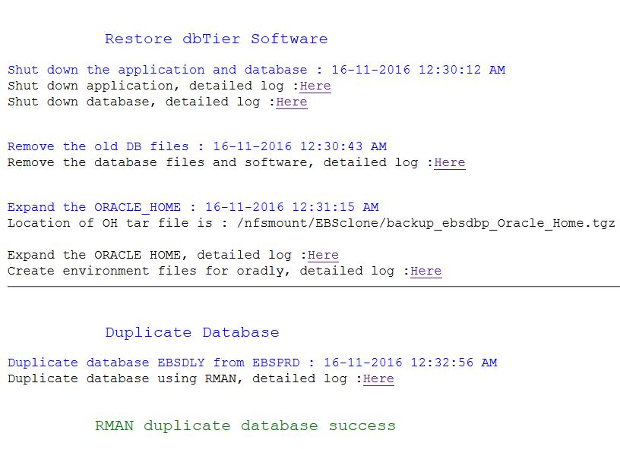
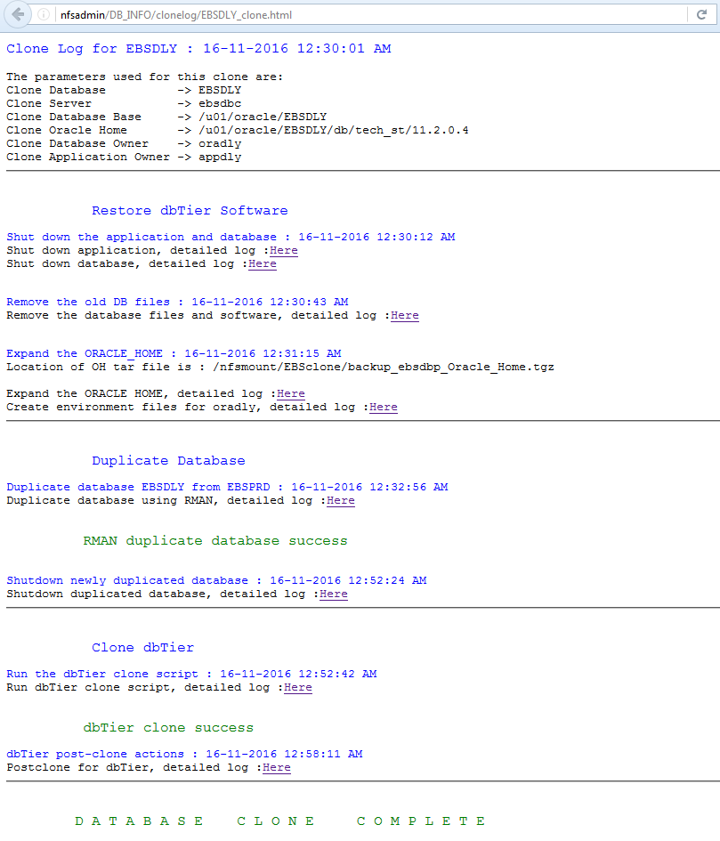
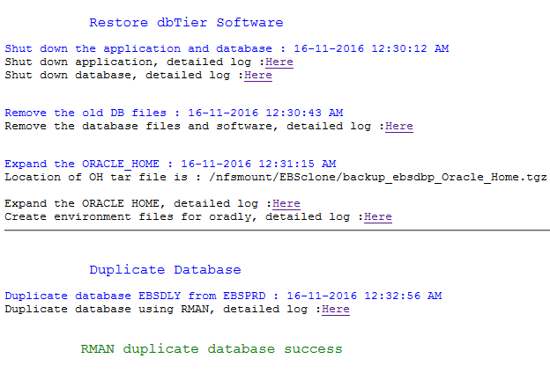
Notes:
This is our clone output file presented as an html page.
Each step of the clone can be viewed by clicking the relevant log
In this example it took approx. 20 mins for the rman database duplicate

Slide 55
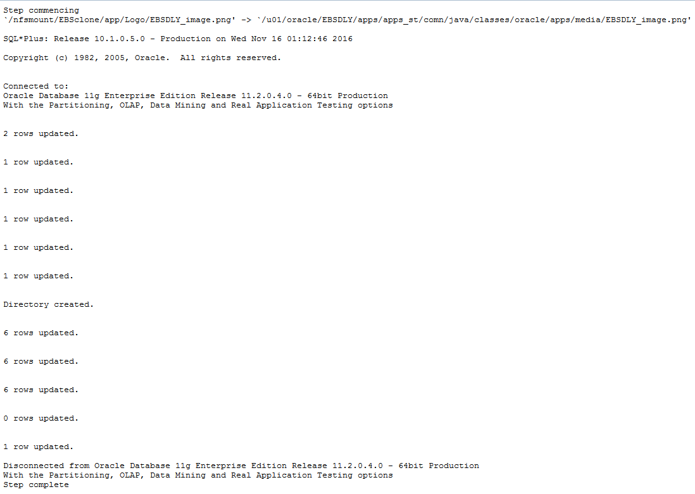
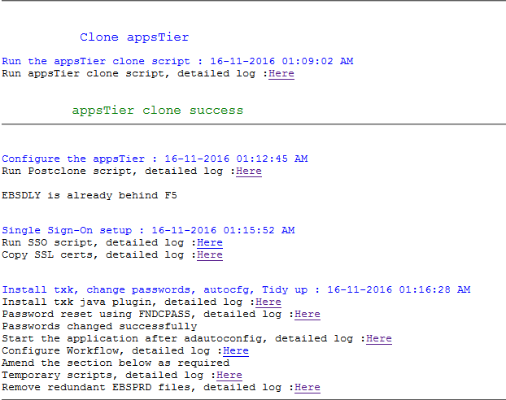
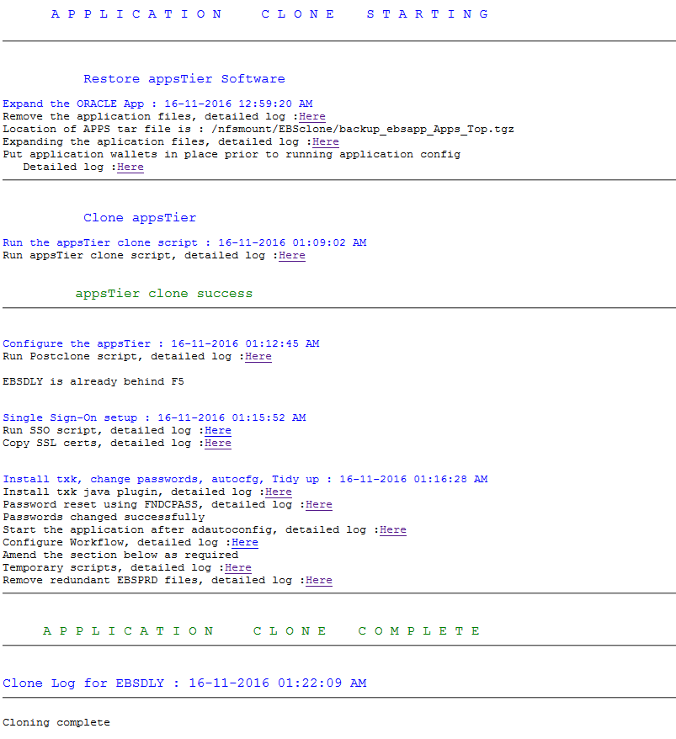
Notes:
And 52 minutes for the complete cloning process.

Slide 56
Thank you.
?
Clone scripts are available from
a.j.mcguiness@ljmu.ac.uk

Slide 57
Built Environment Building

