Slide 1
Developing an Application to Support Collective Bargaining Using B.I.
Katie Millar, Lead Metrics & Analysis Specialist
Chris Ferguson, Analytics & BI Reporting Analyst
Vanessa Kientega, Analytics & BI Reporting Analyst
Canada Alliance 2019
November 5, 2019

Slide 2
Collective Bargaining Support
The Role of the Metrics & Analysis Specialist in Collective Bargaining
1 Faculty Association
1 Management Group
Prior to each round of bargaining and negotiations, the Metrics & Analysis Specialist is responsible for compiling a baseline total compensation summary, a demographic reporting summary, and a cost model.
KPI is 1 month for preparing these 3 items.
In 2019, the Specialist team supported 7 rounds of collective bargaining plus 1 analysis of TMG total compensation. This equates to 8 baselines, 8 demographic reporting summaries, and 8 cost models.
In 2019, the projected work effort for this support equated to 1.0 Specialist FTE.
McMaster University
11 Bargaining Units
Notes:
There are 11 different bargaining units at McMaster University, plus 1 management group (TMG) and 1 Faculty Association (MUFA).
Each of these employee groups have unique Collective Bargaining Agreements (CBA’s), with unique administrative requirements.
For each round of collective bargaining, the Metrics & Analysis Specialist is responsible for providing a baseline total compensation summary, a demographic reporting summary, and a cost model.
Using our old processes, the KPI for preparing these three items is 1 month.
In 2019, the Specialist team supported 7 rounds of collective bargaining plus 1 analysis of TMG total compensation. This equates to:
8 different baselines
8 different demographic reporting summaries
8 different cost models
8 different collective agreement implementations
In 2019, the projected work effort equated to 1.0 FTE! The Specialist team is comprised of 2 team members, and recently expanded to 3 team members.

Slide 3
Collective Bargaining Support
The Role of the Metrics & Analysis Specialist in Collective Bargaining
Baseline
Cost Model
Collective Bargaining
CBA Implementation
Demographic Reporting

Slide 4
What is a Baseline?
A baseline is a total compensation summary for a specific employee group.
The baseline identifies all employer-paid payroll data for a 1-year period (ie. employee earnings which add to gross payroll, employer paid benefits, employer paid tax withholdings). The 1-year period is always the last year of the existing CBA.
In collective bargaining, the baseline guides decision making as it summarizes where the employer is spending their payroll dollars.
The old process of compiling a baseline included extracting all employer-paid payroll data from the HRIS system by using Query Manager, and manipulating and massaging this data by using Excel.
Depending on the employee group, manually compiling the baseline could take anywhere from 1-2 weeks.
The cost model depends on the creation of the baseline.

Slide 5
What is the significance of the baseline in the cost model?
The baseline is used as a benchmark to calculate the impacts of collective bargaining proposals on an employer’s total compensation costs.
The old cost model was compiled using Excel.
Tradeoffs in negotiations are costed based on whether an item is wage rate (WRT) or non-wage rate (NWR).
Wage rate items will increase as correlated with an increase to an employee’s base hourly rate (or salary). Ie. vacation earnings, life insurance, and CPP.
Non-wage rate related costs are included in the total compensation in the baseline year, but will not increase as a result of an increase to an employee’s base hourly rate (or salary). Ie. medical and dental benefits.
Notes:
The baseline is used as a benchmark to calculate the impacts of collective bargaining proposals on an employer’s total compensation costs.
The old cost model was compiled by using Excel, and used the same methodology for each employee group.
One of the more important nuances to the cost model was identifying wage rate and non wage rate related earning codes, deduction codes, and taxation codes. These items are summarized in the baseline.
Tradeoffs in negotiations are costed based on whether an item is wage rate or non wage rate.
Wage rate items will increase as correlated with an increase to an employee’s base hourly rate (or salary). Examples include vacation earnings, life insurance, and Canada Pension Plan withholdings.
Non wage rate related costs are included in the total compensation in the baseline year, but will not correlate with an increase to an employee’s base hourly rate (or salary). Examples include medical and dental benefits.

Slide 6
The Cost Model
Examples of cost scenarios:
Across-The-Board (ATB) rate increase
Merit Increase
Increase to Band Minimum (ITM)
Minimum Wage Increase
Combinations of these increases could apply to the same 1-year period, thus our cost models must be flexible to allow for multiple cost increases and compounding.
When costing for an employee group, portions of the population within that employee group could be entitled to certain increases while other portions are entitled to different increases. Our cost models must be flexible enough to allow for the different increases within a group.
Slicing and dicing the data on a variety of attributes and measures is the key to a successful cost model in bargaining.

Slide 7
Human Resources & Institutional Reporting and Analysis (IRA) Collaboration
McMaster University had invested in Oracle Business Intelligence.
The IRA team leads this project, and is working on structuring University data within the Business Intelligence tool.
The IRA team approached Human Resources, and noted they were ready to begin the BI for Workforce project earlier than anticipated.
Human Resources made the decision to begin with a BI for Payroll tool, summarizing payroll data in aggregate dashboards. The goal was to make payroll data more transparent, and to aggregate the data in a meaningful way in order to better support decision makers across the University community.
As a bonus side project, we explored the possibility of automating the baseline and cost model used for bargaining support. This became known as the “Projection Tool.”
Can we automate the baseline and cost model?

Slide 8
Automation of the Baseline and Cost Model: Embarking on the Projection Tool Project
01
McMaster has a complex reporting landscape
02
Baseline and cost model very resource intensive
03
Key to cost model success is flexibility
04
Ensure the projection tool allows for data cleansing
05
Projections need to be timely and accurate

Slide 9
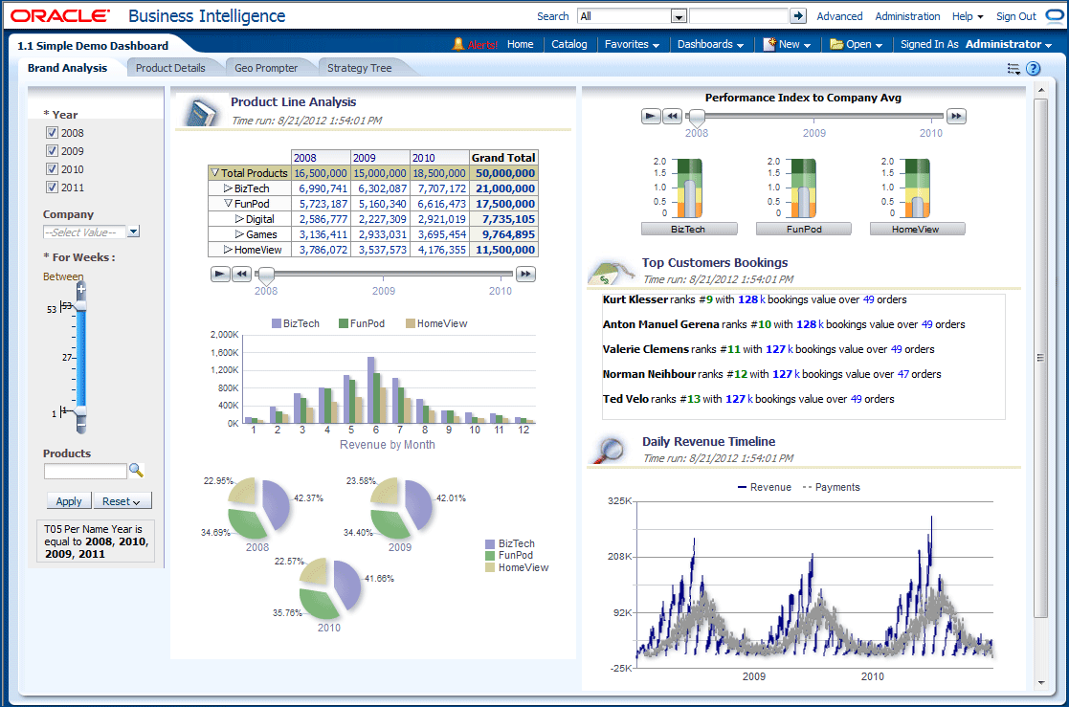
Projection Tool: BI for Payroll
The Specialist team uses the same 4 queries to extract payroll data when compiling any baseline. These 4 queries became the foundation for the BI for Payroll reporting tool and the projection tool.
The majority of PeopleSoft tables and fields required to build the tools were identified in these queries.
Working group sessions were held with key stakeholders across the University community to determine which measures should be included in the tool.
Filters and different ways to organize the payroll data (ie. Slicing and dicing options) were brainstormed in these working sessions.
Some categories in the baseline and cost model were not saved in PeopleSoft Human Resources. Delivered reporting functionality was explored and enabled by the Specialist team in order to ensure all of the necessary measures could be utilized by the users of the reporting and projection tools. This includes utilizing special accumulators to identify wage rate and non-wage rate codes.

Slide 10
Key Measures
Actual amount based on a selected period
Base year total estimation and average rate
ATB increase (per Period)
Merit Increase (per Period)
Compounded increase (per Period)
Hourly Average rate

Slide 11
4 Different Scenarios
ATB/ Merit
Step 1: ATB % and/or Merit % are applied to each individual
Step 2: The increase is estimated based on the number of weeks in the projection period
Band Minimum Adjustment + ATB/Merit
Step 1: Employees that do not meet the minimum salary in their band range are adjusted
Step 2: ATB % and/or Merit % are applied and the increase is estimated
ATB/Merit + Band Minimum Adjustment
Step 1: The employee Current Rate is compared to the desired rate and the % increase is calculated
Step 2: The group increase is then calculated based on this %
Hourly Rate
Step 2: Employees that still do not meet the minimum of their band are adjusted
Step 1: ATB % and/or Merit % are applied

Slide 12
How can we build it?
Interface Option 1: BI Answers
Pros:
We've used it before
Secure
Cons:
Prompts are not dynamic enough to meet requirements
All calculations will be done at run-time.

Slide 13
How can we build it?
Interface Option 2: Database Writeback in BI Answers
Pros:
Allows us to do calculations in the database to improve performance.
Cons:
Still not dynamic enough to meet requirements

Slide 14
How can we build it?
Interface Option 2: Oracle Apex
Pros:
Oracle software that can be integrated with OBIEE
Can build forms, more dynamic
Cons:
Integration with OBIEE is not currently supported by Oracle, poses risk

Slide 15
How can we build it?
Interface Option 4: Develop Custom Solution
Pros:
Could be built to our exact specifications
Cons:
Our team lacks expertise in developing custom applications
Possible security risks

Slide 16
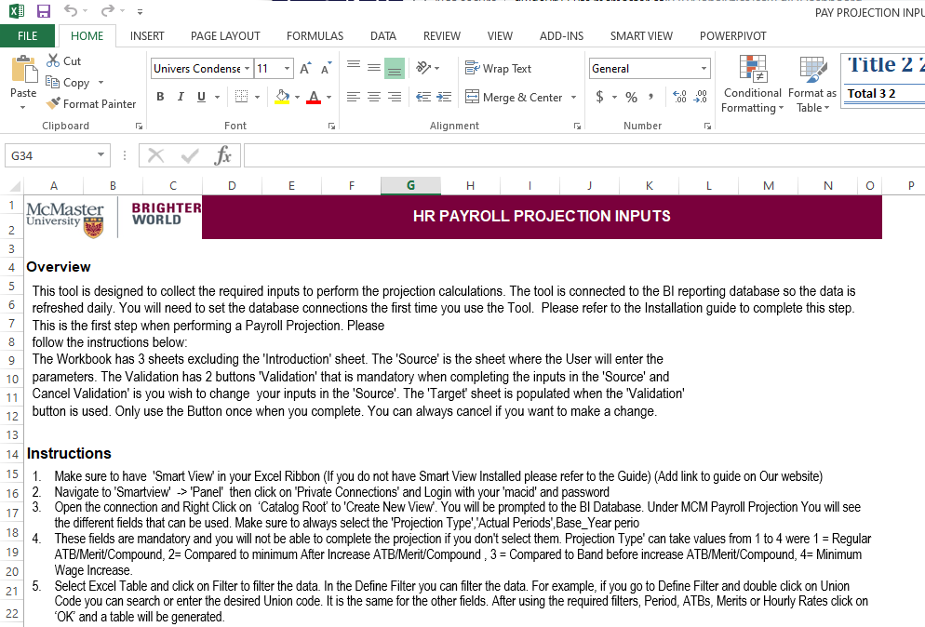
How can we build it?
Interface Option 5: Smart View Integration with Microsoft Excel
Pros:
Users are comfortable with Excel
Macros give us freedom to create custom solutions
Cons:
Many steps to the process

Slide 17
How does it all fit together?
SmartView
Connect to the BI datawarehouse
Excel Macro
Input Parameters (ATB/Merit/ Hourly Rates/ Dates …)
Validate the inputs and
ODI (Oracle data integrator)
View Report
Filter /Slice/Dice
OBIEE
Generate all the calculations
Load the Excel File
Retrieve data based on the User Selections
Export
Customize
Extract Actuals

Slide 18
Let’s get into it!
Demo

Slide 19
What’s next?
Reduce the steps for the USER
Explore additional delivered reporting functionality in PeopleSoft Human Resources
Goal is to completely eliminate any manual manipulation of data in Excel, and ensure all reporting, slicing, and dicing options are available in the projection tool.
All collective bargaining demographic reporting to be done using BI
Creation of a collective bargaining dashboard
Monitor the projection results vs actuals
Comparisons will be done using the projection tool and old methodology for the next few rounds of collective bargaining
BI for Workforce; structuring all employee life cycle transactions, benefit data, recruitment data, and demographic data in the BI tool.
Predictive People Analytics
What attributes make up a successful employee?
Can we predict when employees will retire or terminate?

Slide 21
Katie Millar, Lead Metrics & Analysis Specialist, millak2@mcmaster.ca Chris Ferguson, Analytics & BI Reporting Analyst, ferguscr@mcmaster.ca Vanessa Kientega, Analytics & BI Reporting Analyst, kienteg@mcmaster.ca
Thank you!

