Slide 1
An exam committee approval process on steroids and Graduation tracking with Evaluation Management
Glasgow
EMEA Alliance 2016
October 12, 2016

Slide 2
About us
Niels Oost
Functional Analyst
Ioana Sabau
Process and Relations Management
Inholland University of Applied Sciences

Slide 3
Inholland introduction
Business case
Analysis
Design
Demo in Campus Solutions

Slide 4
Inholland University of Applied sciences
Students:
Bachelor: 26450
Master: 320
Employees: 1794 FTE
1089 FTE teachers
705 FTE staff
Oracle:
PeopleSoft CS 9.0 + tools 8.54
Technical Application Manager 1 FTE
Functional Analyst Student Administration 2 FTE
Functional Analysts Student Progression 3 FTE

Slide 5
Introducing Inholland
social mission: to provide quality:
top-quality professional education
both in content and norms and values
warm and friendly
known for its personal touch
commitment to students

Slide 6
Introducing Inholland
10 campuses
About 80 bachelor programmes in all fields of study
7 master programmes.
geared towards the needs of the professional field
contemporary and in-demand graduation tracks.

Slide 7
Introducing Inholland
Extensive and challenging courses
Proper guidance and excellent coaching
Students develop themselves as individuals and prepare themselves to become responsible professionals with a respectful view of society.

Slide 8
Introducing Inholland
One of the largest and most modern institutions of higher education in the Netherlands
A student population of about 27,000 students in 10 different cities.

Slide 9
Faculties
Faculty of Creative Business
Faculty of Health, Sports and Social Work
Faculty of Business, Finance and Law
Faculty of Education, Learning and Philosophy
Faculty of Engineering, Design and Computing
Faculty of Agriculture, Food and Life Sciences
About 80 Progammes:
Bachelor
Associate Degree
Master
Full-time, part-time, dual

Slide 10
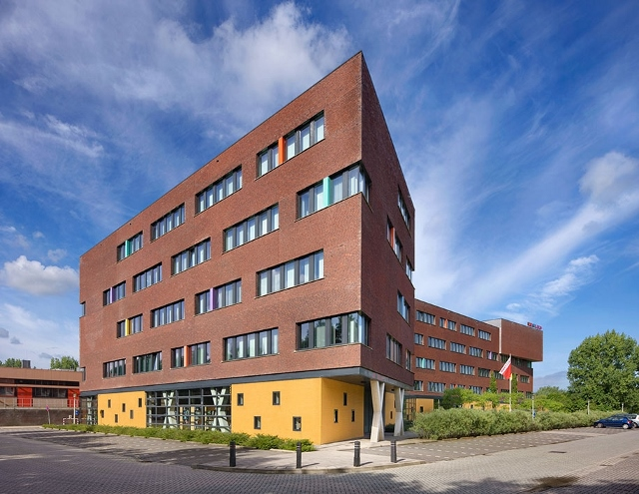
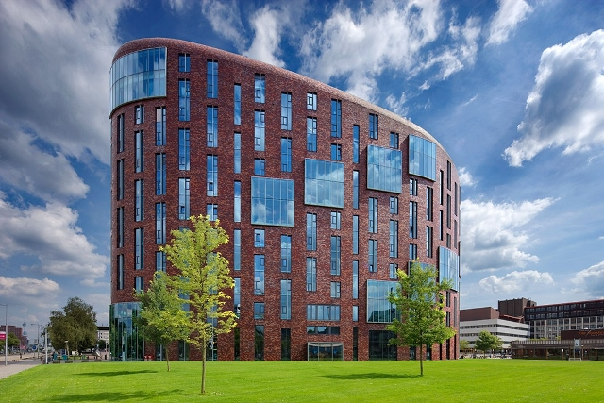
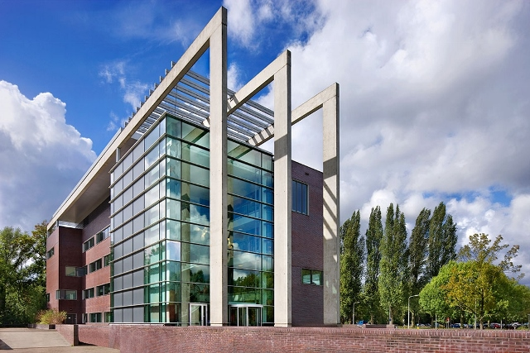
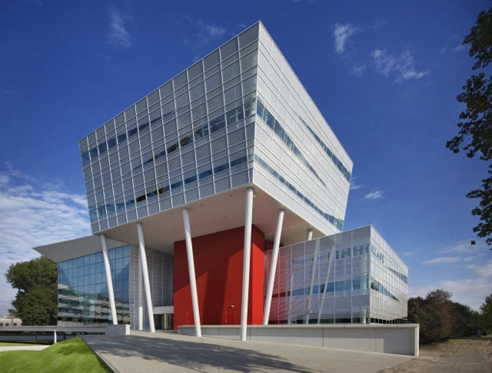
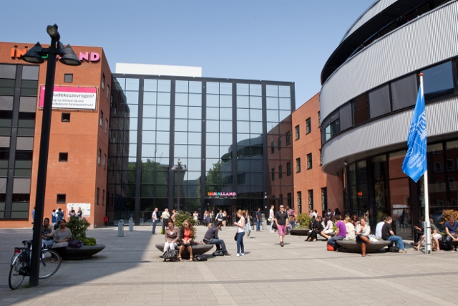
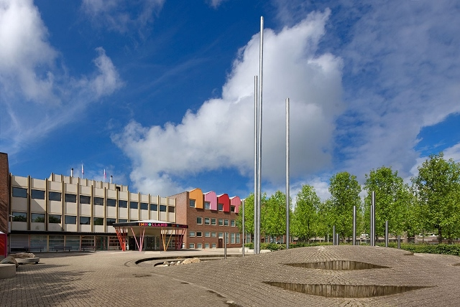
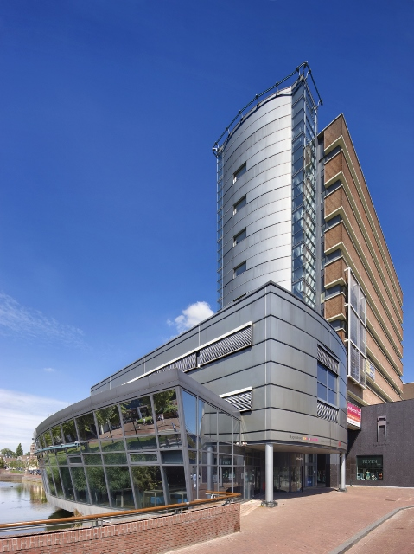
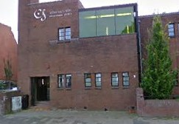
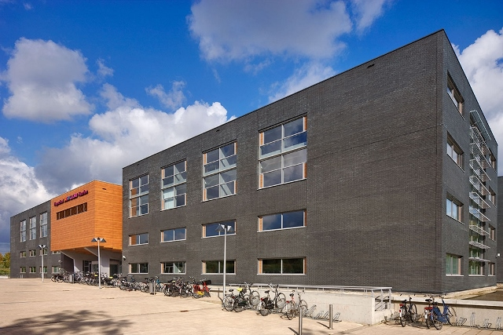
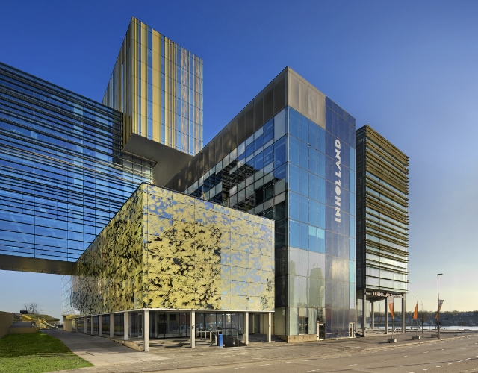
Introduction Inholland locations
Alkmaar
Amsterdam
Amstelveen
Delft
The Hague
Diemen
Dordrecht
Groningen
Haarlem
Rotterdam

Slide 11
Dutch Higher Education funding basics
Example: 4 year Bachelor Study
€ 1.984: Annual tuition fee
€ 6.000: Annual governmental funding
€ 6.000: Governmental graduation bonus

Slide 12
Business Case 1/2
Reduce MSExcel usage.
Single source of truth.
Maximize government founding
Minimize privacy risks.

Slide 13
Business Case 2/2
Provide 24/7 status info to student and staff.
Reduce business process complexity.
Hyperion Interactive Reporting needs to be replaced.
Automation of several manual checks.

Slide 14
Requirements
No need for ‘Apply for graduation’ in Self Service, student progression is the trigger.
Committee collaboration.
Minimum of two approvers
No admin pages for committee users.
Get rid of Excel sheets.
Track & Trace

Slide 15
Analysis
Business process support:
Student Records Graduation tracking
Checklists + comments
Evaluation Management
Service Requests
Organizational Change:
Around 250 new active users in CS
Different role for the service organization:from initiator to proces monitor

Slide 16
Technical analysis
Printing
Runcontrol page
Query & BI publisher
Process automation
Rules Engine
Application Engine

Slide 17
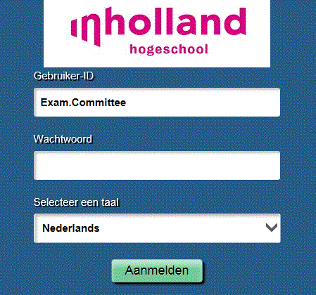
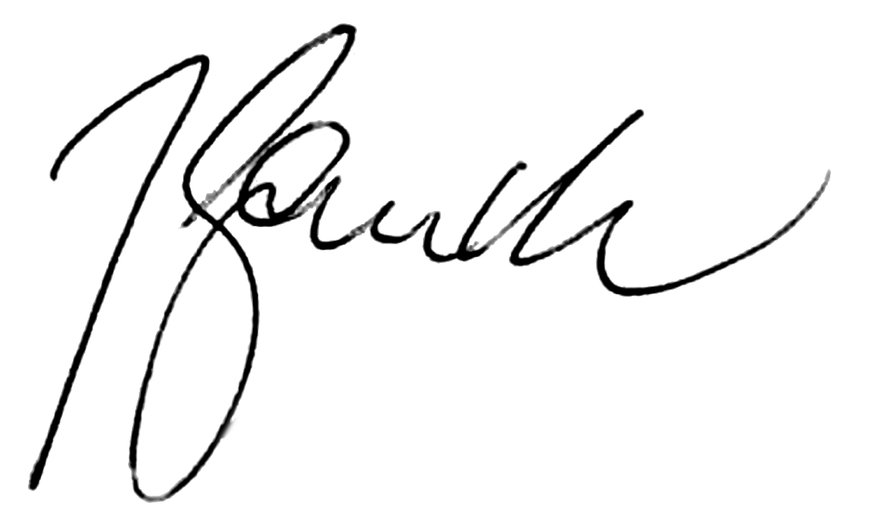
Previous Business Process
Interactive Reporting
Campus Solutions
Interactive Reporting
Dutch
Education Authority
Dutch
Education Authority

Slide 18
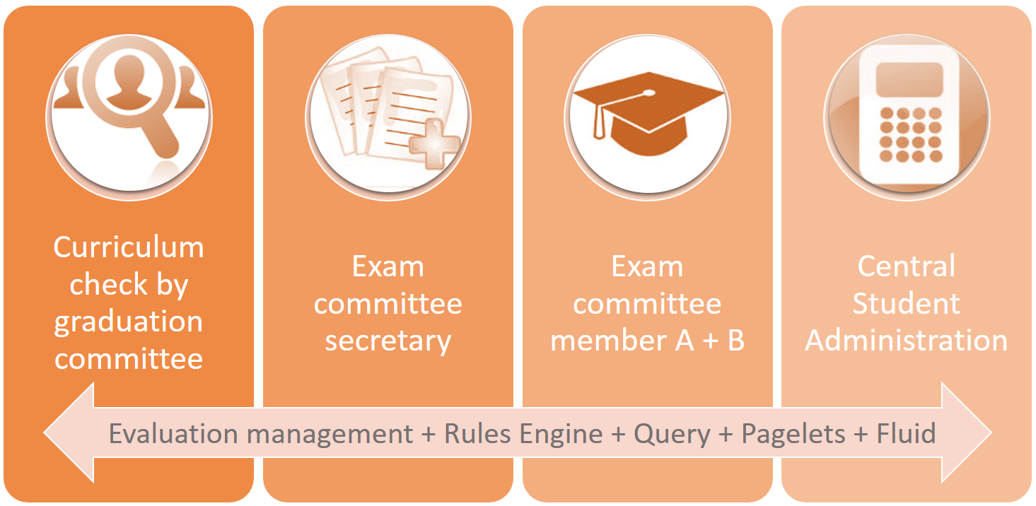
New Process Design

Slide 19
Process Overview
Query 240 ECTS
Evaluation Management: Programme
Evaluation Management: Student Administration
Graduation tracking: Service organization
1. Graduation committee
2. Preparer Exam Committee
3. Exam Committee
Approval of both the Exam Committee and Student Adminstration
Generating the certificates
Automatic report to Dutch Education authority

Slide 20
Query 240 ECTS
Evaluation Management: Programme
Evaluation Management: Student Administration
Graduation tracking: Service organization
1. Graduation committee
2. Preparer Exam Committee
3. Exam Committee
Approval of both the Exam Committee and Student Adminstration
Generating the certificates
Automatic report to Dutch Education authority

Slide 21
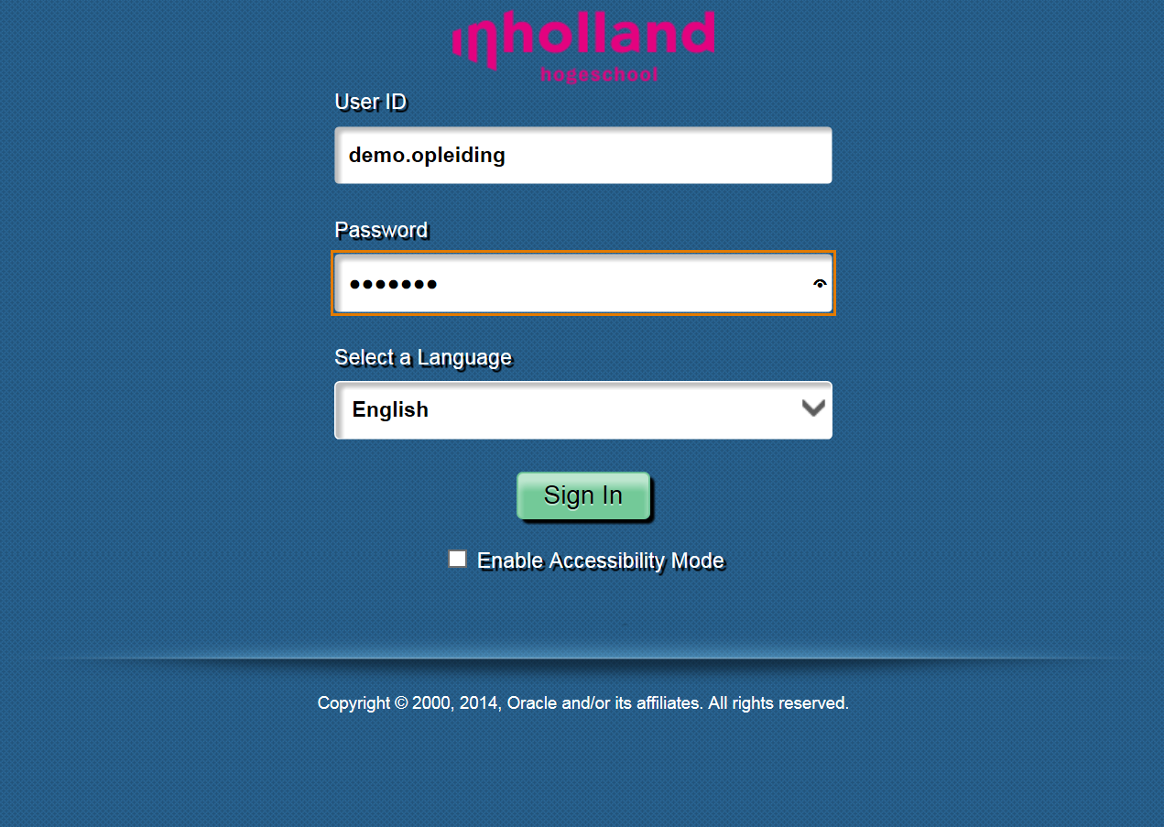

Slide 22
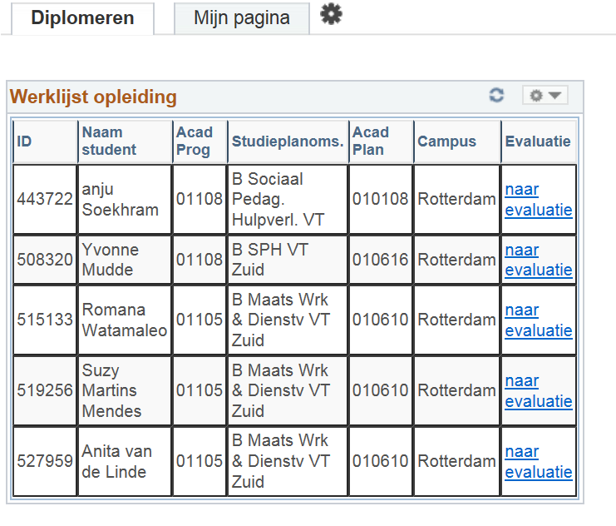
(Graduation)
(My page)
(Worklist programme/faculty staff)
(Name)
(Name programme)
(Evaluation)
To evaluation

Slide 23
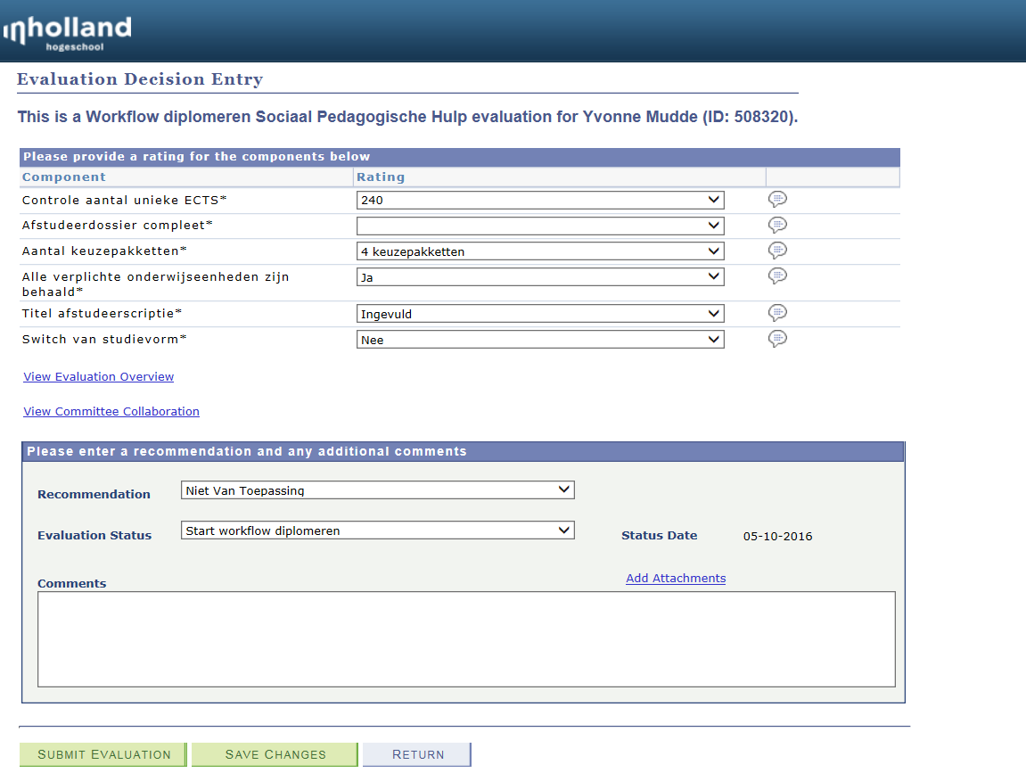
(Check number of credits)
(Graduatioan dossier complete)
(Number of minors)
(compulsory courses completed)
(Thesis title)
(Switch study variant)
Not applicable

Slide 24
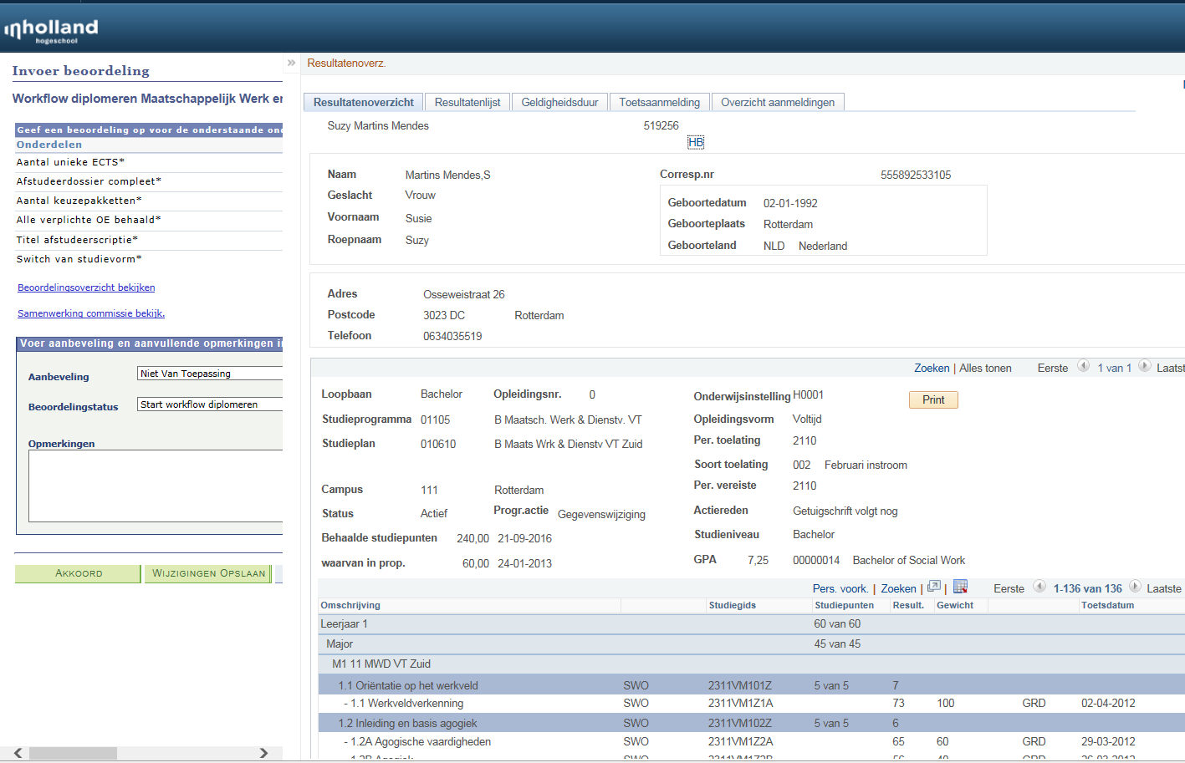
Results overview

Slide 25
(Check number of credits)
(Graduation dossier complete)
(Number of minors)
(compulsory courses completed)
(Thesis title)
(Switch study variant)
Not applicable

Slide 26
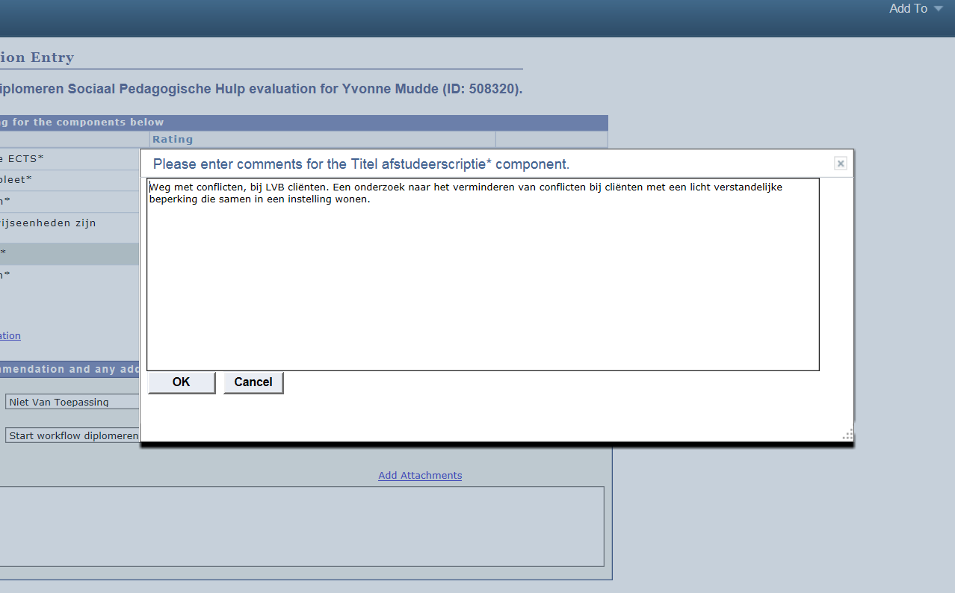
Fill in or check thesis title

Slide 28
Query 240 ECTS
Evaluation Management: Programme
Evaluation Management: Student Administration
Graduation tracking: Service organization
1. Graduation committee
2. Preparer Exam Committee
3. Exam Committee
Approval of both the Exam Committee and Student Adminstration
Generating the certificates
Automatic report to Dutch Education authority

Slide 29
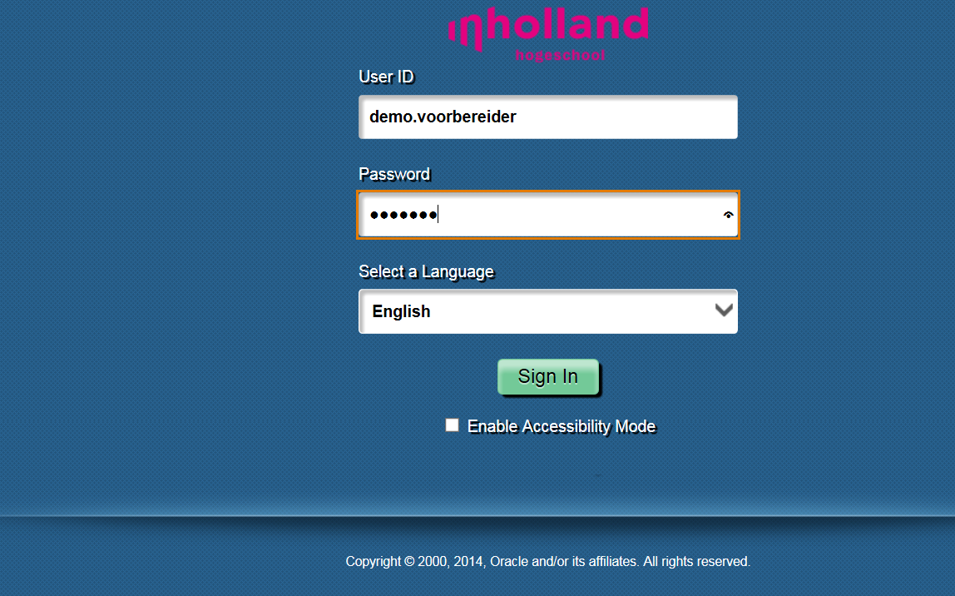
We log in as the preparer for the Exam Committee

Slide 30
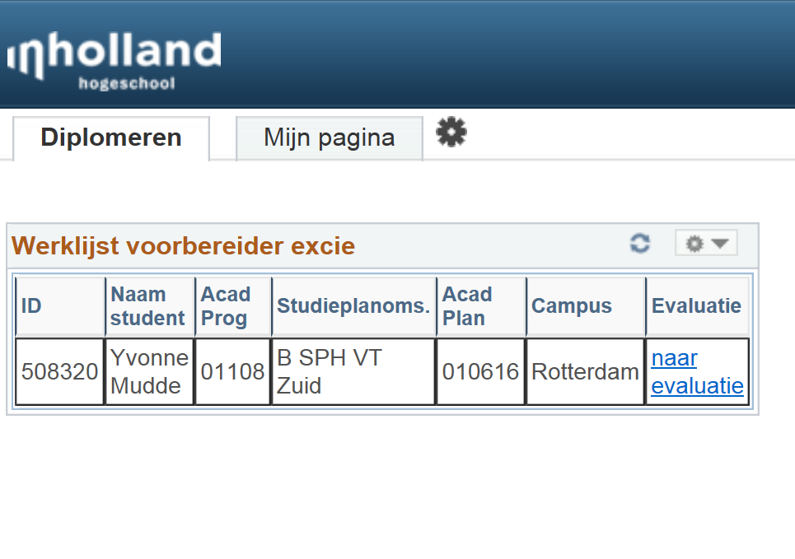
(Graduation)
(My page)
(Worklist preparer Exam Committee)
(Name)
(Name programme)
(Evaluation)
To evaluation

Slide 31
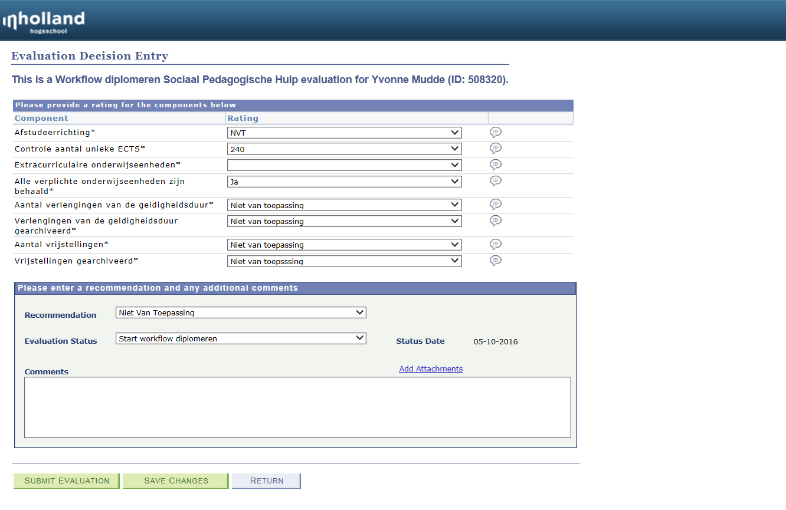
(Graduation track)
(Check number of credits)
(Extra curricular courses)
(Compulsary courses completed)
(Extensions of validity of grades)
(Extensions archived)
(Exemptions)
(Exemptions archived)

Slide 32
Degrees can pass with merit (‘met genoegen’) and with distinction (‘cum laude’)
The system automatically calculates if a student is eligable for this special designation.
The rules engine is used for this purpose.

Slide 34
Query 240 ECTS
Evaluation Management: Programme
Evaluation Management: Student Administration
Graduation tracking: Service organization
1. Graduation committee
2. Preparer Exam Committee
3. Exam Committee
Approval of both the Exam Committee and Student Adminstration
Generating the certificates
Automatic report to Dutch Education authority

Slide 35
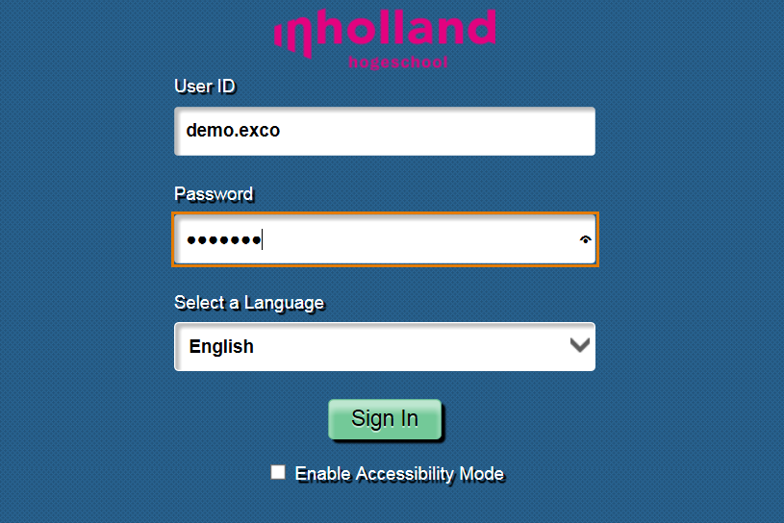
We log in as a member of the Exam Committee (aka Board of Examinations)

Slide 36
Worklist Graduation

Slide 37
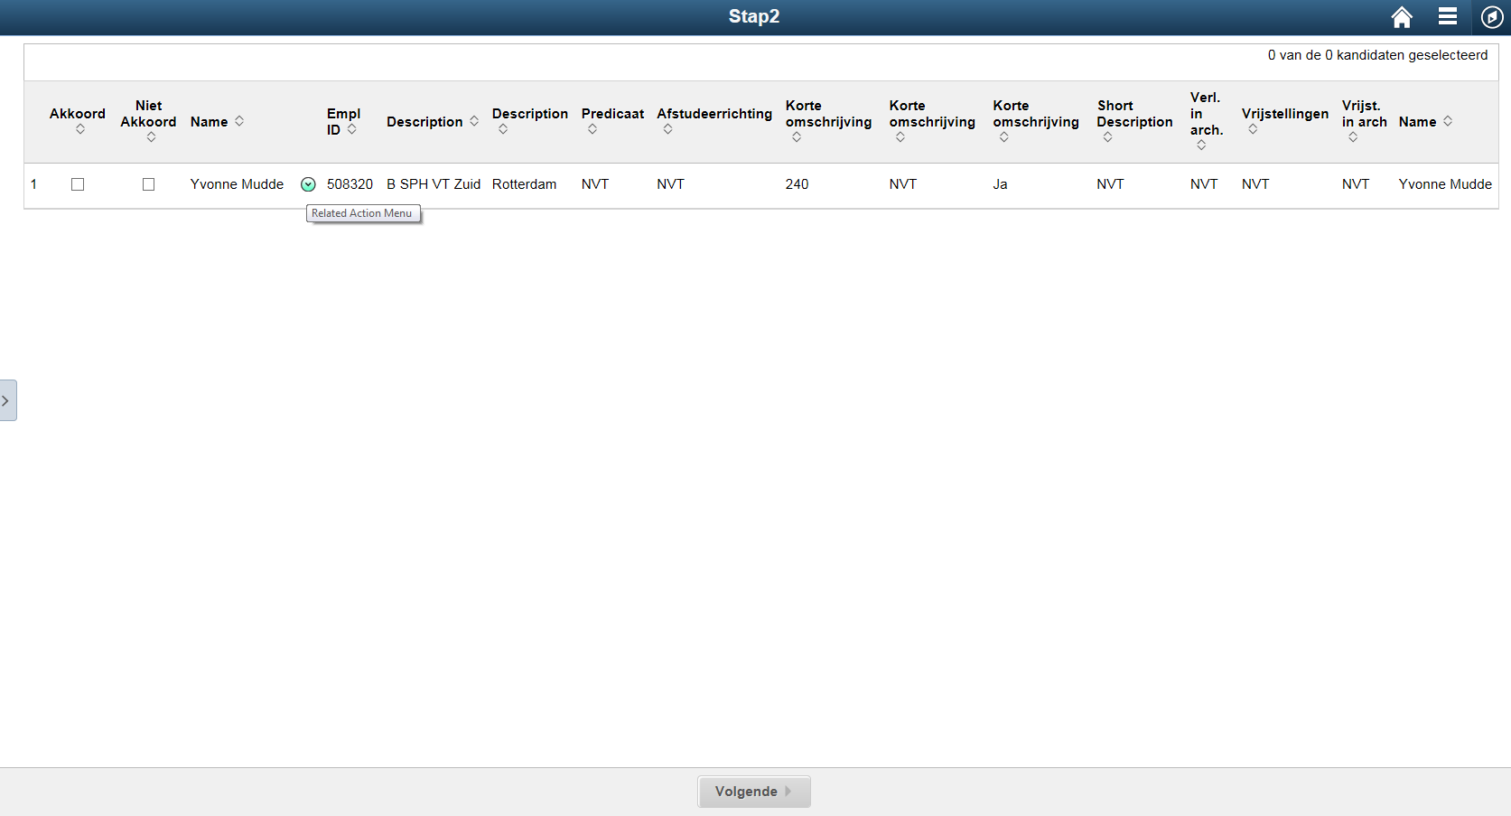
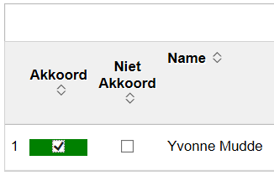
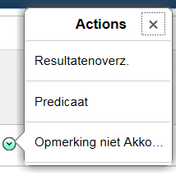
(Check these students)
Approval
Name
Campus
Graduation
track
Compulsary
courses
In archive
In archive
No approval
Programme
Designation
Credits
Extensions
Exemptions
Related actions:
Results overview
Designation
Comments no approval
Next

Slide 38
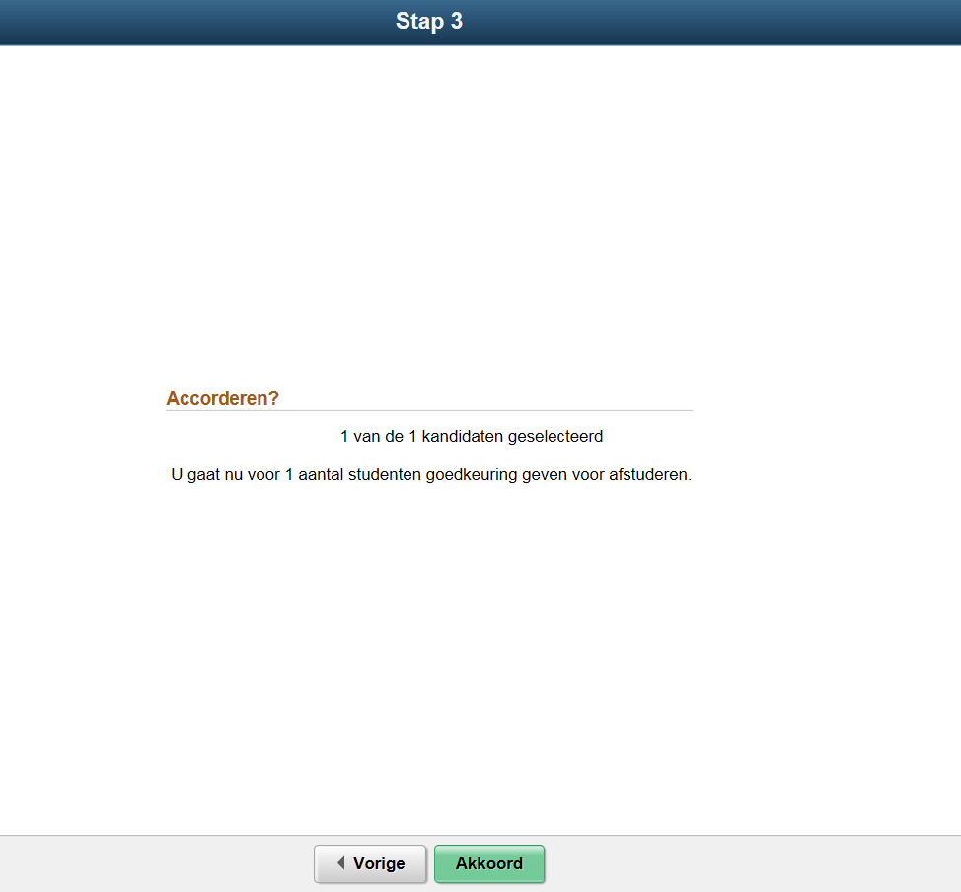
(Step 3)
Approve?
1 of 1 candidates selected
You are now going to approve 1 student for graduation.
Approve
Previous

Slide 39
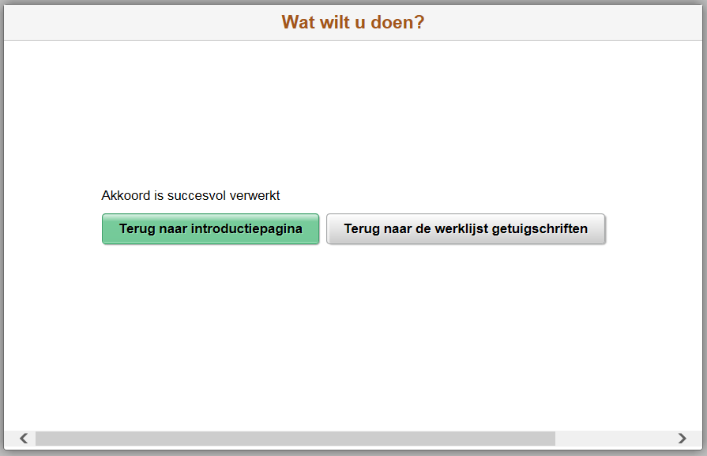
What would you like to do?
Approval has been successfully processed
Back to introduction page
Back to worklist graduation

Slide 40
Query 240 ECTS
Evaluation Management: Programme
Evaluation Management: Student Administration
Graduation tracking: Service organization
1. Graduation committee
2. Preparer Exam Committee
3. Exam Committee
Approval of both the Exam Committee and Student Adminstration
Generating the certificates
Automatic report to Dutch Education authority

Slide 41
Student administration check
Propedeutic Exam in archive
Student administration approval

Slide 42
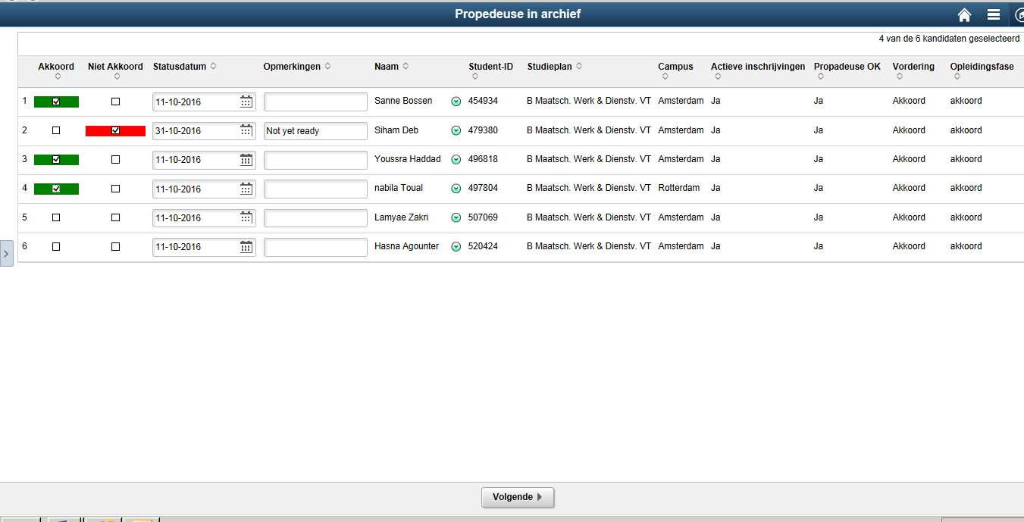

Slide 43
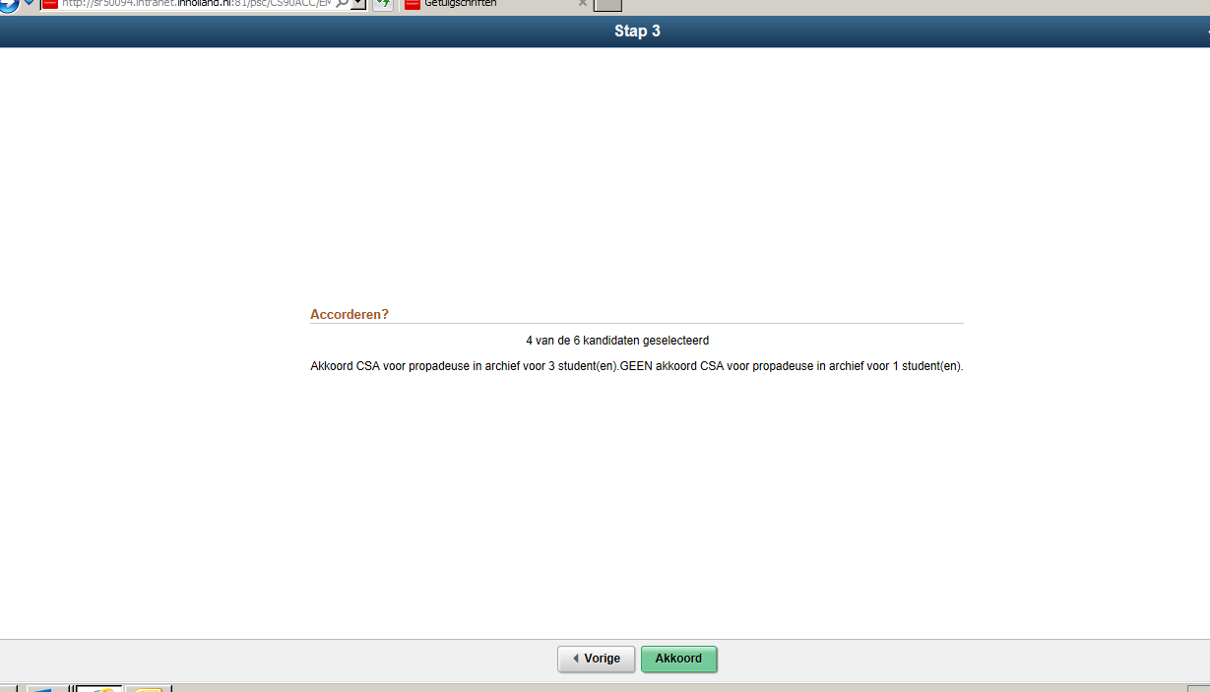

Slide 44
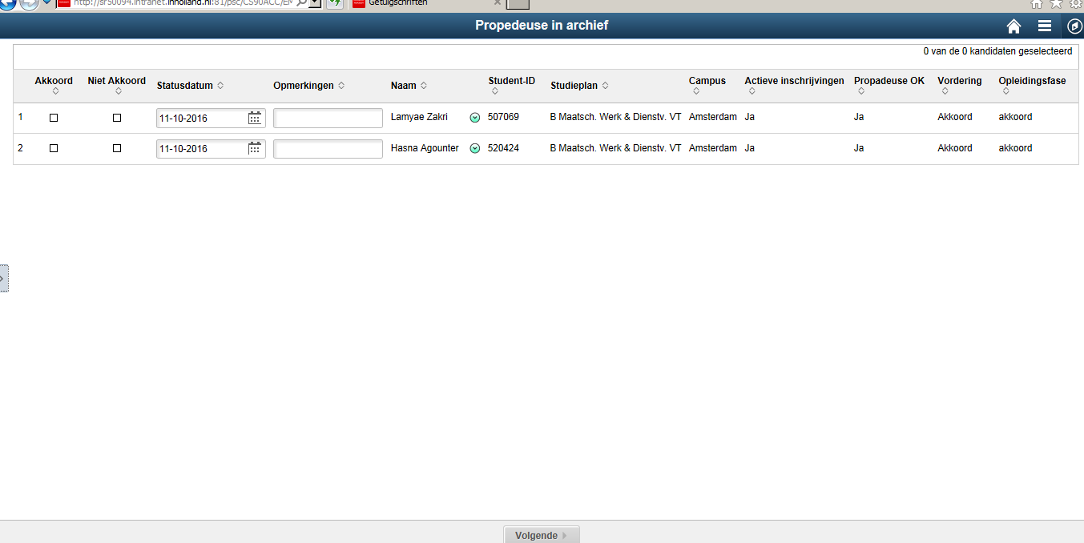

Slide 45
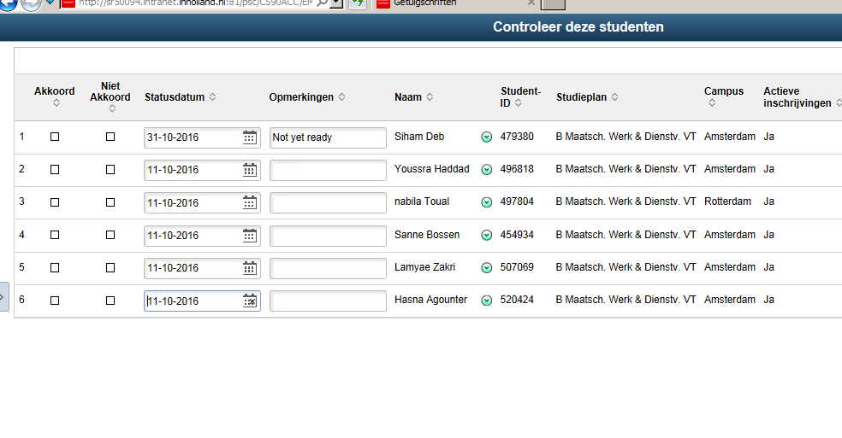

Slide 46
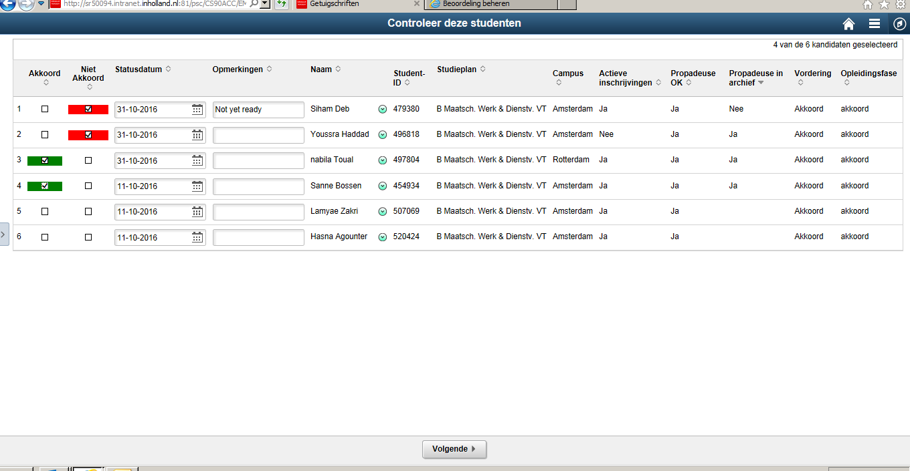

Slide 47
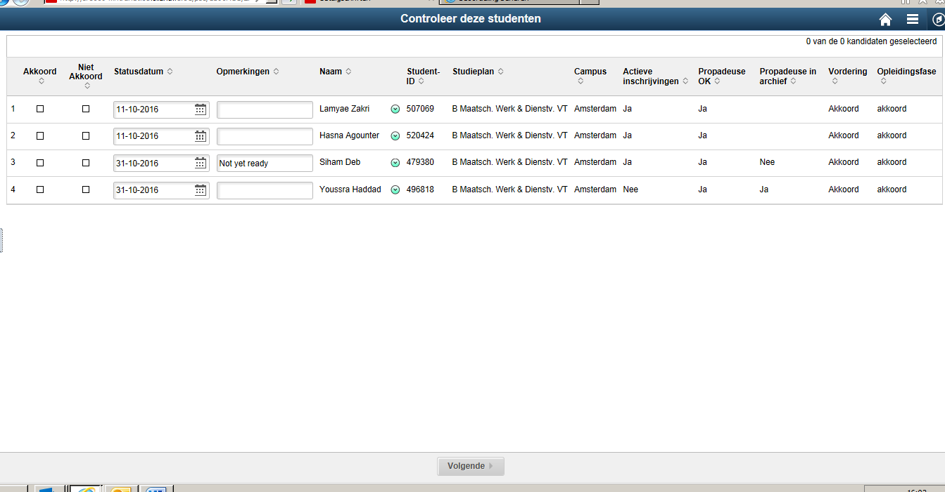

Slide 48
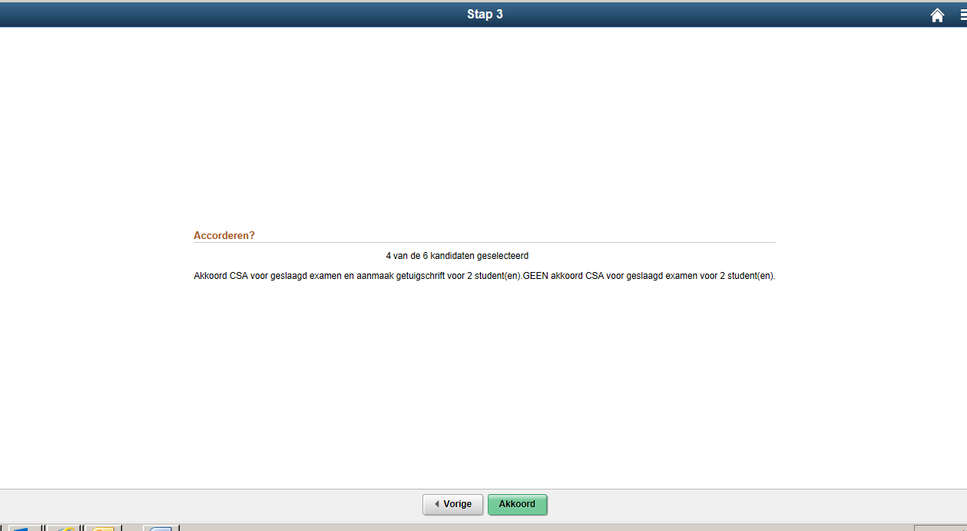

Slide 49
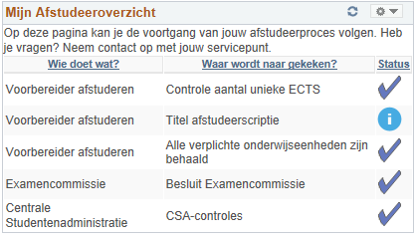
Self Service students
The student can follow the process and check if the thesis title is correctly registered.

Slide 50
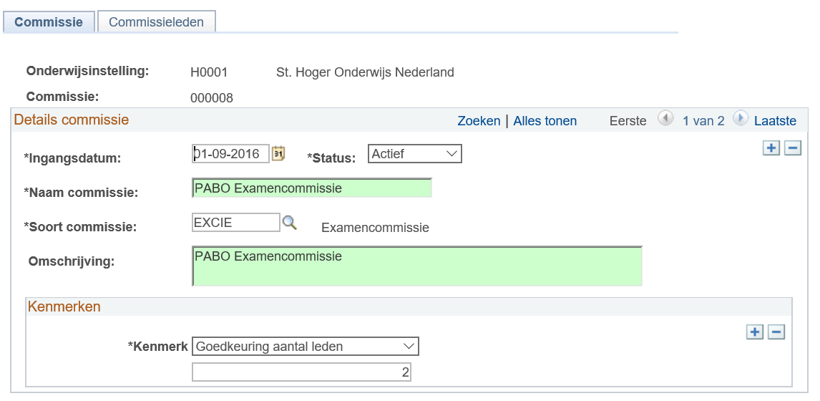
The Exam Committees are connected with Academic Programmes through CAF
Approval of how many members

Slide 51
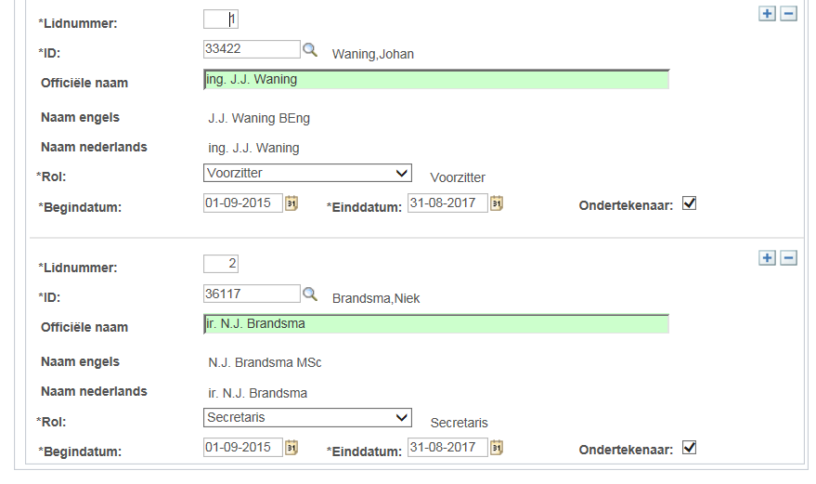
Name with titles in both Dutch and English
role of committee member
Is going to sign the certificates

Slide 52
Query 240 ECTS
Evaluation Management: Programme
Evaluation Management: Student Administration
Graduation tracking: Service organization
1. Graduation committee
2. Preparer Exam Committee
3. Exam Committee
Approval of both the Exam Committee and Student Adminstration
Generating the certificates
Automatic report to Dutch Education authority

Slide 53
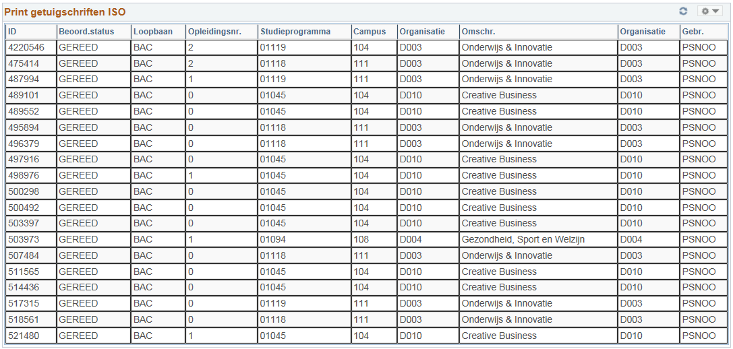
List of students that have green-light for printing of certificate

Slide 54
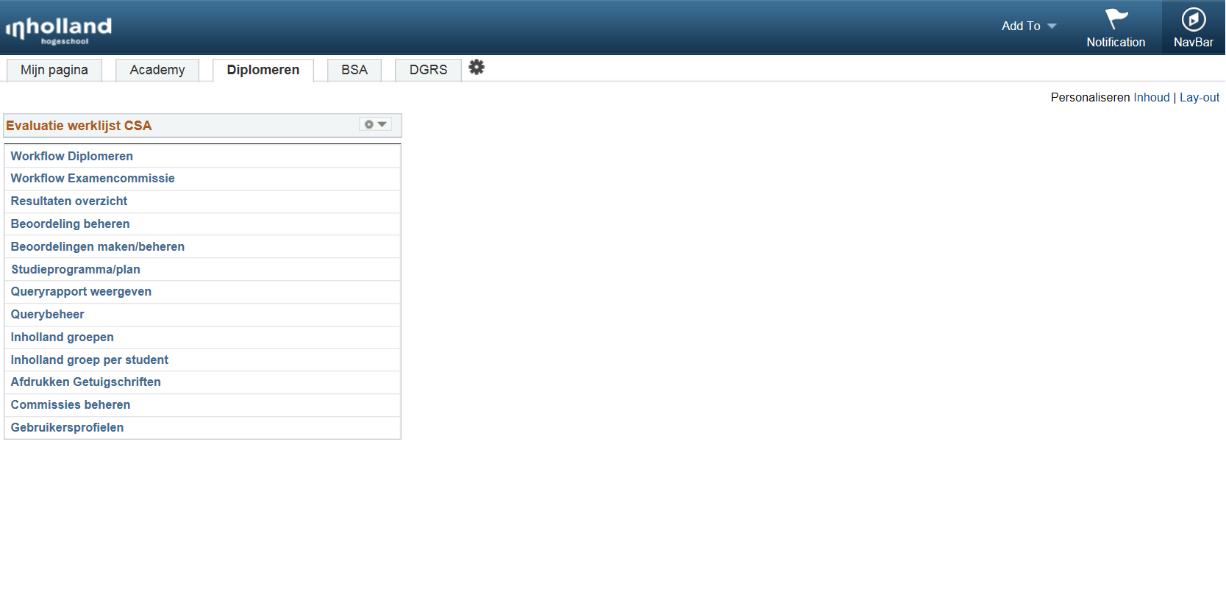
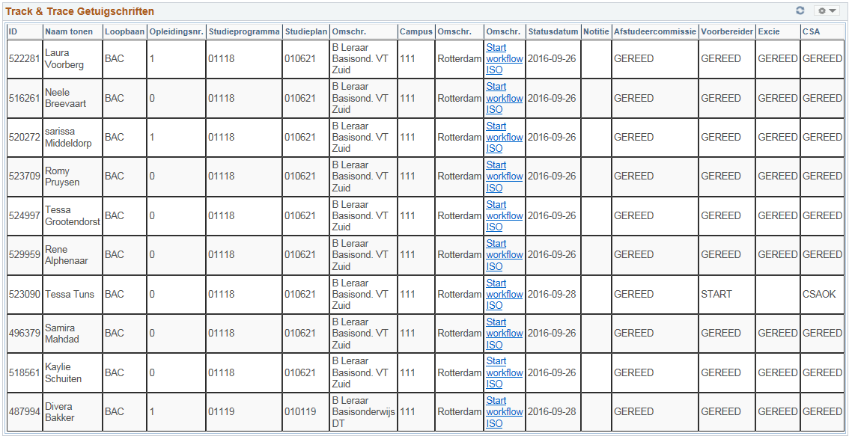
From the graduation dashboard authorized users can
Generate the certificates.

Slide 55
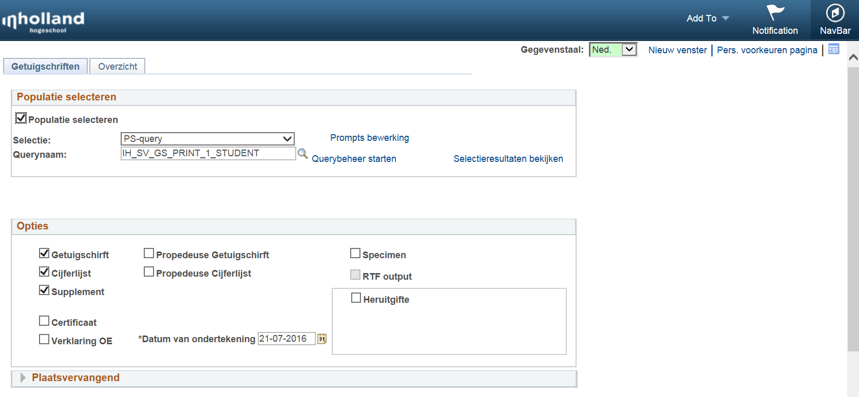
Population selection
Run control that uses pop select to generate graduation certificate, grade list and supplement
Selection of certificates
Date of signature
reissue

Slide 56
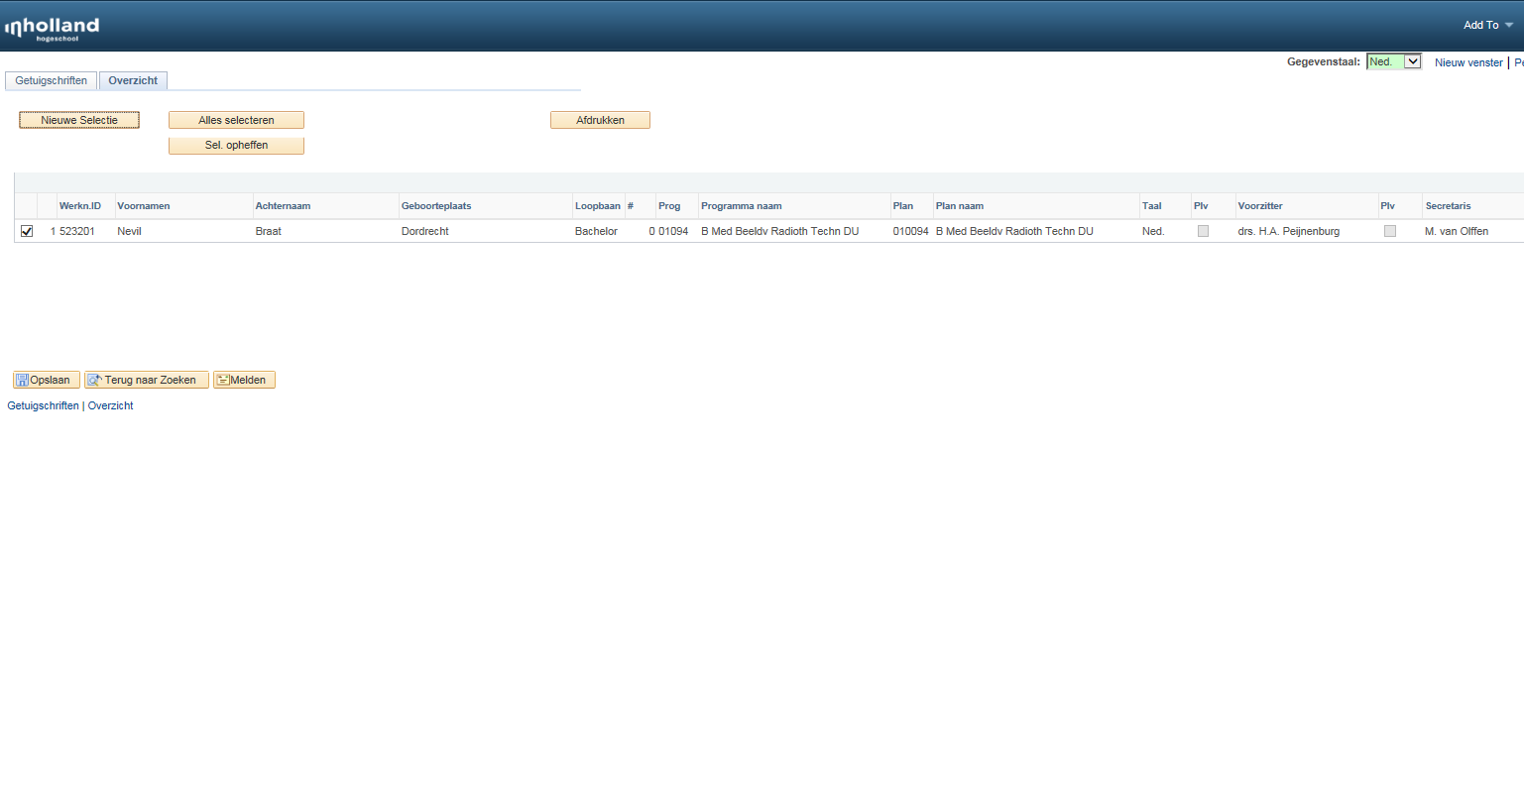
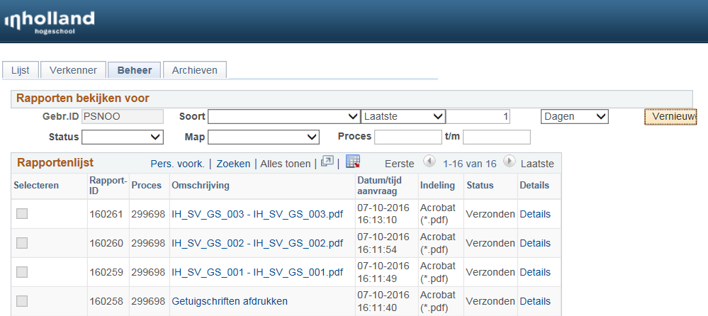
The run control then displays the relevant values that will
appear on the documents as a final check.
PDF
Documents
Are generated

Slide 57
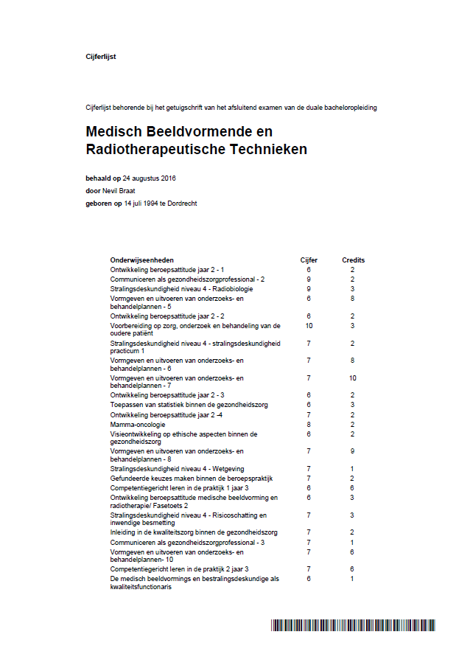
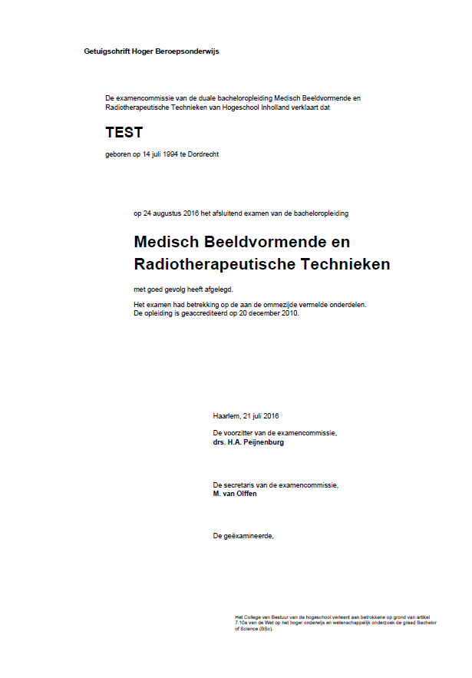
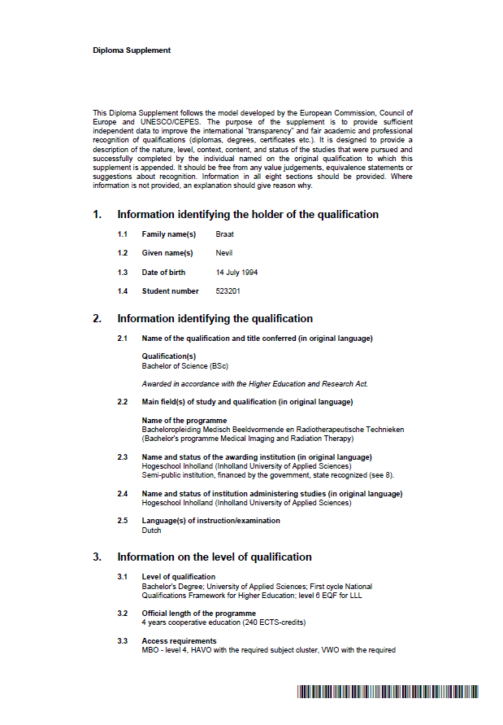
3. supplement
1. Graduation certificate
2. Grade list

Slide 58
Query 240 ECTS
Evaluation Management: Programme
Evaluation Management: Student Finance Administration
Graduation tracking: Service organization
1. Graduation committee
2. Preparer Exam Committee
3. Exam Committee
Approval of both the Exam Committee and Financial Adminstration
Generating the certificates
Automatic report to Dutch Education authority

Slide 59
Track & Trace Graduation certificates
On the right hand side we see all statusses of actors in the entire process

Slide 60
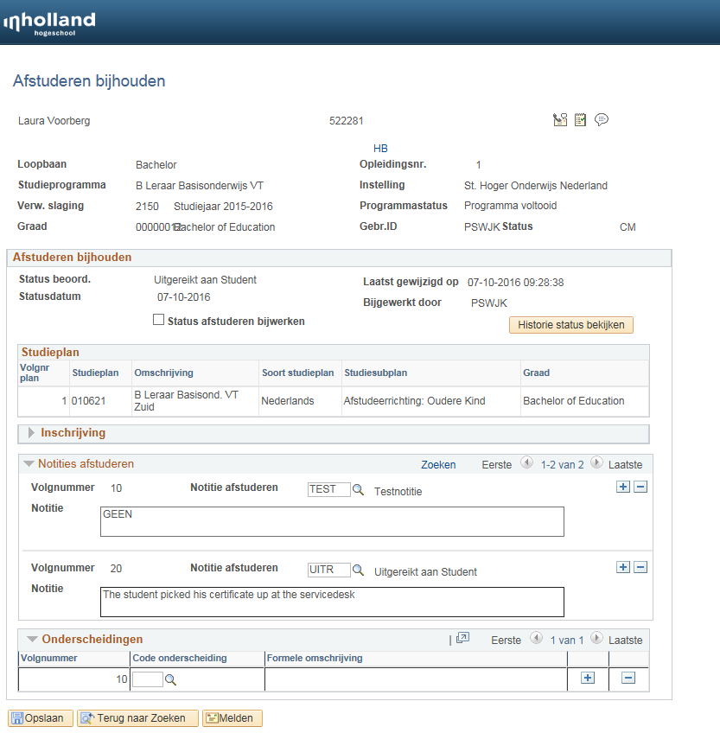
Graduation tracking

Slide 61
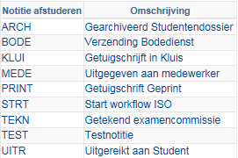
History graduation tracking
All steps can be registered:
Start workflow ISO
Cerificate printed
Certicate in vault
Handed out to employee
Signed by Exam Committee
Send by messenger service
Handed to student
Archived in student dossier

Slide 62
The entire graduation workflow is now completed
Query 240 ECTS
Evaluation Management: Programme
Evaluation Management: Student Finance Administration
Graduation tracking: Service organization
1. Graduation committee
2. Preparer Exam Committee
3. Exam Committee
Approval of both the Exam Committee and Financial Adminstration
Generating the certificates
Automatic report to Dutch Education authority

Slide 63
Questions???

