Slide 1
Automating Award Disbursement At NAIT
CS 5013
November 6, 2017

Slide 2
presenters
Toni Tessari
Sabrina Giordano
Business Analyst
NAIT
tonit@nait.ca
Manager, Advancement Services
NAIT
sabrina@nait.ca

Slide 3
Overview
About NAIT
Project Goals & Phases
The Transformation
Major Project Decisions
Challenges and Achievements

Slide 4
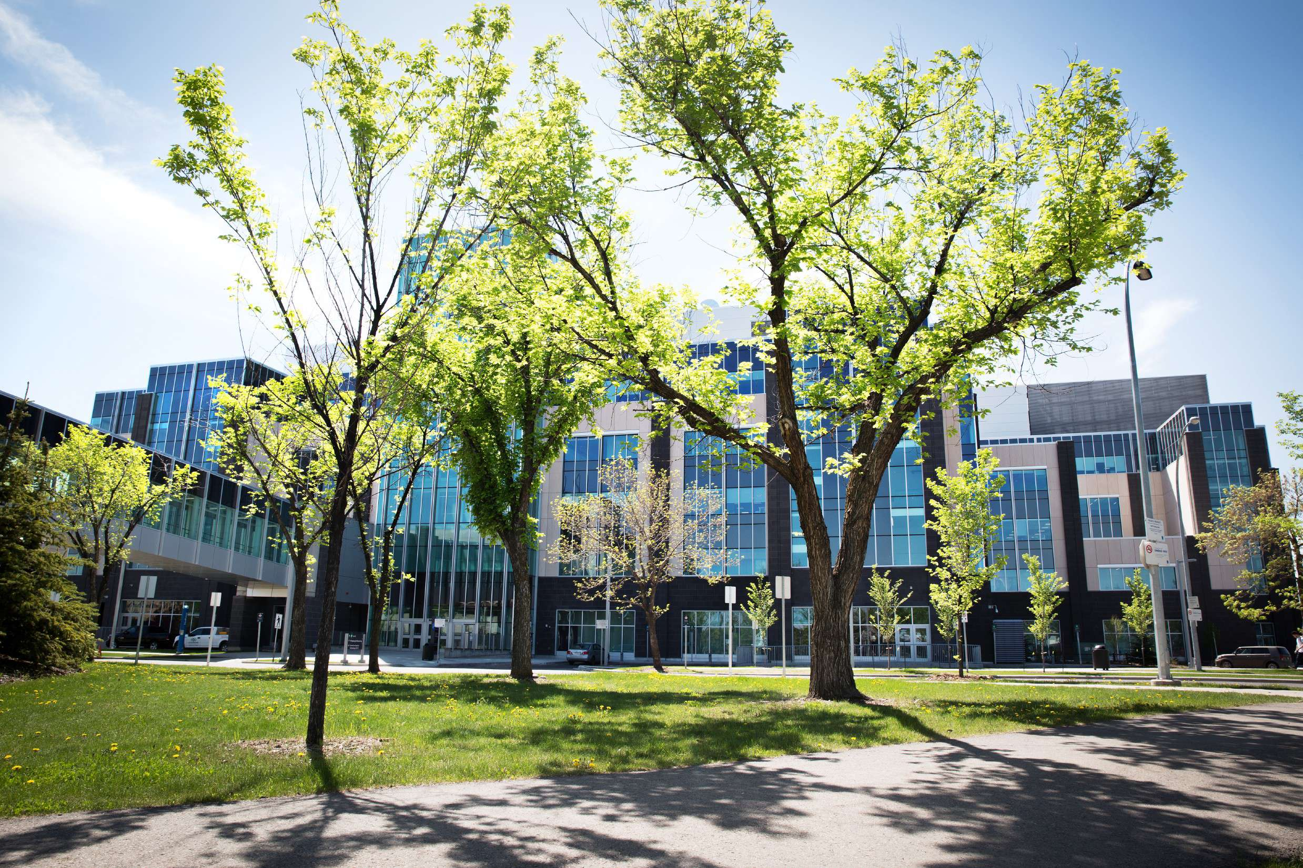
NAIT
Northern Alberta
Institute of Technology

Slide 5
About NAIT
~45,000 students register in 3 careers each year
Credit Programs: 13,000
Non-Credit: 8,000
Apprentices: 7,000
~1,000 Active Awards
~ 4,200 Recipients
~ 8,000 Scholarship & Bursary Applications
~ 8 major application periods over 4 terms
Notes:
8000 applications for a total of 29,000 unique award applications
Also deal with Government Scholarships that are not disbursed by NAIT.
Challenges with Apprentice awards: short attendance periods

Slide 6
THE PROJECT

Slide 7
Project setting
Campus Solutions V9.0
PeopleTools 8.53
6 month window
Team of analysts, end users, and managers
Resources all less than half time
January Go-live
Notes:
Running the PeopleSoft jobs was the easy part. Don’t underestimate the time it will take to review your awards, make setup decisions, and put the pieces of the puzzle together.
Dedicated project time: 3 mornings a week.
Lengthy period allowed for decision making to fit in with the business cycle.
January go-live date allowed us to use a single system for T4A data.

Slide 8
Project Goals
USE PEOPLESOFT We want to integrate Scholarship & Bursary processes with student accounts and other features.
REDUCE MANUAL PROCESSING Make use of automated disbursement features.
IMPROVED STUDENT EXPERIENCE Improve the application process.
ACTIVITY GUIDES Collected required information from students efficiently.
Notes:
Before this project, all of our Scholarship & Bursary administration activity occurred in a home grown database with no integration into PeopleSoft. This meant there was no ability to leverage information on a student record during their time as a student, nor after they are graduated and were alumni of the polytechnique.
With PeopleSoft, we wanted to bridge some of the gaps caused by having 2 separate systems: access to student data, maintaining separate systems and security, lack of integration with student accounts.
Manual processing: The old processes were heavily manual, time consuming, and required the use of a ton of paper in order to initiate payment for a selected recipient.
Students: students found the old application confusing and time consuming.
Now the students have direct involvement in the process and are communicated with through the use of email messaging and activity guides.

Slide 9
Project Team
Advancement
Scholarships & Bursaries
Registrar’s Office
Accounts Payable
Student Services
Cash Office
Notes:
- This change not only impacted the Scholarships & Bursaries team, but also many other units across campus. We knew that in order to have a successful implementation, we needed to engage the other areas right from the beginning of the project.
- We included the Registrar's Office, the Cash Office, Accounts Payable, and Student Services right from the onset. And we began by not only explaining the project, but also connecting it to the work they do and how this project would positively impact their units.
- We also were completely transparent with each until regarding the expectations we had of them on this project and what we anticipated would be the amount of resources they would need to dedicate towards it.

Slide 10
approach
FIT-GAP ANALYSIS
ANALYSIS OF RISK
WILLINGNESS TO REVISE PROCESSES
COMMUNICATION
Notes:
- Once we had buy-in, our approach continued to be centered around engagement.
- We held multiple sessions with each of the other areas and walked through current process vs what the new proposed process in Campus Solutions would look like.
- In these sessions, we identified where there were easy wins, or "fits", and where there were "gaps" and together talked through how to solve those gaps.
- With that came an evaluation of risk. If we had to change a current process in order to fit into delivered functionality in Campus Solutions, what was the risk?
- With that risk, were we willing to revise processes or did we need to find another solution?
- More times than not, the risk was minimal and with consensus, the project team worked through slight revisions to the processes.
- And, throughout the entire project, we communicated, communicated, communicated. I can't stress that enough. On a regular basis, project updates were distributed, decision documents created and distributed, and meetings were held to review progress and updates.

Slide 11
Project Phases
Award & Disburse
Apply & Evaluate
Package
Notes:
We identified 3 distinct processes within our project and decided to roll out in phases:
Award & Disburse. This process had the highest manual effort and no integration within PeopleSoft systems.
Apply & Evaluate. We left this for Phase II because we already had a functioning on-line application form.
Packaging or automated evaluations. For the future.
Overall, we are very happy that we did the project in this order.
Pros:
The team became familiar with PeopleSoft setup and processes before building a custom application.
Allowed us to streamline the business process which is helping with the design of the student application form.
Cons:
Maintaining 2 systems for more than a full cycle.

Slide 12
The Transformation

Slide 13
The Transformation
Print requisition form
Manually adjust requisition form
Accountant review
Send form to AP to create voucher
Cheque production
Manually separate cheques
Notes:
These manual steps were followed for every single cheque.
Print Requisiton: process was all paper-based.
Now: Entering awards directly into PeopleSoft removed this step.
Manual adjust: for things like address changes, etc.
Now: Using PeopleSoft removed this step. Students can now update their own addresses.
Accountant Review: make sure we have the funds and the right chartfields on the form.
Now: Chartfields are set up in the system. Accountant sets up Fiscal item type on receipt of funds which prevents over-disbursement
Send form to AP: Another set of hands on the paper. Third round of data entry.
Now: Batch Refunds
Cheque Production: no change
Manual separate: Scholarship & Bursary cheques removed from mailout by hand
Now: All funds go directly to students. one of our biggest changes that we’ll talk about more later.

Slide 14
The Transformation
Assign Award
Batch Refunds
Notes:
From the staff perspective:
Now only two steps.
This is an over-simplification because we have a large number of processes running in the background to automate things.

Slide 15
Technical changes
Aid Year Activate
Authorize
Disburse
Aid Term Activate
Student completes Guide
Post to student account
Make Award
Send Communication
Batch Refunds
Add Activity Guide
Add Service Indicator
AP Refund process
Notes:
We now have a PS job that runs nightly and contains 23 processes that automate the following jobs.
All of the processes here are used as delivered, with the exception of the Activity Guide which has a page within the framework.
Items with the green band are manual processes that are triggers for other processes.
Aid Year/Term: We activate all registered students so that this doesn’t have to be done manually for each recipient.
Make Award: Manual process based on committee selections.
Add Guide, service indicator, and communication: prep for student portion
Student completes Guide: 1. confirm address, 2. Confirm SIN, 3. Declaration
Auth & Disburse: Guide triggers disbursement processes
Batch Refunds: Still run manually; however we could automate in the future. Cash Office is very cautious especially as we roll out new processes.
AP: All cheques go straight in the mail.

Slide 16
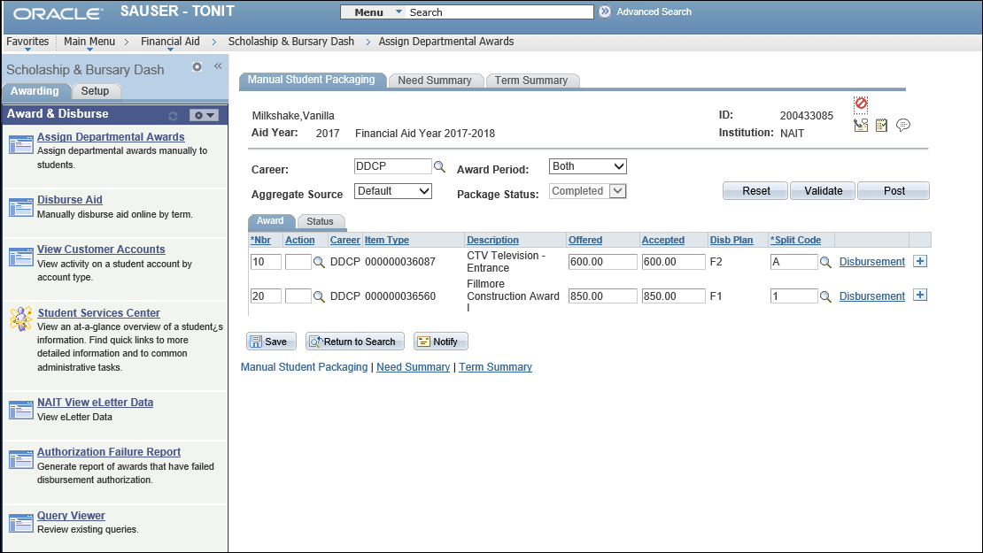
What S&B Staff see
Notes:
We took advantage of Pagelets, Navigation Collections, and WorkCenters to build a quick access dashboard for staff.
In most cases, the only step that they need to take is coming here to Offer/Accept the award.

Slide 17
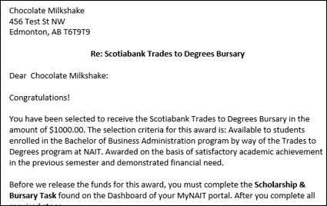
What the students see
Notes:
- Once a student is selected as a recipient, they receive an e-notification that there is a message for them on their portal.
- Within that first communication, they are advised that they have been selected as a recipient, the specific scholarship or bursary they were selected for, the value they are receiving, and most importantly
- The steps they are required to take in order to receive the funds.
- i.e. completing the Scholarship & Bursary Task found on the dashboard of their portal.
- They are also encouraged to send a thank you card to the donor.

Slide 18
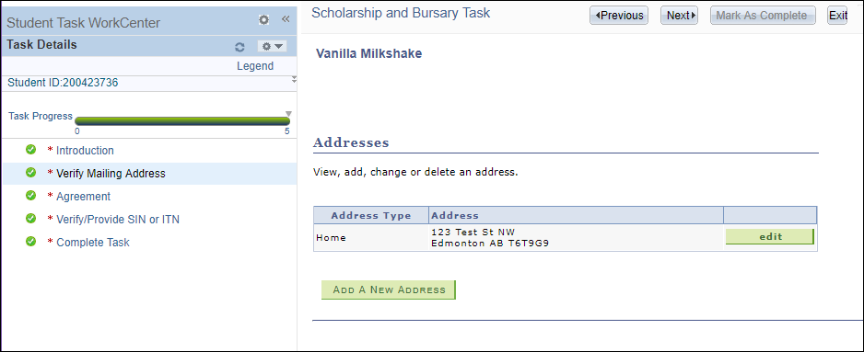
What the students see
Notes:
Within the Scholarship and Bursary Task, the students are asked to:
- verify their mailing address and make any revisions that are required.
- This will also update the address on their student record.

Slide 19
What the students see
Notes:
- They are provided with FOIPP statement/declaration
- And they are asked to provide consent for:
- the information they have provided
- that we are able to share their information with the scholarship or bursary donor
- if they should have a change of circumstances that they will contact the Scholarships & Bursaries Office

Slide 20
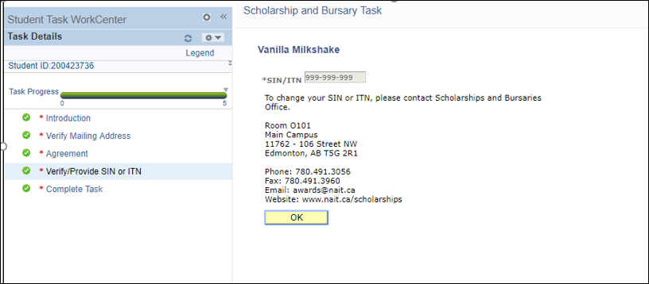
What the students see
Notes:
- Then they are prompted to provide a Social Insurance Number or Individual Tax Number.
and
- To complete their task
- Until they click on "Complete Task" they can return to this activity guide at any time.

Slide 21
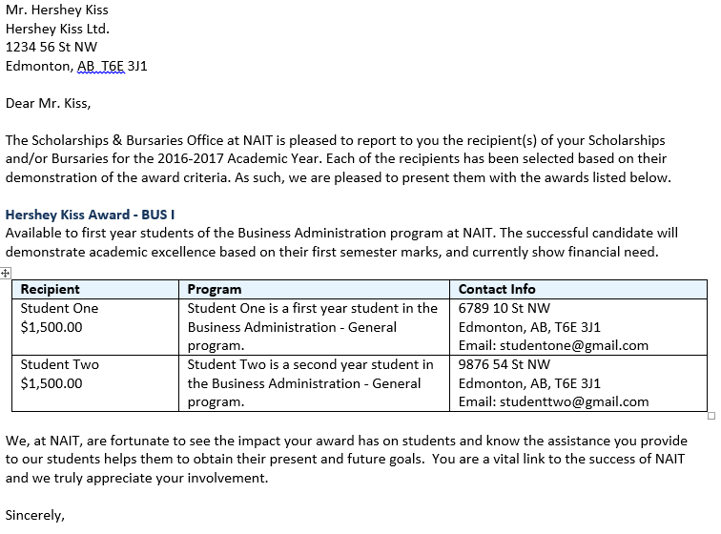
What the DONORS see
Notes:
- With all the pertinent information begin captured and stored in Campus Solutions, we are able to generate letters for donors from the system.
- These letters are triggered with the use of a query when all the awards for a particular donor have recipients selected for them.
- Then batch processes are run to produce letters similar to the one on the screen.
- Donors are reminded of the Award Name, Award Criteria, and are provide with the contact information for each of the recipients.

Slide 22
Customization
Activity Guide
Aid Year Roll – mods to delivered:
Only roll Item Types that are active as of Aid Year end
Only roll Restricted Aid if FA Item Type is active
Custom CAF values
Set Fiscal Item Type values to zero
Donor Load from Raiser’s Edge
T4A process
Notes:
Activity Guide: Used the delivered guide technology, but we did have to add a custom page for the SIN.
Our SIN is stored in a custom, encrypted field.
Aid Year Roll:
A few tweaks to the delivered process
Requested enhancements from Oracle.
Donor Load:
Required some basic name and contact information in order to print the Donor letters.
It was defined as a critical requirement that Advancement staff weren’t trying to maintain this information in 2 systems.
T4A process:
We already had a custom T4A Self-Service component for students, but it pointed to our Finance database. We modified this to use the student account in CS.
Includes process to build T4A data based on Item Type settings.

Slide 23
MAJOR DECISIONS
SHORT DESCRIPTION

Slide 24
Disbursement Options
Decision:
Disburse directly to the student regardless of outstanding balances.
The exception to this is Athletic Scholarships which pay tuition.
Result:
Multiple charge priorities to direct how the awards are applied to student accounts.
This is working well!
Notes:
Excess financial aid account
Charge priorities.

Slide 25
Cheque pickup vs mailout
Decision:
Can we mail all cheques directly to students?
Impact:
Scholarship & Bursary staff will not have personal contact with students.
Awards ceremonies use a certificate instead of a cheque.
Result:
Students have participation and responsibility in the process.
Led to better response rate on “thank you” cards.
S&B staff miss the happy students picking up cheques.
Notes:
This is a prime example of what I spoke about earlier: a willingness to revise process.
- Historically, we have had students come in person to pick up their scholarship or bursary cheque. This allowed us to connect with them in person, take photos or video for any upcoming promo events, present to them at evnets, and build relationships with the students.
- We looked at every possible solution for separating the cheques so that we could still perform this function.
- Unfortunately, the work flow we chose in Campus Solutions meant that cheques were created for students for a multitude of reasons including refunds as well as scholarship or bursary payments.
- Therefore there was no easy way of separating the cheques once they were printed.
- We felt the risk in making this change was minimal and that students would be better informed and therefore more engaged in the process and with our office. This has proven to be true as we are seeing the volumne of thank you cards to the donors increase.
- We also found an easy solution for award ceremonies, and we present a certificate instead of a cheque.

Slide 26
COMMUNICATION plan
Notes:
- I can't stress enough how important communication is. We started with a communication plan, and we concluded with a plan.
- This plan had a different objective: informing the NAIT community of the changes to scholarship and bursary processes as a result of this project.
- We identified our target audiences to include very specific areas as well as the broad NAIT community and booked specific presentation times for each of these groups.

Slide 27
COMMUNICATION PIECES
Notes:
- A post card was created and posted on the internal staff portal and hyperlinked to view the specific details.
- From there, staff were able to self-enroll in an information/training session.

Slide 28
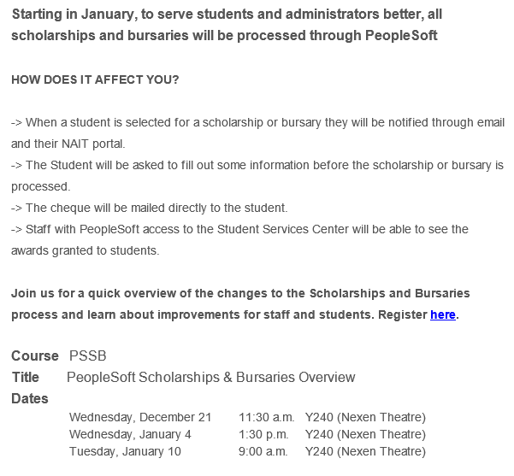
COMMUNICATION PIECES
Notes:
- In addition, we emailed the postcard along with the following message to a targeted audience, specifically the academic staff.
- Again, from here, staff could self-enroll in the training time slots.

Slide 29
Challenges and achievements
SHORT DESCRIPTION

Slide 30
Challenges
Phases mean maintaining 2 systems until Phase 2.
Activity Guides limitations meant Term-based instead of awards-based guides.
Exceptions require manual intervention.
Some setup tweaks after go-live
Production support transition: roles and process had to be defined for new, automated jobs.
Notes:
We’re working through some processes and exceptions as we go this year.
We still have to keep our old S&B system up and running for now.
Limitations in system.
Once we automate, the processes for exceptions aren’t intuitive for all staff. WE expect this to resolve itself as end users become familiar with the full cycle.
Emergency bursaries
Cross-over between aid years
Had to set up awards that could be received every term as separate awards. Primarily our internal athletic awards
Production support transition

Slide 31
Achievements
Reduced manual effort for disbursements.
Primarily used delivered functionality.
Sensitive data (I.e. SIN) collected on-line and encrypted.
Student information consolidated in Campus Solutions.
Students take initiative to receive funds.
Better communication throughout the process.

Slide 32
CELEBRATION
Notes:
- At the end of Phase 1 of the project, we had a party!
- Everyone that was engaged in the project, for a short time or a long time, was invited to celebrate.
- We had a few individuals share words of thanks and then we ate cake.
- We also took our project team out for a celebratory team lunch.
When you achieve successes such as we had, it is important to celebrate.

Slide 33
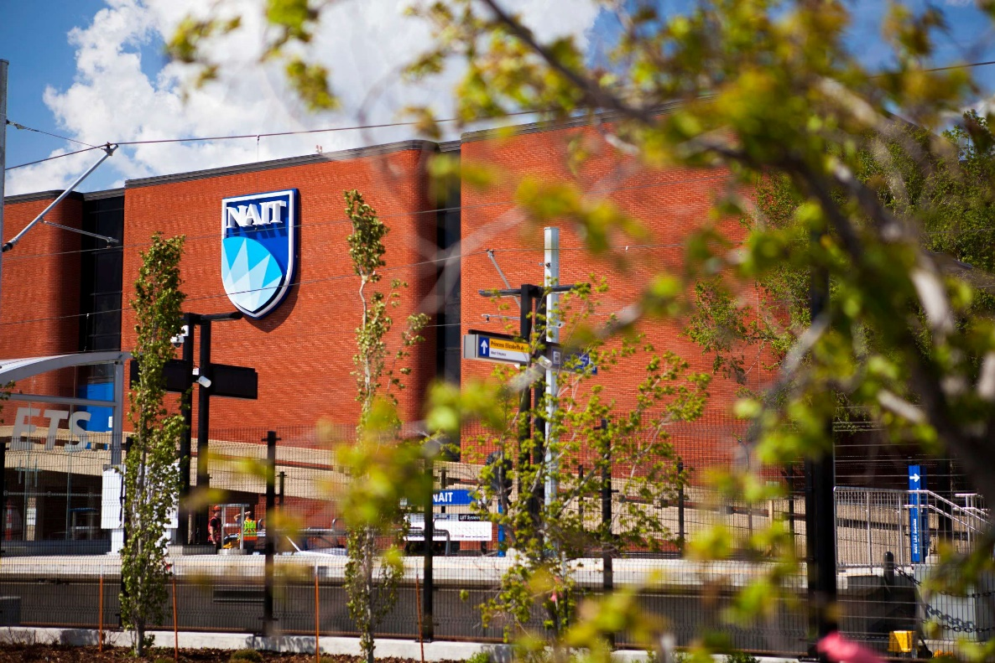
Concluding thoughts
ANY QUESTIONS?

Slide 34
presenters
Toni Tessari
Sabrina Giordano
Business Analyst
NAIT
tonit@nait.ca
Manager, Advancement Services
NAIT
sabrina@nait.ca
all Alliance presentations will be available for download from the Conference Site

Slide 35
THANK YOU!

