Slide 1
Goodbye UPK! Concordia University explores new technologies for employee training on Peoplesoft Campus Solutions 9.2
SESSION # 6044
Wed, Nov 14, 2018 (11:00 AM - 12:00 PM)

Slide 2
presenters
Madeleine Ward
Sonia Aguilar
Documentation and Training Analyst
Concordia University
madeleine.ward@concordia.ca
Documentation and Training Analyst
Concordia University
sonia.aguilar@concordia.ca

Slide 3
Concordia University
Sir George Williams Campus - Downtown
2018 Enrolment Count : 50 315
Undergraduate : 37 053
Graduate : 9 040
Continuing Education : 4 222
2018 UFTE Count : 29 430
Faculty & Staff : 6450
Two Campuses

Slide 4
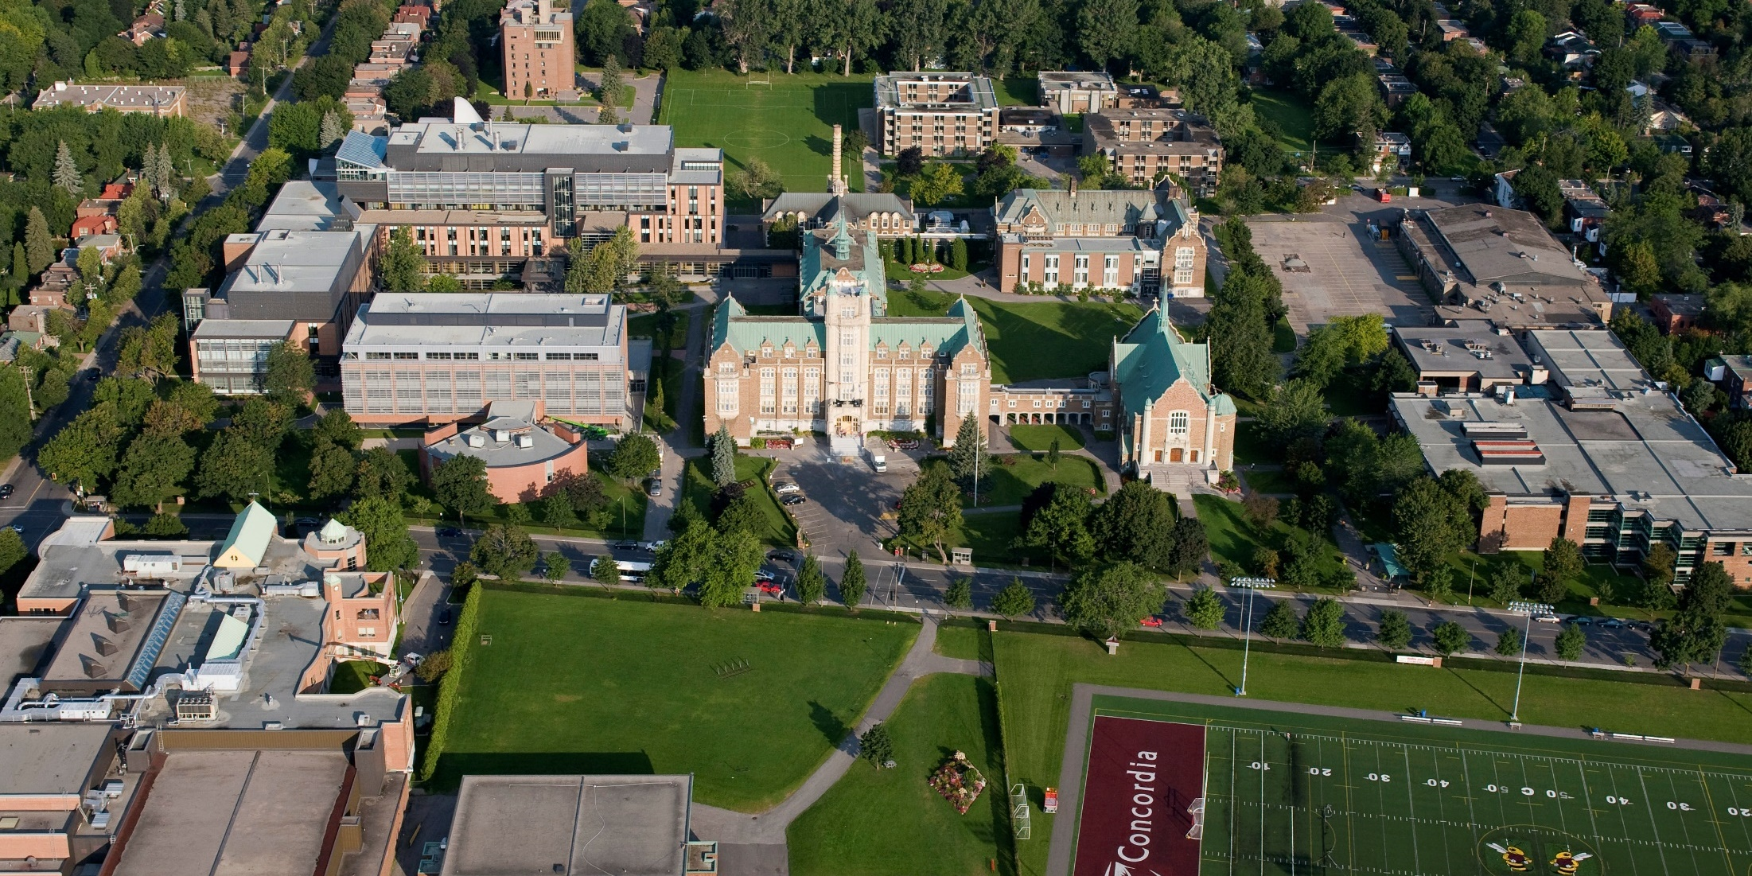
Concordia university & ORACLE
Loyola Campus - NDG
Current Production Environment
CS 9.2 PUM Image 5
PeopleTools 8.55.15
Oracle RDBMS 12c
Upgraded to 9.2 April 1st 2018

Slide 5
Sir George Williams Campus
Goodbye UPK! Concordia University explores new technologies for employee training on
Peoplesoft Campus Solutions 9.2

Slide 6
Question??
Which software are you currently using to create your training materials?

Slide 7
Outline
Preparing for the Future of Training at Concordia Discuss how we began the process of searching for a replacement software as the UPK support comes to an end.
Main Features of the Replacement Software Explore the features we were most interested in to cover the gaps we found with UPK.
Our Software Requirements Describe how we built and rated our list of software requirements.
The Next Steps in Training & User Support Our vision of the future of training & user support at Concordia University.

Slide 8
Preparing for the future of training at Concordia
How we began the process of searching for a replacement software as the UPK support comes to an end.

Slide 9
UPK End of support
UPK support ending April 2019, now December 2022
Needed to replace UPK
Reviewed end-user and developer feedback on UPK
Search for a replacement software

Slide 10
End-User Feedback
UPK Modes
UPK Print it! can be difficult to follow without the visual support of the screenshots
UPK Modes
UPK Do it! Users need to resize the screen to have it side by side with the SIS
General Comments
Users verify the number of steps in the UPK to evaluate the complexity of the process
UPK Print-it! The date doesn’t appears in the printed job-aid making it difficult to know which is latest version
Users can easily miss updates when reviewing the UPKs quickly
Users prefer delivery methods that provide quick access without having to exit the SIS
UPK Search index difficult
UPK Try-it! Users must follow the step-by-step recording
UPK display could be intrusive for users with only one screen

Slide 11
UPK with modes

Slide 12
Developer Feedback
UPK Developer
No statistics on UPK usage
UPK Developer
Need to publish the entire library when we make a correction to UPK
General Comments
Difficult to search for UPK in developer
Difficult to show updates to processes in UPK
Not context-sensitive- not able to add it for topics already recorded
With multi-user library, UPKs do not always appear for both users
No collaboration feature in library
Bugs and browser issues with UPK
Lots of editing required after recording

Slide 13
Sis and help link
Help Link

Slide 14
Search for replacement software
researched software online (Google it!)
brainstorming sessions
watched videos of different software
invitations from software companies
read blogs, online forums
spoke to other developers/IDs
https://stocksnap.io/photo/HAAVHIALEK

Slide 15
Main Features of the Replacement Software
Explored the features we were most interested in to cover the gaps we found with UPK.

Slide 16
Documenting SOFTWARE & features
Software | Record | Output/ Publish | Enable Users | Personalize Learning | Manage Content | Fluid Design | In –App, Contextual Help
Software A | Content recognition in application | Simulations,PDF, PPT, Word documents | Context-sensitive help | Personalized homepage access | Content management functionality (reporting) | Resizes content & user interface elements | End-users can access all relevant help content
Software B | Object recognition | Clones, Lessons, Help guides, PDF | Access content in-application | Push In-Application Assistance | Monitor user activity and content usage in real-time | Resizes content & user interface elements | Help content accessible to users, at their desk or on the move

Slide 17
Main Features Available in upk
Content Development
Library Management
Content Deployment
-Web architecture
-Supports SCORM/AICC
- SIS Help menu integration
-Outline development
-Record
-Publishing templates
Features we don’t have
-Knowledge Center: usage tracking for content consumption
-In application support: context- sensitive

Slide 18
Newer Features
Content Development
-Library Management
Content Deployment
-Web architecture
-Supports SCORM/AICC
-SIS Help menu integration
-Outline development
-Record
-Publishing templates
-On premise or cloud
-Responsive design
-Reporting
-Context –sensitive
- Built-in collaboration feature in library
-HTML 5
-Accessibility
-In-app interactive
New Features

Slide 19
our SOFTWARE requirements
Describe how we built and rated our list of software requirements

Slide 20
Overview of software requirements
REQUIREMENTS
END-USER
DEVELOPER
ADDITIONAL
OUTPUT

Slide 21
User experience requirements
Feature | Feature Details | Rating
Ease of Navigation | Fast, easy to navigate to desired step | E
Context sensitive help | Assistance directly on page | E
Platform agnostic | Responsive design for cross device & platform compatibility | E
Interactive | Engaging, interactive | E
Ease to access content | Non-intrusive on screen | E
E=essential
D=desirable
O=optional

Slide 22
developer requirements
Feature | Feature Details | Rating
Ease to create/ develop training materials | Quick and easy development | E
Ease to update training materials | Update a single frame without having to re-record the entire process | E
Object recognition / Object type / Content recognition | Captures the objects that make up an application's interface (labels, buttons, tables and menus) | E
Produce multiple outcomes from a single recording | Videos, documents, simulations, job aids | E
Possible to add branching / alternative paths | Reduce the number of recordings required for a process | D
Assessment, quizzes | Self-assessment | D
Recording type | Continuous or frame-by-frame | E

Slide 23
Output/publishing requirements
Feature | Feature Details | Rating
Produce SCORM file | Can upload UPKs to Moodle & SIS Help link | E
Multiple formats | Training manuals, job aids, process documents, videos, simulations | E
Responsive design | For cross device & platform compatibility | E
On premise/cloud | Software on premise or on cloud | D
Multi output updating | Possible to update all the delivery methods/outcomes at the same time | E
Possible to update only one topic | Don’t have to publish the entire library when making corrections | D
Easy Moodle integration | Moodle is our LMS | D
HTML 5 | HTML Responsive to mobile devices | E

Slide 24
Additional Software requirements
Feature | Feature Details | Rating
Ability to migrate UPKs to replacement software | Option to use converted UPKs | D
Single sign-in | Replacement software can be accessed by SIS help link | E
Management of user access | Users can be setup by role | E
Reporting | Monitor end-user activity & content usage | E
Outline | Built-in collaboration/workflow feature in library | D

Slide 25
The next steps in training & user support

Slide 26
Next steps: Replacement software
Align with another project
Select replacement software
Review the requirements for the replacement software
Schedule product demos

Slide 27
Next steps: Identifying Strategies & Challenges
Personas
Strategies
Attend workshops on replacement software
Challenges
User
New software = Change = Anxiety, Resistance
Learn new software
Not get help when they need it
Fear software will be too complex
Step-by-step handouts
Contact trainers for help
Time to attend training

Slide 28
Next steps: Identifying Strategies & Challenges
Personas
Developer
Strategies
Convert 400 UPKs to the replacement software
Change Management
Challenges
Large number of users to train
400 UPKs to replace
Workshops for end-users
Create a process to replace UPKs
Learning curve= slower development
Business process owners to review UPKs
Content Sustainability
Communicate change to end-users

Slide 29
Overview of next steps
1
3
Select Replacement Software
Next Steps for End-Users
2
4
Identify Strategies & Challenges
Next Steps for Developers

Slide 30
Outline revisited
Preparing for the Future of Training at Concordia Discuss how we began the process of searching for a replacement software as the UPK support comes to an end.
Main Features of the Replacement Software Explore the features we were most interested in to cover the gaps we found with UPK.
Our Software Requirements Describe how we built and rated our list of software requirements.
The Next Steps in Training & User Support Our vision of the future of training & user support at Concordia University.

Slide 31
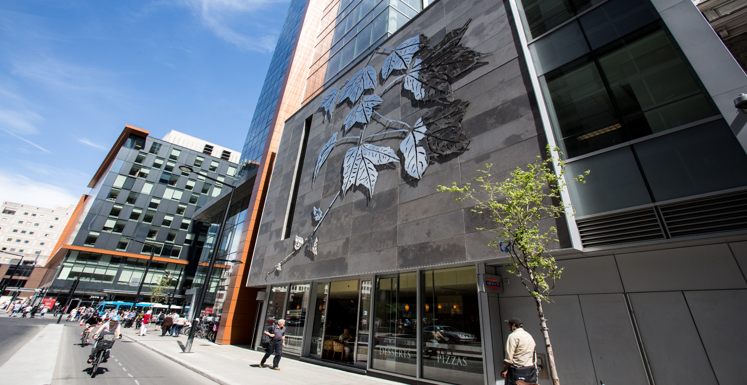
Concluding thoughts
QUESTIONS??

Slide 32
presenters
Madeleine Ward
Sonia Aguilar
Documentation & Training Analyst
Concordia University
Madeleine.ward@Concordia.ca
Documentation & Training Analyst
Concordia University
Sonia.aguilar@Concordia.ca
all Alliance presentations will be available for download from the Conference Site

Slide 33
THANK YOU!

