Slide 1
Taming the elusive activity guide
SESSION 36049
10 November 2016

Slide 2
presenter
Michael Warren
Functional Business Analyst
The Australian National University
Michael.Warren@anu.edu.au

Slide 3
The Australian national university
22,000 student headcount
15,000 student load
1,600 academic staff
2,100 general staff

Slide 4
ORGANIsATION & ORACLE
Campus Solutions: 9.0
PeopleTools: 8.53
Upgrading to CS9.2 PT8.55

Slide 5
Overview
DRIVERS & REQUIREMENTS How the need to replace the Task Wizard was identified and the process we followed to find a solution
ACTIVITY GUIDES Explaining Activity Guides and how they were identified as a suitable replacement for the existing Task Wizard
HOW DO ACTIVITY GUIDES WORK Activity Guides in action and a look at the configuration behind the functionality
CHALLENGES, HURDLES & SECURITY Exploring some of the issues we faced while implementing Activity Guides.

Slide 6
Drivers & Requirements
How the need to replace the Task Wizard was identified an options analysis

Slide 7
What is a task wizard
A student task wizard is guided process that gathers critical information required for students to study at the ANU.
Student Declarations
Emergency Contacts
Address Information
Statistical Information
Membership Preferences
ECAF forms

Slide 8
Drivers to replace the task wizard
Upgrade to CS 9.2
More Flexibility
Existing Requests

Slide 9
REQUIREMENTS FOR A REPLACEMENT
Maintain existing functionality and tasks
Simplify the login and task assignment logic
More flexibility with the addition and removal of tasks
User must be given direction to tasks
Restrict user access until the Task Wizard has been complete
Improve the look and feel of the Task Wizard

Slide 10
TimeFrame
Original Timeline
February
April
July
August
Review Existing functionality and Explore Delivered solutions
FitGap Analysis Complete and Recommendations presented
Specifications and development complete in acceptance environment
UAT and Go Live Decision
Revised Timeline
August
Delay with development on ECAF pages
October
Decision to configure in CS 9.2 and release with the upgrade project in April
November
CS 9.2 configuration
April 2017
Release with CS 9.2 upgrade project
ADU 9-11 November 2016

Slide 11
ACTIVITY GUIDES
What Activity Guides are and how they were identified as a suitable replacement as Task Wizard

Slide 12
What are Activity Guides?
Present guided processes to users using the PeopleSoft Activity Guide framework which is based on the WorkCentre framework.
Properties Of Activity Guides:
Templates & Instance structure
Configurable tasks
Flexible
Auditable

Slide 13
Templates & Instances
A Template is a master copy of all the tasks that have been identified for a particular process
An Instance is a copy of the template with different context data
- PSFTOracle

Slide 14
Satisfying requirement
Maintain existing functionality and tasks
Simplify the login and task assignment logic
More flexibility with the addition and removal of tasks
User must be given direction to tasks
Restrict user access until the Task Wizard has been complete
Improve the look and feel of the Task Wizard

Slide 15
OLD Business process

Slide 16
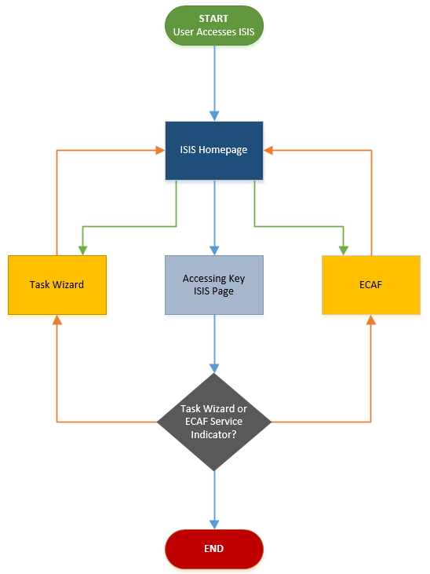
NEW Business process

Slide 17
How do activity guides work?
Configuring an Activity Guide to replace the Student Task Wizard

Slide 18
Activity guide DEMONSTRATION
Woo!
Activity Guides!
Show us how it works already!
What she said!
←

Slide 19
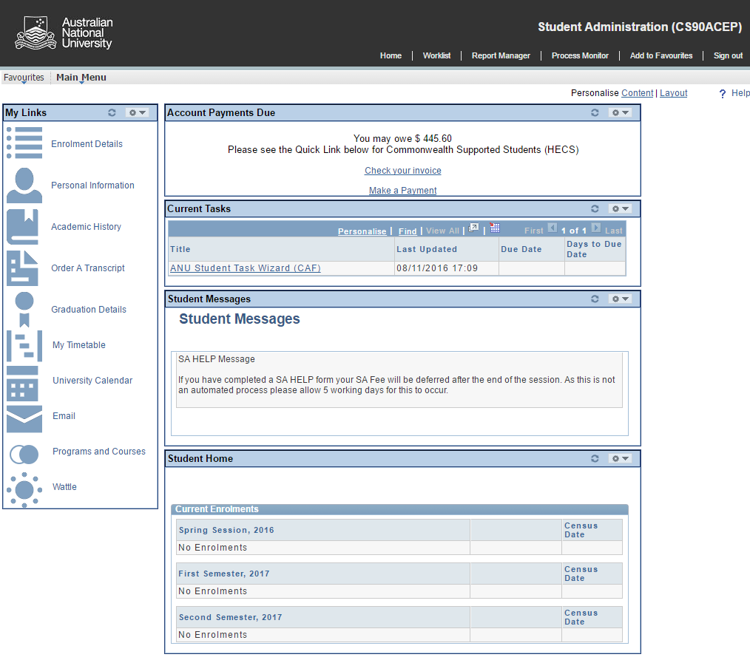

Slide 20
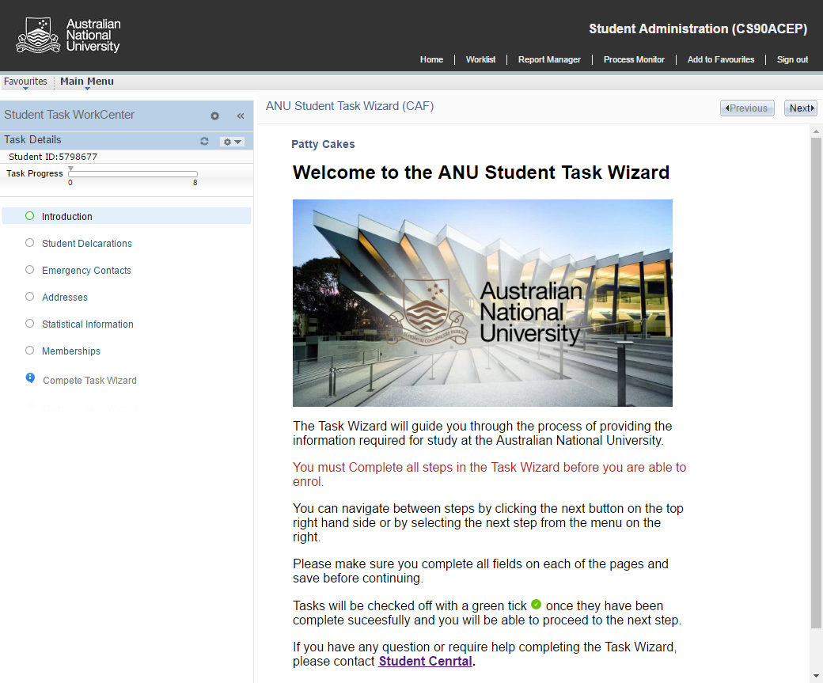

Slide 21
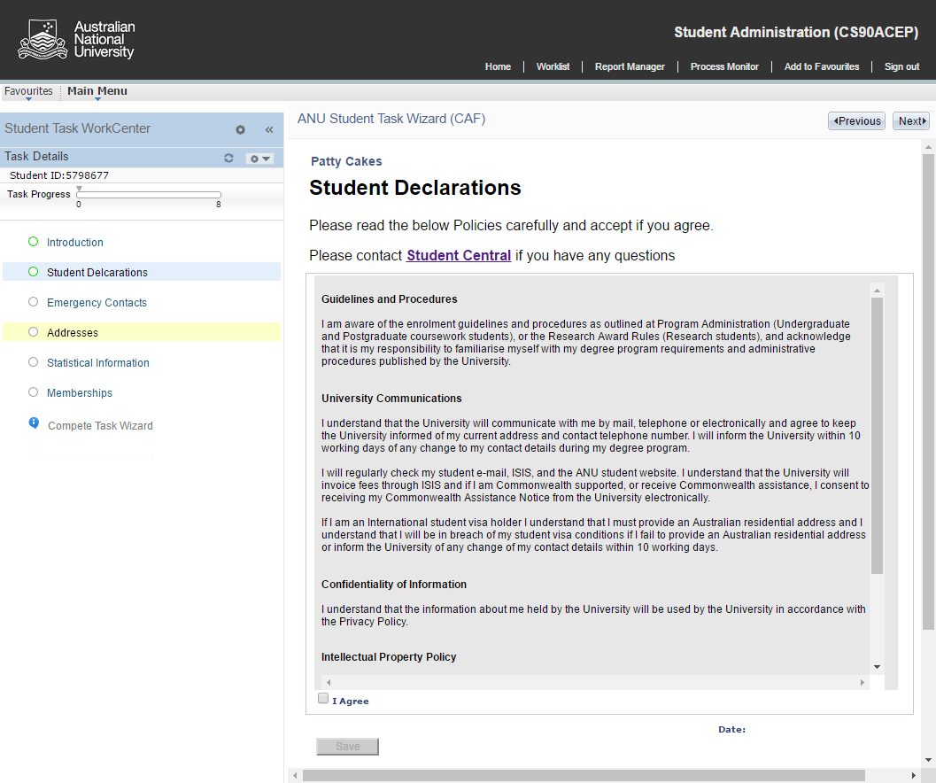

Slide 22
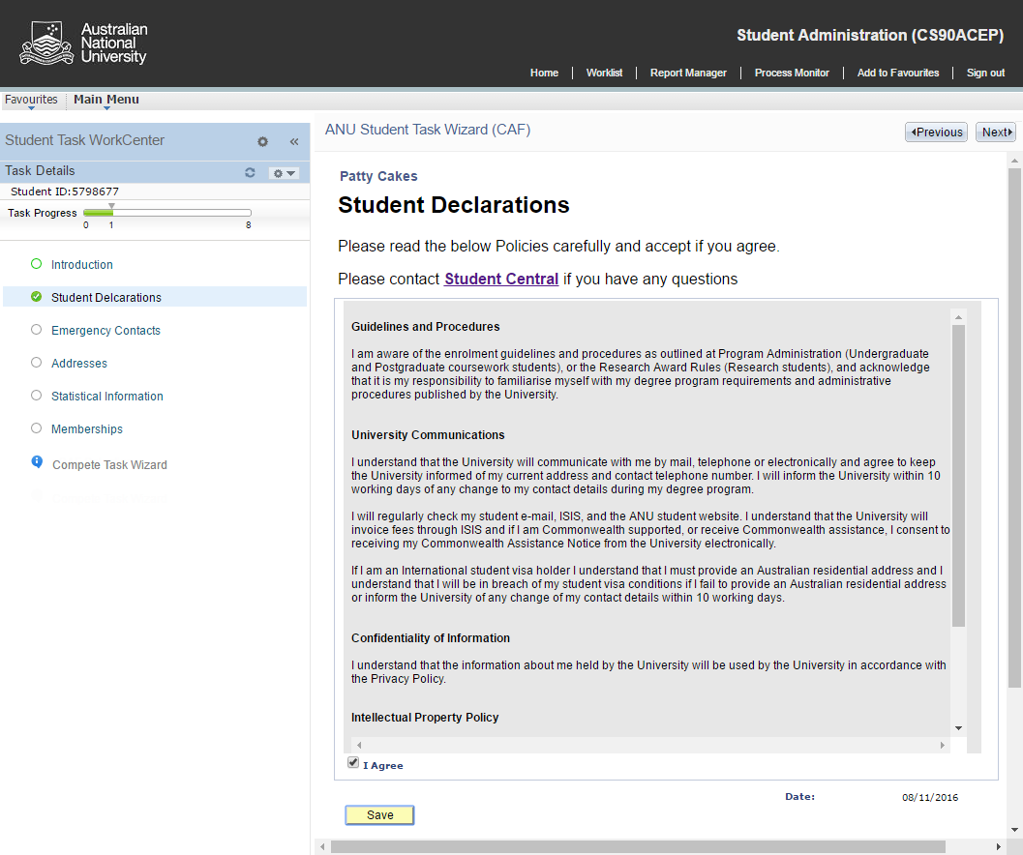

Slide 23
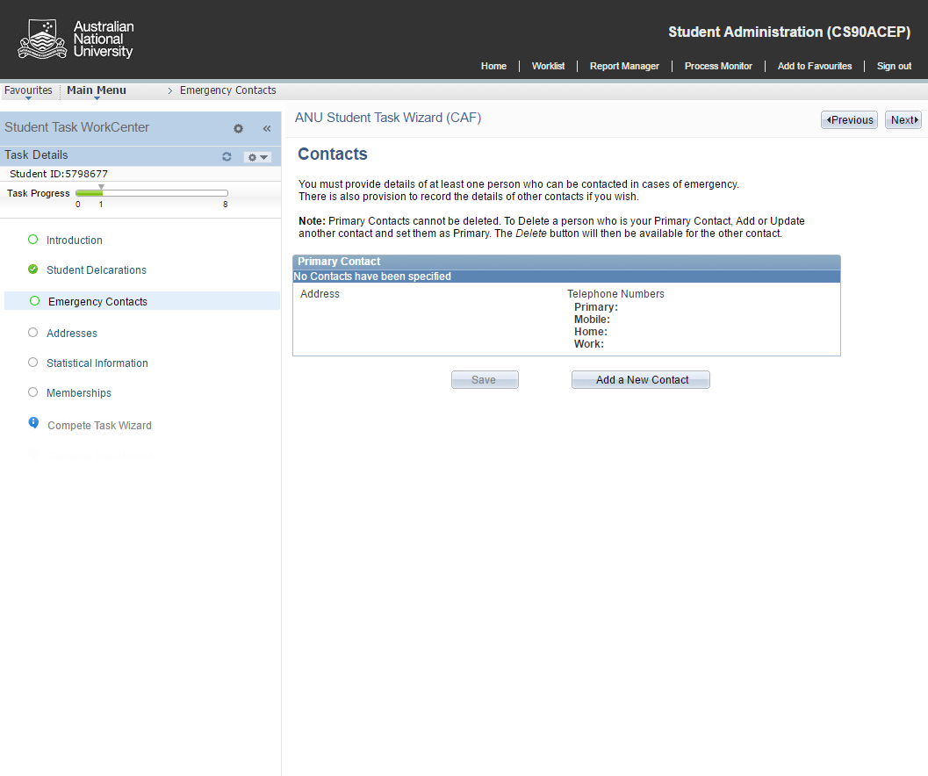

Slide 24
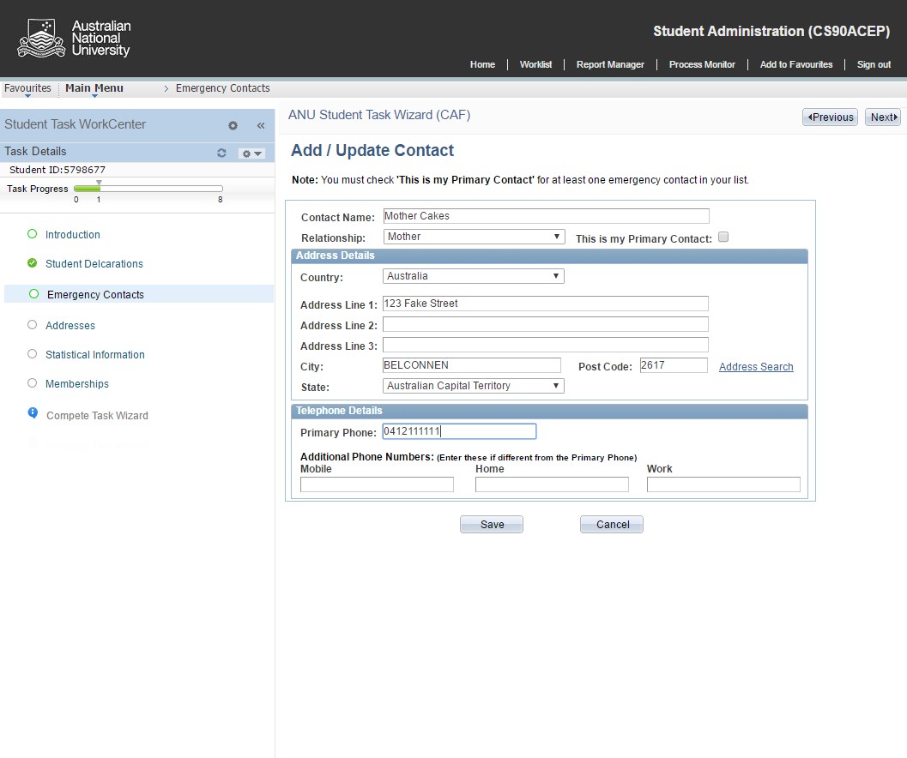

Slide 25
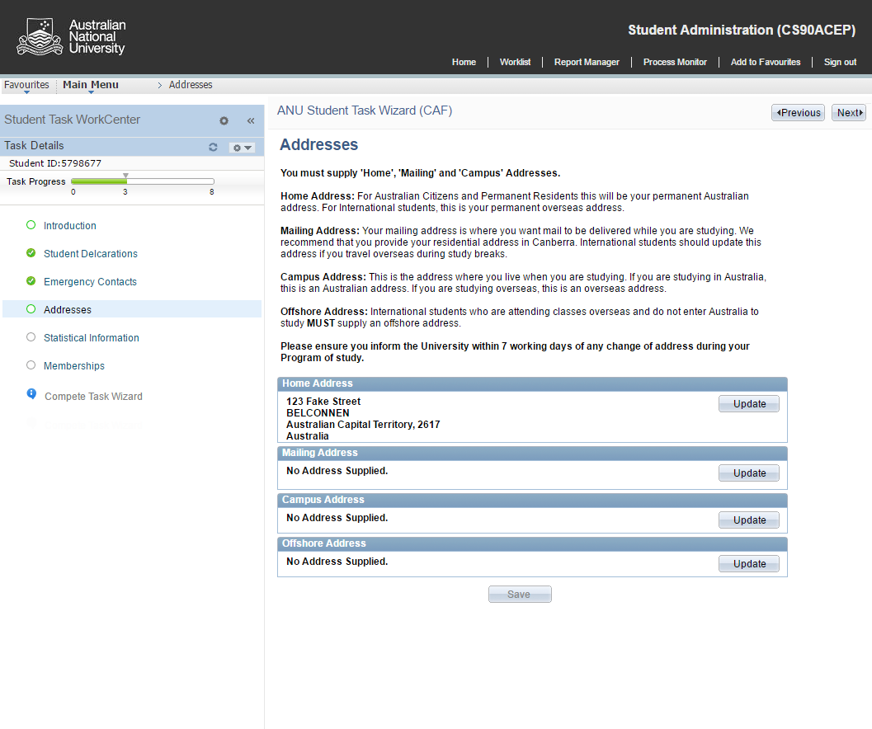

Slide 26
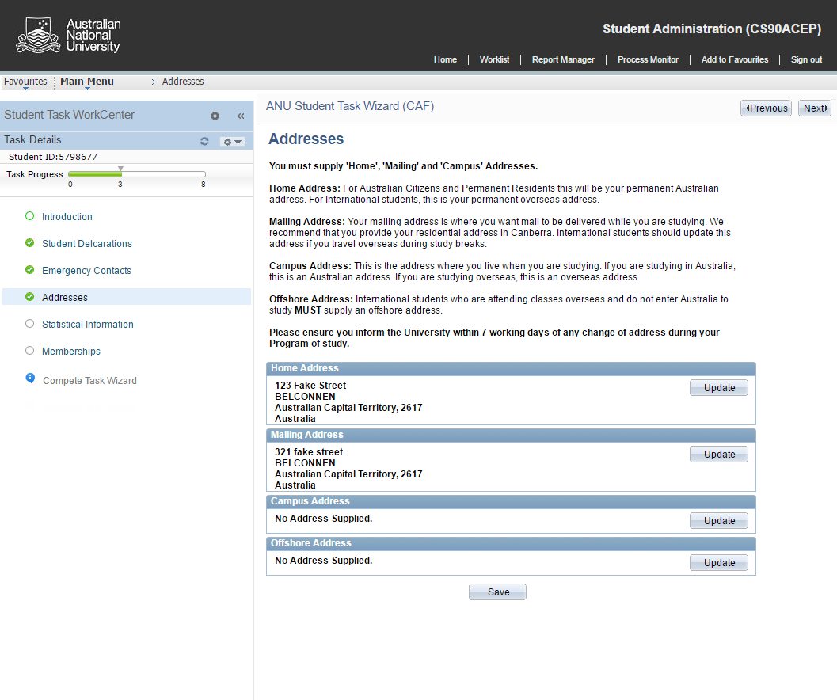

Slide 27
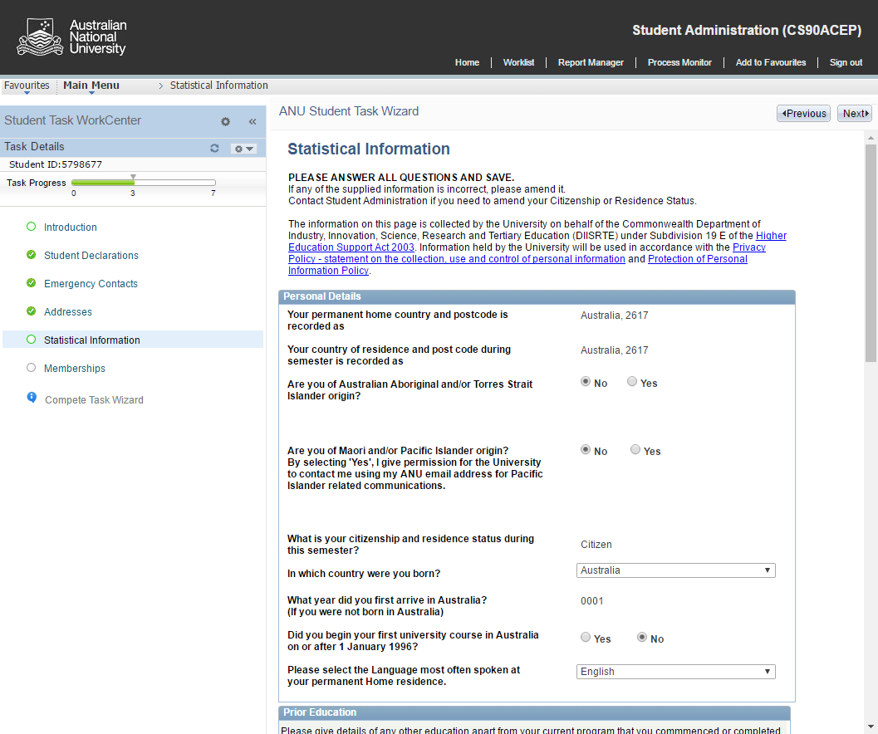

Slide 28
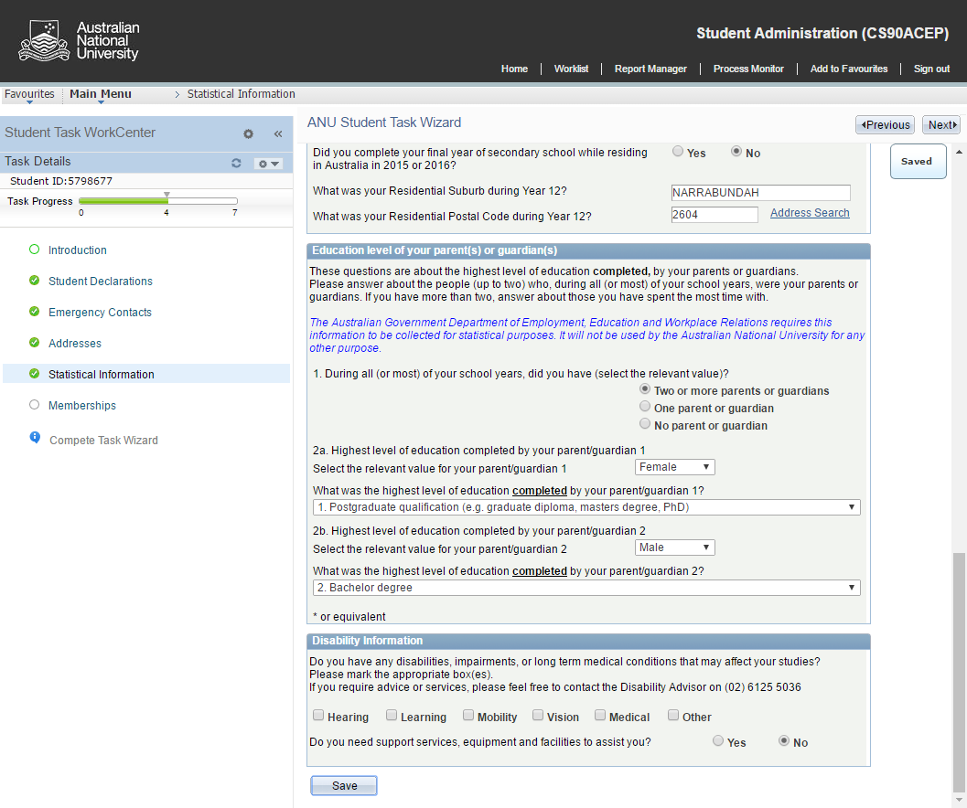

Slide 29
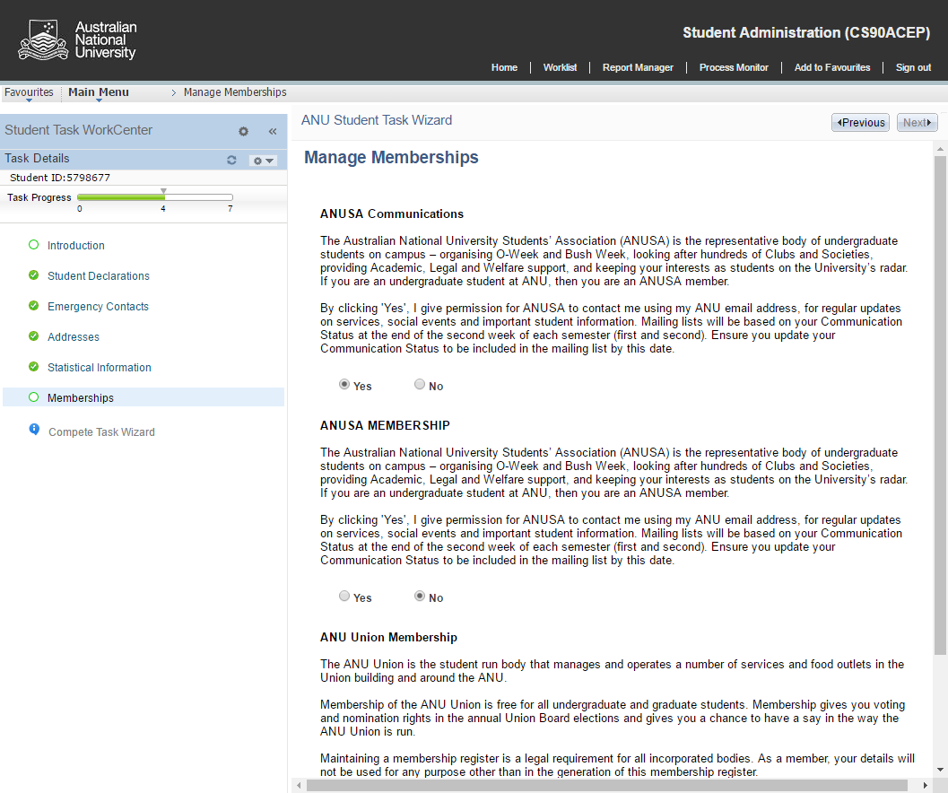

Slide 30
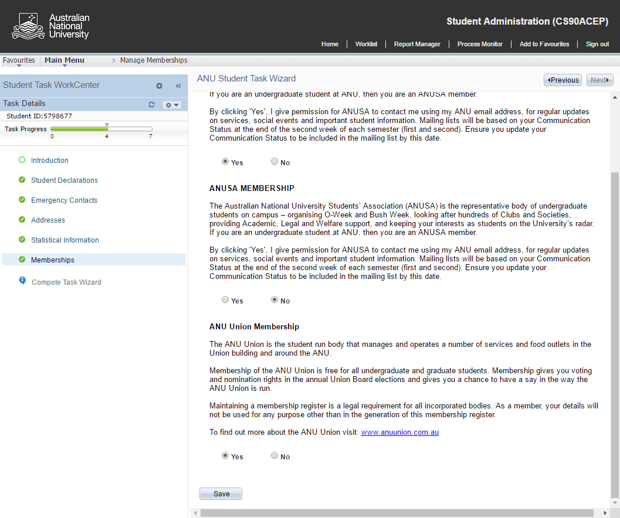

Slide 31
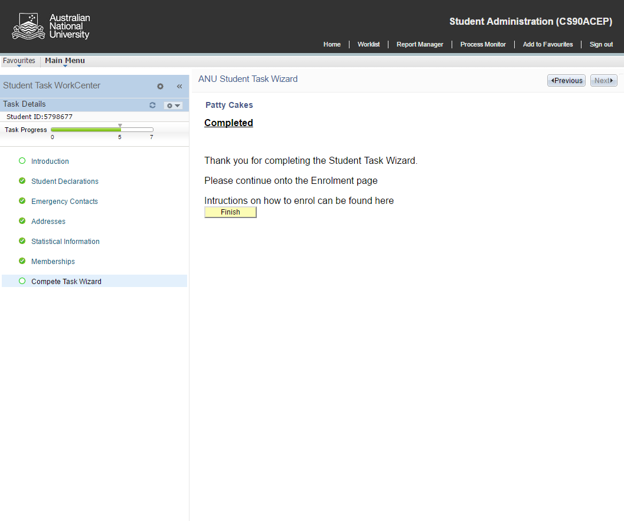

Slide 32
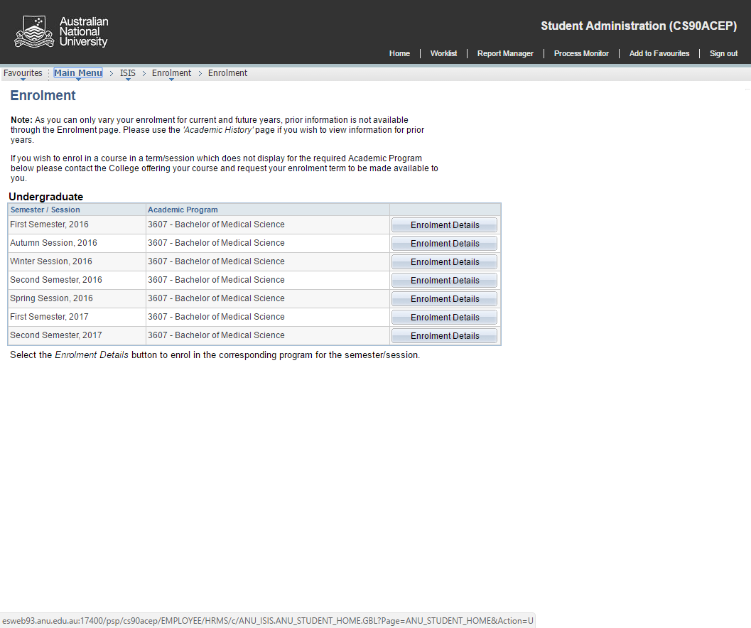

Slide 33
Activity guide configuration
1
3
5
Content Service References
Tasks
Assign
Instances
Template
Action Items
Review
2
4
6

Slide 34
Activity guide configuration
1
Content Service References

Slide 35
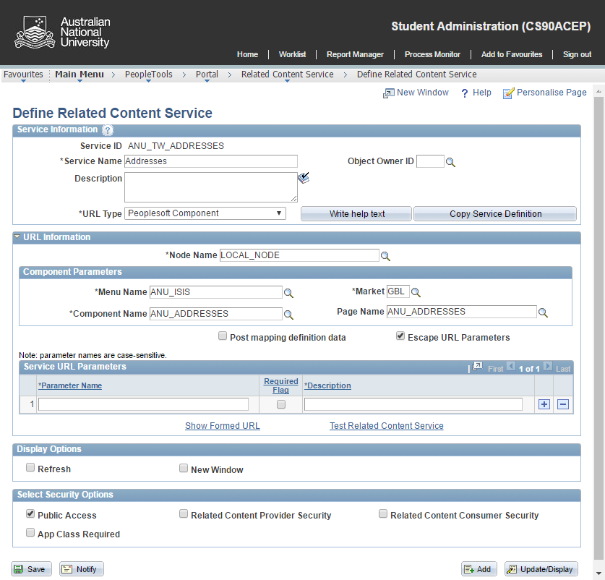
Define Related Content Services

Slide 36
Activity guide configuration
Template
2

Slide 37
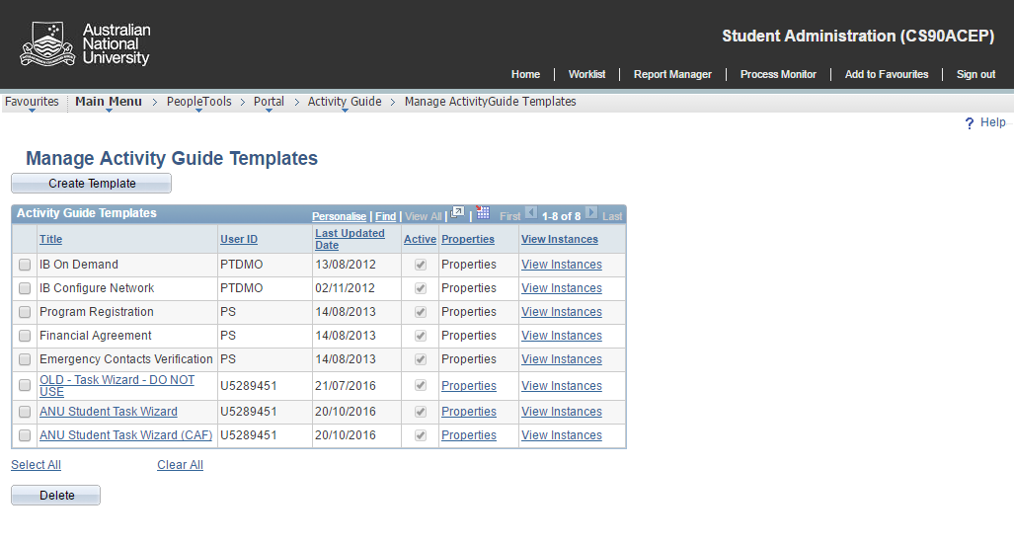
Create Activity Guide Template

Slide 38
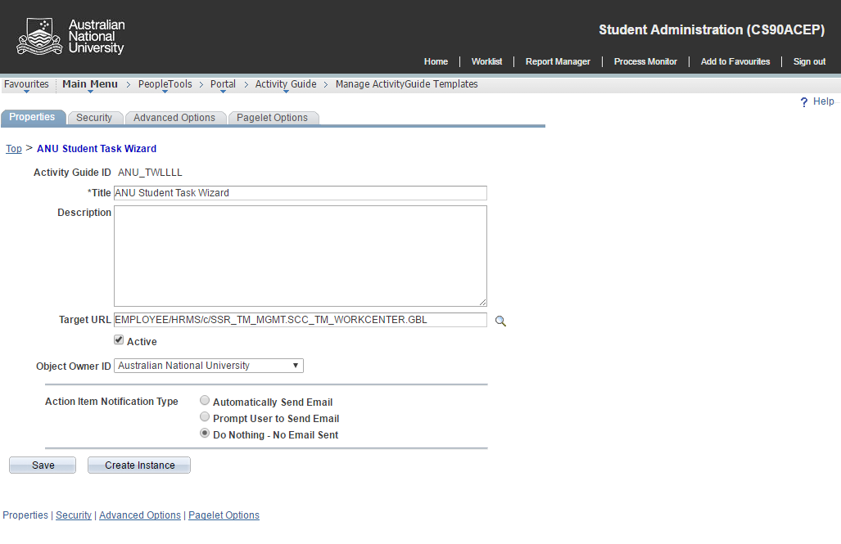
Template – Properties

Slide 39
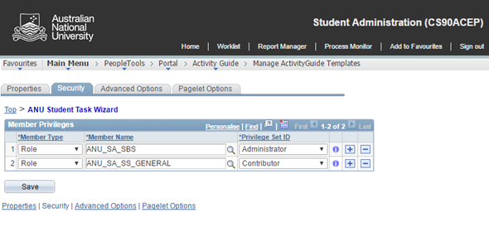
Template – Security
Administrator – update templates tasks and related instances
Contributor – participants that complete action items within a given template instance
Viewer – can view but not update action items within a template instance

Slide 40
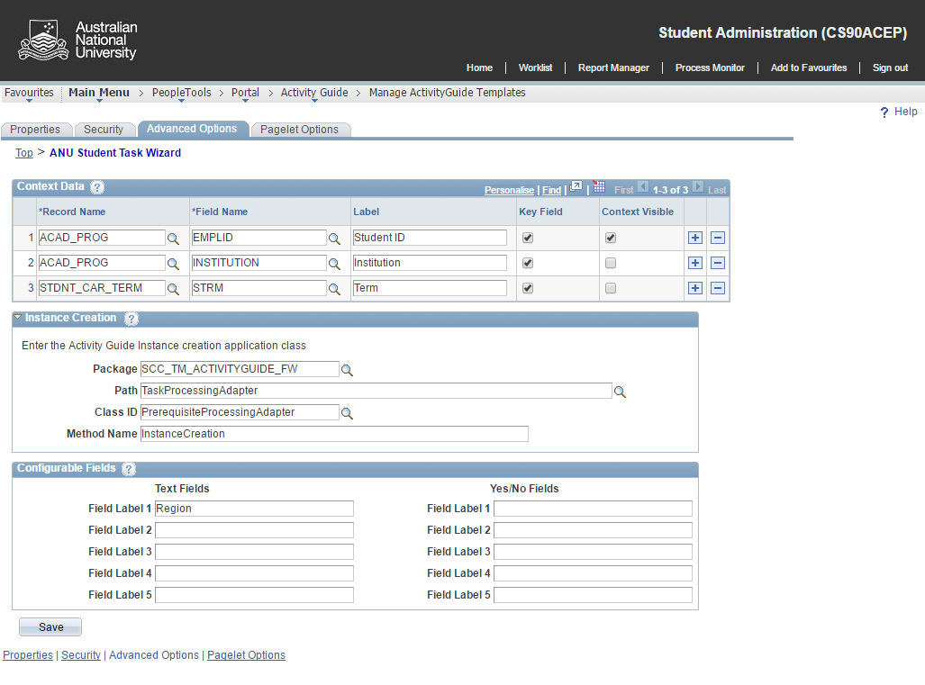
Template – Advanced Options

Slide 41
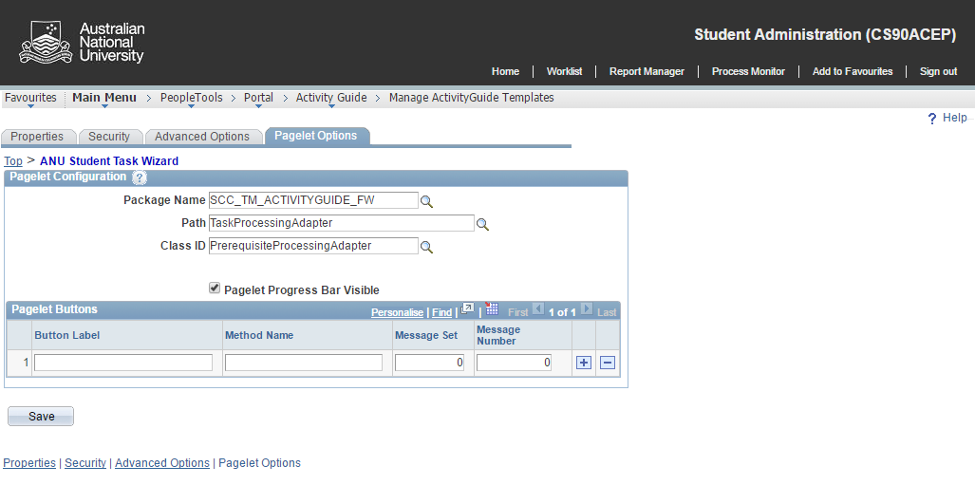
Template – Pagelet Options

Slide 42
Activity guide configuration
3
Tasks

Slide 43
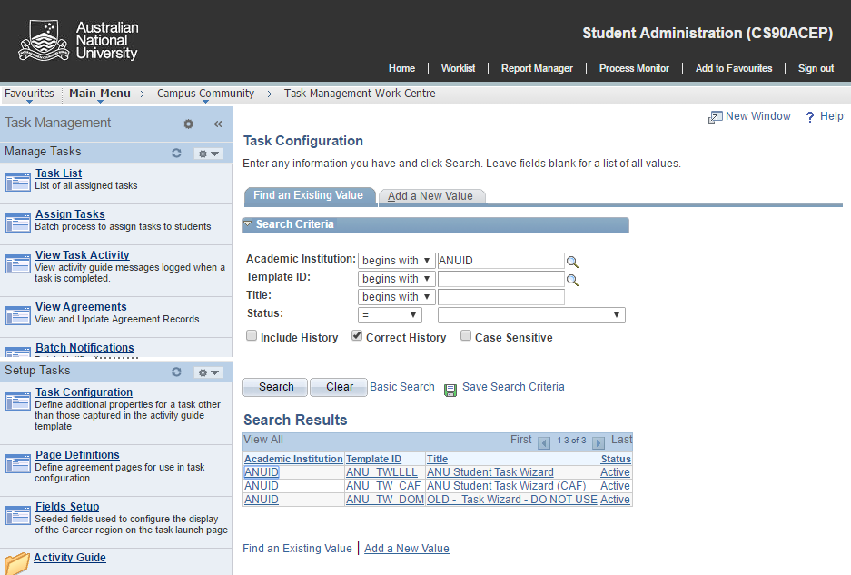
Task configuration

Slide 44
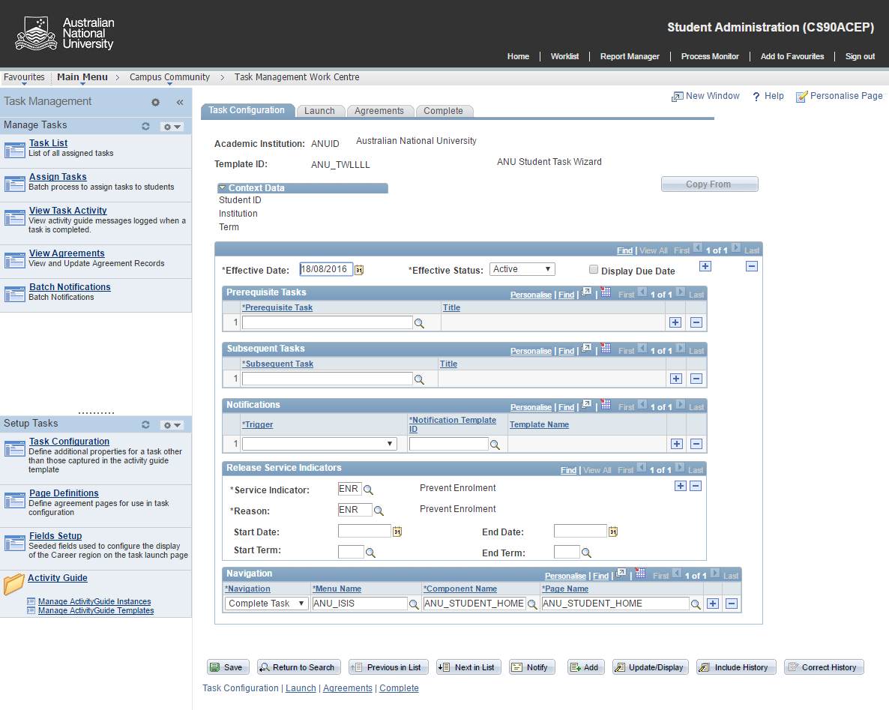
Task configuration

Slide 45
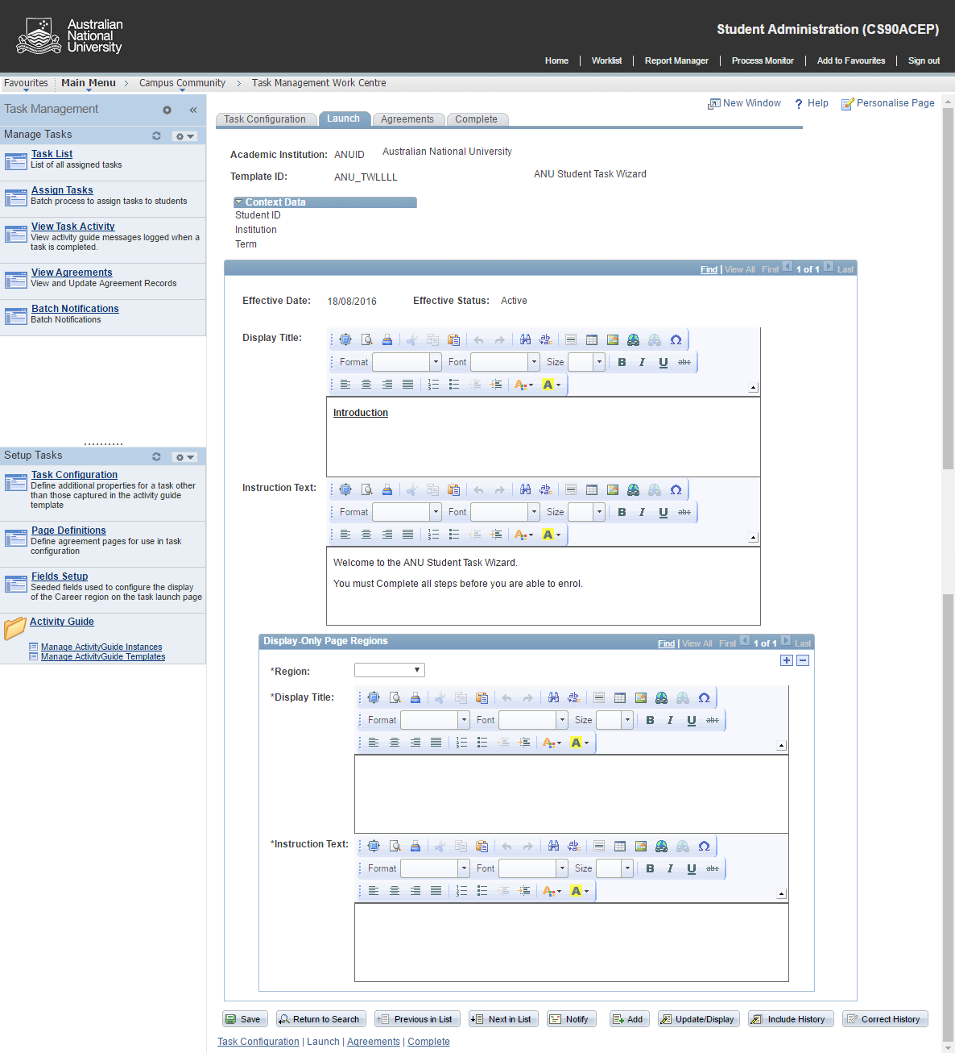
Task config - Launch

Slide 46
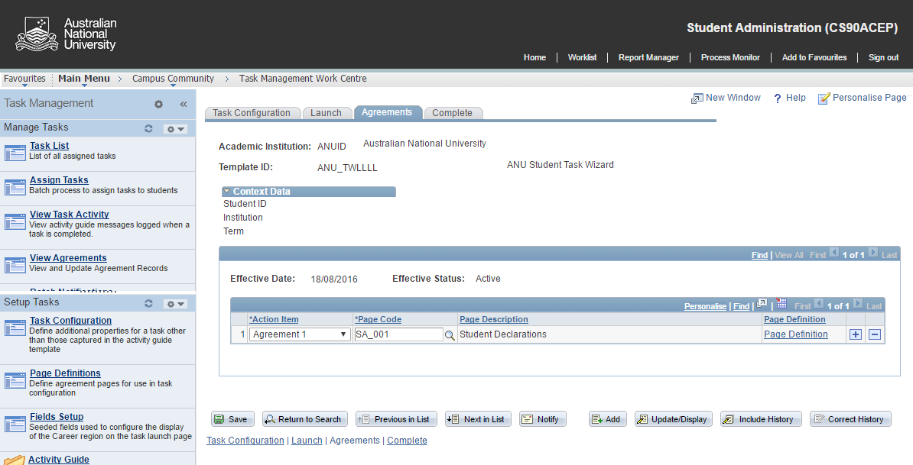
Task config – Agreements

Slide 47
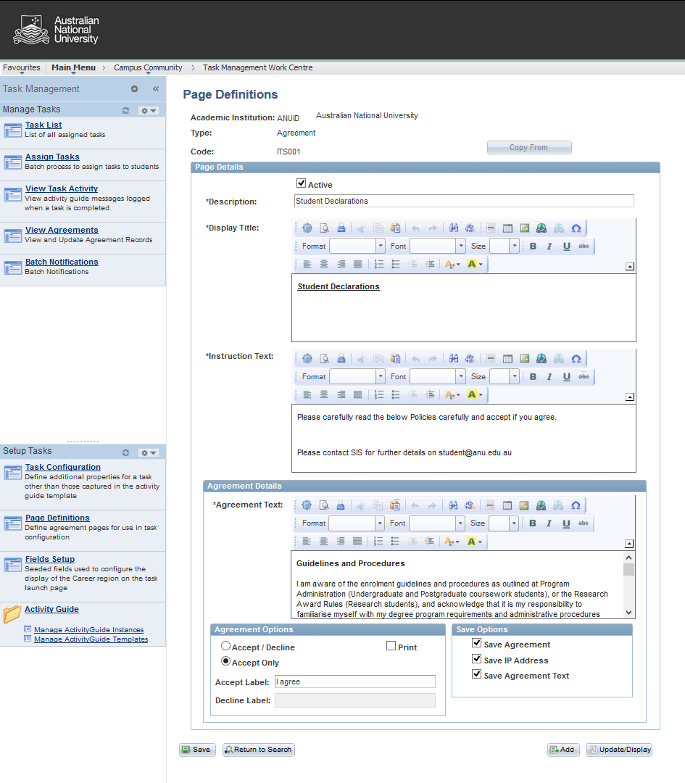
Task config - Agreements

Slide 48
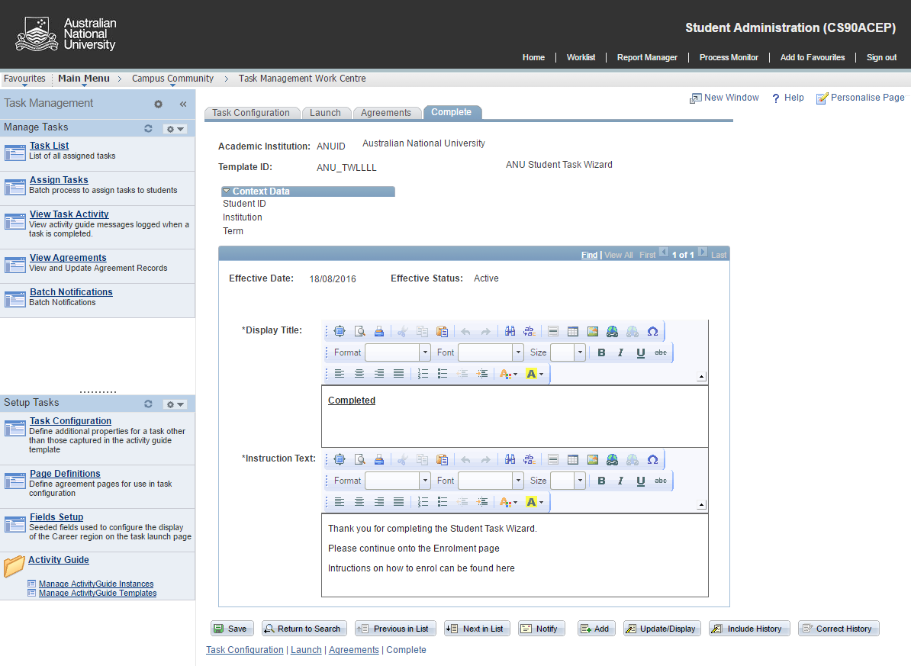
Task config - Complete

Slide 49
Activity guide configuration
Action Items
4

Slide 50
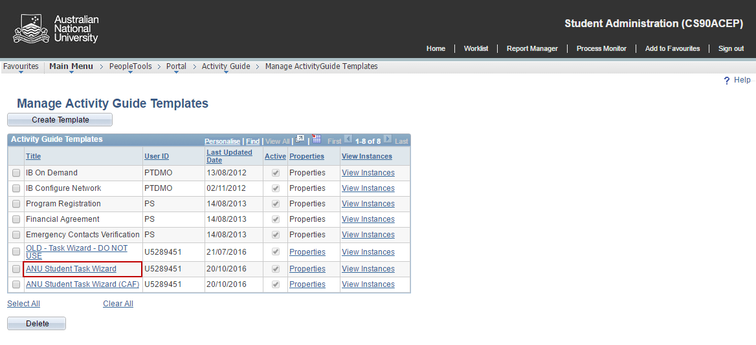
Setup Action items

Slide 51
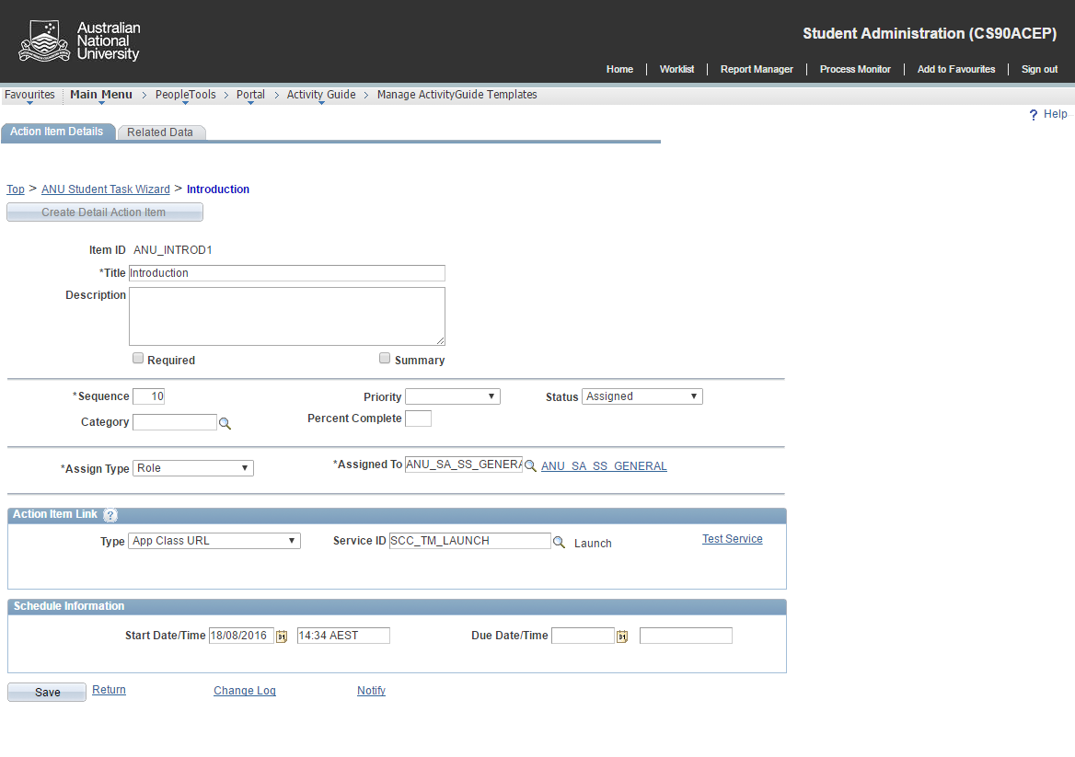
Action items - Introduction

Slide 52
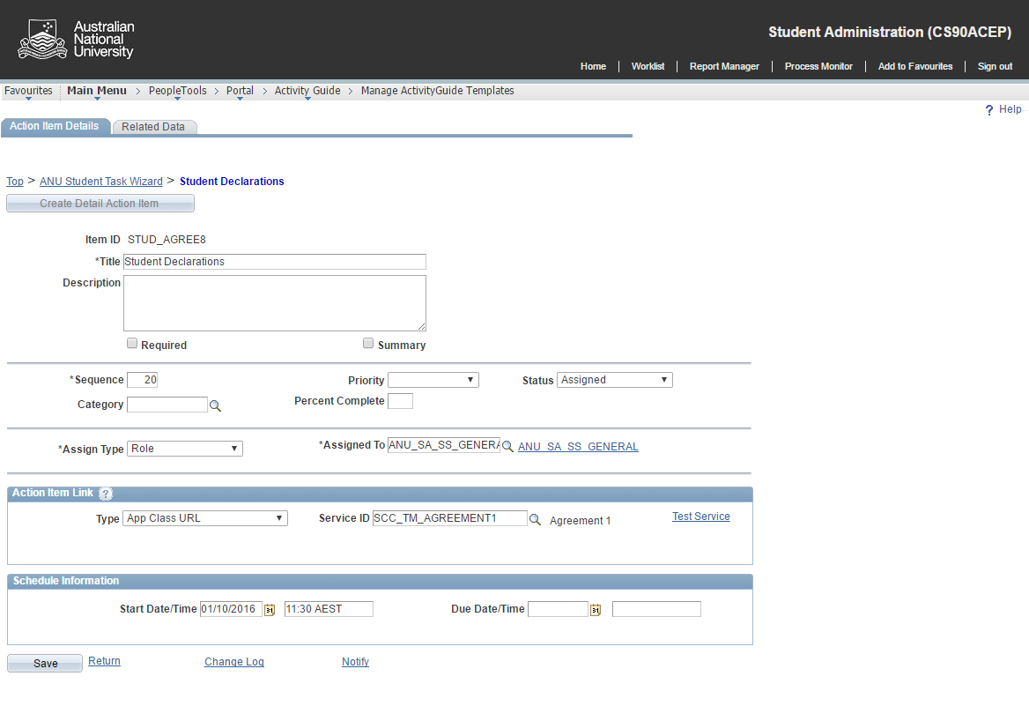
Action items – Student Agreements

Slide 53
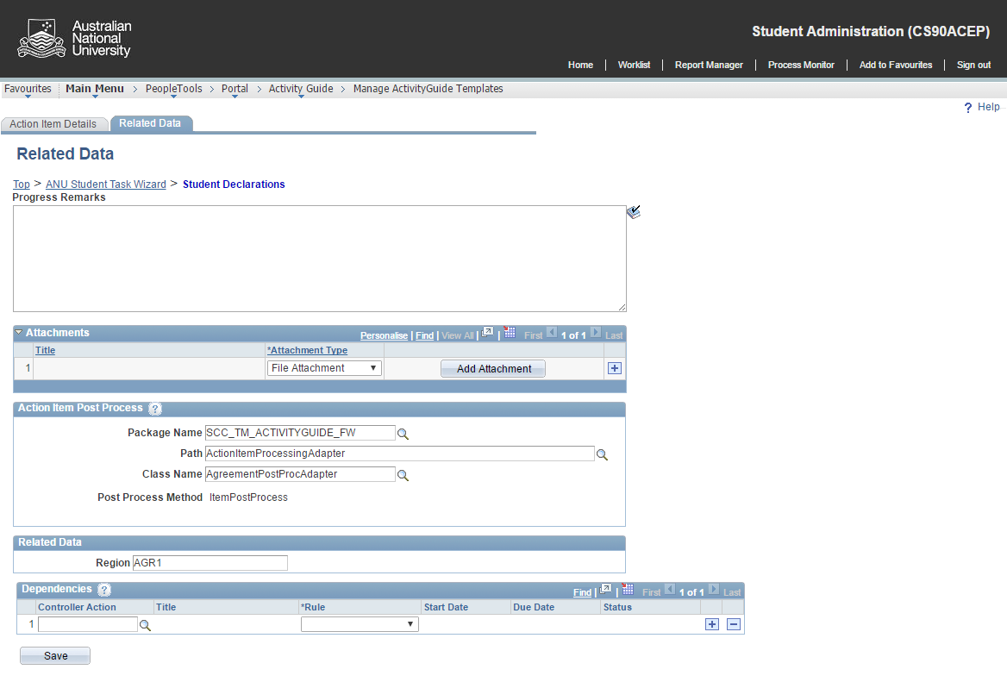
Action items – Student Agreements

Slide 54
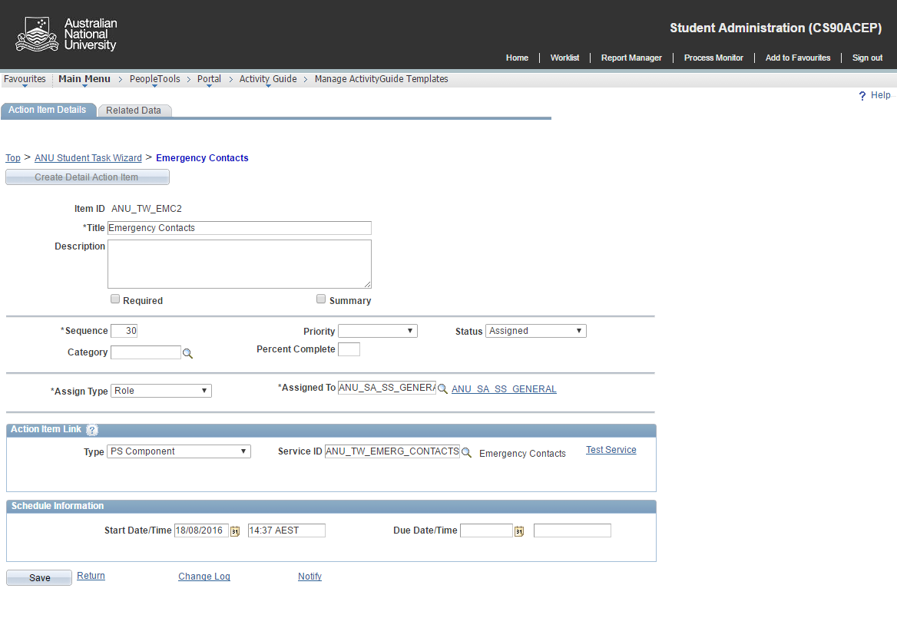
Action items – User defined

Slide 55
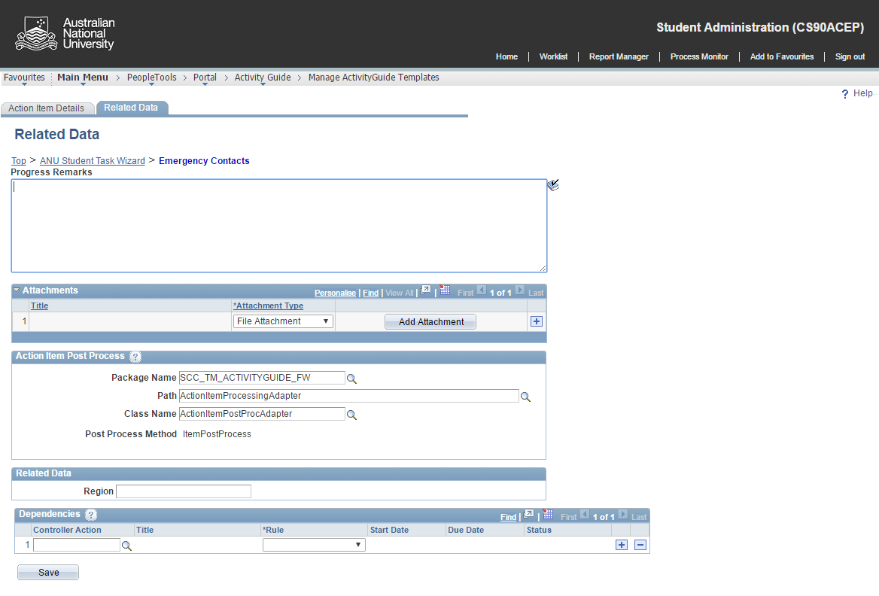
Action itmes – User defined

Slide 56
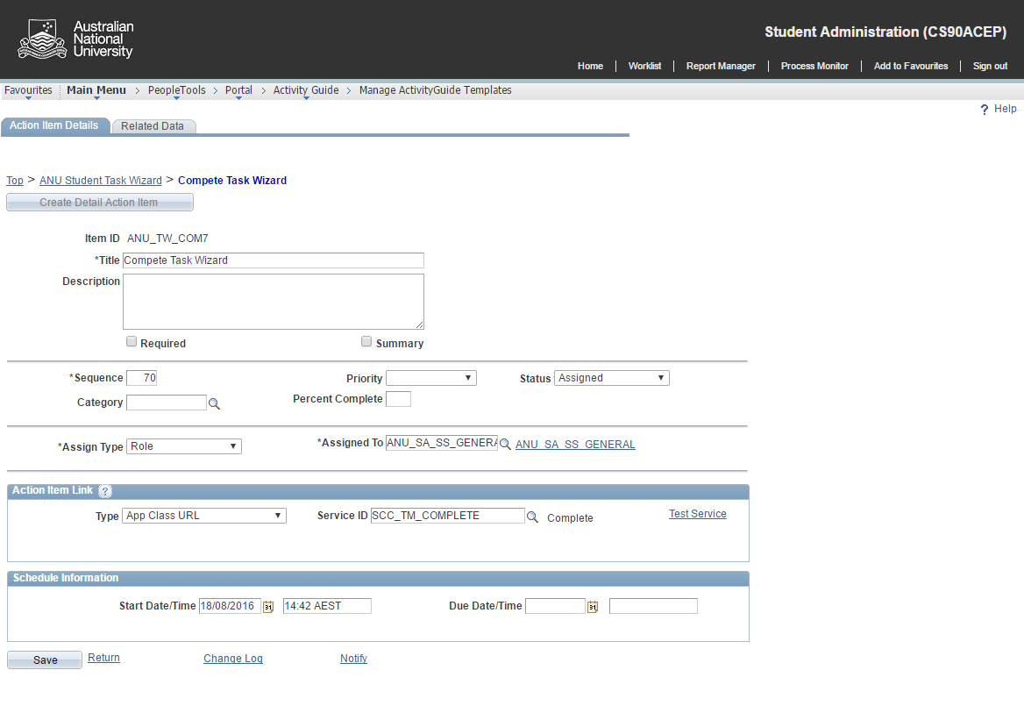
Action items – Complete

Slide 57
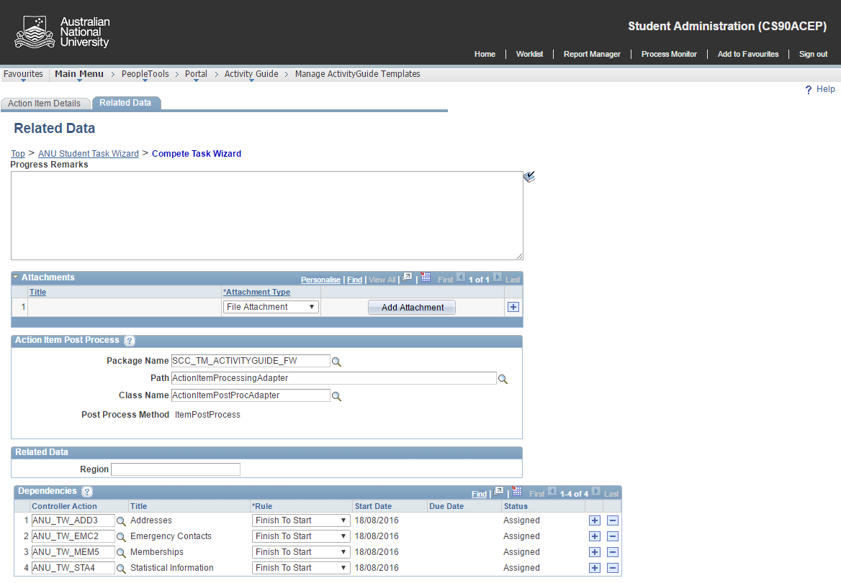
Action items – Complete (Dependencies)

Slide 58
Activity guide configuration
5
Assign
Instances

Slide 59
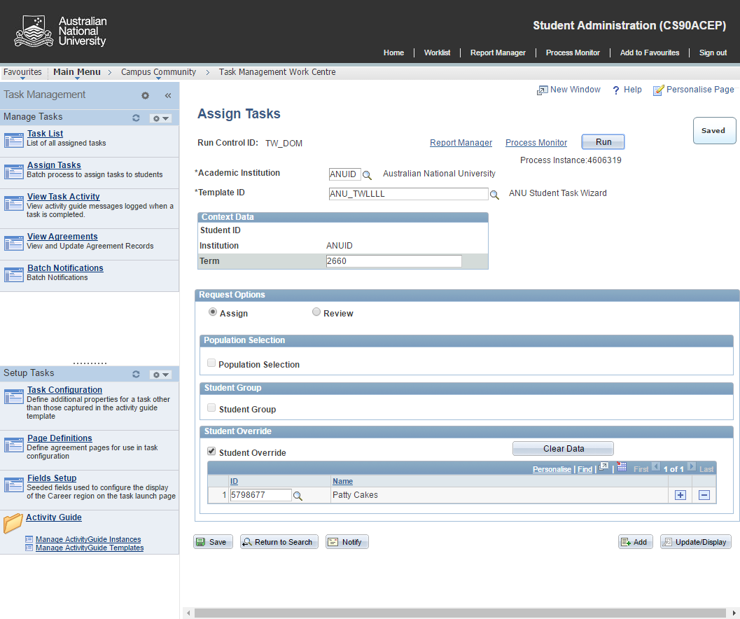
Assigning Activity Guides

Slide 60
Activity guide configuration
Review
6

Slide 61
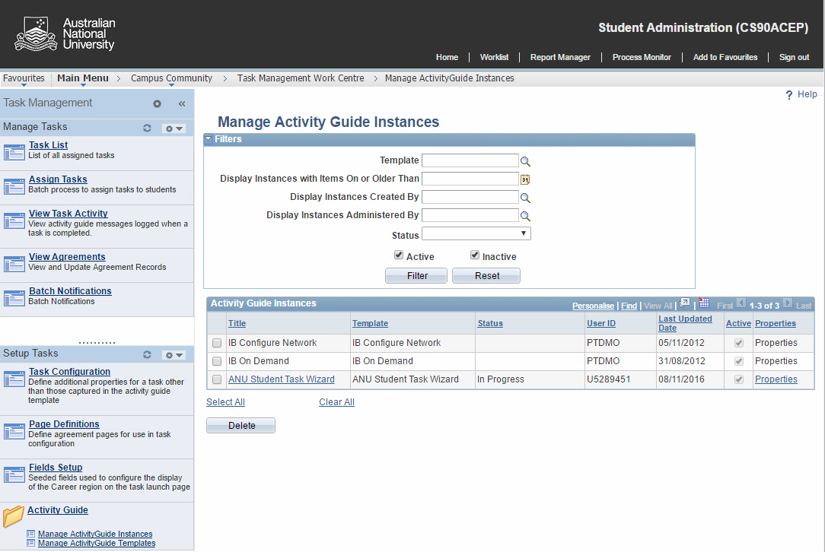
Review – AG Instances

Slide 62
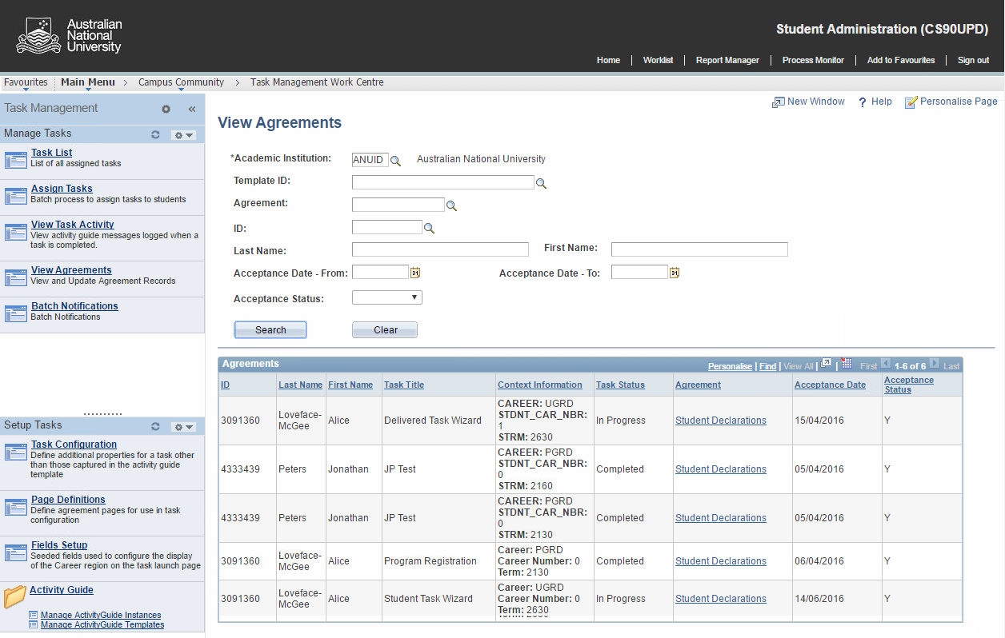
Review – Agreements

Slide 63
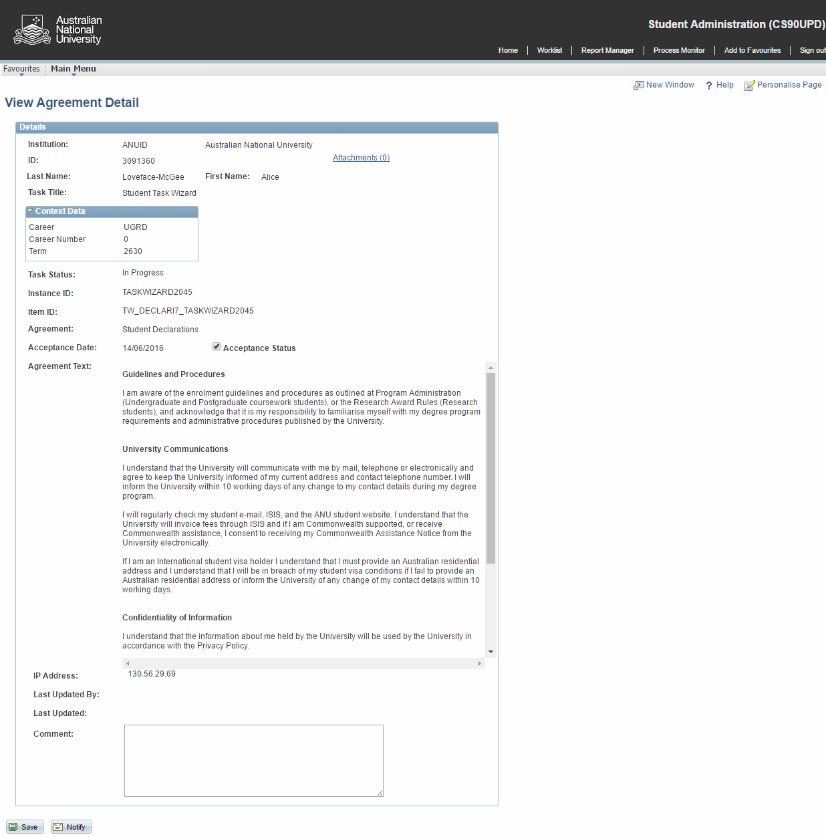

Slide 64
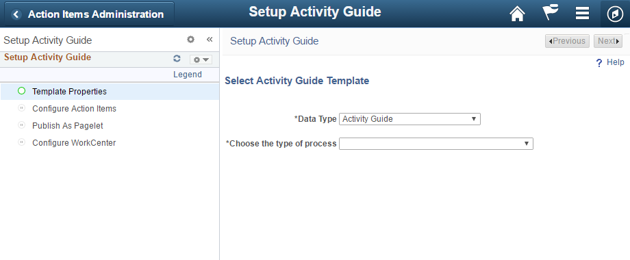
AN ACTIVITY GUIDE FOR ACTIVITY GUIDES

Slide 65
Challenges, hurdles and security
Exploring issues we faced while implementing Activity Guides.

Slide 66
Challenges, hurdles, and security
Web Library Security
Delivered Pagelet Exposure
Process issues (TW+ECAF+DECLARATIONS)
Page Mods
Controlling Access

Slide 67
Concluding thoughts
ANY QUESTIONS?

Slide 68
presenter
Michael Warren
Functional Business Analyst
The Australian National University
Michael.Warren@anu.edu.au
References
PeopleTools: Creating an Activity Guide
PSFTOracle
https://www.youtube.com/watch?v=8FIKtyOF49w
all Alliance presentations will be available for download from the Conference Site

Slide 69
THANK YOU!

