Slide 1
Monitoring Student Academic Progress using Degree Audit System
SESSION 3022
Tue, May 08, 2018

Slide 2
presenters
Gary Leung
Andrew Chan
IT Manager
The University of Hong Kong
wtleung@hku.hk
Senior IT Manager
The University of Hong Kong
atcchan@hku.hk

Slide 3
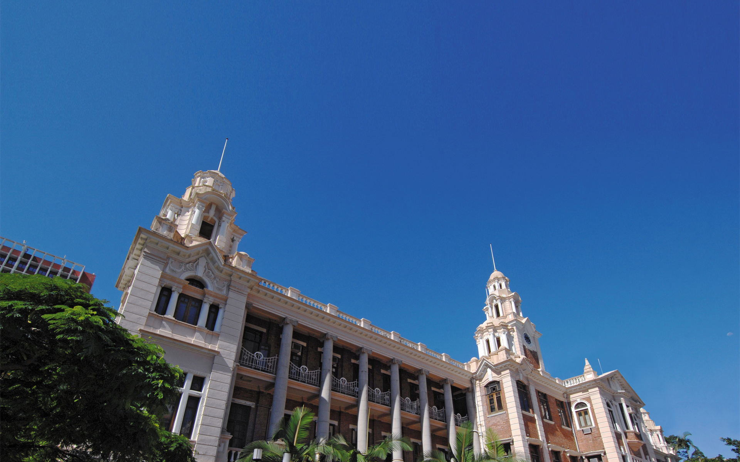
The university of hong kong

Slide 4
THE DEGREE AUDIT SYSTEM

Slide 5
The University of Hong Kong (HKU)
Founded in 1911
Over 28000 students
Over 16000 undergraduate students
Since curriculum reform in 2012, many students are allowed to declare major or minor offered by another faculty (E.g. Science students can declare Minor in Korean Studies, Arts students can declare Major in Psychology.)

Slide 6
Student Information System in HKU
Launched Campus Solutions 9.0 in 2010
Launched Degree Audit System (u.achieve 4.2) in 2015

Slide 7
Why DO we need Degree Audit?
Graduate requirement checking is maintained by individual faculties
4-year cohort since 2012
Over 50 programmes
Over110 major/ 80 minors

Slide 8
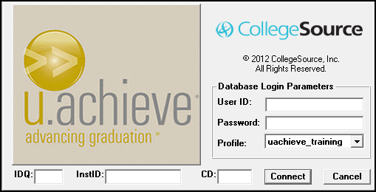
What is u.achieve
Developed by University of Miami in 80’s
Licensed to many US institutions
Owned by CollegeSource Inc.
Moved from Cobol to Java in 2010 (now 100% Java code)

Slide 9
Architecture of Degree Audit System
Use the same database of Campus Solutions but has its own schema
Use database views to retrieve Campus Solutions data real-time
Use its own web/application server (our server has 8 cores, 10GB RAM and 100GB storage) running Tomcat and Java
Authentication using CAS
Web browser is all required to generate and view audit reports
Encoders need to install a client program on their PC

Slide 10
SIS Data Access Object (DAO)
u.achieve DB
Exception
SIS DB
Student Information
Degree Program
Major and Minor
Course enrollment
Exception records
Advance Standing
Credit Transfer
Course Exemption
Notes:
Let me explain more on the loading of student data from both u.achieve and SIS databases. The SISDao (data access object) will load data from SIS DB except the customized information such as Advanced Standing, Credit Transfer and Course Exemption. For those customized data, they will be imported to u.achieve DB directly by exception records. Therefore, the SISDao will also load data from both u.achieve DB and SIS DB.

Slide 11
ENCODING structure
DPROG
Requirement
Requirement
DPROG
Sub-Requirement
Sub-Requirement
Requirement
DPROG
Sub-Requirement
Sub-Requirement
Sub-Requirement
Sub-Requirement
Sub-Requirement
Sub-Requirement
Sub-Requirement
Requirement
Notes:
I would like to introduce the encoding structure. In general, a Degree program will have requirements and under each requirements, there are sub-requirements. And, it is common that it may have more than one requirement and which have a set of sub requirements. Moreover, the degree audit system accept multiple levels. Therefore, we can define the requirements at multiple levels for a degree program.

Slide 12
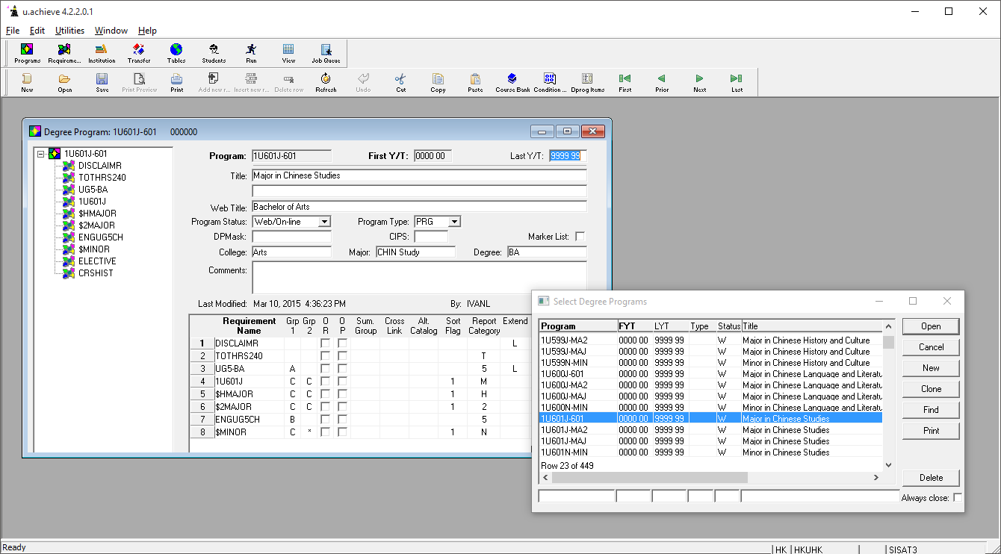
u.Achieve client

Slide 13
Basic functions of Degree Audit System
Interactive HTML degree audit report of one student
PDF degree audit report of one student
Batch report (PDF or text) for a set of students

Slide 14
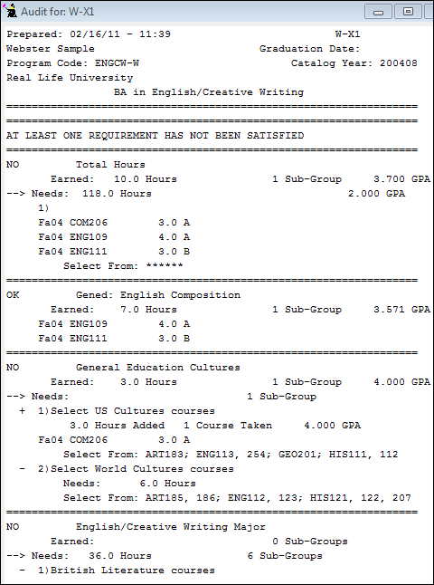
The degree audit
Student coursework is displayed through audits, dynamic reports that show:
Requirements that are complete…
and not complete
The sub-requirements a student has satisfied…
and not satisfied
Courses taken that fulfill requirements
Courses that can fulfill remaining sub-requirements

Slide 15
HTML report
Pie chart of total credits
Bar chart of credits taken/completed/required by major or minor
Drill down to sub-requirement
GPA by major, minor or sub-requirement
Expandable requirement details
Suggested courses to fulfill each requirement
Course history by term
GPA and course taken by term

Slide 16
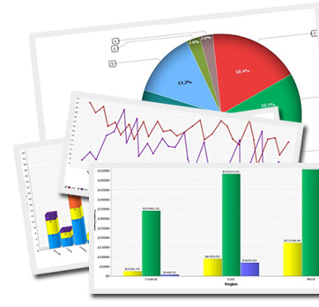
Run a Student Audit

Slide 17
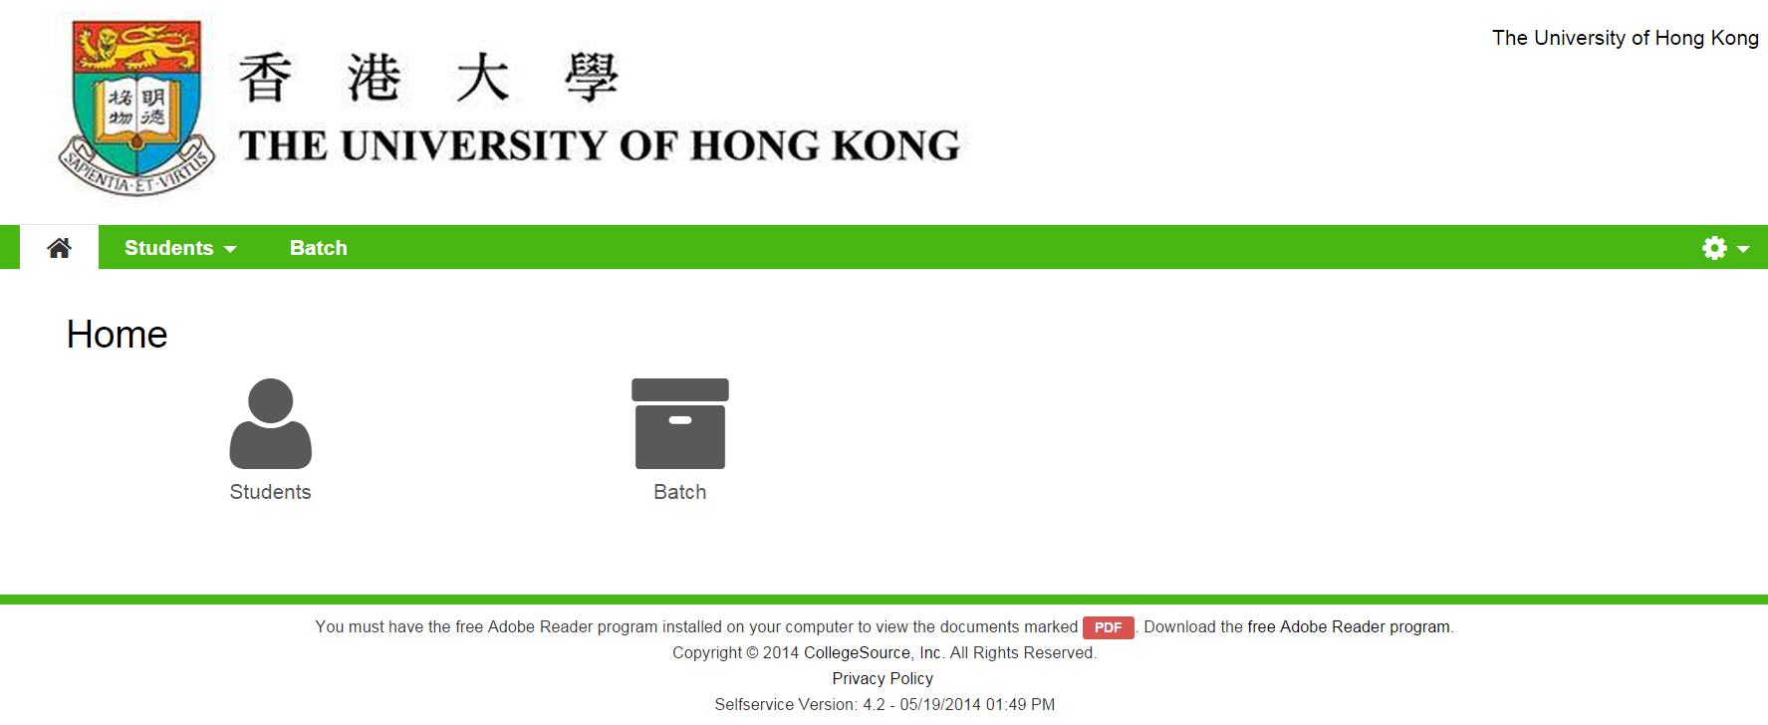
Run a Student Audit
Notes:
User can click on the Student icon for generating the degree audit of a student

Slide 18
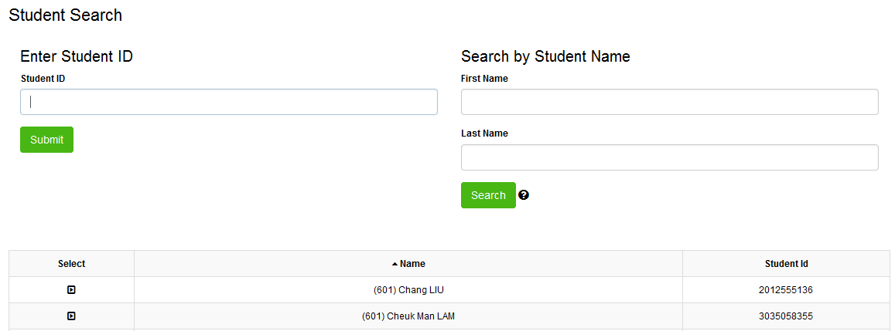
Student Search
You can either input a Student ID here
Or input the student’s Last Name or First Name to search the student

Slide 19
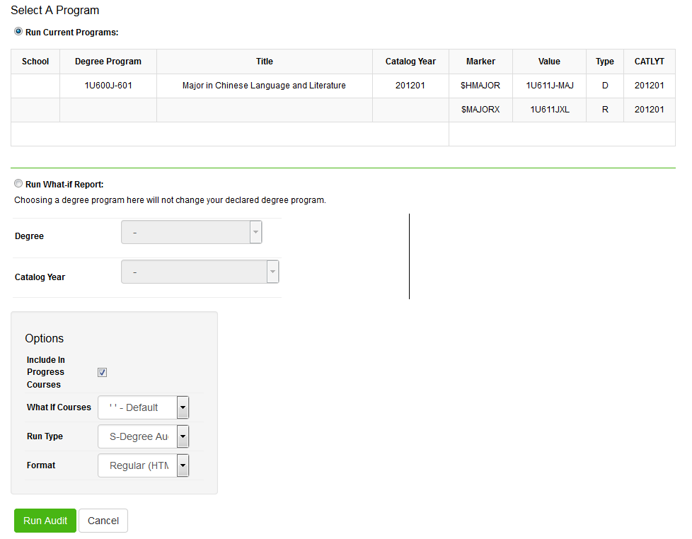
Request Audit
Notes:
There are some options that you can set while generating the audit report. For example, you can define the output format for the audit report.

Slide 20
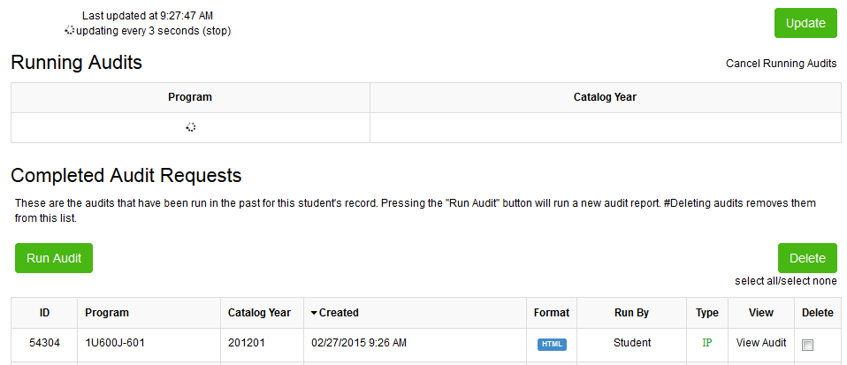
Running Audit

Slide 21
Completed Audit Requests

Slide 22
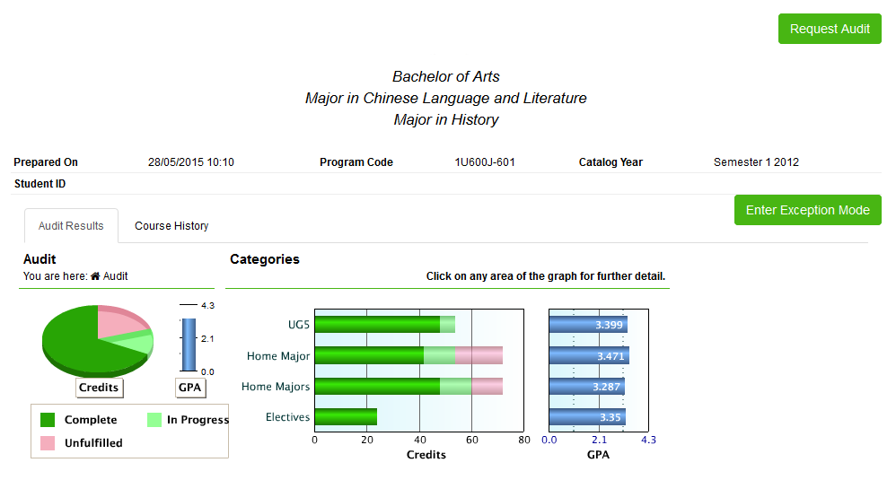
Audit Results
Student Name
Student Number

Slide 23
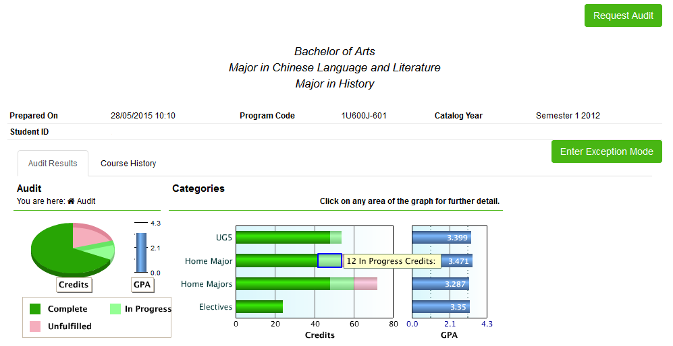
In Progress
Student Name
Student Number

Slide 24
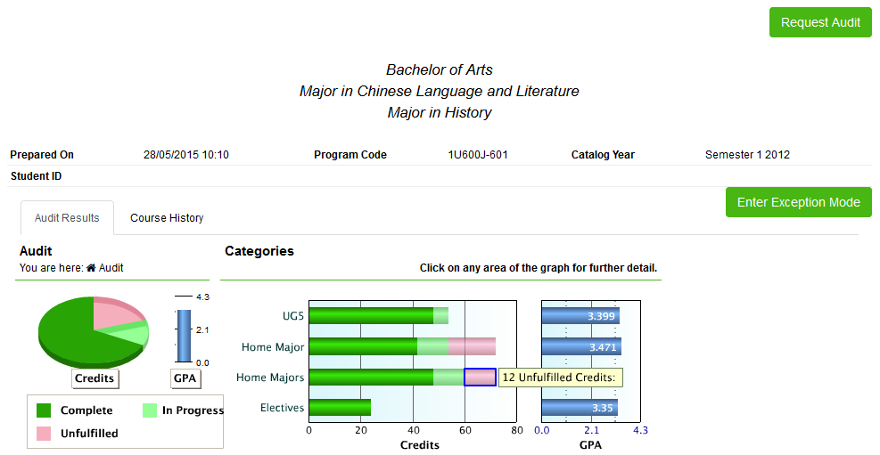
Unfulfilled Hours
Student Name
Student Number

Slide 25
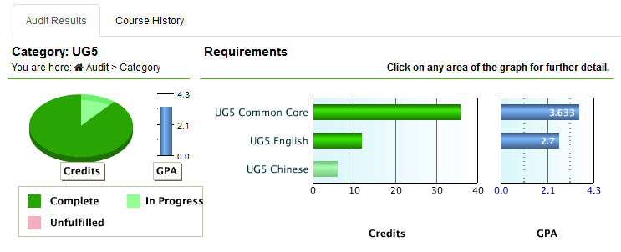
Requirement

Slide 26
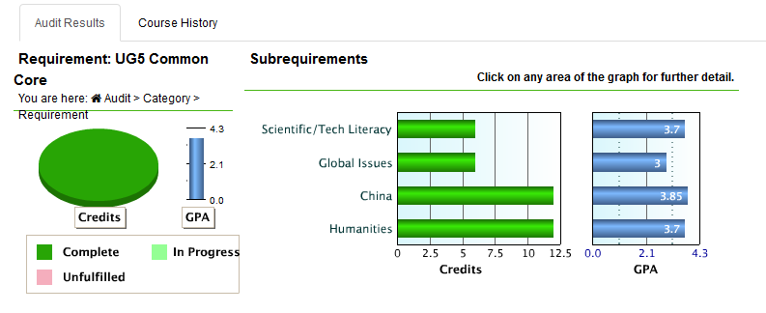
Sub-requirement

Slide 27
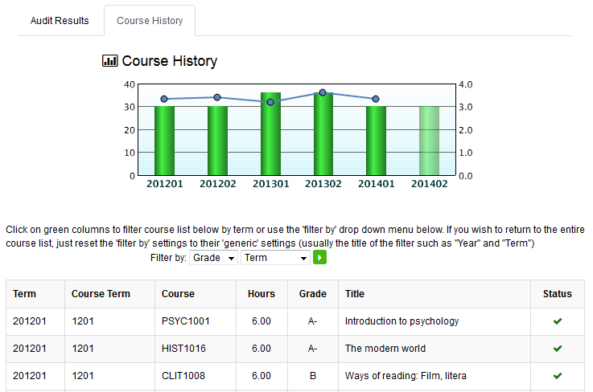
Course History

Slide 28
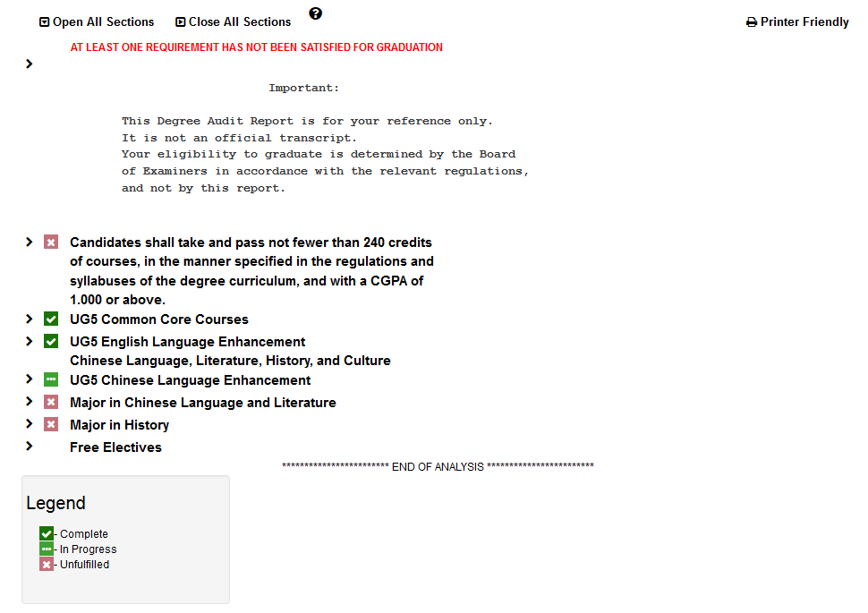
Result

Slide 29
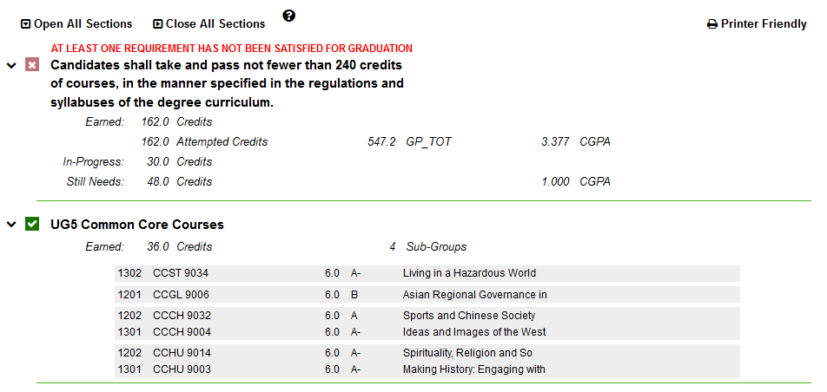
Open All Section

Slide 30
Advanced Standing

Slide 31
Course Exemption

Slide 32
Credit Transfer
Notes:
.

Slide 33
Batch Audit

Slide 34
Batch report
User defined batch conditions (e.g. academic program equals "699" and requirement term equals "1701")
Batch can be shared to other users for execution and/or editing
Registry staff, faculty administrators and department administrators can execute reports
Generated audit reports of one batch can be download as a single file

Slide 35
Batch Audit
Allows users to run the audit for a group of student
Batch audit only available in pdf format

Slide 36
Run a Batch Audit

Slide 37
To Run a Batch Audit

Slide 38
In Progress

Slide 39
Completed

Slide 40
View the Audit Report

Slide 41
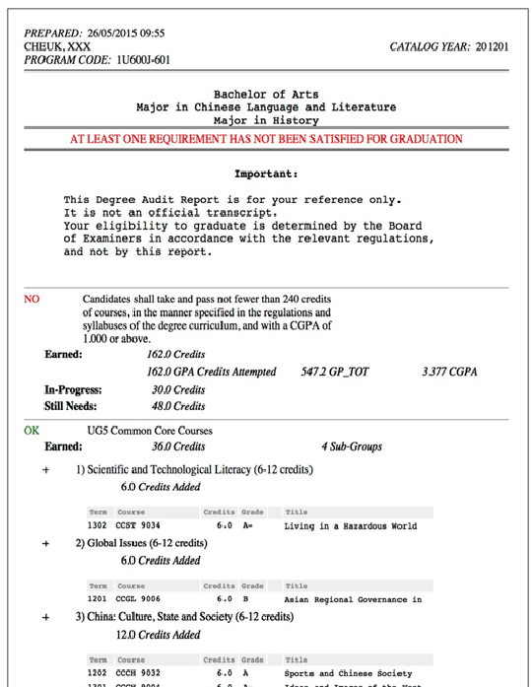
Example

Slide 42
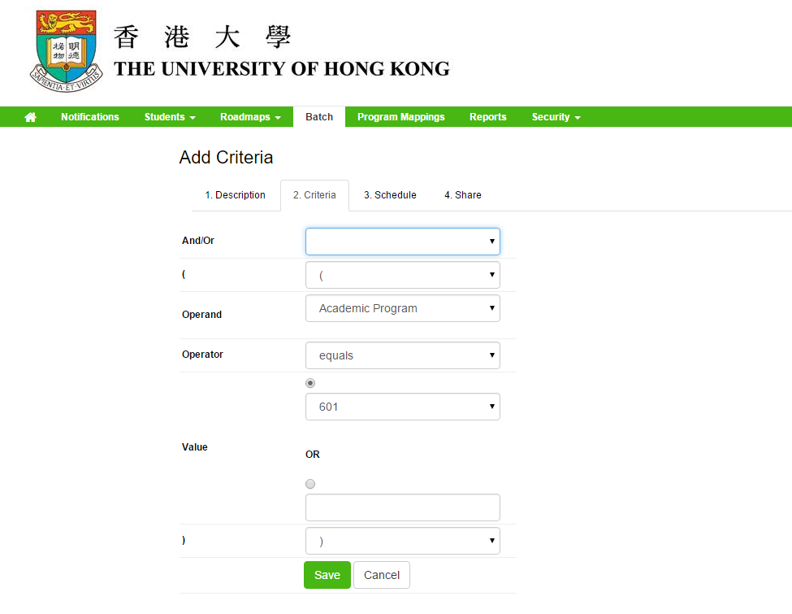
Define batch audit

Slide 43
To achieve student performance monitoring

Slide 44
Who can use this system?
Students (Undergraduate)
Advisors
Administrators (Registry, Faculty Offices, Department Offices, Academic Advising Office)

Slide 45
What do they want to achieve?
Students want to know if all requirements are satisfied, and "what-if" they choose another major or minor
Advisors want to know the progress of their advisees
Administrators want to know the progress of their students
Administrators want to generate degree audit reports after inputting Advanced Standing, Credit Transfer and Course Exemption data in SIS
Administrators want to identify students at risk (missing core courses, behind schedule, over-enroll certain courses)

Slide 46
How does the Degree Audit System address their needs?
What-if report
High-speed batch report generation
Auto-generation of exceptions using Advanced Standing, Credit Transfer and Course Exemption data in SIS
Provide summary data of degree audit reports to further analysis to be done.
Keep track of all attempts by students to generate degree audit report

Slide 47
What-if report
Simulate the degree audit report if the students choose other academic programs or plans.
Simulate the degree audit report if the students take certain courses in the future (not yet implemented in HKU).

Slide 48
What-if report

Slide 49
What-if report

Slide 50
High-speed batch report generation
Generate over 3400 reports in 20 minutes.
Small impact to SIS database (used less than 10% of CPU during batch report generation of 3400 students).
Requires more resources on web server when many queues are configured.
We configure 8 queues on a VM server with 8 CPU and 10GB memory.

Slide 51
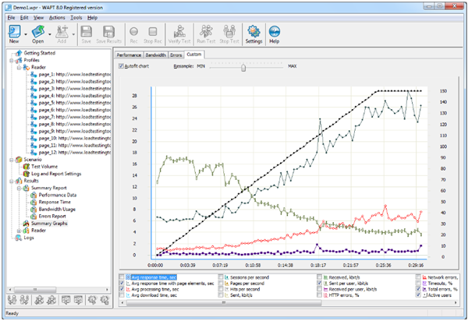
Stress Test
Development Server: 4 cores with 4GB memory
Tools: WAPT Pro 3.1
Running base time: 20mins
Every 10s increase:
For 100 and 150: 5 users
For 200 and above: 10 users

Slide 52
Stress test result
 | Concurrent Users | Transaction (per min) | Transaction (per hour) | App Server CPU Utilization (max) | DB CPU Utilization (max)
Generate Audit | 100 | 10 | 600 | 25% | ~20%
 | 150 | 15 | 900 | 30% | ~20%
 | 200 | 20 | 1200 | 40% | ~20%
 | 300 | 30 | 1800 | 70% | ~20%
 | 400 | 39 | 2340 | 75% | ~24%
Read Audit Only | 400 | 108 | 6480 | 80% | ~10%
Delete Audit Only | 300 | 40 | 2400 | 60% | <10%

Slide 53
Auto-generation of exceptions
u.achieve have different types of exceptions (force requirement to complete, force course to requirement, change credit, change groups etc)
We have integrated SIS Credit Transfer and Exemption System to u.achieve so that additional enrollment and exceptions are refreshed automatically.
Examples are: exemption to Chinese Language Enhancement, Common Core courses, course mapping to certain requirement of majors/minor

Slide 54
Advanced Standing

Slide 55
Course Exemption

Slide 56
Credit Transfer

Slide 57
Credit Transfer

Slide 58
Degree Audit Summary
Automatically generated after generating batch reports
Summary report by students against all requirements of curriculum, majors or minors
Summary report by batch showing the percentage of students who have not satisfied certain requirements
Example: how many students (in certain batch) have not satisfied Common Core requirements and who are they

Slide 59
Degree Audit Summary

Slide 60
DA Summary – By Student

Slide 61
DA Summary – By REquirement

Slide 62
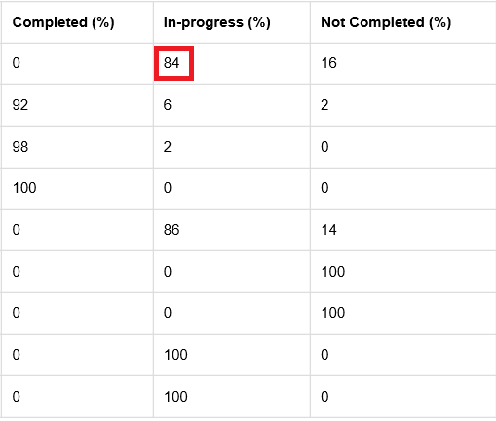
DA Summary – By REquirement

Slide 63
Student engagement
All attempts of degree audit report generation by students are recorded
No of reports per student | Headcounts (Jan-Apr 2018) | Percentage (%) out of eligible students
0 | 2370 | 40.7
1 | 665 | 11.4
2 | 775 | 13.3
3 | 434 | 7.4
4 | 418 | 7.2
>4 | 1167 | 20.0

Slide 64
Identify abnormal situation
Students are normally required to take 6 Common Core courses only
Complicated by Advanced Standing, Credit Transfer or Course Exemption
In the past we cannot easily identify students who have taken extra Common Core courses
Using the degree audit summary tables, we can now identify these cases by simple query
Steps:
Generate audit reports for target students
Find students who have completed Common Core requirements but have extra courses under free electives.

Slide 65
Identify abnormal situation

Slide 66
Future plans
To students’ preference of majors/minors (via What-if reports)
To explore the possibility to use course planner to collect students’ planned courses (to know which courses are more popular)
To predict which students are at risk (e.g. missing of core courses in their third year of study, enrolled a wrong capstone course.)

Slide 67
Summary
The Degree Audit System allows students, advisors and administrators to better understand students' academic progress
It also provides analytic data for a group of students
It is a tool for tracking student performance and for identify abnormal cases
It could be a tool for planning and projection.

Slide 68
THANK YOU!

