Slide 1
OASIS Student Portal
Session 2011
14 November 2016

Slide 2
presenter
Yvonne Yong
Senior IS Analyst
Singapore Management University
yvonneyong@smu.edu.sg
Application Support for Student Information Systems
Over 11 years of experience with PeopleSoft
9 years of experience with Campus Solutions

Slide 3
Singapore Management University

Slide 4
Singapore Management University (SMU)
A premier university in Asia, the Singapore Management University (SMU) is internationally recognised for its world-class research and distinguished teaching.
Established in 2000, SMU’s mission is to generate leading-edge research with global impact and produce broad-based, creative and entrepreneurial leaders for the knowledge-based economy.
Home to around 9,000 undergraduate, postgraduate, executive and professional, full- and part-time students.
SMU has six schools: School of Accountancy, Lee Kong Chian School of Business, School of Economics, School of Information Systems, School of Law, and School of Social Sciences.

Slide 5
SMU & ORACLE

Slide 6
SMU & Oracle
PeopleSoft Campus Solutions | Version
Current Version | 8.9
Campus Solutions Modules | Academic Advisement, Student Financials, Admissions & Recruiting, Student Records, Campus Community, Campus Self Service
PeopleTools | Version
Current Version | 8.49
Oracle Database | Version
Current Version | 11g RAC
SUN Solaris | Version
Current Version | 10

Slide 7
Overview
1
3
BACKGROUND
History
Objective & Scope
INTEGRATION
User Roles
Single Sign-on
Web Parts
2
4
USER EXPERIENCE
Information Architecture
UX Study
GO LIVE
Beta Launch
Feedback
Usage

Slide 8
BACKGROUND
A brief history on the Student Portal and project objective

Slide 9
History
OASIS – Online Access to Student Information System
Launched in 2005, was dated and lacked modern aesthetics and features.
Facilitates the discovery and access of information resources by students to support their academic experience at SMU.
With the dramatic increase in the academic programmes, and the student population having advanced expectations of a modern portal, this results in an unsatisfactory experience for both student end users as well as administrators.

Slide 10
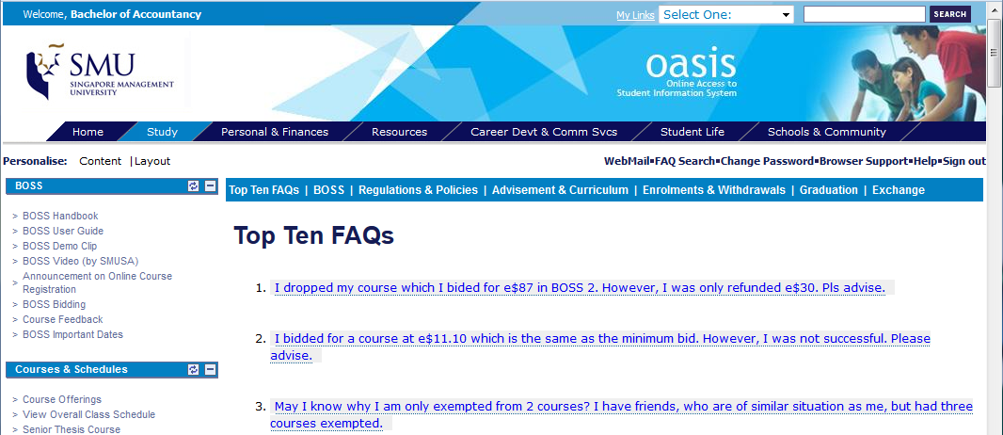
Old OASIS Student Portal

Slide 11
Perception on Old Portal
- Cluttered
- Information Overload
- Too many links
- Static Content

Slide 12
Objective & Scope
To give the student portal (OASIS) a new look and feel
To incorporate modern portal features
To improve the ease of finding information
To present the up-to-date and context-sensitive information to students
To provide a more seamless content management process for administrators

Slide 13
User Experience
Actively involve content administrators and students in the design of the new student portal

Slide 14
Designing Information Architecture
Reviewed survey results conducted by SMU Student Association on IT services
Deconstructed and documented all content from old portal
“Card Sorting” exercise on main content areas to design new Information Architecture
Converted all HTML and PDF content into portal pages that can be maintained by content owners

Slide 15
New Features
Interactive menu
Top Apps
Supporting Functions & Related Links
Search
FAQ Hub
Widgets with personalized academic details
Calendar

Slide 16
Interactive Menu

Slide 17
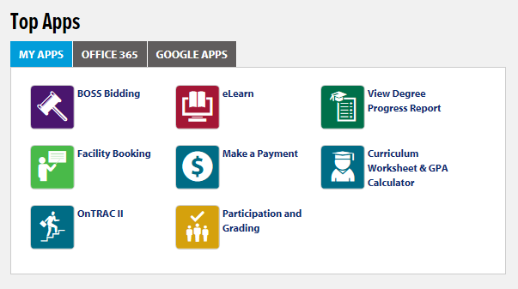

Slide 18
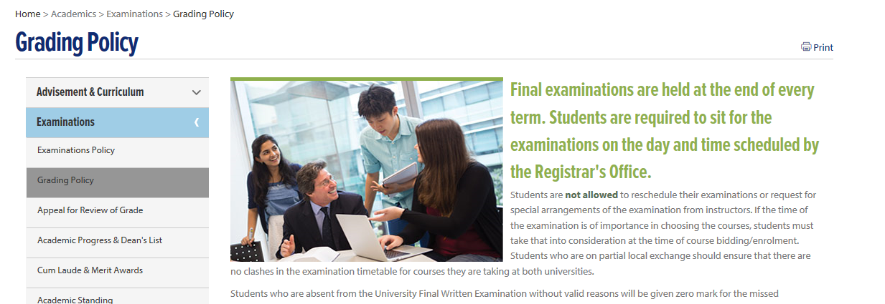

Slide 19
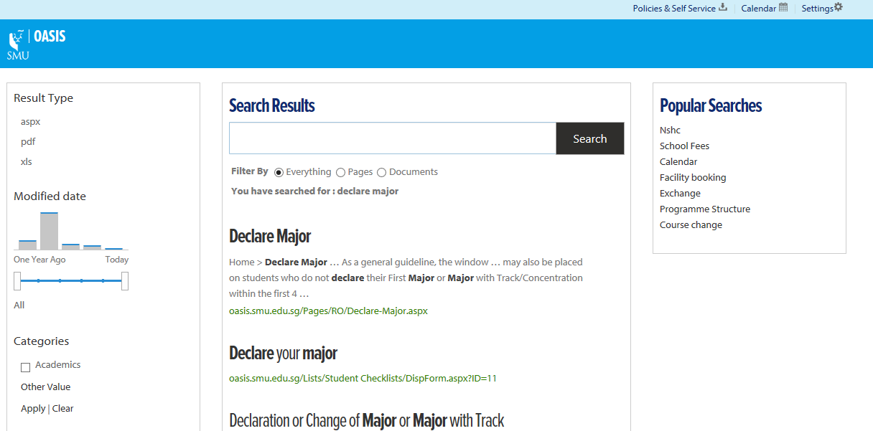
Search

Slide 20
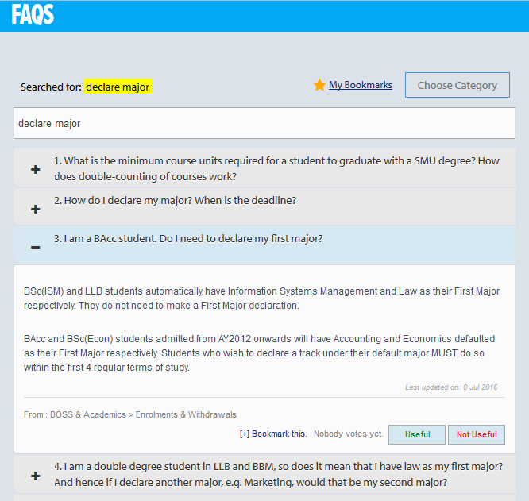

Slide 21
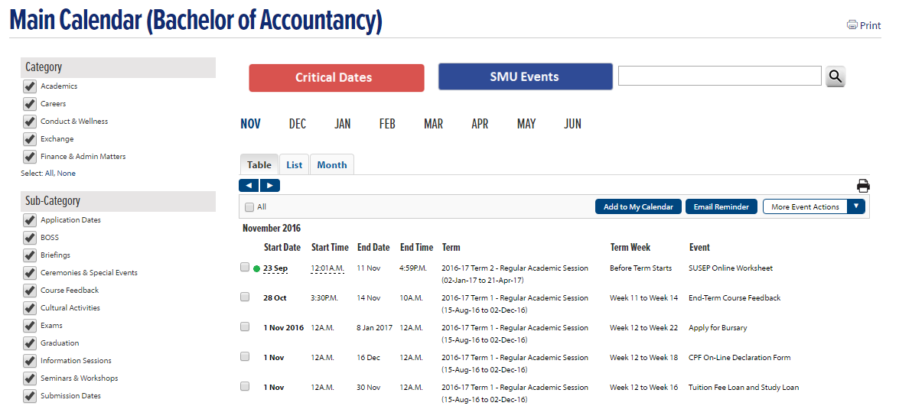
Calendar

Slide 22
Prototyping
Created portal prototype with desired features
Devised initial framework for organizing information
Engaged key content owners eg. Finance, Career Services, Student Life, Global Exchange, with suggested framework and communicated new features
Content owners to review the content to see if it is still relevant and up to date, and provide material to fill in the new portal framework
Conducted workshops with students to rate the importance of the new features

Slide 23
UX Study
12 students were given 16 tasks to complete in the portal prototype

Slide 24
Usability Test Video

Slide 25
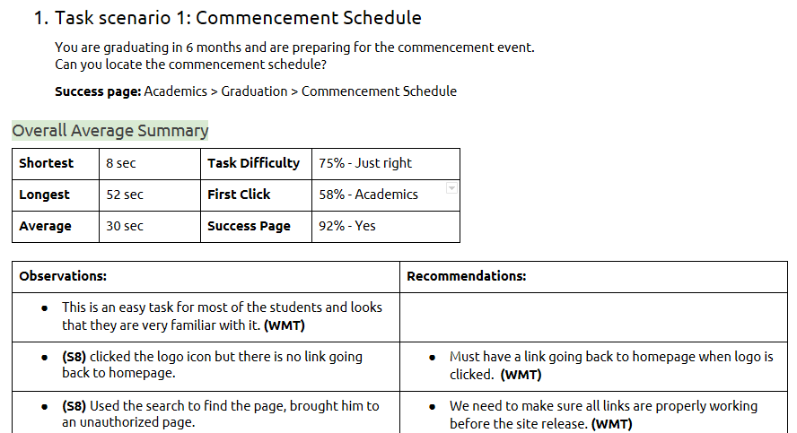
Results Analysis

Slide 26
Integration to PeopleSoft Campus Solutions
File transfer
Authentication token
Web services

Slide 27
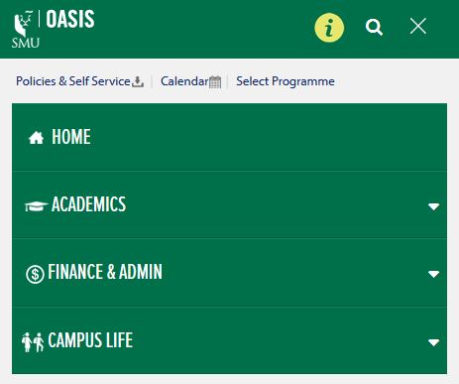
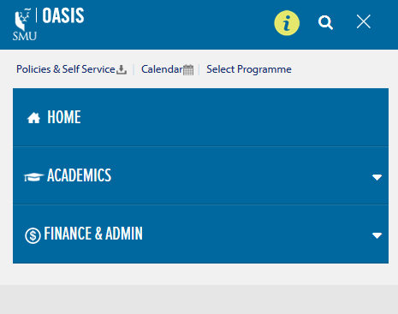
User Roles
Students’ academic attributes determine the student’s portal layout such as:
- Colour scheme
- Menu headers
Students also only see their relevant:
- Academic/School announcements
- Checklists
- Access to e-services

Slide 28
User Roles
Requirement:
The portal profile should be determined by student information residing in the Integrated Student Information System (ISIS), such as:
Academic programme
Academic Level
Programme status
Solution:
The student data is generated in ISIS to a data file by a regularly scheduled process.
The file is transferred and data loaded to the portal’s database which is translated to the portal’s user permissions.

Slide 29
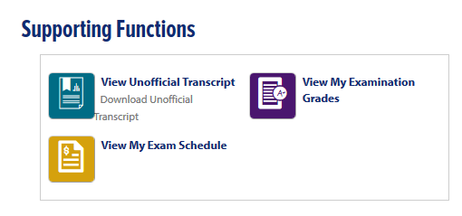
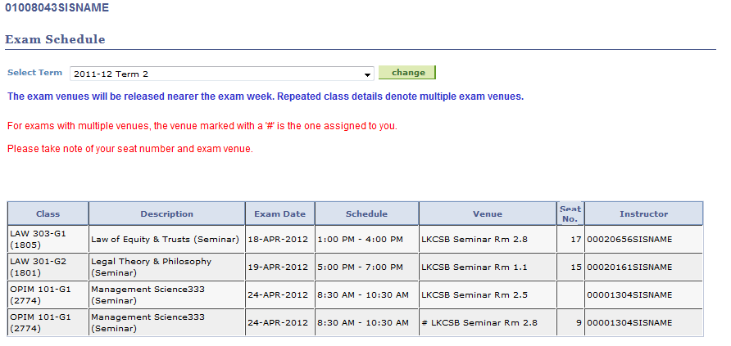
Single Sign-on

Slide 30
Single Sign-on
Requirement:
Users access OASIS portal Single Sign-On through Active Directory Federated Service (ADFS).
Students cannot access e-services pages directly from ISIS.
They must go through the OASIS portal.
Solution:
InFlight Shared Secret SSO
Single Sign-On from SharePoint into PeopleSoft using Shared Secret cryptography

Slide 31
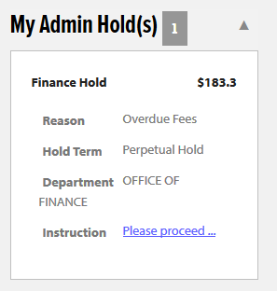
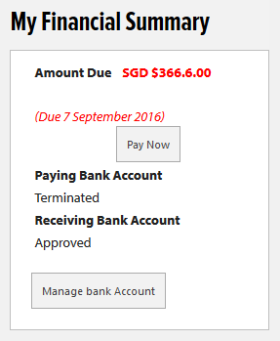
Web Parts
Personalised and Summarized
Information at glance

Slide 32
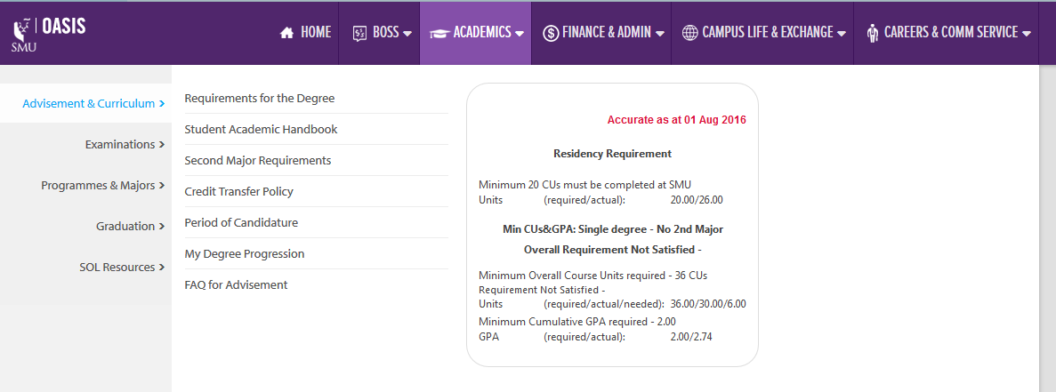
Web Parts

Slide 33
Web Parts
Requirement:
Important student summary data from ISIS to be displayed through widgets, to reduce the number of clicks required to get information
Solution:
Data from the Integrated Student Information System database retrieved through .Net web services, and consumed by the SharePoint app

Slide 34
Go-Live
Beta Launch
Feedback
Usage Analytics

Slide 35
BETA LAUNCH
A Beta Launch was planned to give users a period to experience the new OASIS while the old portal was still up and running.
This was to gather feedback from students where key improvements could be incorporated before the actual Go-Live.

Slide 36
Vivace 2016
Secured a booth at SMU’s annual CCA fair
Give students a sneak preview of the new OASIS where they could:
- Win a T-Shirt and OASIS stickers!
- Take photos with our interesting props!

Slide 37
Easter Egg Hunt
“Easter eggs” were placed within the OASIS site for a period of time.
Contest was marketed on Facebook and submissions were accepted on Facebook page.

Slide 38
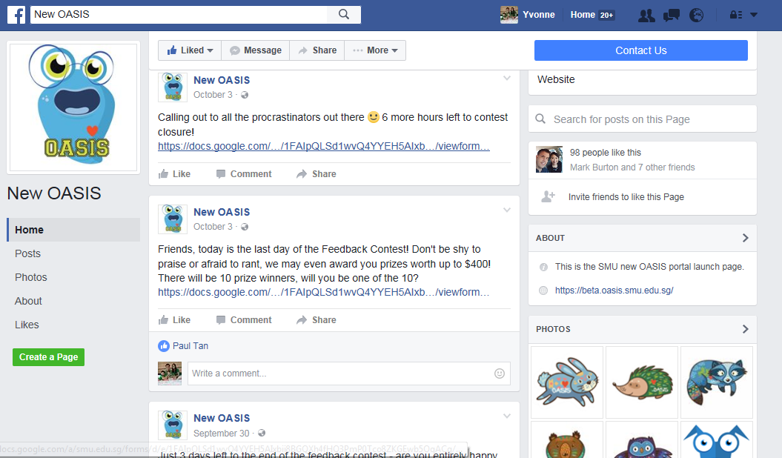
Social Media

Slide 39
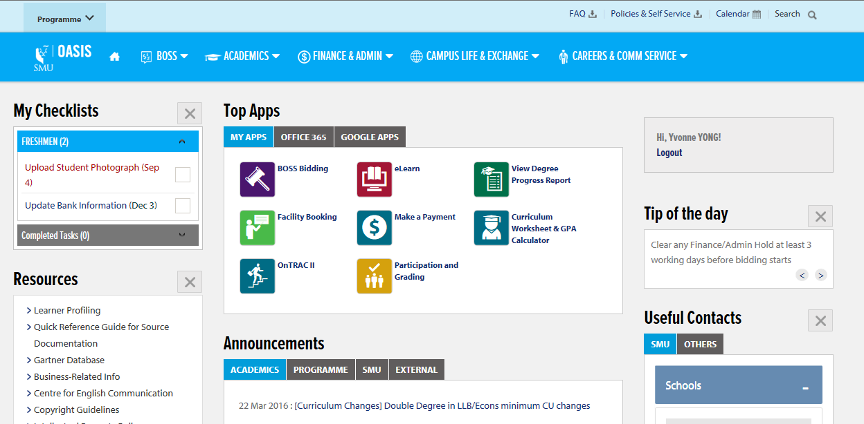
Demo

Slide 40
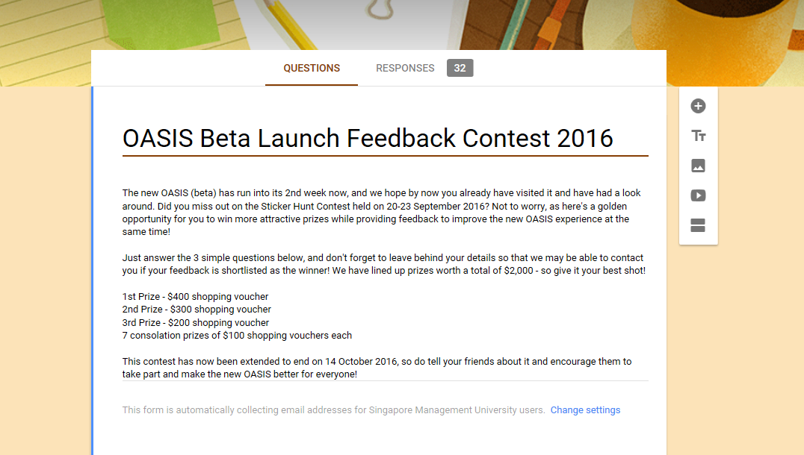

Slide 41
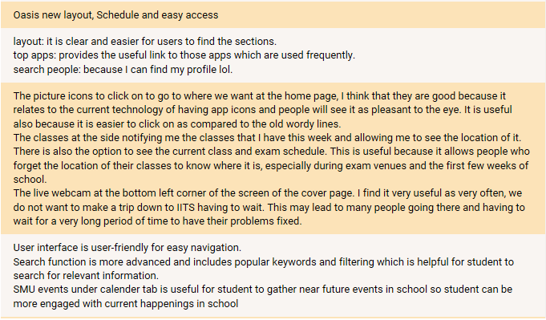
Compliments

Slide 42
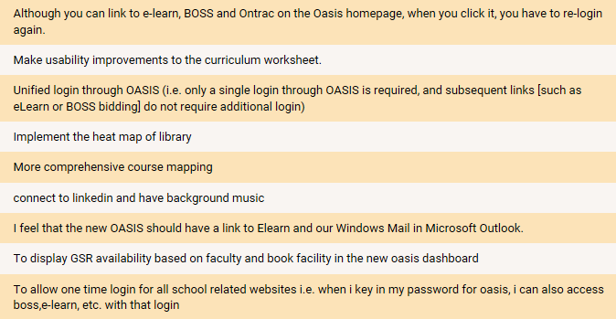
Areas for improvement

Slide 43
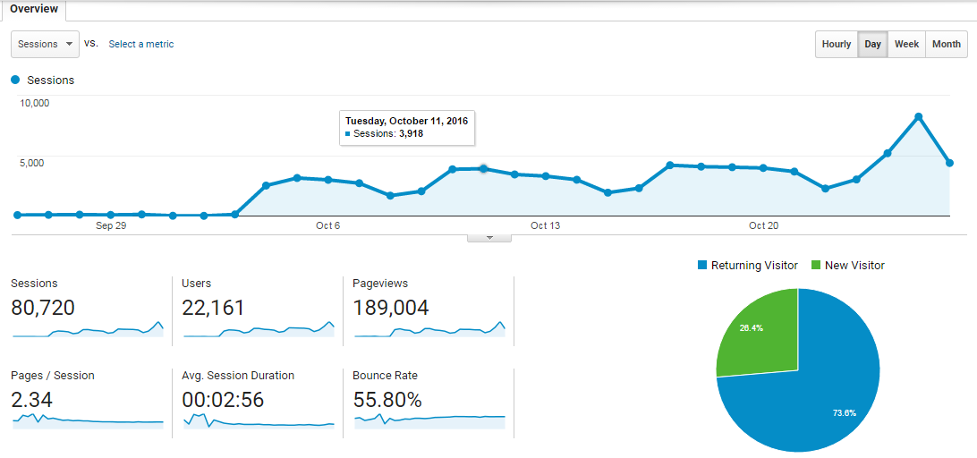
Usage Analysis
With Google Analytics

Slide 44
What We Learnt
Importance of student engagement
Observed different mindsets and behaviours

Slide 45
Q&A

Slide 46
presenter
Yvonne Yong
Senior IS Analyst
Singapore Management University
yvonneyong@smu.edu.sg
all Alliance presentations will be available for download from the Conference Site

Slide 47
THANK YOU!

