Slide 1
Student self service photo upload
SESSION 36016
Fri, Nov 11, 2016
Notes:
Thanks for coming along

Slide 2
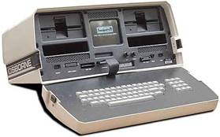
presenter
Murray Gould
Business Analyst
University of the Sunshine Coast
mgould@usc.edu.au
14 years in HE and 20 years in VET sector
@ USC since 2013
PeopleSoft user since 2002
Notes:
About me:
HE starting at RMIT in Melbourne
VET - Starting at Finley TAFE delivering IT training (with Apple II, first laptop – Osborne 1) in 1982

Slide 3
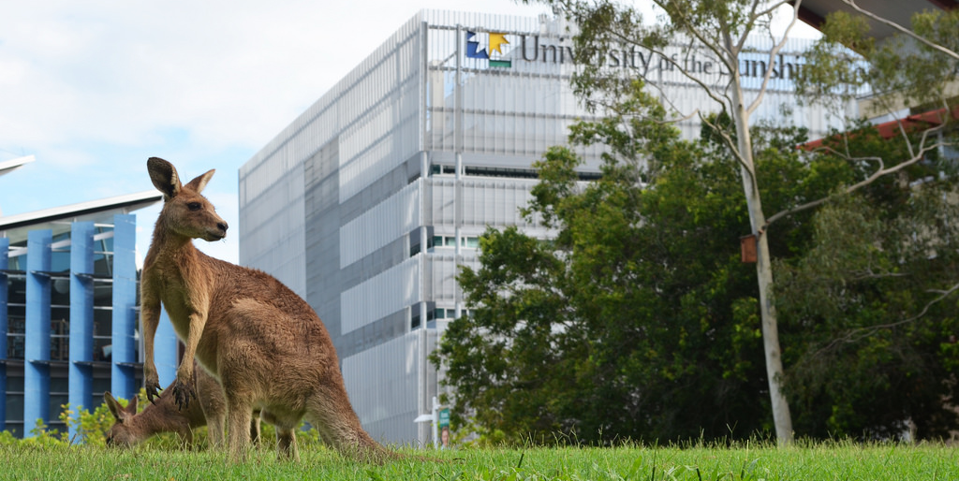
Students: 11,602
Staff: 906
Multiple campuses: Sippy Downs, Gympie, Fraser Coast, Southbank…
Notes:
USC has …..
Students are EFT figures
Most students at Sippy Downs, new (2016) Fraser Coast campus has over 500 students

Slide 4
USC & ORACLE
Campus Solutions 9.0
PeopleTools 8.54.07
Bundle 34
Notes:
USC is on ….
We went live with the current tool and bundle set in April this year

Slide 5
Organisational Context
Bring it together
Notes:
Where does this work fit into where USC is at – the drivers for the work

Slide 6
The University
Rapid growth
Major new campus at Petrie
Optimise access, engagement, retention & student success rates
Student mindset from “scared” to one where they are being “cared” for
Review of student administration leading to a new student services & engagement division (SSE)
Notes:
USC is experiencing …..
How is USC changing?
1. USC – a growing university
1., 2. USC aims for 20,000 students with dual main campuses at Sippy Downs and Petrie (North Brisbane)
Lots going on, other staff are presenting, is a theme

Slide 7
Student Services and Engagement (SSE)
Seamless provision of student services
Drive change that enhances the student experience
First year is the most critical year
What the new SSE includes
Original student administration (including SIS team)
Student services – personal wellbeing, careers and employment
Academic Support (Program Advice)
Notes:
Framework of the request for this functionality is the new …..
SA – student outcomes and service focus, new senior staff and structure
SIS team - student information systems, where I work

Slide 8
ID Photo and id card process
The deliverables

Slide 9
OverviEW
A REQUEST FOR IMPROVED AND ONLINE ID photo Functionality
IMPLEMENTATION APPROACH Vanilla flavoured where possible
Notes:
There was a …….
Student can send in a photo well before attending the uni for the first time and pick their card up later quickly and easily

Slide 10
ID card process - before
Email in a photo or have the photo taken on campus
Gallagher software produces individual ID cards
Photo uploaded to Campus Solutions (CS) overnight
Photo not visible to the student (USC mod)
Notes:
Photos are loaded into the Gallagher system so an ID card can be produced

Slide 11
New ID card process
Upload photo, email or photo on campus
Email to be discontinued
Uploaded photos approved by SSE staff
Approved photos transferred in bulk to Gallagher software
Gallagher software produces ID card
Manually actioned, produced in a bulk process
Photo uploaded to CS overnight (no change)

Slide 12
Implementation approach
Delivered if possible

Slide 13
Delivered and existing functionality
Photo displayed to student
USC Central
Checklists/message centre/To-Do items
add photo
Gallagher/CS
Upload photos to/from Gallagher
Produce ID cards and manage photos

Slide 14
New functionality
Photo approval process
New tables
Photo staging table
Approved photos
Network directory for uploaded approved photos
Notes:
Also audit table

Slide 15
What was delivered
Photo process

Slide 16
Student experience – CS
1
3
Add Photo
Add Photo process
Photo Approval
Photo approval or rejection
2
4
Photo Approval
Photo awaiting approval
Photo rejected
Photo deletion results in email to student via the CRM

Slide 17
Student experience – CS
5
7
Add Photo
Student can add another photo
Interface
Photos uploaded to Gallagher and returned to Campus Solutions
6
8
Photo Approved
Photo approval process
Photo in CS
Photo visible to student
Notes:
Using existing interface – no change to other system

Slide 18
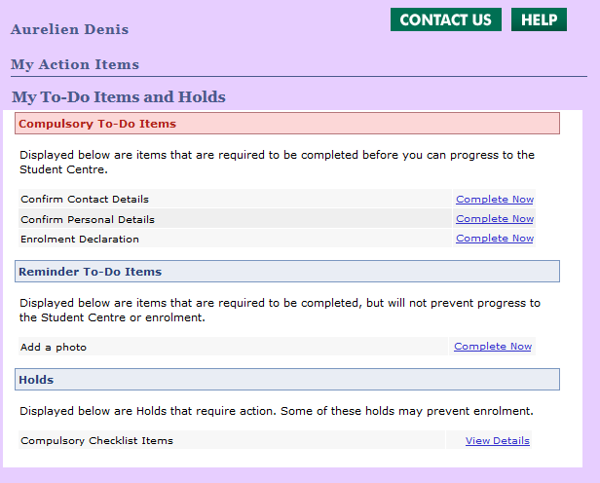
Reminder To-Do item
Notes:
What was actually built and delivered

Slide 19
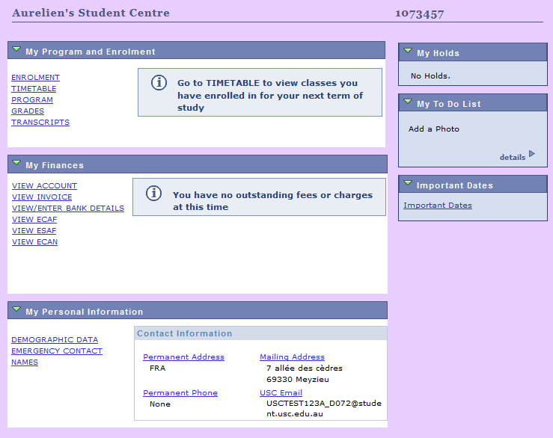
To Do List

Slide 20
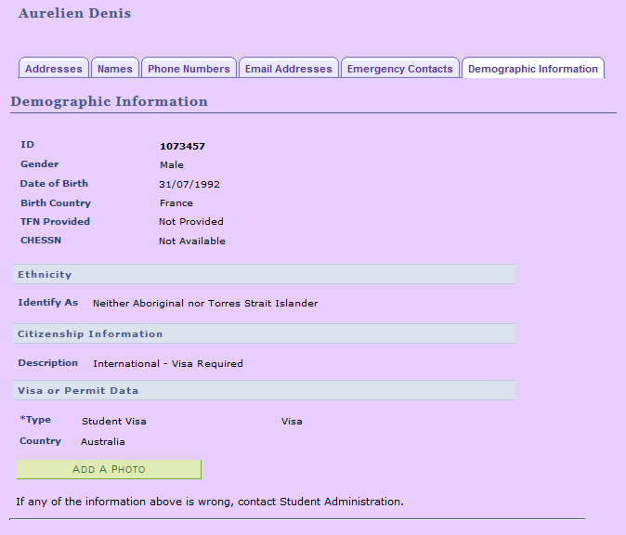
Add A Photo
Notes:
Click Add a Photo button to go to the new page

Slide 21
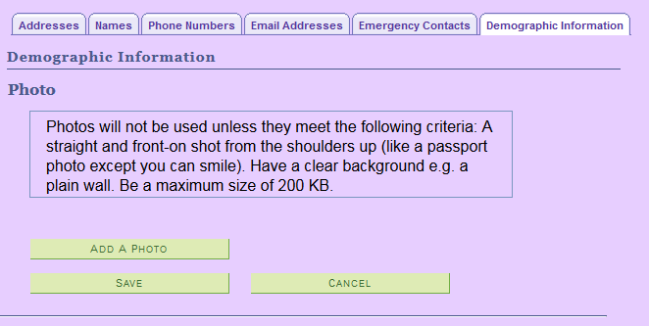
New Photo page
Notes:
New page with configurable message text, the size limit is also configurable

Slide 22
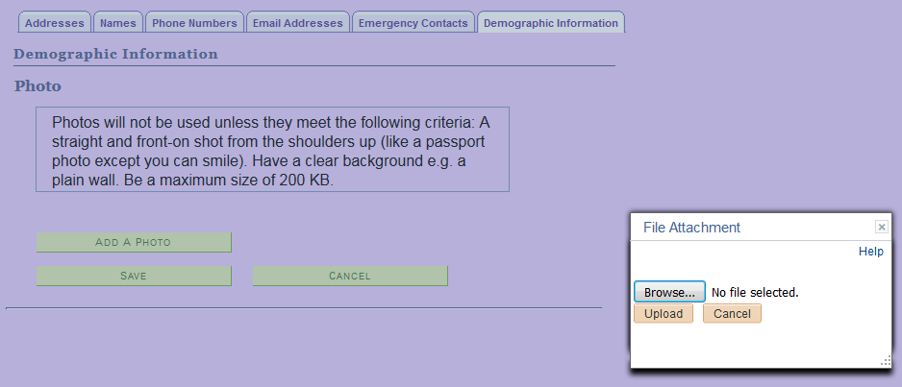
Delivered file upload
Notes:
Same dialog box as used in CS staff access

Slide 23
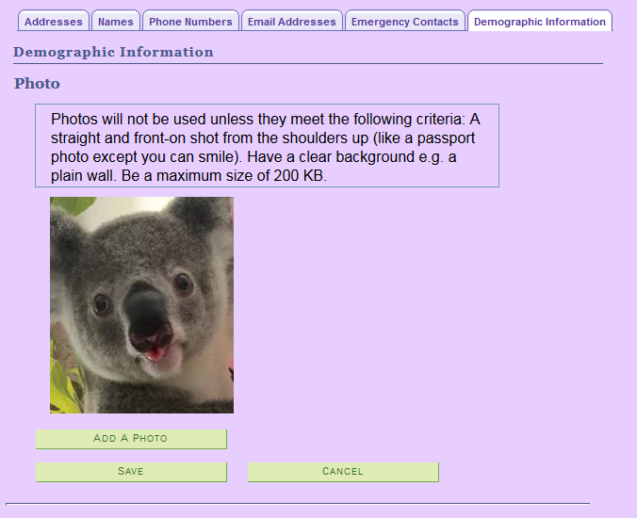
A good photo
Notes:
Student clicks Save and photo is uploaded

Slide 24
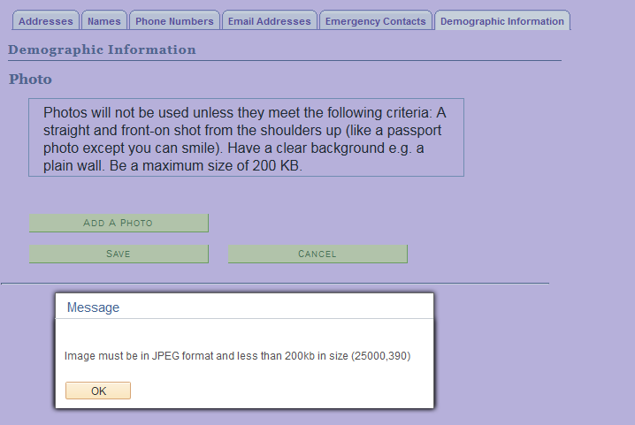
Not good
Notes:
Photo will not upload, Campus Solutions detects the file is not a JPEG or exceeds the size limit

Slide 25
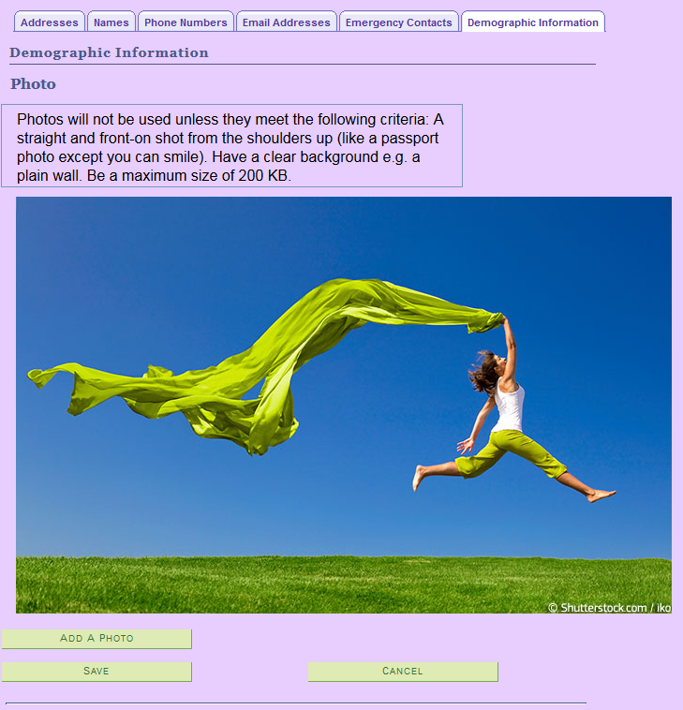
Not to be approved!
Notes:
Photo is a JPEG and is within the size limit. Photo can be saved and loaded into the staging table

Slide 26
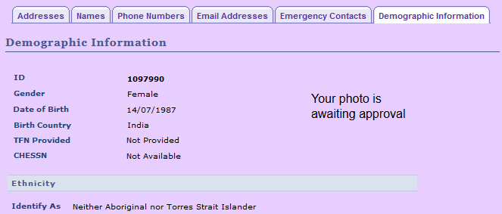
Approval process
Notes:
What the student sees when the photo has been saved by the student. Notification, no Add button

Slide 27
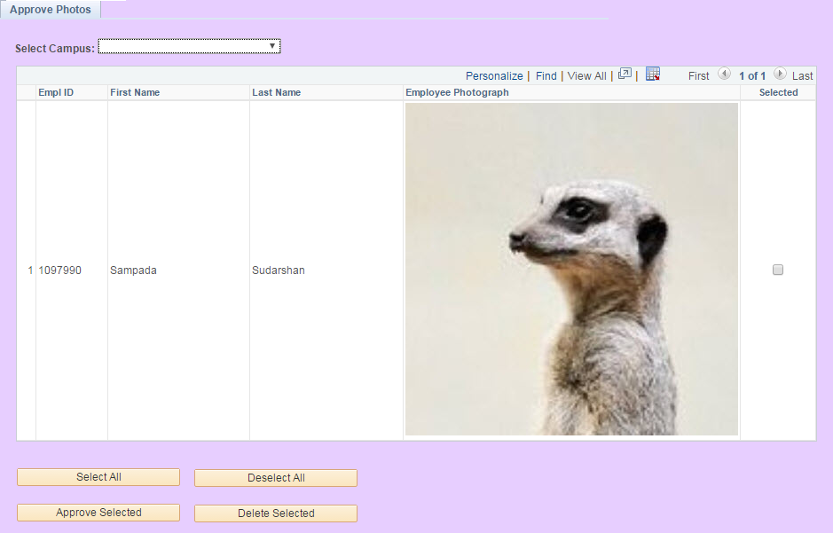
Approval process
Notes:
Campus filter – some campuses will look after their own photos or are done in a batch
Approval page lists 20 at a time

Slide 28
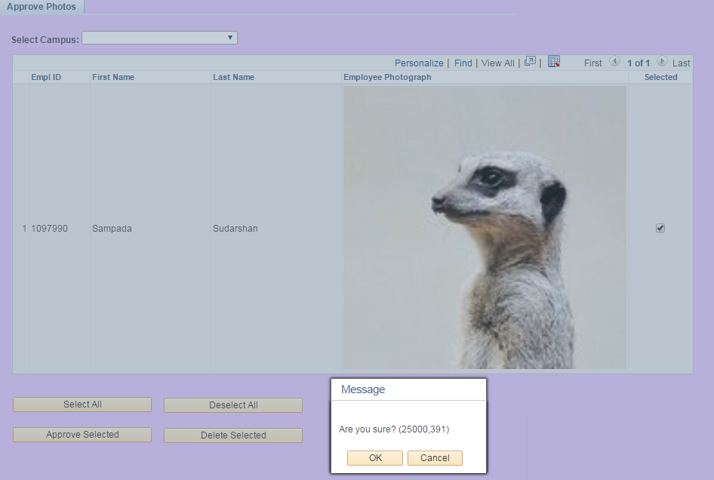
Approval process
Notes:
Files are named Idnnnn.jpg and a csv file listing the ID's and filenames is created

Slide 29
Ready to go

Slide 30
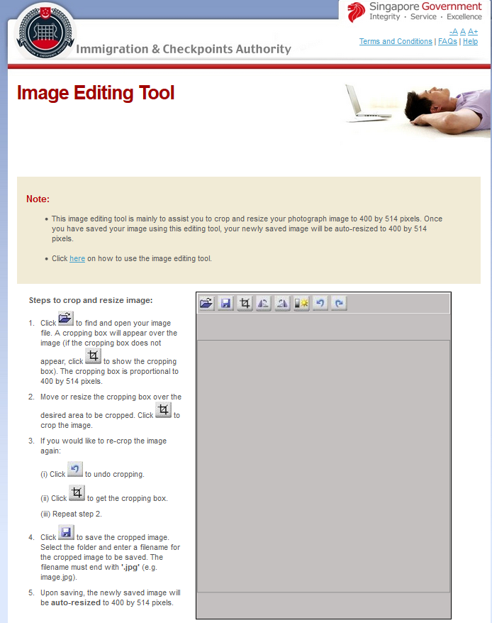
Out of scope
Photo editing web sites
https://iconline.ica.gov.sg/iconline/xhtml/photoediting/tool/imaging.jsp
Notes:
Plenty of these
Singapore gov’t website

Slide 31
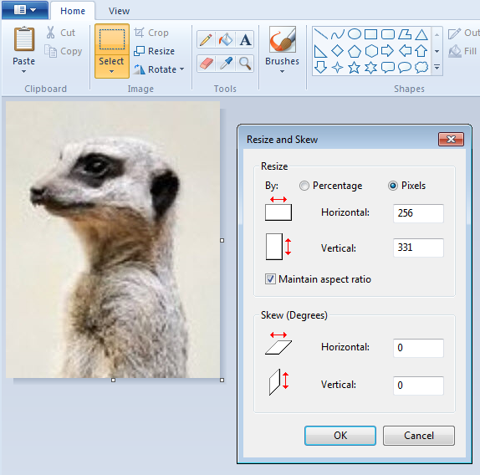
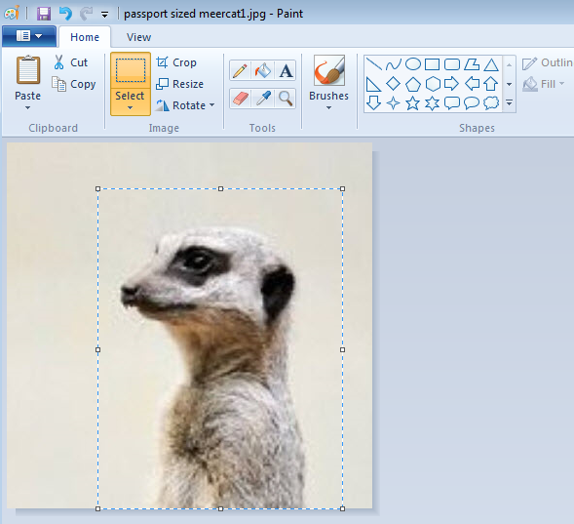
Out of scope
Cropping and resizing files
Notes:
Can crop and resize in paint – Gallagher pixel size is best, Gallagher just reduces/increases the file size it its 170 * 240 requirement when it loads photos

Slide 32
Concluding thoughts
ANY QUESTIONS?

Slide 33
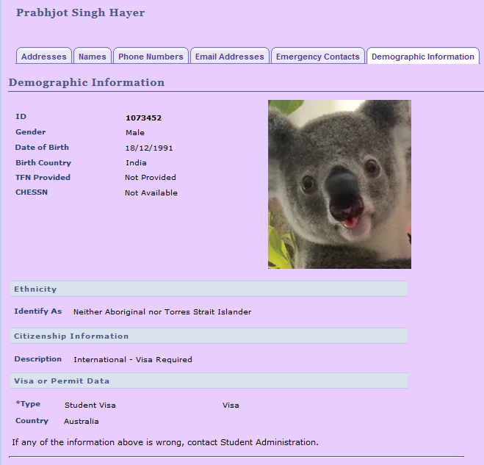
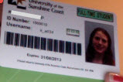
SUMMARY
Notes:
USC Central for photo loading and display
Gallagher for ID production (managed by USC Central)
Students always have the add photo button – if no photo or approved photo
Reminder when made an offer or when have a future dated enrolment (again without a photo)

Slide 34
presenter
Murray Gould
Business Analyst
University of the Sunshine Coast
mgould@usc.edu.au
all Alliance presentations will be available for download from the Conference Site

Slide 35
THANK YOU!

