Slide 1
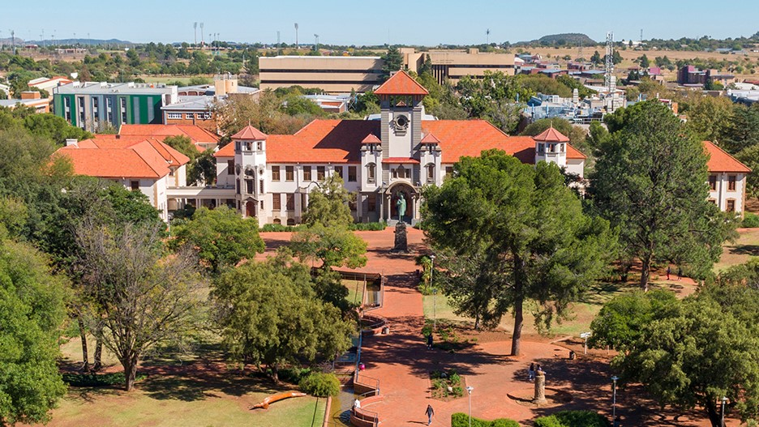
Univ of Pretoria's Centralised Contract Repository (PeopleCode/WebCenter)
SESSION # 10023
TUE 10 JUL 2018

Slide 2
presenter
Barry Hudson
Programme Director: Enterprise Systems
University of Pretoria, South Africa
barry.hudson@up.ac.za
Barry is also:
- Representative for EMEA region on the HEUG Board &
- Chair of EMEA HEUG
bhudson@heug.org

Slide 3
UniVERSITY of PRETORIA, South AFRICA
65,000+ students
10 Faculties
5 Campuses

Slide 4
UNIV. OF PRETORIA & ORACLE
PeopleSoft: CS, CRM, HCM, FSCM (Ver 9.2 Tools 8.56)
Oracle: SOA suite, Access & Identity Management suite; WebCenter Portal; WebCenter Content; OBIA/OBIEE

Slide 5
SESSION OvervieW
This session describes the University of Pretoria’s systems used to manage the institution’s portfolio of contracts
It first provides background on policy changes within UP pertaining to the management of contractual documentation
It then addresses:
UP’s initial approach … of solely using Oracle WebCenter Content Management suite to store both:
Agreement metadata and
Agreement / Contract related images
The problems and issues encountered with this initial approach
The current (revised) approach of using:
PeopleSoft to manage the metadata about Agreements, whilst integrating to
Oracle WebCenter Content Management - which is used to manage the images and scanned content

Slide 6
BACKGROUND
Apart from contracts that UP enters into with staff from an HR/Employment perspective, and contracts entered into with students (for Study Contracts, Bursaries, etc.) the institution enters into a host of other types of contracts, e.g.
Advertising & Marketing
Construction
Cooperation
Rentals and Leases
Acquisition of, and sale of, immoveable property and assets
Sponsorships and Donations
Indemnity
Secondments
Insurance
IT and other licensing
Research contracts and Grants
Confidentiality and Intellectual Property
Provision of services to UP (landscaping, security)
Service Level Agreements
Surety
Etc. etc.

Slide 7
BACKGROUND
Earlier external audits conducted at UP had raised concerns that UP lacked comprehensive contracting, and contract document management, …. processes, procedures and systems. For example:
Contractual relationships were being entered into by UP entities without the required compliance with institutional policies and signing authorities
Physical copies of contracts were distributed across the organisation with no central database identifying where the physical signed contracts were being filed/stored
There was no central system recording “which UP parties” had entered into “which type of contracts” with “which external parties”
Contractual obligations arising from these contracts were poorly monitored to ensure compliance by UP (or by the third party)

Slide 8
Management of Contracts and Contract Documents
Institutional response:
In late 2017 a revised Contract Management Policy was approved by UP Executive:
Included in this policy were requirements that:
All contracts* entered into with third parties by UP staff were to be accompanied by a “Contract Approval Routing Document” that could prove that all the necessary parties (as determined by the policy) had been consulted prior to signing, and that the signatories had acted in accordance with the institution’s approval framework
Once the contract has been signed, all signed documentss – together with their respective “Approval Routing Documents” - are to be scanned; and that
These scanned images are to be uploaded into a single, searchable electronic database.
UP’s IT Department were then tasked with designing and deploying a contract repository into which these contract images could be loaded
[* Certain categories of contracts were explicitly excluded from this process – primarily employments contracts with UP staff and academic contracts with student]

Slide 9
Management of Contracts and Contract Documents
Notes:
The primary intention of the requested IT system (at the time) was to:
Create a single repository into which these scanned contract images could be uploaded and indexed
Facilitate the search-and-retrieval of these contract images (by authorised parties) by leveraging the metadata/ indexing data assigned to these images when these images were uploaded
This system was not intended (at the time) to be a Contract “management” system in the sense of:
Explicitly recording UP’s contractual obligations to third parties; or
Recording a third party’s contractual obligations to UP; or
Recording planned contractual milestones and outputs – and their due dates; or
Recording dates on which contracted obligations were actually delivered, or
Alerting staff to upcoming / overdue deadlines and milestones, or
Using the Contracting system to predict anticipated contract-related outflow and inflows of funds

Slide 10
Management of Contracts and Contract Documents
Since UP had previously acquired and deployed the Oracle WebCenter Content Management suite (which currently contains some 7 million documents), UP’s IT Department then configured this suite to provide the required electronic repository for these scanned Contract-related documents
However, when configured, this tool went further than the initial brief – in that the initial brief focused solely on storing and retrieval of “already signed” contracts
Instead, the deployment of WebCenter enabled authorised users to:
First create an electronic “Contract Folio” for every new potential contractual relationship (where a “Folio” is analogous to a cardboard hanging folder within a conventional physical filing cabinet”
To subsequently upload multiple electronic documents pertaining to this contractual relationship into this Folio – so that the entire collection of related documents were “collected together” within the relevant Folio e.g. the Folio may contain:
Draft Contracts
Agreement/Contract-related communications (e.g. emails)
Minutes of contract related meetings
(Scanned) Signed contracts and the (Scanned) Contract signing Routing sheet
Reports arising as outputs from the contract, etc.

Slide 11
Management of Contracts and Contract Documents
The schematic on the next slides endeavours to depict this initial design – where UP solely employed the Oracle WebCenter Content Management suite.
(Later slides will indicate how UP later revised this approach to address shortcomings that were subsequently identified)

Slide 12
Management of Contracts and Contract Documents
ORACLE WEBCENTER
STEP 1: FOLIO
Step 1(a).
In Oracle WebCenter, create a electronic “Folio” for each new “Relationship” between UP and a third party(s) w.r.t. some or other intent
UP’s Relationship with Entity X re ABC
Step 1(b)
Assign metadata to this Folio that “describes” key attributes of this relationship
Email
STEP 2: DOCUMENTS
Step 2(a).
When documents arise from this relationship, scan and check these into the ‘parent’ Folio
Meeting Minutes
Draft Contract ver 1
Draft Contract Ver 2
Step 1(b)
When checking in documents assign metadata to these documents to classify and assign attributes
Signed Contract
Amend-ment to signed Contract
Repeat Steps 2(a) and 2(b) for each new document

Slide 13
Management of Contracts and Contract Documents
Relationship metadata included:
Name of 3rd party
Classification of 3rd Party (Private / Public)
3rd Party’s Country
Persons at 3rd party
Relationship classification (e.g. Sponsorship)
Details of Relationship
UP Faculty / Dept that “owns” relationship
UP Persons involved
UP Persons with view rights to Folio
ORACLE WEBCENTER
STEP 1: FOLIO
Step 1(a).
In Oracle WebCenter create a electronic “Folio” for each new “Relationship” between UP and a third party(s) w.r.t. some or other intent
UP’s Relationship with Entity X re ABC
Step 1(b)
Assign metadata to this Folio that “describes” key attributes of this relationship
Email
STEP 2: DOCUMENTS
Step 2(a).
When documents arise from this relationship, check these into the ‘parent’ Folio
Meeting Minutes
Draft Contract ver 1
Draft Contract Ver 2
Step 1(b)
When checking in documents assign metadata to these documents to classify and assign attributes
Signed Contract
Amend-ment to signed Contract
Repeat Steps 2(a) and 2(b) for each new document

Slide 14
Management of Contracts and Contract Documents
ORACLE WEBCENTER
STEP 1: FOLIO
Step 1(a).
In Oracle WebCenter create a electronic “Folio” for each new “Relationship” between UP and a third party(s) w.r.t. some or other intent
UP’s Relationship with Entity X re ABC
Step 1(b)
Assign metadata to this Folio that “describes” key attributes of this relationship
Document metadata included:
Type of document
If Doc Type = Signed Contract, then record
Contract Start and End Dt
Contract Signed date
UP signatory
3rd Party signatory
Contract Value
Contract Lifecycle (e.g. addendum)
Email
STEP 2: DOCUMENTS
Step 2(a).
When documents arise from this relationship, check these into the ‘parent’ Folio
Meeting Minutes
Draft Contract ver 1
Draft Contract Ver 2
Step 1(b)
When checking in documents assign metadata to these documents to classify and assign attributes
Signed Contract
Amend-ment to signed Contract
Repeat Steps 2(a) and 2(b) for each new document

Slide 15
Management of Contracts and Contract Documents
The WebCenter tool thus enabled authorised users to: ….. (Cont’d)
Complete a template of metadata that enriches the “Contract Folio”
Name of 3rd party; Classification of 3rd Party (Private / Public); 3rd Party’s Country; Persons at 3rd party; Relationship classification (e.g. Sponsorship); Details of Relationship; UP Faculty / Dept that “owns” relationship; UP Persons involved; UP Persons with view rights to Folio
Complete a different template of metadata that references any electronic Documents uploaded into these Folios
Contract Start and End Dt; Contract Signed date; UP signatory; 3rd Party signatory; Contract Value; Contract Lifecycle (e.g. addendum), etc
Search within the metadata of both Folios and uploaded Documents in order to retrieve documents to which the user has authorised access that were residing within these Folios.

Slide 16
Management of Contracts and Contract Documents
After configuring WebCenter Content as described above
A subset of the envisaged future users of this system were subsequently identified by Faculties and Support Departments
These users then received training in the use of this WebCenter tool - and the process of scanning and uploading of their contracts into this suite commenced.
Hundreds of contracts were subsequently uploaded by UP’s pilot users
However,
Users complained about the non-intuitiveness of the user interface
The metadata as captured did not fully support new reporting requirements that were only identified after the system had been deployed
Some very complex entity security rules - regarding who would have access to this metadata and the related contract images emerged later - and these security requirements could not be easily satisfied solely using the WebCenter Content tool’s capabilities

Slide 17
Management of Contracts and Contract Documents
It was subsequently decided to develop a more user-friendly PeopleSoft-based “front-end” to the Oracle WebCenter /CMS suite that is more capable of supporting:
Ever evolving (and increasingly complex) UP contract document security requirements that govern who can access which Folios and which Contract documents, and
A host of additionally requested functionality e.g.
Forecasting of revenue inflows/ expenditure outflows arising from these contracts;
Linking of contracts to anticipated academic outputs (e.g. PhDs to be funded);
Linking of contracts to envisaged academic activities (e.g. student exchanges with other educational institutions);
Listing of planned contracted deliverables and their due dates (including early alerts for these deliverables),
Reminder functions (e.g. to generate invoices to debtors), etc.
An underlying database that is capable of delivering critical reports that assist in Contract Management, and understanding the institution’s portfolio of customers and legal obligations

Slide 18
Management of Contracts and Contract Documents
In this RE-DESIGNED approach, it was decided that :
Metadata about both Agreement Relationships and Documents ….
The core metadata – needed in searching, reporting, etc. – would in future reside in PeopleSoft tables …
And hence the number of metadata fields previously linked to images in Oracle WebCenter could be significantly reduced
Images …..
Any associated images and documents that are uploaded via PeopleSoft are immediately transferred to Oracle WebCenter via RIDC web services (and the image/file is then deleted from the PeopleSoft staging tables), and
Documents already in Oracle WebCenter are retrieved using PeopleSoft as the user’s interface (Users no longer have access directly via WebCenter to these documents)
Security ….
PeopleSoft custom security would be developed – as this is far more capable (than was WebCenter) of managing the complex rules re a user’s right to interrogate contractual information, e.g.
Some users are enabled to see all the metadata about the contract AND retrieve related documents
Some users are enabled to see all the metadata about the contract but are NOT permitted to retrieve related documents
Other users – whose security in insufficient – will not be able to see any information pertaining to specific relationships (Discussed in detail later in this presentation)

Slide 19
Management of Contracts and Contract Documents
STEP 1: RELATIONSHIP
Step 1(a).
For each new relationship between UP and a third party(s) w.r.t. some or other intent, create a new “Relationship” within PeopleSoft & then enrich this “Relationship” with metadata that “describes” key attributes of this relationship
PEOPLESOFT
ORACLE WEBCENTER
Email
Relationship Information
FOLIO: UP’s Relationship with Entity X re ABC
Step 1(b)
When the Psoft Relationship entity is fully populated, trigger RIDC interface that auto-creates the Folio in WebCenter (and passes back WebCenter’s ID for the new Folio)
STEP 2: DOCUMENTS
Step 2(a).
When documents arise from this relationship, add metadata about the document in PeopleSoft (linking the document to earlier “Relationship”)
Document Information
Email
Step 2(b).
Then upload scanned document into P/Soft… which then uses RIDC to insert Doc into WC Folio; returns WebCentre’s ID for this Doc, then auto-deletes uploaded document from PeopleSoft
SOUTH AFRICAN HEUG 10/11 JULY 2017

Slide 20
Management of Contracts and Contract Documents
STEP 1: RELATIONSHIP
Step 1(a).
For each new relationship between UP and a third party(s) w.r.t. some or other intent, create a new “Relationship” within PeopleSoft & then enrich this “Relationship” with metadata that “describes” key attributes of this relationship
PEOPLESOFT
ORACLE WEBCENTER
Email
Meeting Minutes
Relationship Information
FOLIO: UP’s Relationship with Entity X re ABC
Step 1(b)
When the Psoft Relationship entity is fully populated, trigger RIDC interface that auto-creates the Folio in WebCenter (and passes back WebCenter’s ID for the new Folio)
STEP 2: DOCUMENTS
Step 2(a).
When documents arise from this relationship, add metadata about the document in PeopleSoft (linking the document to earlier “Relationship”)
Document Information
Document Information
Meeting Minutes
Step 2(b).
Then upload scanned document into P/Soft… which then uses RIDC to insert Doc into WC Folio; returns WebCentre’s ID for this Doc, then auto-deletes uploaded document from PeopleSoft
Repeat Steps 2(a) and 2(b) for each new document

Slide 21
Management of Contracts and Contract Documents
STEP 1: RELATIONSHIP
Step 1(a).
In PeopleSoft, for each new relationship between UP and a third party(s) w.r.t. some or other intent, create a new “Relationship” & enrich this “Relationship” with metadata that “describes” key attributes of this relationship
PEOPLESOFT
ORACLE WEBCENTER
Relationship Information
Signed Contract
Amend-ment to signed Contract
Meeting Minutes
Draft Contract ver 1
Draft Contract Ver 2
Email
Step 1(b)
When Relationship entity fully populated, trigger RIDC interface that auto-creates the Folio in WebCenter (and passes back WebCenter’s ID for the new Folio)
FOLIO: UP’s Relationship with Entity X re ABC
STEP 2: DOCUMENTS
Step 2(a).
When documents arise from this relationship, add metadata about the document in PeopleSoft linking to earlier “Relationship”
Document Information
Document Information
Document Information
So the images now reside in WebCenter Content (which is optimised to manage large volumes of documents), but the data ABOUT the relationship and documents now reside in P/Soft tables … where it is more easily accessed to facilitate reporting, analysis, etc.
Document Information
Step 2(b).
Then upload scanned document into P/Soft… which then uses RIDC to insert Doc into WC Folio; returns WebCentre’s ID for this Doc, then auto-deletes uploaded document from PeopleSoft
Document Information
Document Information
Repeat Steps 2(a) and 2(b) for each new document

Slide 22
Management of Contracts and Contract Documents
But before doing a walk-through of the process to add a new Agreement Relationship, we need to first talk about Agreement Relationship Types and Sub-types … as each Relationship needs to be classified (primarily for reporting purposes)
Within the configuration options of this system are tables that:
Define which Contract Types are permitted
Define what Contract Sub-Types are permitted
Which Sub-types can be used in conjunction with which Types
See next slides ..

Slide 23
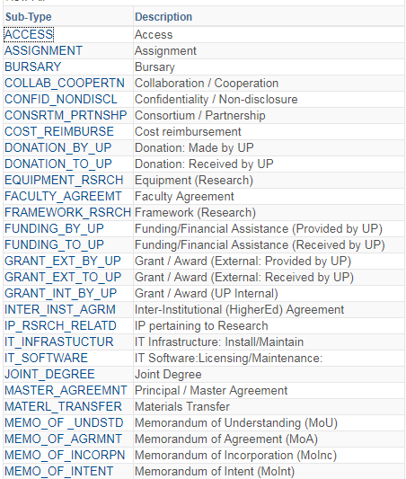
Adding a New Agreement Relationship
Typical list of “SUB- TYPES” of Agreements

Slide 24
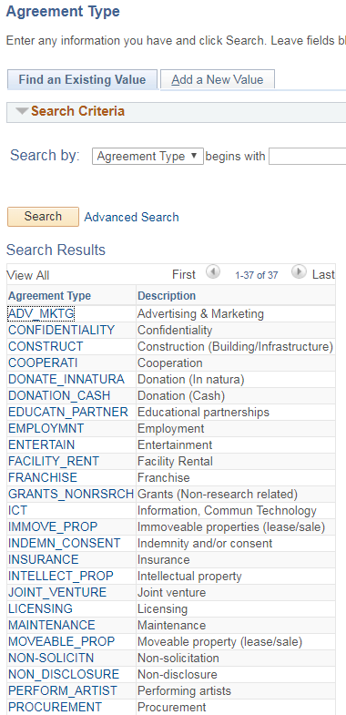
Adding a New Agreement Relationship
Typical list of “TYPES” of Agreements

Slide 25
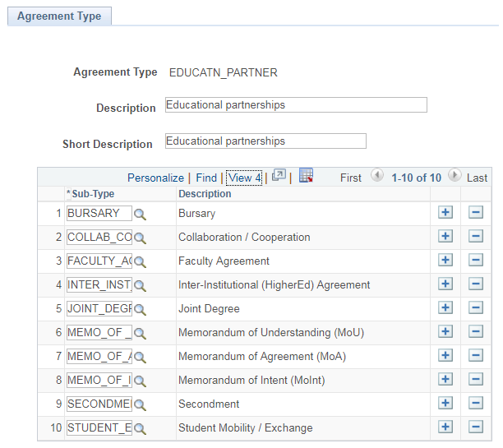
Adding a New Agreement Relationship
For each Agreement TYPE, can specify with which “SUB- TYPES” may be used in conjunction with this TYPE

Slide 26
Management of Contracts and Contract Documents
What follows are some screenshots showing the new PeopleSoft “front end” for capturing Agreements, and how this system integrates with Oracle WebCenter Content ….
To re-cap: In the PeopleSoft Agreement Management system
Step 1: Add a new Agreement Relationship identifying
The party(s) with whom UP intends contracting
The nature (Type/ sub-type) of the relationship
Detail about the intent of this relationship
Who in UP is authorised to access the Contract
Behind the scenes :
For each Agreement Relationship added in PeopleSoft, RIDC web services create the associated Contract FOLIO within the WebCenter suite,

Slide 27
Management of Contracts and Contract Documents
Cont’d….
In the PeopleSoft Agreement Management system
Step 2: As documents relating to this Contractual Relationship are obtained/received
Upload these documents against the Contractual Relationship
Classify the uploaded Document – and provide a description of the document
If the Document Type refers to a “Signed Contract”, record details of the Contract (“Structure”, Status, Start/End dates, etc.)
Behind the scenes :
As documents are uploaded against the Contractual Relationship in PeopleSoft, these documents are transferred using RIDC web service to the relevant Folio within the WebCenter suite

Slide 28
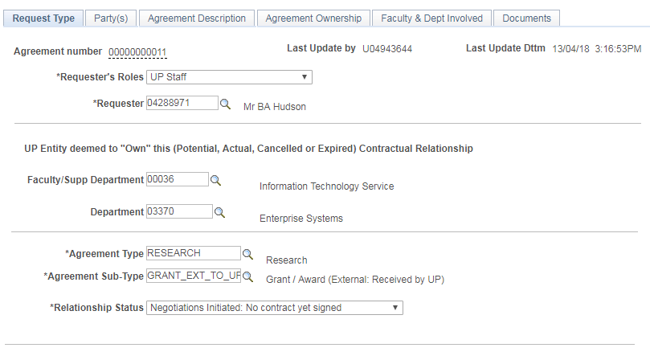
Adding a New Agreement Relationship
When the data capturer invokes the PeopleSoft menu to add a completely new “Agreement Relationship” they are taken to a multi-tabbed function …
On the “Request Type” tab they can indicate on whose behalf they are capturing this Agreement Relationship
They record which UP entity is deemed to OWN the contract
Use Agreement Type and Sub-type to classify the NATURE of the Contract, e.g.
Lease
Marketing
Intellectual Property
Services provided to UP
Services provide by UP
etc.
More on this later …

Slide 29
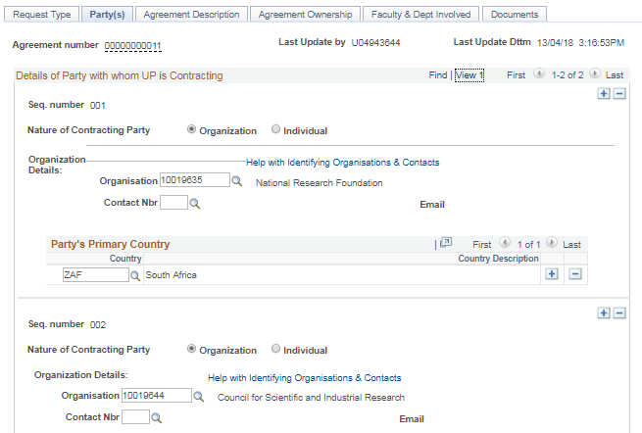
Adding a New Agreement Relationship
On the Party’s tab, look up the Organisation(s) and/or Individual(s) with whom UP is pursuing a Contract.
In this case, the Agreement is tripartheid - involves UP and 2 non-UP parties
Optionally record the Contact Nbr of Persons in that Organisation who are involved in this Contract
Record the Organisation’s Country (if not defaulted from Organisation).
Country - and implied continent – is used extensively in reporting

Slide 30
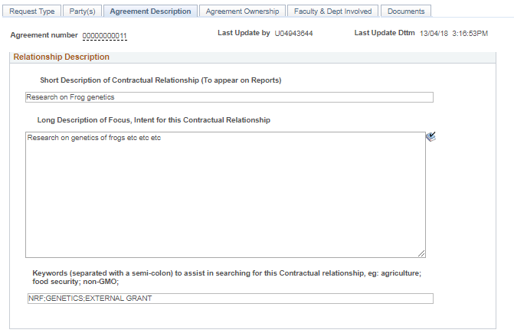
Adding a New Agreement Relationship
On the “Agreement Description” tab, provide (searchable) Short and Long Descriptions of the “intent / focus” of this Agreement Relationship
Provide Searchable keywords describing the Contractual Relationship

Slide 31
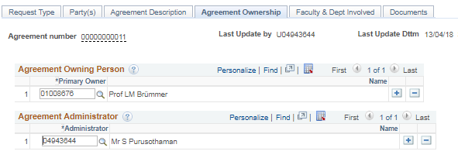
Adding a New Agreement Relationship
On the “Agreement Ownership” tab, clarify which UP person(s) are deemed to “own” this Agreement Relationship – and hence will later be permitted to view this Relationship and all related documents
Ditto – record which persons are seen as UP’s Administrators of this Relationship’s information in PeopleSoft

Slide 32
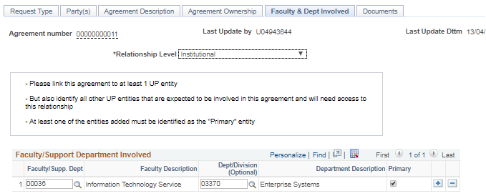
Adding a New Agreement Relationship
On the “Faculty & Dept involved” tab, provide information about which UP Entities are involved, or will need to have access to, this Agreement Relationship and its documents

Slide 33
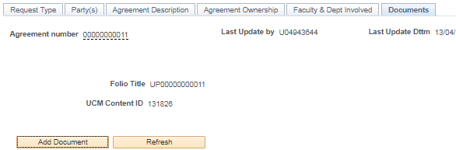
Adding a New Agreement Relationship
When the Agreement Relationship is added and saved for the first time, then an Agreement Number is assigned by the system
On the “Documents” tab, no Documents can be added to this Relationship in PeopleSoft until the WebCenter FOLIO - in which the documents will reside - has been created.
To create the FOLIO, the user would click the “Create Folio” button
Create Folio

Slide 34
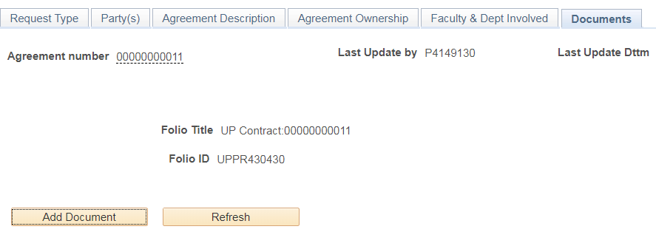
Adding a New Agreement Relationship
This process triggers an asynchronous web service using RIDC to create the Folio in WebCenter …. And the web service later returns with the WebCenter (UCM) Content ID of the Folio that has been created …. and then reflects that “Folio ID” information here
It is now possible to
Add metadata about any document that relates to this Agreement Relationship, and then
To upload the related scanned image of that document (via PeopleSoft) into this WebCenter Folio.
When the Add Document button is clicked …

Slide 35
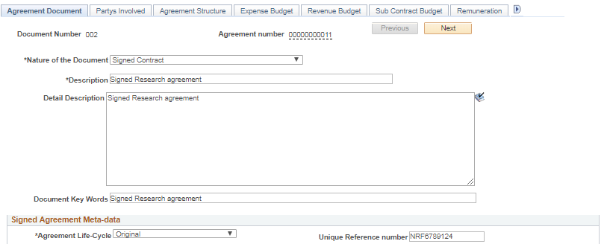
Adding a DOCUMENT to a Contractual Relationship
On the “Agreement Document” Tab, for each document added and linked to the Agreement Relationship, the user must indicate the Nature of the Document. e.g.
Draft Contract
Minutes
Communications
Signed Contract
Reports, etc
The portfolio of metadata fields that need to be completed to describe the document depend on the “Nature of the Document” option selected earlier. However, a short and long description field is required for all document types
If the document NATURE = SIGNED CONTRACT …
Then a host of metadata fields (lower down on this same tab, but displayed in the next slide) become mandatory

Slide 36
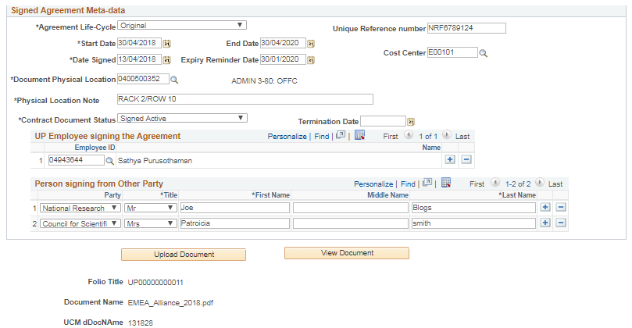
Adding a DOCUMENT to a Contractual Relationship
Classify what document this is in the Agreement Life Cycle
Original,
Renewal,
Addendum Added,
Amendment, or …
Annexure to.
Then capture:
Contract Start and End Dates
Date Contract was signed
Expiry Reminder Date
Where paper version of document can be found
Doc Status (discussed later)
Signed but not yet effective
Signed and Active
Was signed, now expired
Intentionally Terminated
Record names of the UP and 3rd party signatories to the signed contract

Slide 37
Adding a DOCUMENT to a Contractual Relationship
Let’s take a brief detour to look at what appears in this “Contract Document Status” field

Slide 38
Management of Contracts and Contract Documents
The “Contract Document Status” field on previous screen is automatically updated by the system on a nightly basis – to a Status determined by the combination of Today’s date versus the Signed Contract’s Start and End Dates
TODAY’S Date isbetween Start/End
Signed Contract Start Date
Signed Contract End Date
Therefore Contract deemed to be “Active”
TODAY’S Date is after End date
Signed Contract Start Date
Signed Contract End Date
Therefore Contract deemed to be “Signed – but closed/Completed”
TODAY’S Date is before Start Date
Signed Contract Start Date
Signed Contract End Date
Therefore Contract deemed to be “Signed – but not yet Active”
However, the system does allow a manual override – where a previous Signed Contract has been consciously ABORTED/TERMINATED before the planned End Date – in which case the Terminate date must be captured

Slide 39
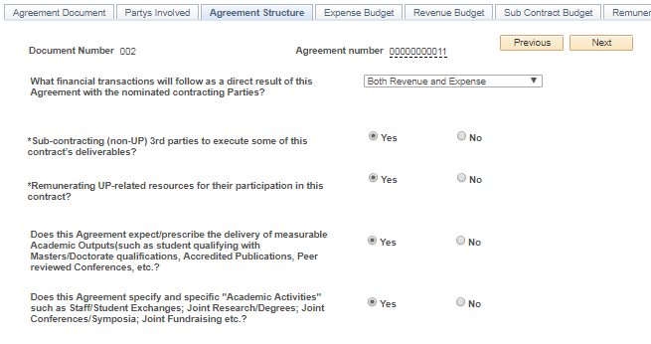
Adding a DOCUMENT to a Contractual Relationship
For documents of type “Signed Contract” this “Agreement Structure” Tab asks questions about the “intent” of the agreement/contract, e.g.
Whether it implies Revenue and/or Expenses for UP
If the contracts expects Academic Outputs
Expects Academic Activities
Etc.
Each “Yes” answer opens up a new Tab to be enriched …

Slide 40
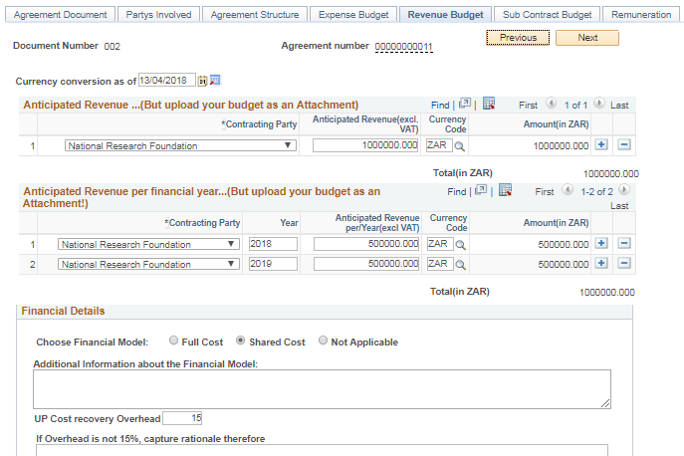
Adding a DOCUMENT to a Contractual Relationship
If it was indicated earlier that the contract will result in Revenue to UP, then the Revenue Budget Tab will appear – where the user can capture info about what monies UP will earn from the 3rd party(s) involved in the Contract
Similar information is requested if UP will incur Expenditure as a result of this contract
They must also provide a forecast of the FINANCIAL YEAR in which this revenue is expected to accrue
A similar tab appears had it been indicated that this contract document would have resulted in EXPENDITURES for UP

Slide 41
Adding a DOCUMENT to a Contractual Relationship
If the contract envisaged that Post Graduates would emerge as a consequence of this contract, then forecasted “Academic Outputs” can be captured on this “Academic Outputs” tab

Slide 42
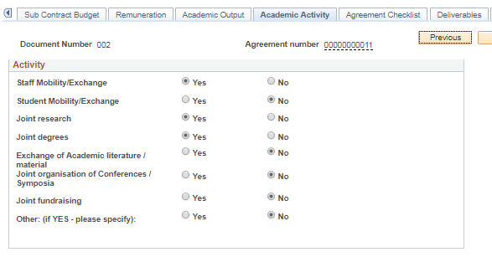
Adding a DOCUMENT to a Contractual Relationship
If the contract envisaged that specific Academic Activities would arise as a consequence of this contract, then the nature of these envisaged Activities can be recorded

Slide 43
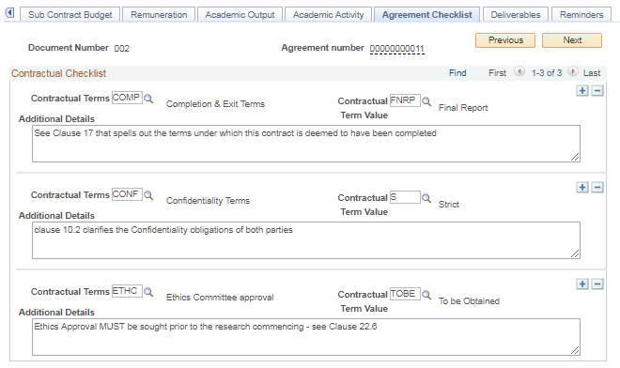
Adding a DOCUMENT to a Contractual Relationship
The “Agreement Checklist” tab requires that assurance be given that various key legal dimensions have been addressed in the contract document, e.g.
Completion/Exit Terms
Confidentiality
Ethical Clearance
Intellectual Property Ownership
Which country’s Laws are applicable
Royalties
Material Transfer obligations
Indemnity
Etc.
This tab is used to record a summary of the content of these clauses

Slide 44
Adding a DOCUMENT to a Contractual Relationship
The “Deliverables” tab enables the obligations referenced in the signed contract to translate into specific Deliverables (or Outputs). The user should translate the fine print of the contract and then record here ……
The details of any agreed/contracted Deliverables/Outputs
The dates specified in the contract when these Deliverables are due;
What reminders they want sent of upcoming/overdue Deliverables/Outputs – and to whom these reminder are to be sent;
They can later return to the function to
Record current status of these Deliverables (Not yet started: In progress; on Hold: Completed)
Record the actual date on which the deliverable/output was met
Store Cross references to report deliverables that are subsequently also uploaded as Documents linked to this Agreement

Slide 45
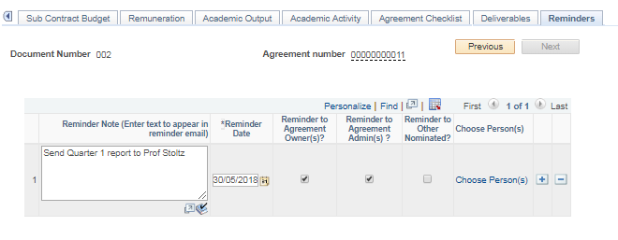
Adding a DOCUMENT to a Contractual Relationship
In addition to the previous tab which focused on Deliverables and their Due dates, this “Reminders” tab enables the user to configure a host of reminders (that are unrelated to Deliverables) that the system must later send as an email to designated persons

Slide 46
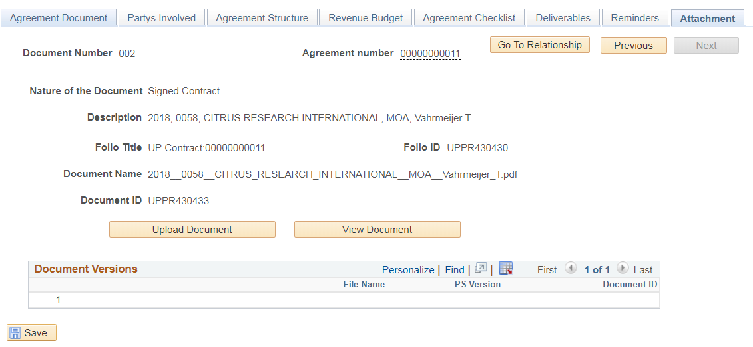
Adding a DOCUMENT to a Contractual Relationship
“Attachment” tab: Having captured the metadata about a Document that links to this Agreement, the user can click on the “Upload Document” button to select the file or image to upload.

Slide 47
Adding a DOCUMENT to a Contractual Relationship
This process invokes the RIDC web services to pass the document (that is temporarily staged in PeopleSoft) to Oracle WebCenter for storing within the previously created Folio. When the RIDC process completes the WebCenter ID of the Document is returned … and this Doc ID is stored in PeopleSoft.
Once in WebCenter, the image previously uploaded to PeopleSoft is deleted from PeopleSoft

Slide 48
Adding a DOCUMENT to a Contractual Relationship
If the user then clicks on the “Go to Relationship” button …. To return to the “Documents” tab within the Agreement Relationship ….

Slide 49
Management of Contracts and Contract Documents
…. Then the “Documents” tab will reflect all documents (Emails, Notes, Outputs, etc) that have be linked to this Relationship
From this Documents “Tab” they will either be able to:
Click on a link to instruct PeopleSoft to retrieve the image linked to a specific document from WebCenter, or merely
To display the previously captured metadata about each Document

Slide 50
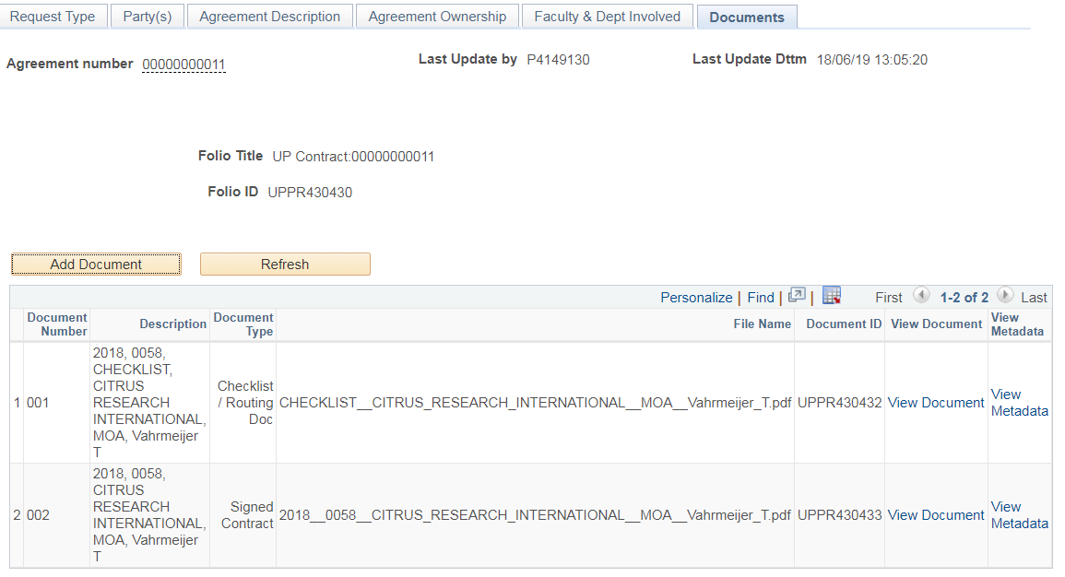
Adding a New Agreement Relationship
The “Documents” tab lists all DOCUMENTS previously linked to this Contract Relationship
For each document linked to this Relationship, the user can elect to either VIEW the previously uploaded document or go and view the Metadata about that document

Slide 51
Management of Contracts and Contract Documents
Effectively then:
In the PeopleSoft tables is all the data about:
The Relationship, the external party’s; entities owning the relationship, as well as a host of information about each of the documents linked to this Relationship (and implied revenue and expenditure streams). This data in PeopleSoft can then facilitate reporting and alerting
In WebCenter Content (which is optimised to manage large volumes of documents) are all the images of any document linked to the Relationship
The only “user” with read/write access to WebCenter is “PeopleSoft” itself – and hence only those users that PeopleSoft security grants either Read or Write access to the “Relationship” in PeopleSoft will potentially be able to view the images in WebCenter of those documents that link to this Relationship
PEOPLESOFT
ORACLE WEBCENTER
External Customer(s)
UP Owner(s)
[Persons]
UP Owner(s)
[Dept]
Agreement
Relationship Information
DOCUMENTS (METADATA):
Email
Doc_1: EMail
Meeting Minutes
Doc_2: Minutes
Draft Contract ver 1
Doc_3: Draft Contract v1
Signed Contract
Doc_4: Signed Contract
Amend-ment to signed Contract
Doc_5: Amendment to Signed Contract
FOLIO: UP’s Relationship with Entity X re ABC

Slide 52
Management of Contracts and Contract Documents: SECURITY
Security considerations
Access to Agreement information is governed by Custom Security developed in PTools
Some of the Security definitions are EXPLICIT – whilst others are IMPLICIT
Explicit Option 1: Person Explicit at the Agreement level
If a User is explicitly defined as either
The Agreement Relationship Responsible Person or
The Agreement Administrative Person, or the
The Agreement Requester
…. for a specific Agreement Relationship contract, then they will be entitled to specific rights (e.g. WRITE) on the Agreement and specific rights (e.g. WRITE) on the Documents of this specific Agreement

Slide 53
Management of Contracts and Contract Documents: SECURITY
Security considerations
Explicit Option 2: Person Explicit at the Department level
A function has been designed that explicitly links a User to a “combo rule” that specifies:
An organisational entity (i.e. a Faculty, Dept or Sub-Dept) somewhere in UP’s organogram tree
PLUS
A definition of what Contract Type and Sub-type this user can see at this “level” in organogram
PLUS
What Rights they have at this “level” in organogram (e.g. READ vs WRITE) on the Agreement vs the Images

Slide 54
Management of Contracts and Contract Documents: SECURITY
Security considerations
And when defining what RIGHTS the user has, there are 3 ROLES that control the User’s level of Access
Relationship Viewer – means the user can only look at the Relationship data in PeopleSoft – but not at the Document data or any related document images in WebCenter
Relationship & Agreement Viewer – means the user can view (READ)
The Relationship data in PeopleSoft
The Document data in PeopleSoft, and
Access any related images
… but cannot edit or update any of this data
Relationship & Agreement Edit – means the user can update (READ/WRITE)
The Relationship data in PeopleSoft
The Document data in PeopleSoft, and
Access any related images
To simplify the management of WHAT rights they inherit, a configuration page exists … viz. …

Slide 55
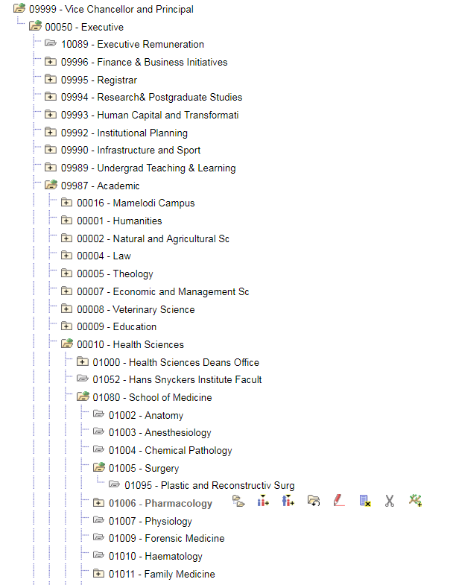
Management of Contracts and Contract Documents: SECURITY
The Security model “by Dept” leverages one of UP’s Department Trees that depict the institution’s organogram
And persons linked to “the top of the tree” would have some defined level of Read or Write access to Agreements of some or other Type/Subtype … but throughout the entire organisation
And an individual given rights at this level (09987), say, could see Agreement Relationships linked to this entity and all these Child entities
And an individual given rights at 01080 (School of Medicine) say, could see Agreement Relationships linked to Dept 01080 or to any of it’s Child Departments
So an individual given rights at Dept =01005 (Surgery) say, could see Agreement Relationships linked to Dept 01005 or its Child Dept 01095

Slide 56
Management of Contracts and Contract Documents: SECURITY
The custom security model starts by first selecting a Department within the organisation “tree”, then for each row below…
Define the persons (EMPLID) with access to this Dept
Define to which Agreement Types (could be “ALL”) and Agreement Sub-types (could be “ALL”) this user has access …..
Defines what of the 3 roles this user has for this combination of Dept+Type+Subtype
So if a specific user was only interested in Agreements dealing with “Leases” (say), they could be limited to only being able to see Agreements where “Type” = “Lease”, but if they were given access at the “top of the UP Dept tree” they’d see all Lease contracts irrespective of which Faculty or UP entity “owned” these Relationships

Slide 57
Management of Contracts and Contract Documents: SECURITY
So, for a specified Department within the organisation “tree” …
This first user has been given the rights to
VIEW (but not edit) all Agreement Relationships and all Relationship-linked documents
For All Agreement Types and Sub-types
That are either linked to this Dept or which are linked to Depts that are sub-ordinate to this Dept

Slide 58
Management of Contracts and Contract Documents: SECURITY
So, for this Department within the organisation “tree” …
This second user has been given the rights to
EDIT all Agreement Relationships and all Relationship-linked documents
Where Agreement Type = “RESEARCH” (and for all Sub-types within this Type)
That are either linked to this Dept or which are linked to Depts that are sub-ordinate to this Dept

Slide 59
Management of Contracts and Contract Documents: SECURITY
So, for this Department within the organisation “tree” …
This third user has been given the rights to
Only View the Agreement Relationship data (i.e. cannot retrieve any related Documents), but
Only of those Relationships where Agreement Type is = “EDUCATN_PARTNERSHIP and only
Where Agreement Sub-Type is either = “BURSARY” or “SECONDMENT” …and
That are either linked to this Dept or which are linked to Depts that are sub-ordinate to this Dept

Slide 60
Management of Contracts and Contract Documents: SECURITY
Security considerations
However, maintaining these explicit rights is very cumbersome – especially as managers of Departments come and go
Implicit Option 1: Department Manager
Within UP’s HCM suite are tables where, for each Dept, a Manager (EMPLID) ought to be specified. (When the manager for a Dept changes, the EMPLID for that Dept is updated in HCM to reflect the new manager)
If a User logs on and wishes to search through the Agreement Relationships, the system will also check to see if their EMPLID appears as the Manager of any Department
If so, they inherit (i.e. “implicit”) rights to interact with certain Agreements. They will be permitted to access all Relationship Agreements linked to that Dept where they are Manager, or linked to Depts that are subordinate to the Depts that they manage

Slide 61
Management of Contracts and Contract Documents: SECURITY
Security considerations
So, to summarise, when a user logs onto PeopleSoft and searches for Agreement Relationships they will only see those Relationships where either:
They were explicitly linked to a specific Agreement (by their EMPLID) as either “Requester”, “Owner/Responsible Person” or “Administrator”
OR
They are designated as a Manager of a Department (in PS HCM) and hence inherit rights to see Agreement Relationships linked to that Department (or its subordinate Depts),
OR
The have been given EXPLICIT rights to a Dept within a specified Dept Tree – and hence they are able to interact with Relationships linked to that Department (or its subordinate Depts)
To simplify the management of WHAT rights they inherit, a configuration page exists … viz. …

Slide 62
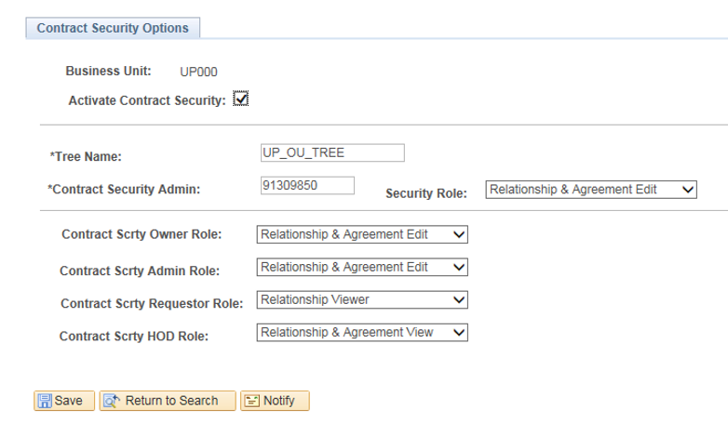
Management of Contracts and Contract Documents: SECURITY
Allows the institution to decide which of the existing Dept Trees (which arrange Depts into an organogram) must be traversed when reviewing Security
If the user is explicitly designated as either (1) The Owner of/Responsible person for; or (2) the Administrator of; or (3) the Requester …. of a Relationship, then these drop down options determine their respective level of access rights [Part of the EXPLICIT Security rules]
If the user inherits rights to an agreement IMPLICITLY as a consequence of being a manager of a Dept, then this drop down determine their default level of access rights

Slide 63
OVERALL STATUS OF THE Agreement Relationship
Recall the very first Tab where a new Relationship was captured …?
In the presentation, not much was said about this field!
This “Relationship Status” is not manually assigned
In the same way that the Status of a Signed Contract can be inferred from the Contract’s Start and End Dates relative to the current date, …
… the System can also infer an overall “Relationship Status”

Slide 64
OVERALL STATUS OF THE Agreement Relationship
If amongst all the documents that have ever been linked to this Agreement Relationship, there have never been any Signed Contracts, … then the System can also infer an overall “Relationship Status” of “Negotiations initiated: No contract signed yet”
If amongst all the documents that have ever been linked to this Agreement Relationship, there is at least one document of type “Signed Contract” AND this Document is in a status of “Contract Active”, … then the System can also infer an overall “Relationship Status” = “Relationship Active: Active Contracts exist”
If amongst all the documents that have ever been linked to this Agreement Relationship, there are documents of type “Signed Contract” BUT all of them are either in a status of “Contract Signed – but Completed/Closed” or a status of “Contract Terminated/Aborted” , … then the System can also infer an overall “Relationship Status” = “Relationship no longer active: all Contracts closed/completed”
A nightly batch job assesses all Document Statuses to deduce and update the status of each Agreement Relationship

Slide 65
Management of Contracts and Contract Documents
Conclusions
The current design – which stores information about potential, current and prior Agreement Relationships in PeopleSoft, but which uses RIDC to store and retrieve documents relating to these Relationships in Oracle Web Center – has addressed a number of UP’s business requirements
It has provided a central infrastructure that improves the institution’s ability to understand, and report on, its portfolio of relationships and to more easily locate the physical copies of signed contracts
It delivers functionality to proactive alert Contract Owners to the approaching expiry of contracts, and can send out reminders of due dates of future or overdue deliverables
It has leveraged security capabilities within PeopleSoft to effectively control “who can see what” information – thereby satisfying some very complex security requirements
It requires the scanning of “Approval Routing Documents” in future to accompany signed contracts – which should improve compliance with UP contracting policies

Slide 66
CLOSING
Thank You!
Questions?

