Slide 1
Criterion-based student accommodation allocations at the university of cape town
SESSION 2002
Tue, Oct 17, 2017
(02:00 PM - 03:00 PM)
Presenter: Deon Coetzee
University of Cape Town

Slide 2
presenter
Deon Coetzee
Senior Systems Analyst
University of Cape Town
deon.coetzee@uct.ac.za
My responsibilities include supporting the University of Cape Town’s Admissions and Timetabling systems (Peoplesoft and Scientia)
I previously support UCT’s Student Accommodation System (RMS)

Slide 3
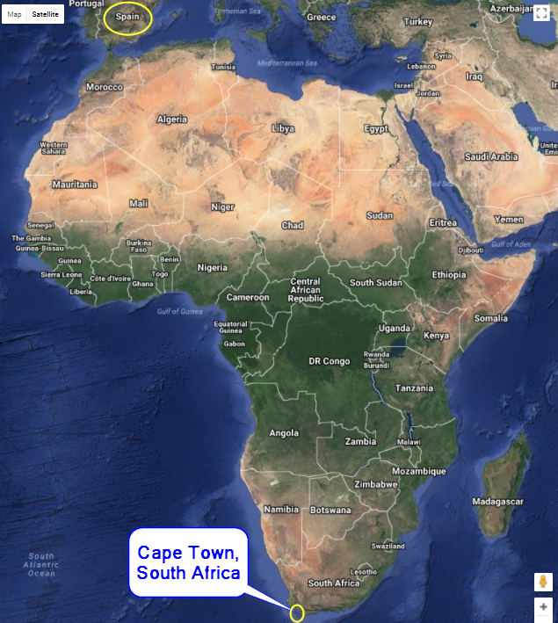

Slide 4
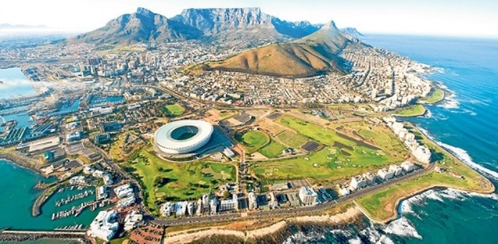
Cape Town Soccer Stadium Soccer World Cup 2010

Slide 5
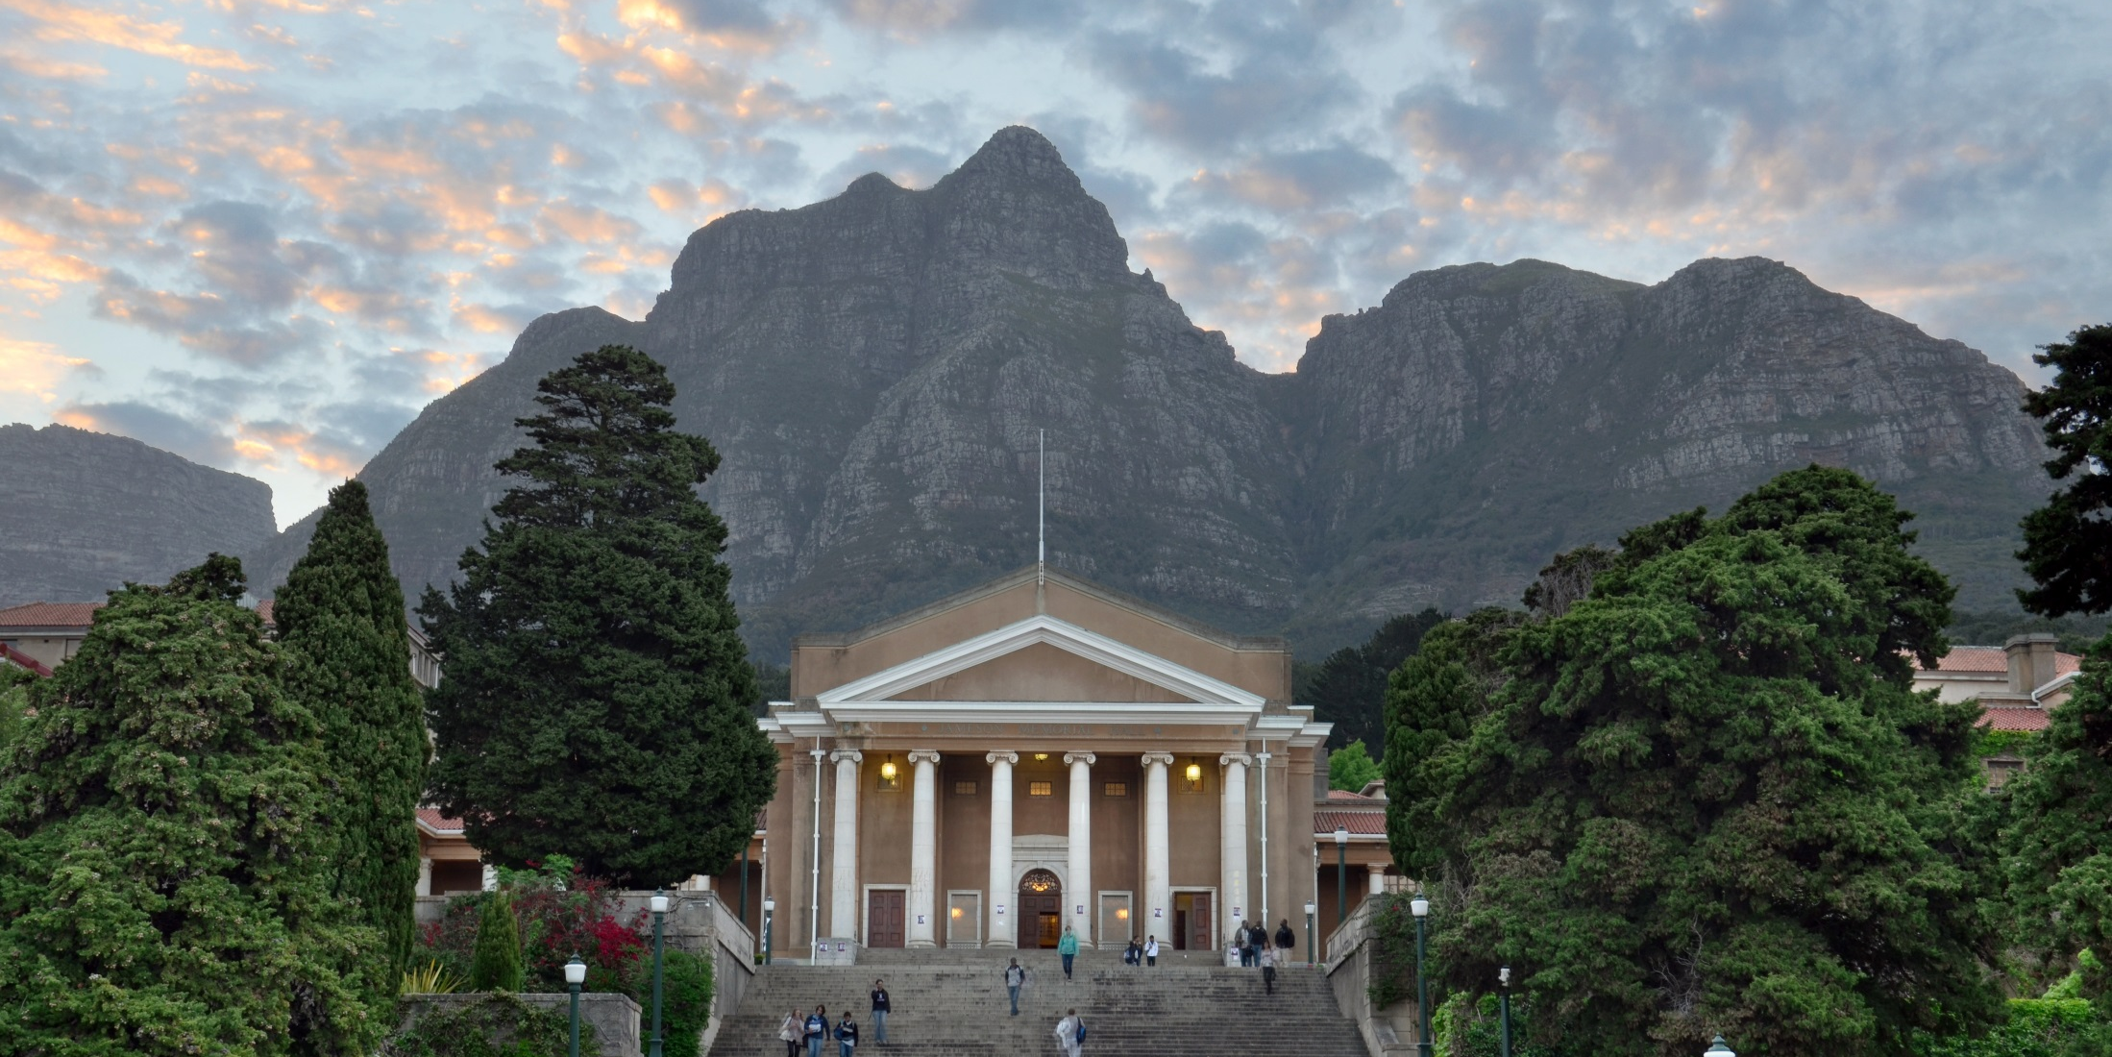
The University of Cape town
Medium-Sized African University
27 000 students
6 faculties
Strong Research Focus
5 Nobel Prize Winners
Worlds First Heart Transplant

Slide 6
ORGANIZATION & ORACLE
PeopleSoft Campus Solutions 9.0 patch #37
People Tools Version 8.54.25

Slide 7
Overview - Criterion-Based Student Accommodation at UCT
Context and Rationale
The Student Accommodation Allocation Context
Life Prior to Criterion-Based Student Accommodation Allocations
The Student Accommodation Policy and Process
Criteria for Student Accommodation Offers
How the Process Works
The Mechanics of the System
Rules-Based Offers
Discretionary Offers
Reporting and Monitoring
Integration with RMS
Conclusion and Questions

Slide 8
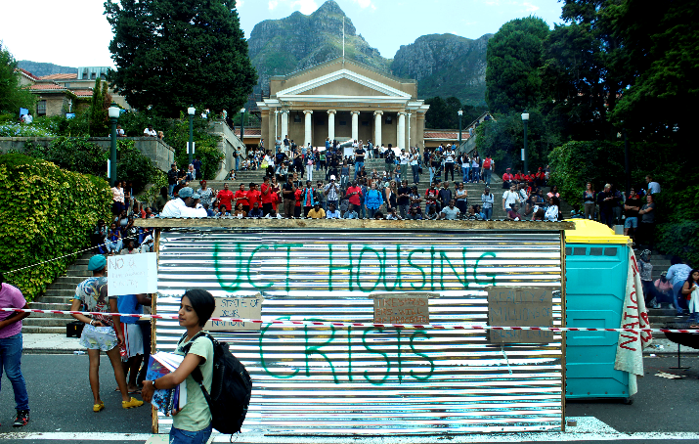
Context and Rationale
A Description of the Student Accommodation Context and the Problems before Criterion-Based Housing Allocations

Slide 9
PICS from #Rhodes must fall and #fees must fall
A Description of the Student Accommodation Context and the Problems before Criterion-Based Housing Allocations

Slide 10
PICS from #Rhodes must fall and #fees must fall
A Description of the Student Accommodation Context and the Problems before Criterion-Based Housing Allocations

Slide 11
PICS from #Rhodes must fall and #fees must fall
A Description of the Student Accommodation Context and the Problems before Criterion-Based Housing Allocations

Slide 12
The context
6 Faculties, 27000 students
2 Academic Programme Choices
Concurrent offers
Decentralised Admissions
Academic Offers Made at Different Paces
Most Academic Offers in early January (After NSC Results)
6600 Available Bed-Spaces
2200 Reserved for New Students
Offer of Housing determinant in retaining Applicants

Slide 13
The problems
Only 4 Processing Staff in Student Housing Office
Some Offers Made by Faculties and Some by Student Housing
Most Academic Offers made 2 months before Start of Term
Housing Offers are dependent on Academic Offers
“First Come First Served” Approach and Data Capture Errors Lead to decreased in applicant retention

Slide 14
Prior to criterion-based accommodation allocations
Prior to Criterion-Based Allocations:
Bed Spaces Allocated to faculties proportionally
Strategic reservation
Allocation Decisions Made by Faculties
Allocation Decisions Implemented by Student Housing Office (in RMS)
Timing Difference in Allocation Decisions – Some Faculties used up Bed Spaces
No Notion of 1 Applicant : Bed Space
Difficulties:
Not enough management of allocation
Inconsistent use of places across faculties
Students falling between cracks
Notes:
Support: over 1500 PS users in the Admissions, Student Records, Fees and Financial Aid areas

Slide 15
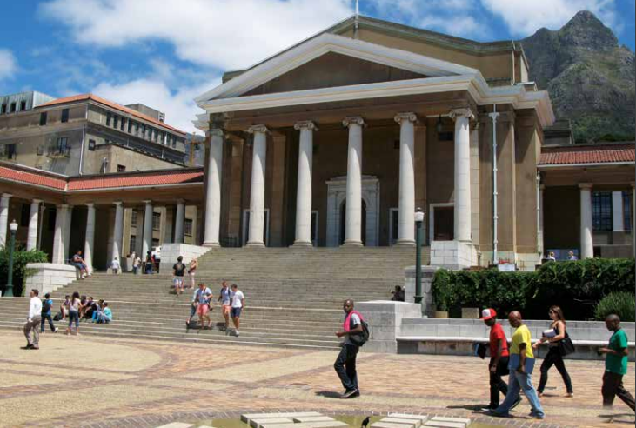
The Student Accommodation Policy and Process
A Description of Criterion-Based Policy and Process

Slide 16
New policy and
process
Criterion-based approach
more control
Both rules-based and discretionary
retaining consistency and flexibility
Both centrally and faculty based offers
general and specific criteria
Responsive to enrolment objectives
not indiscriminate
Introduction of guaranteed admission
A first!
Notes:
Support: over 1500 PS users in the Admissions, Student Records, Fees and Financial Aid areas

Slide 17
Criteria for Institutional offer
Offer of admission
Institutional criteria
Guaranteed admission
Three categories:
Academic merit (90% average)
Financial Aid eligible
Minor (17 on 1 Feb in Year of Admission)
Notes:
Support: over 1500 PS users in the Admissions, Student Records, Fees and Financial Aid areas

Slide 18
criteria for housing faculty and discretionary offers
Offer of admission
Faculty-based offer
Rules-based:
Faculty high score open
Faculty high score redress
Programme
Discretionary
Individual discretion
Non-NSC writers
Programme
Funded students
Notes:
Support: over 1500 PS users in the Admissions, Student Records, Fees and Financial Aid areas

Slide 19
The Process
Bed spaces determined
Offer target (including over offer factor) determined
Offer target split between categories
Targets are loaded into PeopleSoft
Offer against targets reported
Notes:
Support: over 1500 PS users in the Admissions, Student Records, Fees and Financial Aid areas

Slide 20
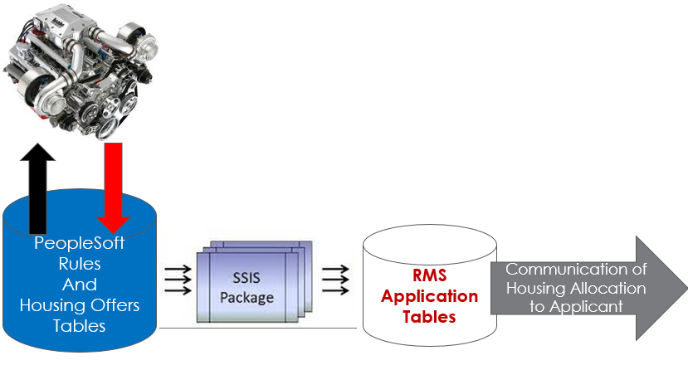
The Mechanics of the System
Explanation of how the Auto-Housing and Discretionary Allocations Work

Slide 21
Overview of the offer mechanics
Pyramidal Nature Of Offers
The Rules Engine :
Controls how Offers are “Given Back” to each Category
Facilitates BO Reporting on Number of Offers available in each Category by Institution and Faculty
Institutional
Rules-Based
Offers
Order of Replacement of Offers
Faculty
Rules-Based
Offers
Faculty Discretionary
Offers
Notes:
Support: over 1500 PS users in the Admissions, Student Records, Fees and Financial Aid areas

Slide 22
What’s involved
Setting Up Institutional Rules
Setting Up Faculty Rules (Discretionary and Criterion-Based)
Running the Auto-Offer Process (Scheduled)
Communicating with the Applicant (Comm Gen)
Integration with RMS
Allocation of Building Spaces in RMS
Notes:
Support: over 1500 PS users in the Admissions, Student Records, Fees and Financial Aid areas

Slide 23
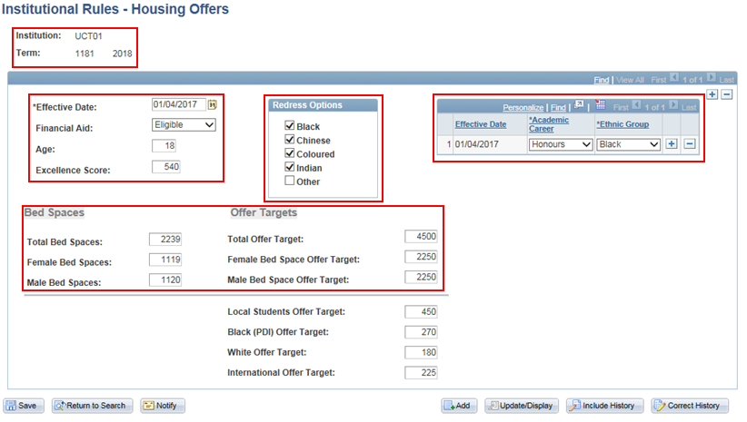
InstitutionAL Rules Setup
Notes:
Support: over 1500 PS users in the Admissions, Student Records, Fees and Financial Aid areas

Slide 24
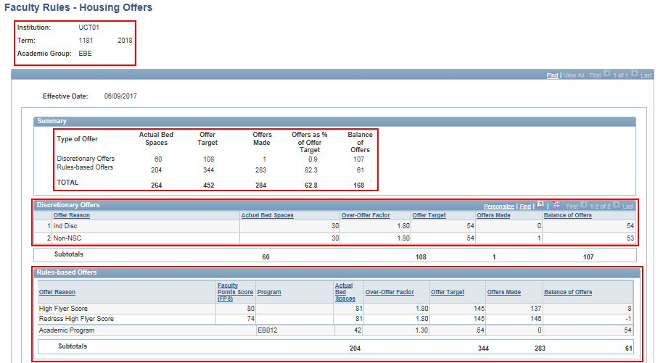
Faculty Rules Setup 1
Notes:
Support: over 1500 PS users in the Admissions, Student Records, Fees and Financial Aid areas

Slide 25
Faculty Rules Setup 2
Notes:
Support: over 1500 PS users in the Admissions, Student Records, Fees and Financial Aid areas

Slide 26
Faculty discretionary offers
Reasons Setup on Faculty Rules Page
Not Rules Driven, ie. Manual Offers
Reported on via Via Business Objects
Notes:
Support: over 1500 PS users in the Admissions, Student Records, Fees and Financial Aid areas

Slide 27
What the accommodation rules engine does
Step 1 : Select the Population
All Applicants with a Housing Interes`t
Step 2 : Apply the Rules to the Population
Step 3 : Assign a Comm Gen Communication to successful Applicants
Step 4: Run Comm Gen to send the Communications
PeopleSoft
Rules
And
Housing Offers
Tables
Notes:
Support: over 1500 PS users in the Admissions, Student Records, Fees and Financial Aid areas

Slide 28
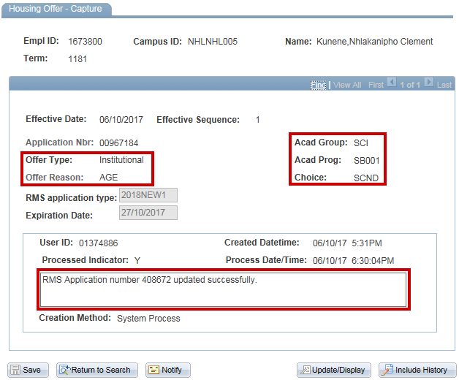
Institutional Offer
Notes:
Support: over 1500 PS users in the Admissions, Student Records, Fees and Financial Aid areas

Slide 29
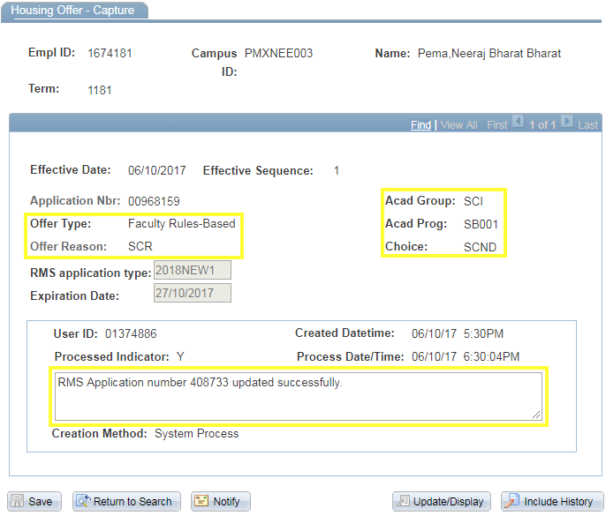
Faculty Rules-Based Offer
Notes:
Support: over 1500 PS users in the Admissions, Student Records, Fees and Financial Aid areas

Slide 30
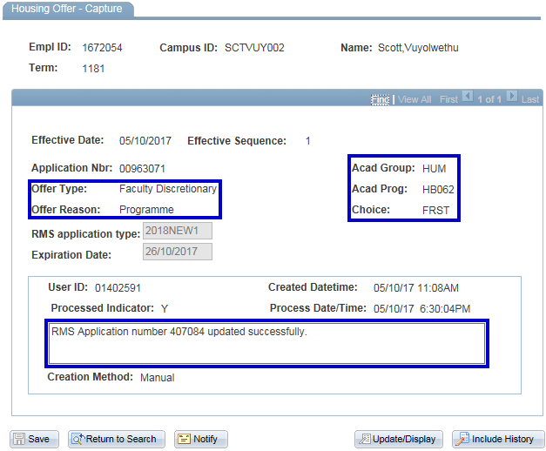
Faculty Discretionary Offer
Notes:
Support: over 1500 PS users in the Admissions, Student Records, Fees and Financial Aid areas

Slide 31
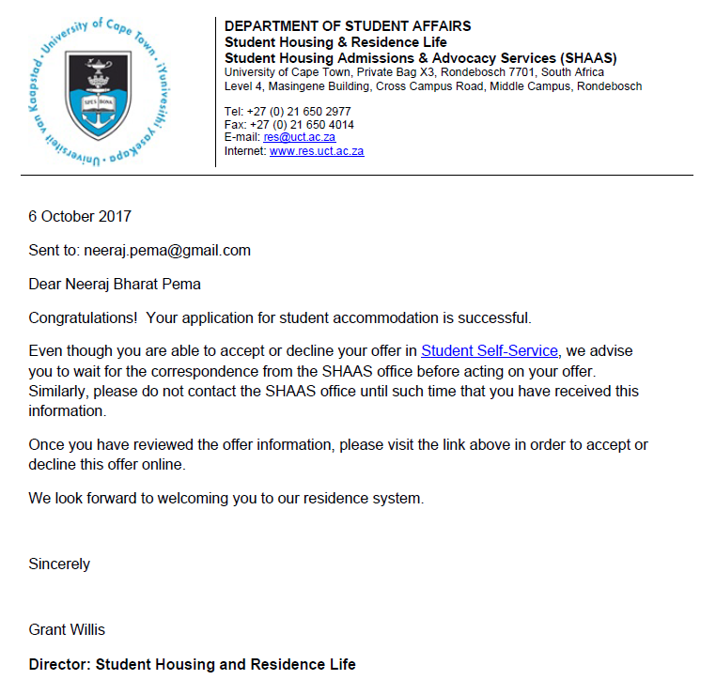
Communicating with the Applicant
Notes:
Support: over 1500 PS users in the Admissions, Student Records, Fees and Financial Aid areas

Slide 32
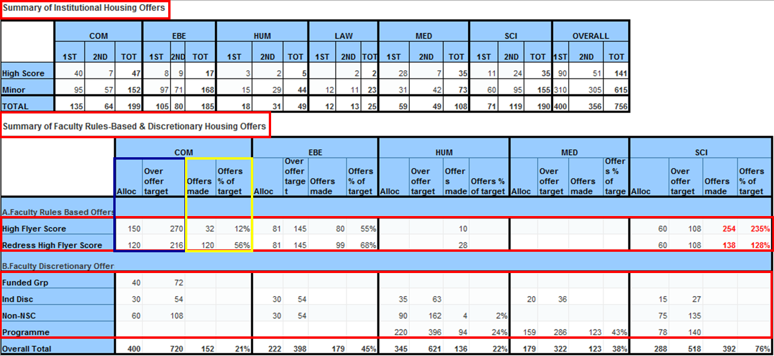
Regular monitoring and management of offers
Notes:
Support: over 1500 PS users in the Admissions, Student Records, Fees and Financial Aid areas

Slide 33
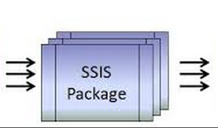
Integration with RMS
PeopleSoft
Rules
And
Housing Offers
Tables
RMS Application Tables
Communication of Housing Allocation to Applicant
Notes:
Support: over 1500 PS users in the Admissions, Student Records, Fees and Financial Aid areas

Slide 34
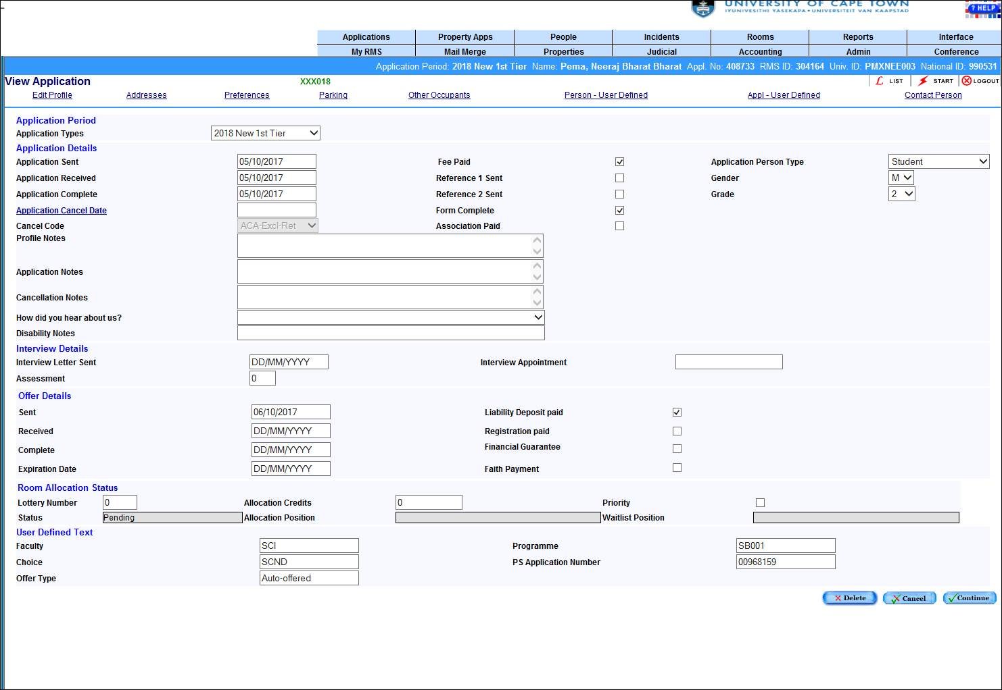
What the offer looks like in RMS
Notes:
Support: over 1500 PS users in the Admissions, Student Records, Fees and Financial Aid areas

Slide 35
Benefits – of the criterion-based accommodation system
Data Accuracy and Consistency
Efficiency and Time Savings
Easy to Setup
Repetitive Tasks automated
Integration with RMS Alleviates Workload in Student Housing
More Time can be spent on more Admissions Decisions and Building Allocations
Fast, Flexible and Responsive to UCT’s Enrolment Targets
Rules-Based Offers (Institutional and Faculty)
Discretionary Offers
Better/Easier Monitoring and Management
Business Objects – Summarizing of Data
No-Double Counting of Bed Spaces
Optimal Occupancy Ensured
Timeous Communication with Applicants

Slide 36
Questions?

Slide 37
presenter
Deon Coetzee
Systems Division, University of Cape Town
deon.coetzee@uct.ac.za
+27 21 650 4405
all Alliance presentations will be available for download from the Conference Site

Slide 38
THANK YOU!

Slide 39
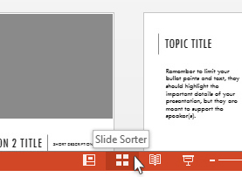
Use the Slide Sorter
Utilize the Slide Sorter view while setting up your slides to see how the flow is progressing on your presentation

Slide 40
SUMMARY

