Slide 1
Canadian Tax Reporting Limitations & Issues
SESSION 5047
November 7th, 2017

Slide 2
presenters
Derek Konieczny
Mark Russom
Sarah Hill
Business Systems Analyst III
McMaster University
konieczd@mcmaster.ca
Business Analyst III
McMaster University
russom@mcmaster.ca
Business Systems Analyst III
McMaster University
hillsa@mcmaster.ca
all Alliance presentations will be available for download from the Conference Site

Slide 3
Overview
SECTION 1 PeopleSoft Finance – Issues and Solutions
SECTION 2 PeopleSoft Campus – Requirements and Customizations
SECTION 3 Human Capital Management: An Evolving Landscape
SECTION 4 Canadian Tax Help Through My Oracle Support Community

Slide 4
mcmASTER University - PeopleSoft Finance Issues and Solutions
PS Enterprise FIN 9.2.19
NOTE: We are currently upgrading to 9.2.25
PeopleTools: 8.55.05

Slide 5
Finance CRA T4A & T4ANR Requirements & Issues
Delivery of a T4A/T4ANR tax slip to applicable recipients
Delivery of a T4A and separate T4ANR XML file as per CRA schema requirements.
Limited functionality to generate a T4A print file
No functionality to generate a T4ANR print file
No T4A/T4ANR XML functionality
Supplier Information lacking fields to capture reporting details (payment types)
No voucher functionality to associate payments with travel and expense (T4ANR)
No location to store issuer contact information

Slide 6
McMaster’s Approach
Developed a customized in-house solution to generate the required XML files
Supplier Information customizations
Custom page and table for holding McMaster contact information
Custom Run Control to generate XML files via Report Manager
Use third party to generate print output

Slide 7
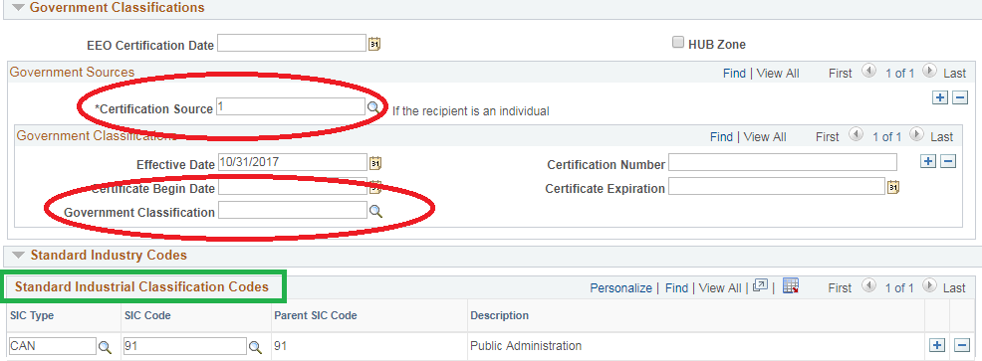
Supplier Information Customizations
Used three existing fields for entering T4ANR details:

Slide 8
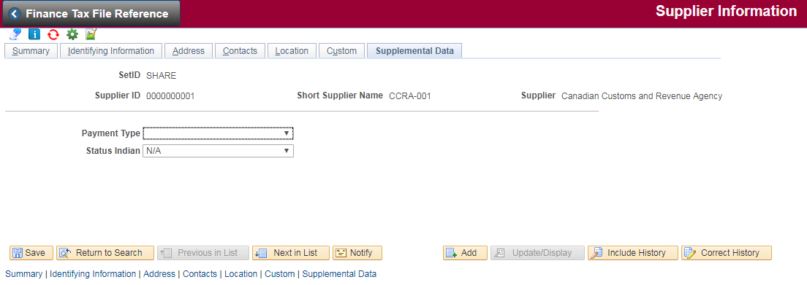
Supplier Customizations CONTINUED
Additional tab for capturing the supplier payment type and Status Indian exemptions
Payment Type options include: Artist Fees, Award/Prize, Fees for Service(s), Goods, Honorarium, Living Allowance, Performers, Preceptor /Stipend, Royalty, Scholarship

Slide 9
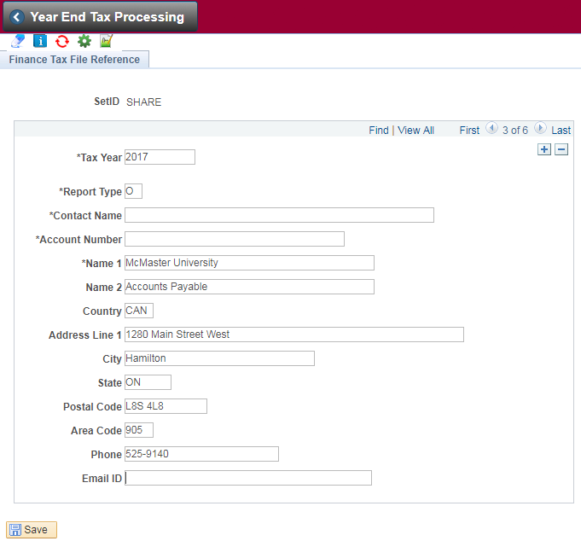
Finance Tax File Reference
Developed a custom page to add McMaster contact information

Slide 10
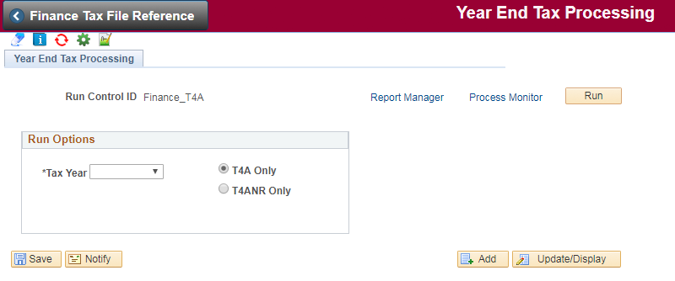
Year End Tax Processing
Created a new run control to generate the required XML file and parse

Slide 11
Open Discussion

Slide 12
CAMPUS SOLUTIONS CUSTOMIZATIONS
PS Campus 9.0.32
PeopleTools: 8.55.05

Slide 13
t2202A REQUIREMENTS
Base months-of-study counts on enrollment data or term activation
Ignore class dates outside the taxation year
Exclude specific programs / plans from tax certificate generation
Consider leaves of absence when calculating months-of-study counts
Determine FT/PT load beyond on other criteria besides academic structure level/load rules
Properly process students in multiple careers w.r.t. months-of-study counts and FT/PT determination
Properly handle student data containing diacritic characters
Easily apply updates to the certificate template when CRA issues changes

Slide 14
t4A REQUIREMENTS
Determine appropriate amounts based on the effective date of individual item lines, as adjustments should apply to the calendar year in which they occur
Generate an XML file as per CRA schema
Properly handle student data containing diacritic characters
Easily apply updates to the certificate template when CRA issues changes

Slide 15
CUSTOM SOLUTIONS
Customized SQR process for T2202A that contains conditional logic for multiple careers, calculating months of study, factoring in leaves of absence and applicable class dates.
UTF-8 character encoding added to admin and Student Center pages in order to properly render T2202A student data with diacritics
Manually updated T2202A RTF is kept current with CRA changes and uploaded to BI Publisher for certificate rendering
XML file generation code “transplanted” from FS to CS and tweaked as required; schema validation and corrections done manually
Copy the Oracle-provided HR template and upload to BI Publisher

Slide 16
Open DIscussion

Slide 17
human Capital ManageMent: an evolving landscape
PS HCM Version 9.2.23
PeopleTools Version: 8.55.05
Sarah Hill
BSc, WKM, PCP

Slide 18
Unique (and not-so-unique) challenges, evolving landscapes
Separate Companies: Employer Copies
Sliding Scale RRSP: T4 Box 52 Pension Adjustment
Close Pay Calendar / Open Pay Calendar
Proactive YE data management: Reports and Queries
ROE reporting & Year End Off-Cycle processing
COBOL embedded tax rate changes
ESS: TD1 Personal Tax Credit Forms (Federal, Provincial forms)
ESS: Providing electronic T4 Slips in place of paper copies
Print files for Tax Slips

Slide 19
Separate companies: employer copies
Challenge: streamline the process for providing separate employer tax slip copies to non-affiliated business owners
Solution: App Engine to automatically: (1) delete any prior Run Control (RC) IDs previously created by the App Engine for the same User (2) create new separate RC IDs for each non-McMaster employer and slip type (3) pre-populate the RC page for each RC ID with applicable list of EMPLID who have current year tax slip
Outcome: after completing Tax Slip cycle, Year End administrator runs the App Engine once for the year, then creates Company PDF file per Company and applicable Slip Type using PS delivered processes

Slide 20
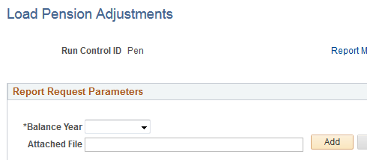
Sliding Scale RRSP: t4 Box 52 Pension Adjustment
Challenge: sliding scale RRSP setup as Plan 80; delivered PS functionality calculates PA on RRSP contributions
Solutions: (1) customization to have system ignore the PS calculated PA tax amount; (2) Configuration to create a Deduction version of PA and add to Tax Form Definitions T4 Box 52; (3) App Engine process to Load Pension Adjustment directly to Deduction YTD Balances
Value Added: YE pay cycle not required; avoids impacting ROE

Slide 21
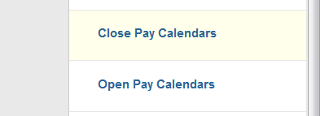
Close pay calendar / Open pay calendar
Challenge: 7 companies, 20+ Pay Groups, 5 or 6 pay runs per month… provide an efficient way to Open / Close other Pay calendars to allow for YE processing with minimal impacts to on-cycle
Solution: Provide two App Engines which support: (1) closing calendars of all company / pay group combinations NOT included in the desired Pay Run ID, and (2) subsequent re-opening of all calendars previously closed by the custom process
Value Added: we use these processes throughout the year for our on-cycle pay runs, not just at Year End

Slide 22
Proactive year end data management
Challenge: Simplify the annual tax slip production cycle as much as possible by providing business with the tools to proactively identify data anomalies
Solutions: (1) Audit Queries: identify tax slip anomalies (can be run separately) (2) App Engine Report which identifies address / bio data anomalies (Schema related) (3) App Engine Report which compiles results of tax slip anomalies not provided by PS and which do not require running separate queries (4) Balance Queries: audit expected totals per DEDCD and EARNCD from Balance YTD Tables grouped by Tax Slip Box # (allows comparison to delivered slip totals) (5) we are currently evaluating leveraging the Balance Queries to create App Engine YE Balancing Report
Best Practice: run HCM Tax Slips, Audits, and Balances Quarterly

Slide 23
Roe reporting & YE off-cycle processing
Challenge: YE off-cycle processing does NOT allow same Pay Period End Date as confirmed on-cycle, thereby creating separate ROE Period Dates, which are incorrectly assumed to be additional Pay Periods on ROE
Issue: has been noted on My Oracle Support as one which requires a resolution; as it requires significant administrative effort wrt ROE
Vote Up: and leave your Comments on the My Oracle Support Idea:
https://community.oracle.com/ideas/13047

Slide 24
COBOL embedded tax rate changes
Challenge: A few rates each year still require Cobol changes, but could easily be managed via table updates instead
Issue: has been raised to Oracle for resolution, as converting to table updates provides an opportunity for all Canadian clients to streamline YE testing and validation
Vote Up: and comment on the My Oracle Support Idea:
https://community.oracle.com/ideas/16962

Slide 25
ESS: TD1 Personal Tax credit forms
Challenge: Providing ESS versions of Federal and Provincial Tax Credit forms would put the updates directly in the hands of employees
Issue: this functionality has been delivered for US employee, but not yet for Canadian employees
Vote Up: and comment on the My Oracle Support Idea:
https://community.oracle.com/ideas/11414

Slide 26
Print Files for tax slips – Still evolving
Challenge: McMaster HCM is exploring providing T4 and T4A slip data to the printer in an XML file instead of our current PDF (LIS)
Value Added: Passes ownership of annual layout changes from in-house to our print provider (an efficiency win for McMaster’s IT team)
Evolving Landscape: CRA is now allowing electronic-only delivery of T4 slips to employees, instead of requirement for employees to consent (may negate need to produce file for T4); evaluating the solution delivered in Tax Update 17-D shortly with our business owners

Slide 27
Open Discussion

Slide 28
Canadian Tax Help Through My Oracle Support Community
How to champion an enhancement

Slide 29
My Oracle SupPort Community - Navigation
Visit support.oracle.com and log in
Click on the Community tab:

Slide 30
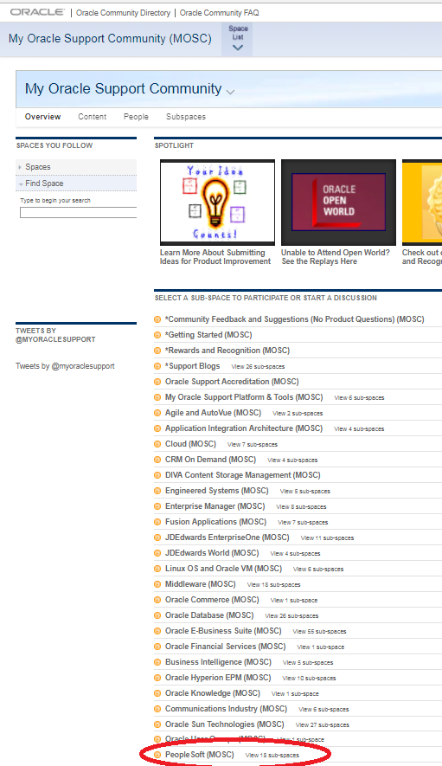
Click on the PeopleSoft (MOSC) link halfway down the page

Slide 31
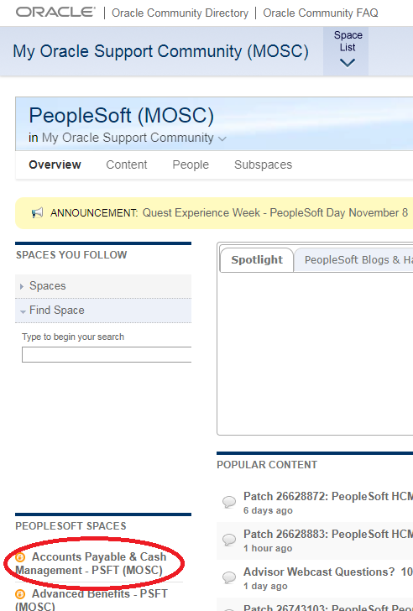
Click on Accounts Payable & Cash Management – PSFT (MOSC) link in the left column

Slide 32
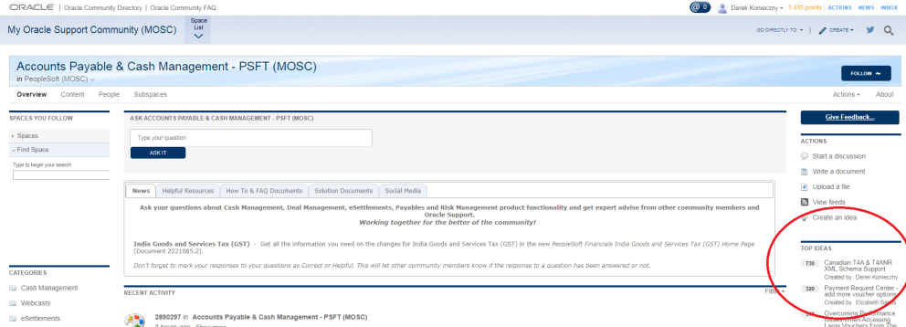
Locate the Top Ideas on the right column

Slide 33
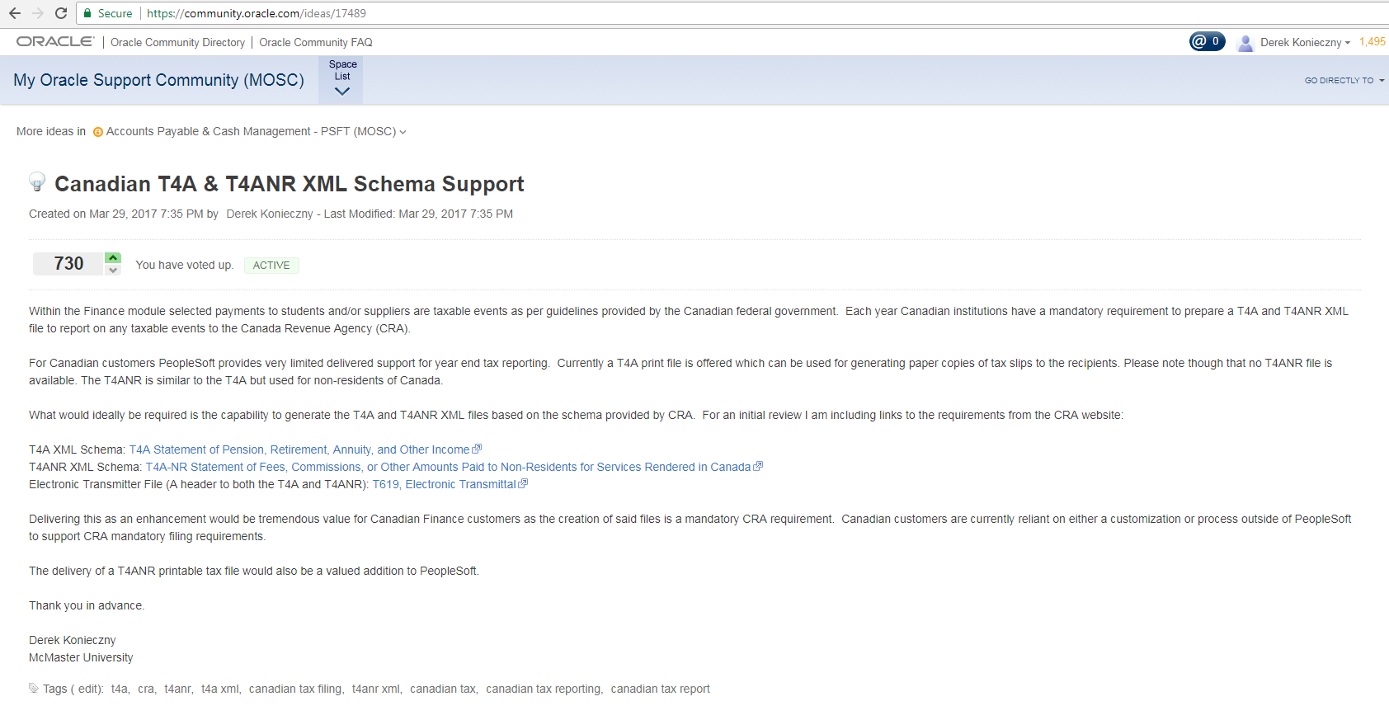
Add your voice to – Canadian T4A & T4ANR XML Schema Support
- Vote up and leave a comment

Slide 34
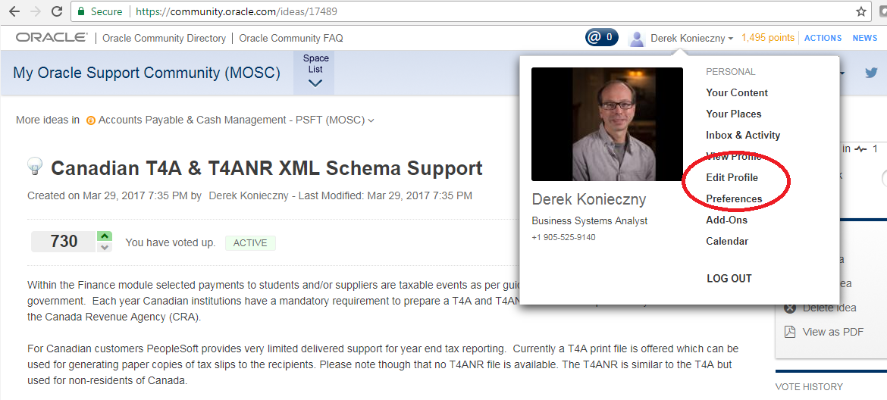
Let Oracle know who you are
Help Oracle know who to contact for idea follow-up. Fill in your Oracle profile

Slide 35
Concluding thoughts
ANY QUESTIONS?

Slide 36
presenters
Derek Konieczny
Mark Russom
Sarah Hill
Business Systems Analyst III
McMaster University
konieczd@mcmaster.ca
Business Analyst III
McMaster University
russom@mcmaster.ca
Business Systems Analyst III
McMaster University
hillsa@mcmaster.ca
all Alliance presentations will be available for download from the Conference Site

Slide 37
THANK YOU!

