Slide 1
HEUG Fireside Chat
(without the fire)
Monday, March 4, 2019
Today’s Fireside Chatters:
Jane Broad, HEUG Past President
Kelly Wilker, VP of Communications and Membership
Jason Wenrick, HEUG President
Michelle Goytia, HEUG Support
Some (very) special guests
All of you! Thank you for attending!

Slide 2
Who are the Advisory Groups?
Elected Volunteers
Expertise in modules/technical areas
Groups average 7 members each
Strive for diversity in membership
All types of institutions: Large, small, public, private, geographic diversity, two-year, four-year, etc.
More information:
https://www.heug.org/page/advisory-groups
Academic Advising
Admissions
Campus Community
Constituent Experience & Advancement (CXA)
E-Business Suite
Enterprise Resource Management (Finance/ERM)
Financial Aid
Human Capital Management (HCM)
Project and Change Management (PCM)
Student Financials
Student Records
Technical & Reporting

Slide 3
What do Advisory Groups do?
Advocate
Advocate to Oracle on your behalf
Enhancements
New functionality
Issue resolution
Solicit feedback and convey it to Oracle
Communicate
Communicate with you
Features
Problems
Opportunities
Solutions/work-arounds

Slide 4
Communicate
Forums
Engage > Discussion Forums
Can subscribe to email notifications or view online
Monitored by AGs
Includes specific topics under broader categories.
Blogs
Newsroom > Blogs
Many different blogs types such as:
General HEUG updates
Board updates
Product news
Regional/conference news
Partner news

Slide 5
Communicate
File Libraries
Engage > File Libraries
Community Specific Files
Conference Files
White papers
Training files
Webinars
E-Academy Product Series
Free to Institutional and System members.
E-Academy Strategic Series
Free to all members.
On-Demand Education
All webinar recordings and slides
Red titles are only available to Institutional and System members.

Slide 6
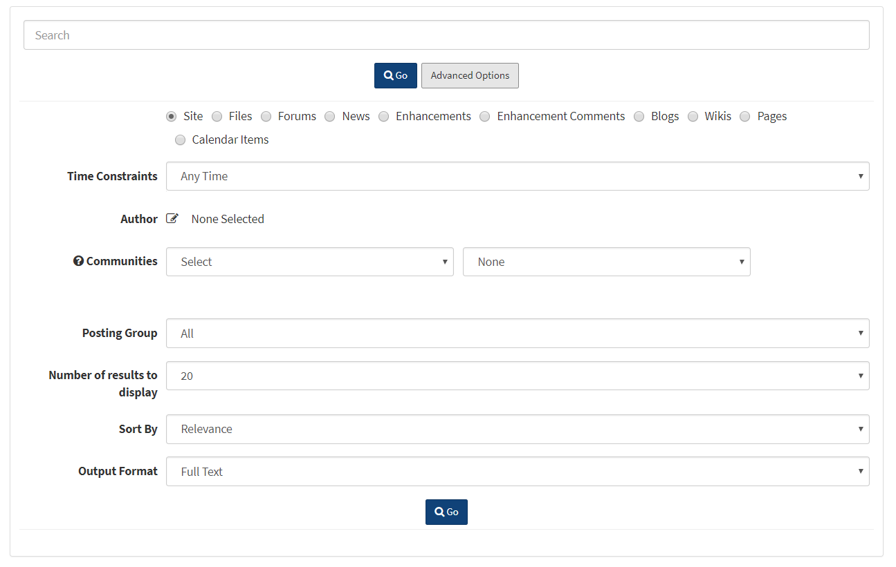
It’s not a secret, but not many people know…
Advanced Search
This will allow you to narrow your search to get clearer results
Help Sections
Tips and Tricks
Short Video Tutorials
Contact Support Information

Slide 7
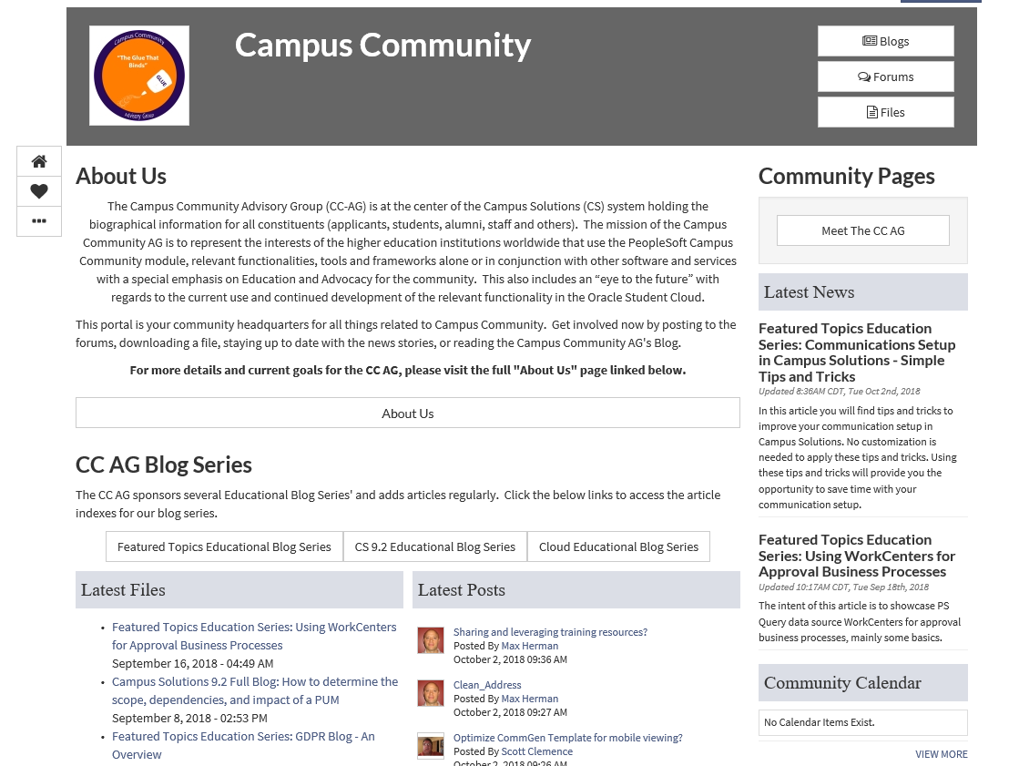
Community Pages
One stop place for your product specific interests
Each community is unique
Under Explore
Header includes links to AG Blogs, Forums, and Files
Sections for Latest Files, Posts, and News
Other information specific to the AG

Slide 8
Your Profile
My Page
The information other members will see about you.
Biography
Give a sense of who you are. Also is required for volunteering with the HEUG.
Signature
Carries over to all listserv posts/emails.
Profile Picture
Make it easier for members to find you. Many people remember what a person looks like over what their name was.
Transactions Tab
Find all of the conference registration invoices and details.
My Subscriptions
Add, remove and adjust any of your subscriptions.
Set the Vacation Mode so you’re not getting bothered while you’re relaxing.
My Favorites
One stop shop for the latest updates on all the forums, communities, blogs, etc you have favorited.

Slide 9
Please chat with us (fireside or not)!
Ask questions on the forums
Beauty of the user driven nature of the HEUG
Double bonus: You get an answer; we see the hot topics
Seek out our email addresses
Tell us what you want to see at Alliance Conferences
Suggest Blog and Webinar Topics
Volunteer to Guest Blog or Host a Webinar
Talk to us at conferences
Participate in surveys
Submit Product Enhancement Ideas
Other ways? What works best for you?

Slide 10
Yes, we want to listen right now…
How do you want to hear from us?
What do you want to hear about?
Forums
Blogs
Webinars
Videos
Newsletters
Social Media
Twitter? LinkedIn? Facebook? Others (for those of us out of the loop)?
Other ways?
Product features & Functionality Highlights
Known issues
Release information
Survey results
Other topics?

Slide 11
This presentation will be available at HEUG.org
(You will find tons of other great presentations there, too!)

