Slide 1
Leveraging xml transcripts achieving fast flexibility
SESSION 5057
6 November 2017

Slide 2
Pre-requisites
Reasonable knowledge of BI Publisher
Comfort with Data Structures, XML Files
Focus on design
Will get quite technical in parts!
Application Designer: App Engine, App Package, File Layout

Slide 3
presenter
Juliana Hui
Technical Team Lead
Simon Fraser University
PeopleSoft professional since 1997
Experience in HR/Payroll and Campus Solutions

Slide 4
Simon Fraser University BC, Canada
3 campuses: Burnaby, Vancouver and Surrey
30,000+ students
6,500 faculty & staff

Slide 5
SFU & ORACLE
Institution-wide usage of PeopleSoft
Campus Solutions 9.0
Interaction Hub 9.1
HRMS 9.1
FSCM 9.2
PeopleTools 8.54
DB2 10.5

Slide 6
Overview
Design process
Review PeopleSoft delivered transcripts
Figure out the Best approach for tackling complex transcripts
Leveraging delivered as much as possible
Minimize customizations
BI Publisher: Specific tips and tricks
Issues encountered
Review of process
Q&A

Slide 7
A quick definition
Student Transcript
An inventory/listing of the courses taken and grades earned by a student, throughout a program.
PeopleSoft “XML Transcript”

Slide 8
Why a new transcript?
Existing COBOL transcript
Not very modern-looking
Business designed their “dream” transcript
Professional publishing tools

Slide 9
Old transcript

Slide 10
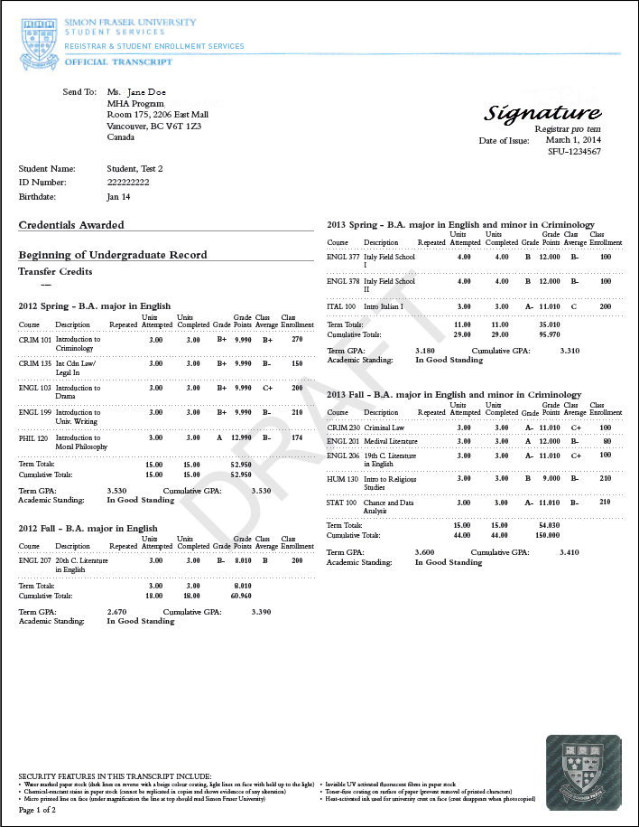
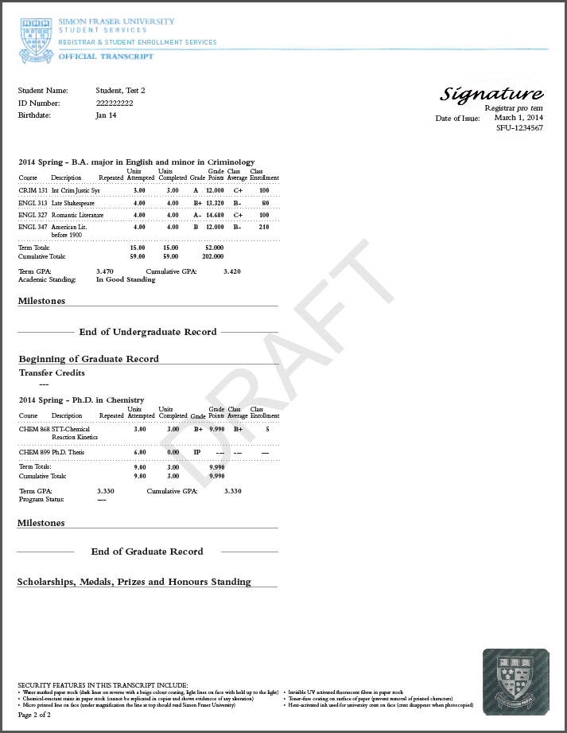
new transcript

Slide 11
Design process
Where do we start?

Slide 12
Peoplesoft-delivered xml transcripts
Are they really flexible?

Slide 13
Configuration page – basic data

Slide 14
Configuration page – careers
“Career” section blank when Chronological transcript chosen

Slide 15
Configuration page – degree/program

Slide 16
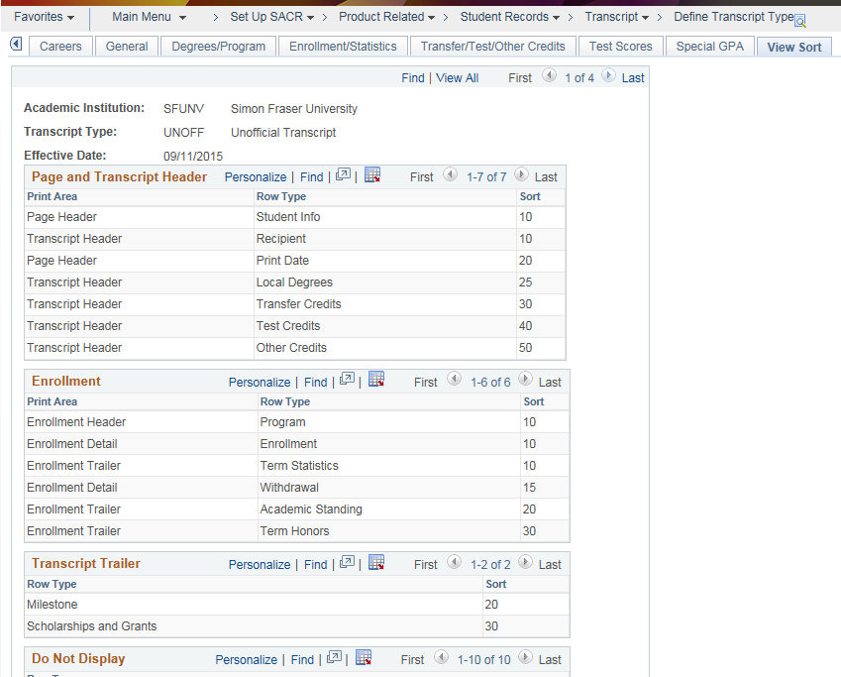
Configuration page – sort order

Slide 17
Peoplesoft-delivered xml transcripts
Structure is controlled by the Config page
Rigid!
Can re-order fields/sections but sections are static
Cannot easily mix/match data from different sections
Cannot add new fields
Careers issue!
Can have separate transcripts per career (page-numbering re-starts, combined information is repeated)
Can have one combined Chronological transcript (which mixes your careers by dates)
Cannot have 1 single transcript showing individual careers in order

Slide 18
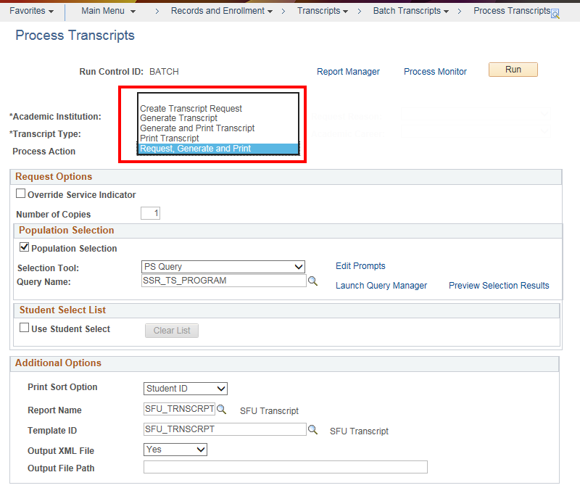
Process transcript

Slide 19
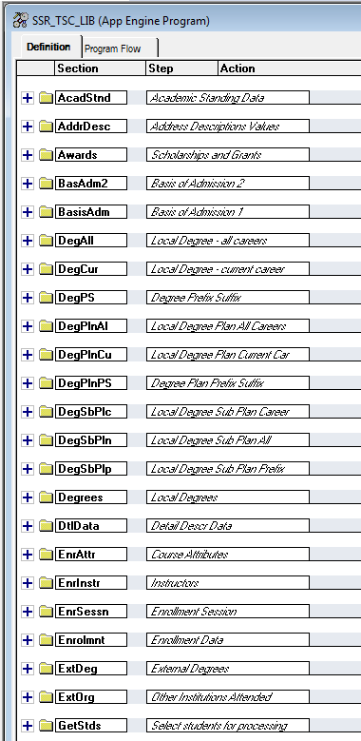
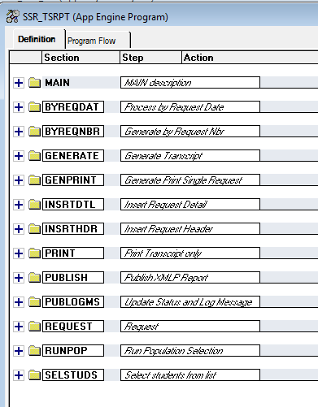
Where to start?

Slide 20
Process transcript (SSR_TSRPT)
Request - creates the request number.
Generate (SSR_TSC_LIB) – gathers the data into temp tables. KEY STEP.
Print – merely prints from the temporary tables.

Slide 21
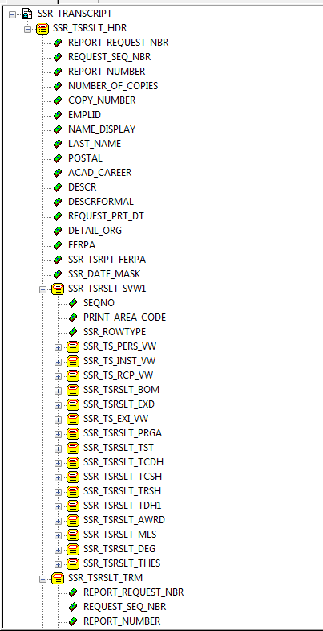
data structure (xml file LAYOUT)
Leverage off the Delivered Process
Simply change the data structure
You don't have to retrieve the data yourself, you just have to shift it around
Start with delivered layout: SSR_TRANSCRIPT

Slide 22
Transcript table references
KEY RESULT TABLES
SSR_TSRSLT_HDR | Header row
SSR_TSRSLT_AWRD | Student Awards - Scholarships and Grants
SSR_TSRSLT_DEG | Student Degrees
SSR_TSRSLT_ENRL | Transcript Results student enrollment coursework
SSR_TSRSLT_RCP | General transcript result record used for student personal data, print date
SSR_TSRSLT_PRGA | All Academic Programs for transcript
SSR_TSRSLT_SVW1 | Transcript results view used to sequence non-term related data
SSR_TSRSLT_SVW2 | Transcript results used to sequence term related data
SSR_TSRSLT_TRM | Transcript results term record
SSR_TSRSLT_TEXT | Transcript Result Table for transcript text location.
select RECNAME, RECDESCR,
DESCRLONG
from PSRECDEFN
where RECNAME like 'SSR_TSRSLT%'
order by RECNAME;
Oracle Technical Guide – “Defining and Generating Transcripts”

Slide 23
Translating the XML File
Header data
NON-term related data sequencing
Personal Information (Emplid, Name, Address, Print Date)
Recipient Data (“Send To”)
Program Data
Subrecords: Plan, Subplan
Transfer Credits (Summary)
Awards
Milestones
Degrees
Thesis
Term Data

Slide 24
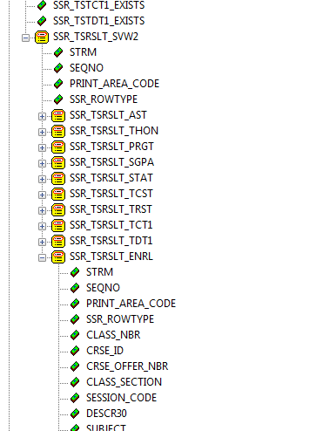
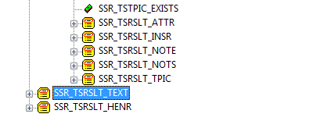
Term data (from previous page)
Term related data sequencing
Academic Standing
Term Honours
Program Data
Subrecords: Plan, Subplan
Term Statistics
Transfer Credits (Detail)
Enrolment Details
Course Attributes
Class Instructors
Class Notes
Class Topics
Transcript Text
Historical Enrolment

Slide 25
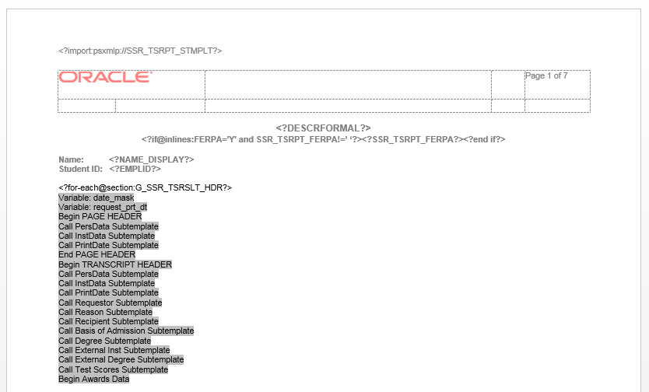
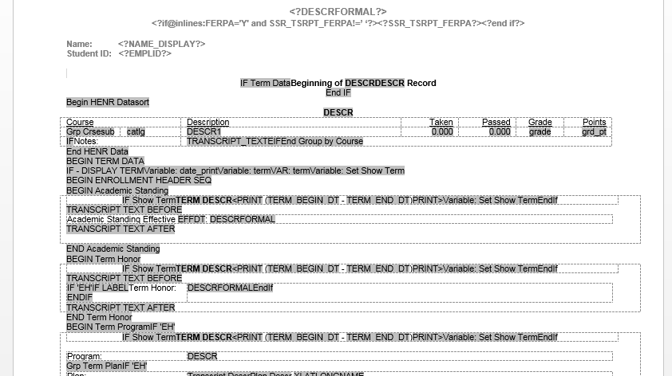
Delivered report template
SSR_TSRPT
7 pages (!)
Extensive use of sub-template
Hidden code
..\..\..\FIELD
IF...END IF, FOR...END FOR
Calculations: <?UNT_TRNSFR +TRF_TAKEN_GPA +TRF_TAKEN_NOGPA?>
<xsl:for-each select="../../../G_SSR_TSRSLT_TEXT[RELATIVE_POSITION='B'][PRINT_LOC='ST'][STRM=$term]"><?TRANSCRIPT_TEXT?></xsl:for-each>

Slide 26
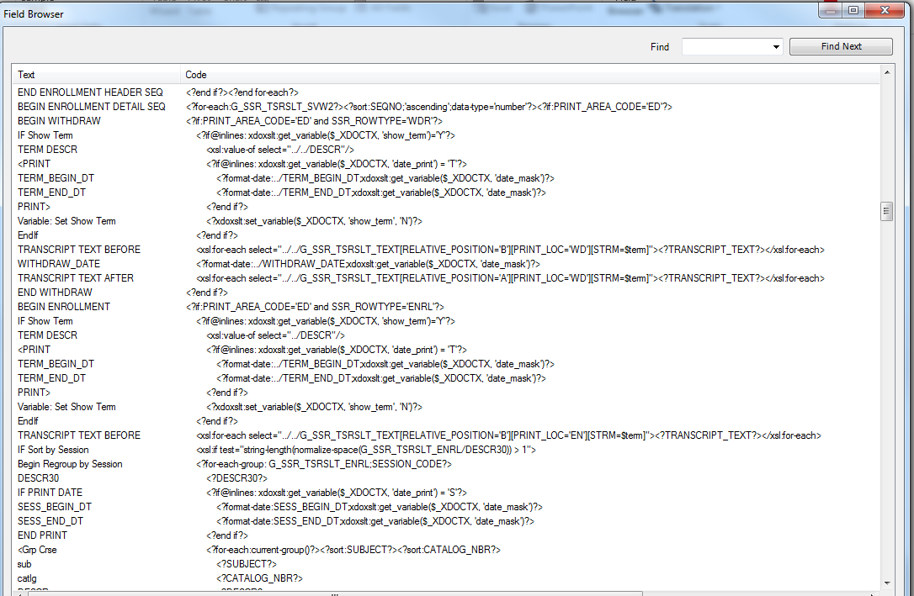
Delivered report template – Field browser

Slide 27
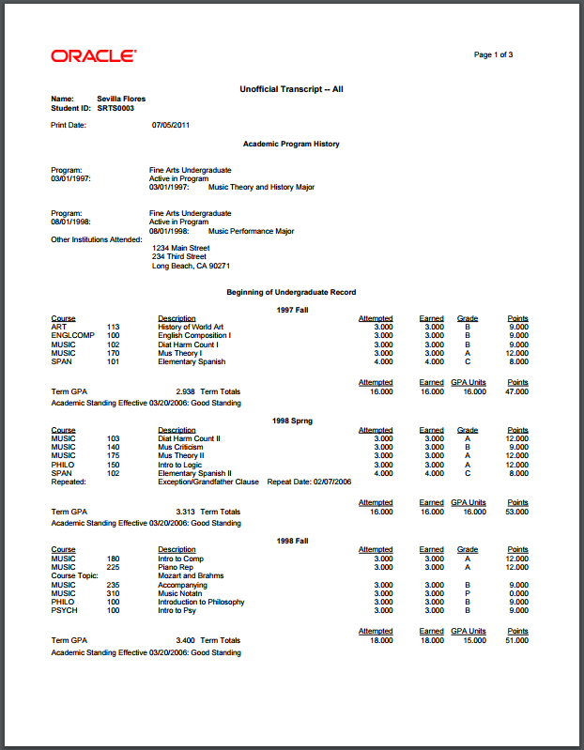
Delivered report template – result

Slide 28
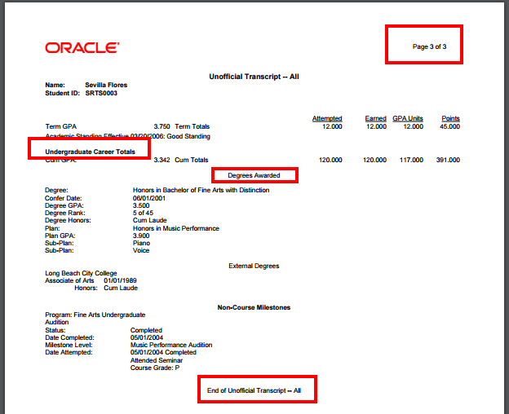
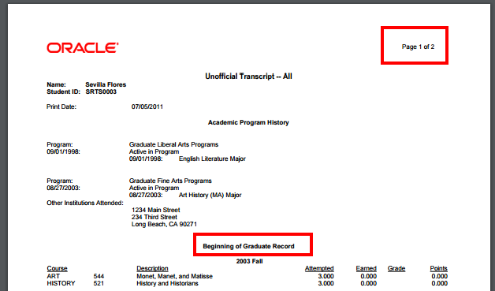
Delivered report template – split career

Slide 29
So if even a developer struggles with the delivered template, how can we expect an end-user to easily modify the layout?

Slide 31
Design Process overview
Design transcript layout
Start from delivered to see types of data
Design data structure
Map from new layout to a new data structure
Get new data into new records
Technical-build views, write App Engine steps
Extract according to new file structure
Use delivered records wherever possible
Add new records
Use XML File to update report template
Start from delivered or create new

Slide 32
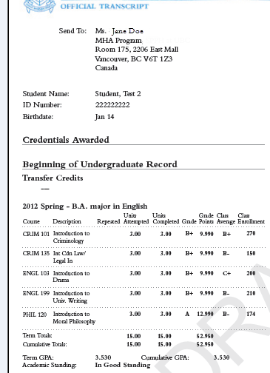
Mapping the Structure
Header Information (not shown)
Recipient Data
Personal Information
Degrees Data
Career Information
Transfer Credits (Detail)
Term + Program Data
Enrolment Data
Course Attributes
Class Instructors
Class Notes
Class Topics
Term Statistics
Academic Standing

Slide 33
Mapping the Structure (2)
Milestones Data
End of Career
Awards Data (Medals, Prizes)
Group by Career
Group by Term

Slide 34
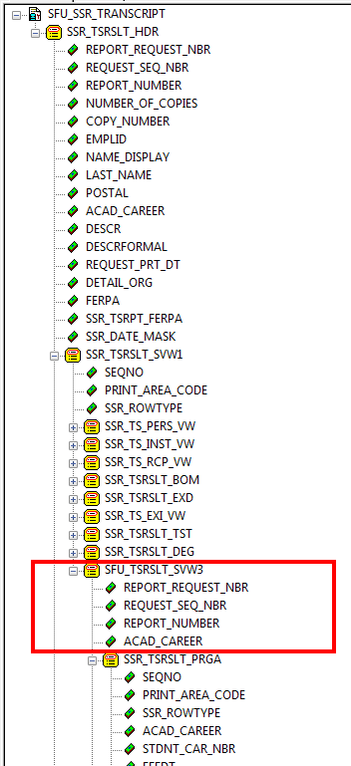
Modify the data (XML) structure
Reuse as much as possible!
Header data
NON-term related data sequencing
Personal Information
Recipient Data (“Send To”)
Degrees (moved higher)
NEW LEVEL – Academic Career data
Program Data
Subrecords: Plan, Subplan

Slide 35
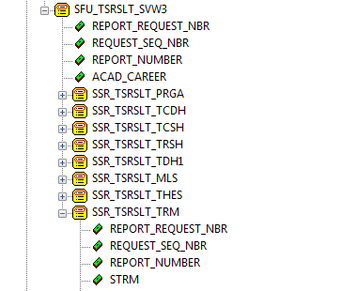
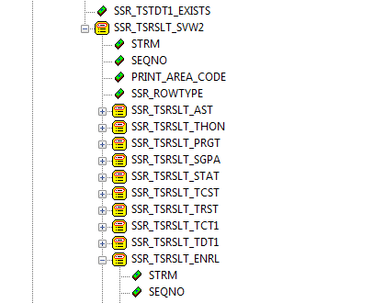
Modify the data (XML) structure (2)
Reuse as much as possible!
NEW LEVEL – Academic Career data
Program Data
Transfer Credits (Summary)
Milestones
Thesis
Term Data
Term related data sequencing
Academic Standing
Term Honours
Program Data
Subrecords: Plan, Subplan
Term Statistics
Transfer Credits (Detail)
Enrolment Details, etc

Slide 36
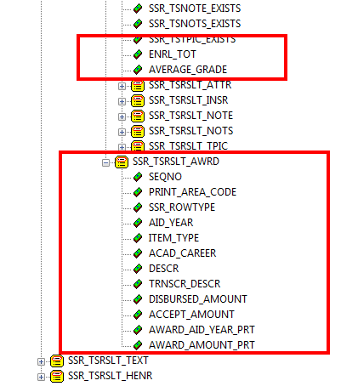
Modify the data (XML) structure (3)
Enrolment Details
New custom fields – Enrolment Total
– Class Average
Course Attributes
Class Instructors
Class Notes
Class Topics
Awards Data (modify)
Transcript Text
Historical Enrolment

Slide 37
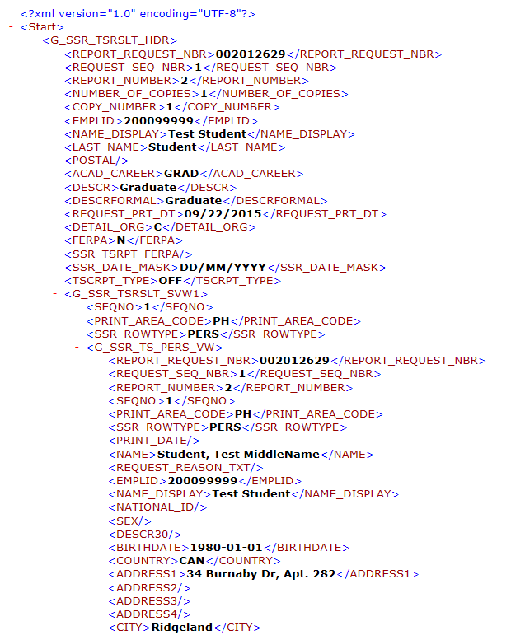
Understand the xml file

Slide 38
Understand the xml file
The structure is identical to the File Layout we have been studying.
Additional informational fields
These can be used for Report Template Logic
Page Header <PRINT_AREA_CODE>PH</PRINT_AREA_CODE>
Transcript Header<PRINT_AREA_CODE>TH</PRINT_AREA_CODE>
Enrollment Header<PRINT_AREA_CODE>EH</PRINT_AREA_CODE>
Enrollment Detail <PRINT_AREA_CODE>ED</PRINT_AREA_CODE>
Enrollment Trailer <PRINT_AREA_CODE>ET</PRINT_AREA_CODE>
Transcript Trailer <PRINT_AREA_CODE>TT</PRINT_AREA_CODE>

Slide 39
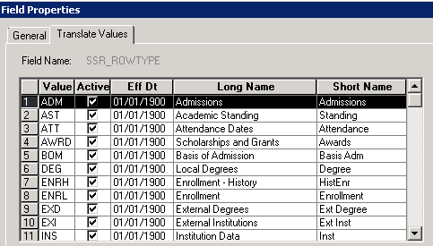
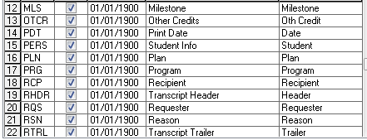
Understand the xml file – Row type
ROW TYPE - <SSR_ROWTYPE>

Slide 40
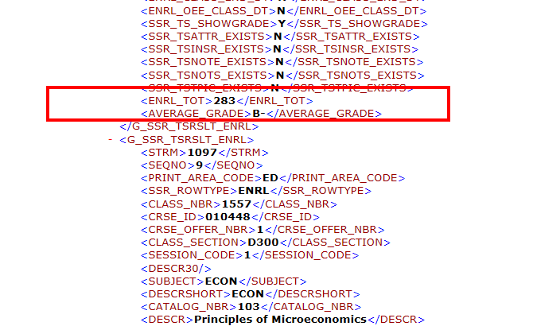
Xml structure – what next?
We have our XML Structure. Now what?
Get the new data into our new records/fields (alongside delivered)
Extract the data into our new XML File layout
Map the new data to the Report Template

Slide 41
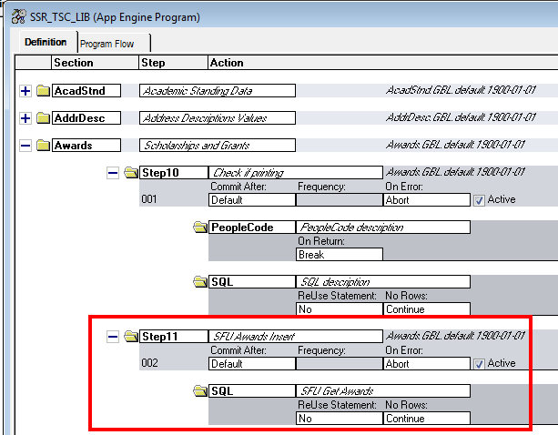
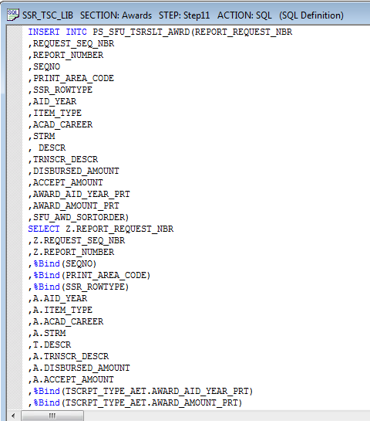
1. Getting the new/custom fields

Slide 42
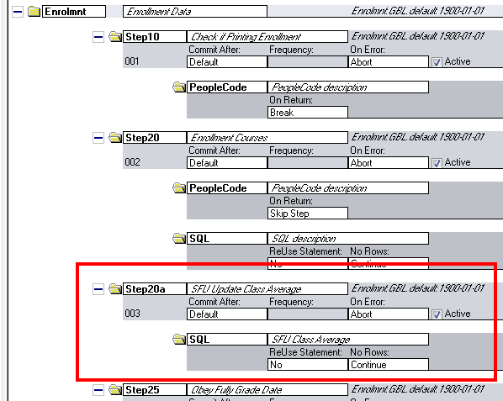
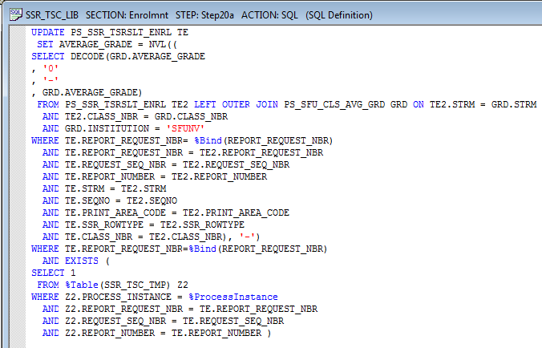
1. Getting the new/custom fields (2)

Slide 43
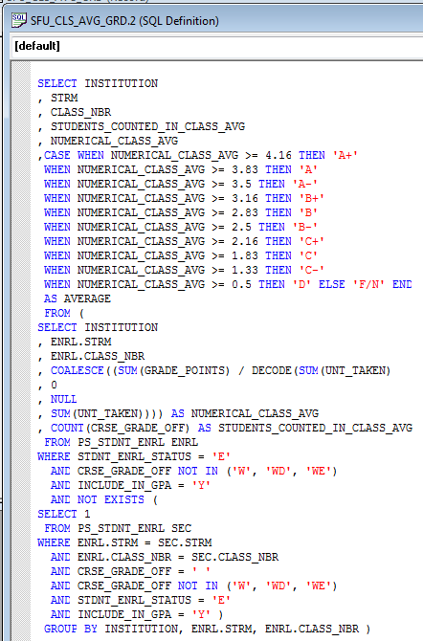
1. Getting the new/custom fields Add a field
Realtime Calculation of Class Average
Code our calculation into a View
Simply inserted data in a new step in the LIB App Engine (Step 1)
Extracted in Step 3 as part of the record (no customization required)

Slide 44
1. Getting the new/custom fields
Modify the Library App Engine: SSR_TSC_LIB
XML File requires a single Record or Field
Some new fields require complex logic
e.g. Class Average
Recommendation: Use views to capture the existing data/ Calculate On-the-fly fields
Extract process will extract the correct value at time of printing
No need to modify the LIB (Library) App Engine to create/calculate data

Slide 45
1. Getting the new/custom fields
Alternative: Populate Custom TEMP records
Modify the LIB (Library) App Engine to include new step(s)
Create new 'temporary' Transcript records to hold the calculated data
Include these in the “Transcript Purge” process as well (SSR_RPT_PURG)
Consider Performance Issues!
Marginal impacts noticed, using Views, with large batch runs.

Slide 46
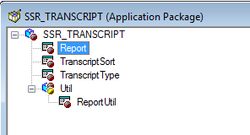
2. Extract the data into our new XML File Layout format
Application Package: SSR_TRANSCRIPT Create new 'temporary' Transcript records to hold the calculated data
Report
method WriteToDatasource
Two sections – one for Chronological, one for Career
Copy the section closest to your format and customize.

Slide 47
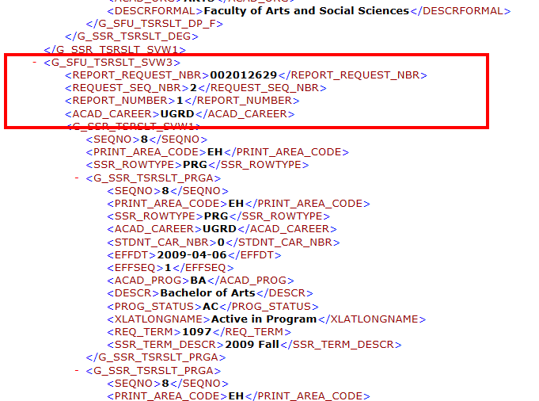
2. Extract the data into our new XML File Layout format

Slide 48
3. MAP THE NEW DATA TO THE NEW REPORT TEMPLATE
Two Options
Start from Delivered?
Delete all the sections you don't want
Tricky: hidden END statements; lose levels of hierarchy
Start fresh
Copy & paste the sections you want to keep
Modify hierarchy where necessary
Follow standard BI Publisher Report Development
You already have the XML File
Should be simple to insert fields from this

Slide 49
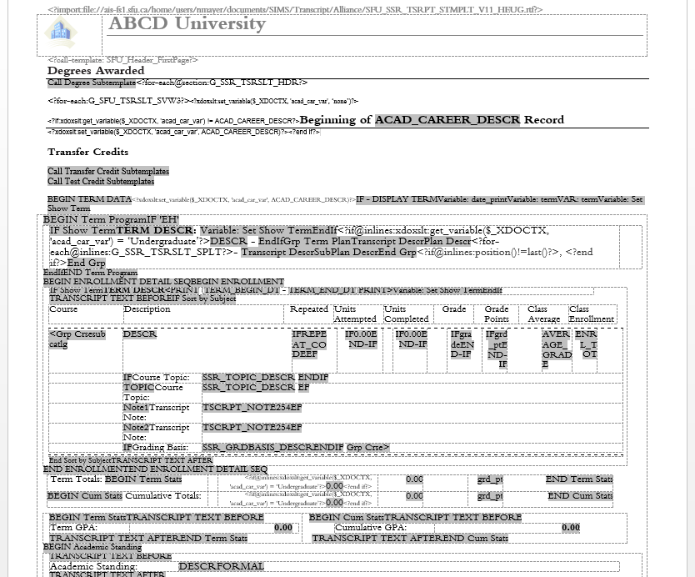
Sample template file
Header data
(Subtemplate – Personal Data, Send To)
Degrees
Academic Career data
Transfer Credits
Term Data
Program Data
Enrollment Data
Course Attributes
Class Instructors
Class Notes
Class Topics
Term Statistics
Academic Standing

Slide 50
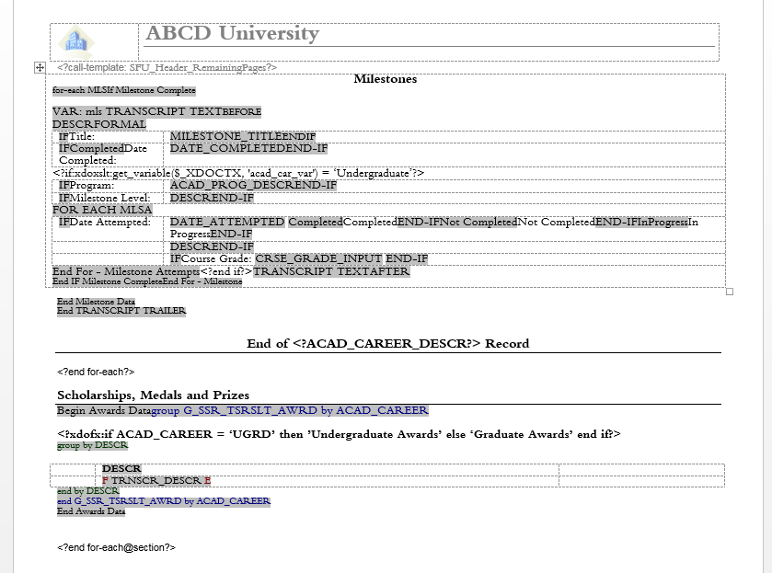
Sample template file (2)
(Subtemplate – Personal Data)
Milestones
End of Academic Career
Awards

Slide 51
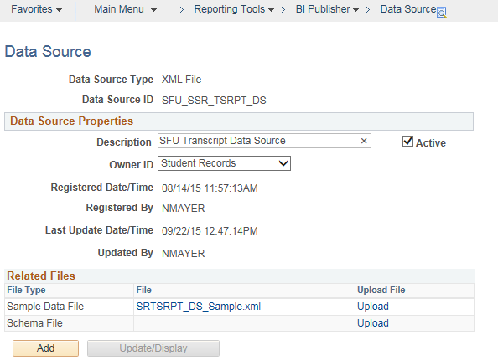
4. Upload and use the template!
The XML File is your data source

Slide 52
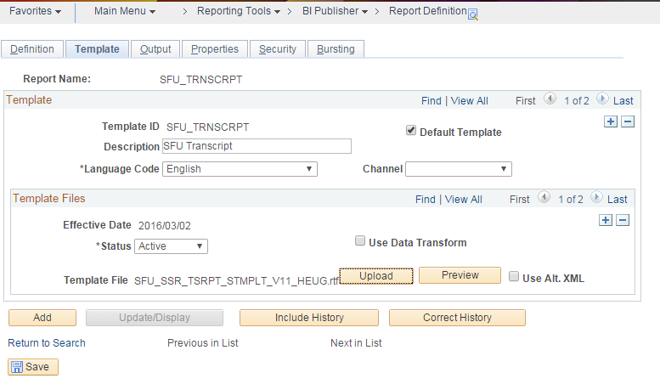
4. Upload and use the template!

Slide 53
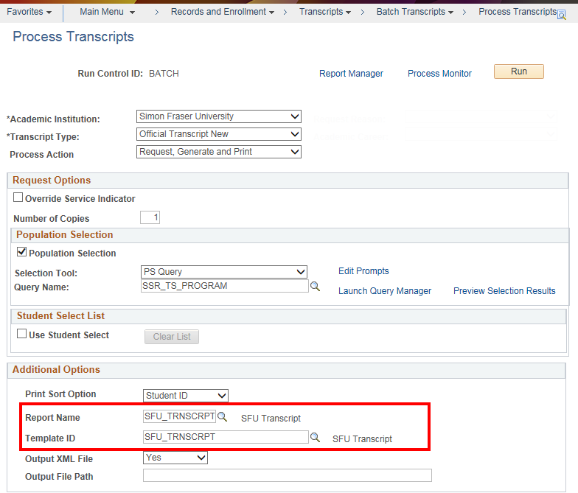
5. testing
Very simple with delivered “Process Transcripts” page!
PDF file and XML file – Report Manager
Test on local desktop once you have the XML file.

Slide 54
Tips & tricks
Things to note!

Slide 55
Template file tips and tricks
Watch those FOR loops!
Use the Field Browser and “Validate Template” regularly
Different Header on Page 1
Word’s “Different First Page” functionality
What about dynamic data from child records? (The loop breaks!)
Workaround: Set up Variables in Page 1 header that are referenced in Page 2 onward

Slide 56
Template file tips and tricks

Slide 57
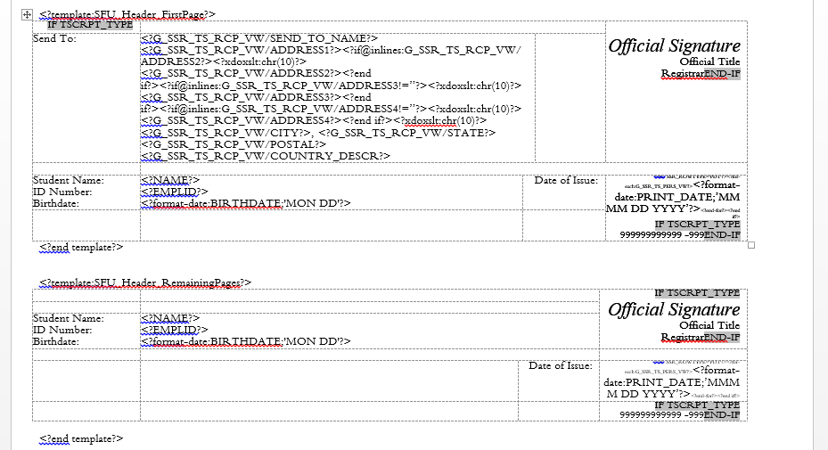
Simpler template file – Sub-template

Slide 58
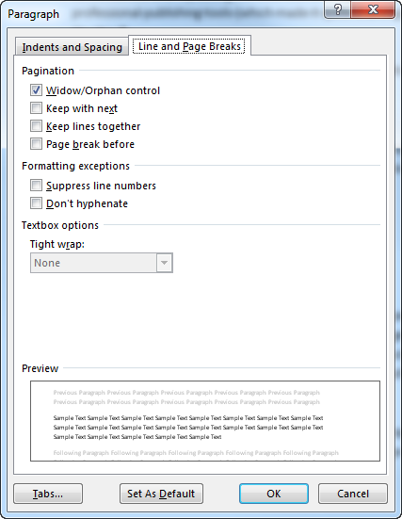
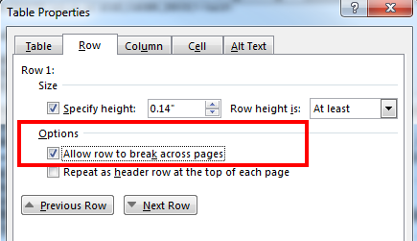
Template file tips and tricks
Page Breaks in the middle of data?
Use tables with no row break flag set
Use Word’s delivered Pagination controls
Run to RTF so user can modify final layout?

Slide 59
My data does/doesn’t print?!
CONFIGURATION
Front-end configuration throughout the system
Print on Transcript? Flags – Program/Plan/Milestones/Degrees/Grading Basis/etc.
Specific Transcript Description fields
A field, and its value, may appear in the XML file but not print.
Check the “Transcript Print Flag” – Y or N?
<TRNSCR_PRINT_FL>Y</TRNSCR_PRINT_FL>
Check the Config level – Official? Unofficial?
Milestones are tricky!
Recommendation: Set everything to ‘Y’ when designing/building transcript.
Switch off as appropriate.

Slide 60
Issues encountered
Things to watch out!

Slide 61
Bi publisher/Pdf issues
Inserting an Image File into a MS-Word RTF template file can cause file size to increase exponentially
BIP runs out of memory
Change Registry flag or minimize image file size
Workaround reference: https://support.microsoft.com/en-us/kb/224663
Chrome Browser will not print dotted lines from a PDF
Known bug with Chrome: https://code.google.com/p/chromium/issues/detail?id=539533
Workarounds: Disable “Chrome PDF Viewer” plugin or Educate users

Slide 62
SUMMARY

Slide 63
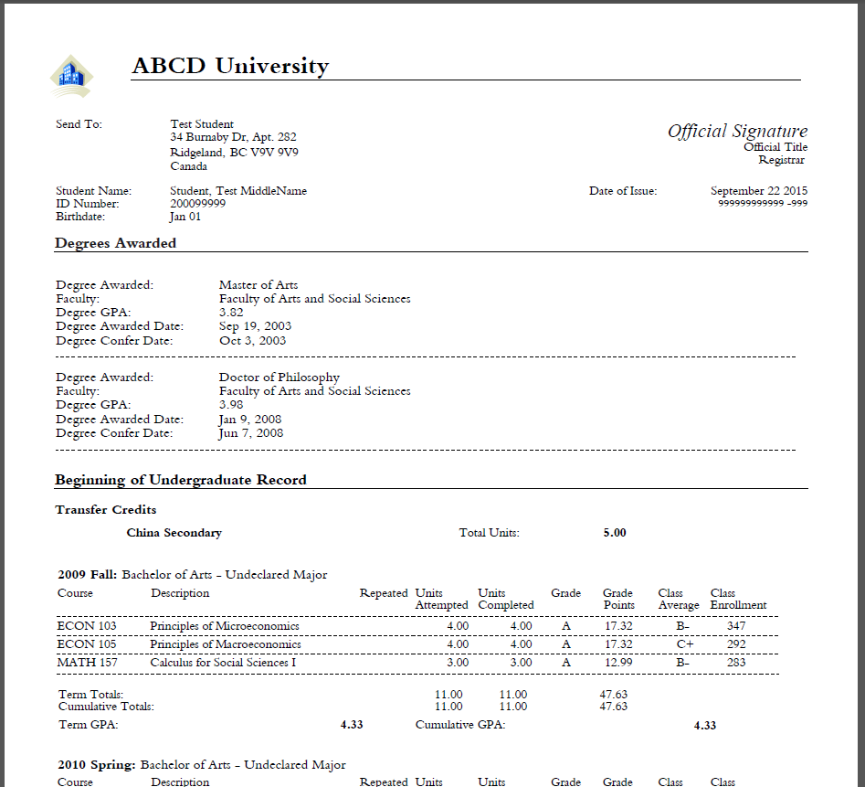
Our final transcript

Slide 64
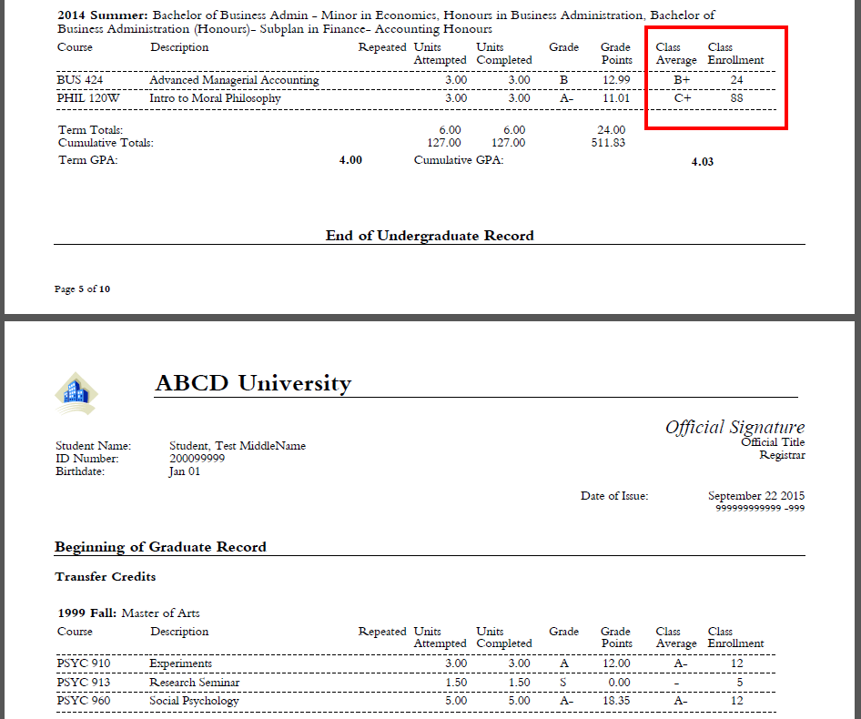
Our final transcript

Slide 65
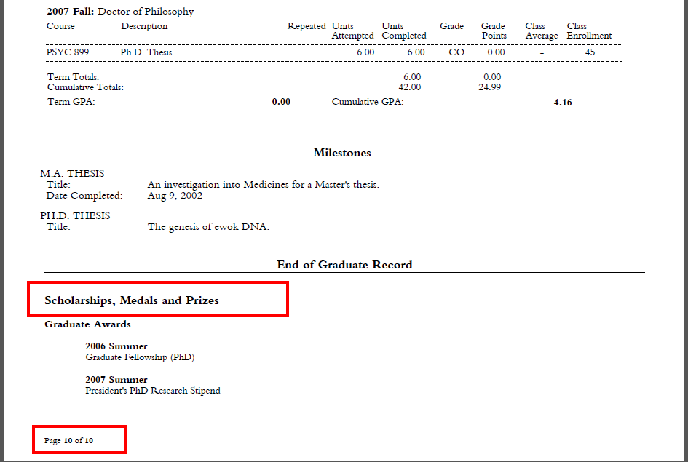
Our final transcript

Slide 66
Approach summary
Design report layout
Design XML File layout
Create layout in App Designer
Get data into new records
Update the “Library” App Engine
Extract according to new file structure
Update the “Extract” App Package Peoplecode
Use XML File to update report template
Start from delivered or write your own

Slide 67
Additional reference: Oracle Technical Guide – “Defining and Generating Transcripts”
ANY QUESTIONS?

Slide 68
presenters
Juliana Hui
Simon Fraser University
all Alliance presentations will be available for download from the Conference Site

Slide 69
THANK YOU!

