Slide 1
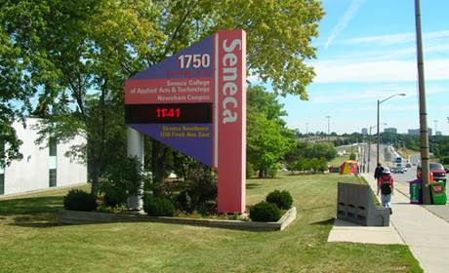
Integrating PeopleSoft HCM with Benefit Provider
Canada Alliance 2017
LakshmiNarasimhan Srinivasan Senior Functional Analyst
Kim Mcgann Manager, Pension & Benefits, Human Resources
Notes:
Lakshmi

Slide 2
Agenda
Introduction – The Team
Strategic Objectives
The Technology Platform
Legacy Process
Business Case
Approach and Solution
Demonstration
Key to a Successful Implementation
Q & A
Notes:
Lakshmi

Slide 3
Seneca Team
Technology Team
Lead Developer
Functional Analyst
Business
Employee Benefits
HRIS
Vendor
Data Analyst – Sun Life
Network File Transfer Analyst – Sun Life
Notes:
Lead Developer – Shilpa Varshney
Functional Analyst – LakshmiNarasimhan
Business
Benefit Manager – Kim Mcgann
HRIS – Kevin Yang
Vendor
Sami Basset
Sam Tapdigov

Slide 4
Seneca Strategic Objectives
Great Foundations– “A different kind of school with a different kind of graduate, supported by great faculty and staff, processes and physical infrastructure”
Services integrated and available on multiple platforms
Extension of HCM and integration with third party system
Secured
Sustainable
Extensible

Slide 5
Technology Platform
HCM
PeopleSoft 9.2
Peopletools 8.55.10
Oracle 11.2.0.4.0
Configuration Structure
10 Benefit Programs
11 Plan Types
Hundreds of Benefit Plan Codes
Custom Bolt-on for Partial-load Benefit Administration

Slide 6
Technology Platform
Sun Life Plan Sponsor System
4 Benefit Policies
FT Administrative Staff & Survivors (Policy 50833)
FT Support Staff & Survivors (Policy 50834)
FT & Partial-load Academic Staff & Survivors (Policy 50832)
Retirees & Survivors (Policy 22182)
Policies are unique with different coverage, waiting periods and premiums.
College Benefit Administrators are granted access to the Sun Life Plan Sponsor System in order to maintain all benefit records on behalf of the Sun Life.
A monthly invoice is generated through this system for each policy detailed by employee and total premium for each of the employee’s coverage.
College remits payment based on this invoice.

Slide 7
Background – Our Relationship with the Benefit Provider
Each College is responsible for self-administering the group benefit policies in regards to:
Enrolment/Termination/Personal data changes (i.e. change of address)
Adding and removing coverage
Adding and removing dependents
Transferring from one policy to another
Banking Information

Slide 8
Legacy Process
Benefit Specialist manually entered group benefit transactions into PeopleSoft 9.2 Base Benefit Tables and would manually enter the same data into Sun Life’s Plan Sponsor’s System.
The automated custom bolt-on updates base benefit tables for Partial-load(PLD) benefit alone.
Queries would be ran in PeopleSoft to identify the new data for PLD’s and then they would manually enter this data in the Sun Life.
Peak periods (beginning of each semester) resulted in many rejected claims due to delays in manual data entry.
Notes:
Describe FT Process
Partial-load Process
New enrolments
E52
Reinstatement Automation
Run Queries
Sun Life update from queries.
During peak periods – 300 reinstatements
Benefit Staff experience
Rejected claims
Employee perspective.

Slide 9
Business Case – What is there to gain?
Eliminates Duplication of work
Benefit Transactions | Number of Transactions
New Full-time Enrolments/Transfers | 126
Full-time Termination of Coverage (Resignations, Retirements, Dismissals) | 96
New Partial-load Enrolments | 60
Partial-load Reinstatement of Coverage | 751
Partial-load Termination of Coverage | 751
Student Status Updates | 94
Total | 1878
Notes:
Whenever you are planning to proceed with a major system enhancement or a business process improvement that will require resources, effort and risk, I would recommend that you get the buy in from the highest levels.
For us critical in order to get the IT resources that we need.
So the big question is “How do you get on the list”. The main question you will need to answer is “What is there to gain” by doing an integration with the Benefit Provider. In short, what is your business case.
Some of the items presented as our Business Case were:
Eliminates Duplication of work
Lucky metrics
Did not keep all metrics
We did not keep metrics but we had enough to demonstrate that integration between PeopleSoft and Sun Life would result in a significant time savings by eliminating the duplication of work
Describe chart.
Over 2000

Slide 10
Business Case – What is there to gain?
Improves Data Integrity
The interface should identify data entry errors:
Missing certificate number
Benefit coverage does not match benefit policy
Multiple benefit coverage elect rows without a termination row
The data being sent does not match Sun Life requirements
Paying Benefit vendor for the coverage that is being used.
One source of truth
Premium reconciliation is more efficient
Improves client satisfaction
Notes:
Data integrity is significantly improved when there is another program validating data entry.
A requirement for the interface design was that interface should be able to identify data entry errors as well as we wanted to ensure that the data being sent to Sun Life was accurate and error free.
By building these additional validations into the interface programming, it provided additional checks and balances to ensure data integrity within our PeopleSoft system and Sun Life Plan Sponsor System.
Ensures that we are paying the benefit vendor for coverage that is being used.
One source of truth. We can rely on PeopleSoft as being the accurate record for Sun Life coverage.
Benefit records match in both systems because it is PeopleSoft data being sent. Prior to the interface, the data may be different since they were both being manually entered. This might include missing a benefit election or forgetting to terminate coverage when a person resigns employment.
Premium Reconcilation is more efficient because the likelihood of discrepancies between Sun Life’s monthly invoice and our Payroll benefit premium deductions is significantly reduced.
Improved client satisfaction
more efficient way to get the data to Sun Life.
Employee benefit transactions are uploaded quicker
Less rejected claims due to delays in manual entry.
In the end, the data is more accurate resulting in timely and efficient claim processing

Slide 11
Business Case – What is there to gain?
Employee Engagement Improves
Manual entry is reduced in half
More time for staff to focus on value add initiatives
Proactive benefit administration vs reactive
Electronic record of all transactions sent to Benefit Provider
Sun Life Plan Sponsor System is live system.
The PeopleSoft data history provides you with a record of Sun Life transaction
Know exactly when coverage elections were sent to Sun Life and when termination of coverage was sent.
Will be able to assist employees with resolving claim resolution more efficiently and accurately.
Notes:
Employee Engagement Improves:
When manual entry is essentially reduced in half, the work experience of the Benefit Staff is automatically improved.
At the beginning of each semester when manual entry is at its peak, I can appreciate that our Benefit Staff must be saying to themselves “Oh no, its that time of year again” and some of those days of continuous manual entry must have seemed long.
In addition, the large volume of manual entries will have had a negative impact to our response times during these periods as a lot of their time had to be focused on getting these transactions into the Sun Life’s system.
The integration will provide the benefit staff with more time for staff to focus on value add initiatives
proactive benefit administration vs reactive.
Since the interface, we were able to design some orientation sessions, outreach drop in sessions and documenting our standard operating procedures.
Electronic record of all transactions sent to Benefit Provider
historical record of what and when data was updated in the Plan Sponsor System.
assist us greatly with claim resolution and employees with benefit inquiries.
There is now one source of truth.
Student Status Example
confident that we know the reason for the decline and that the employee claim will be processed successful this time.

Slide 12
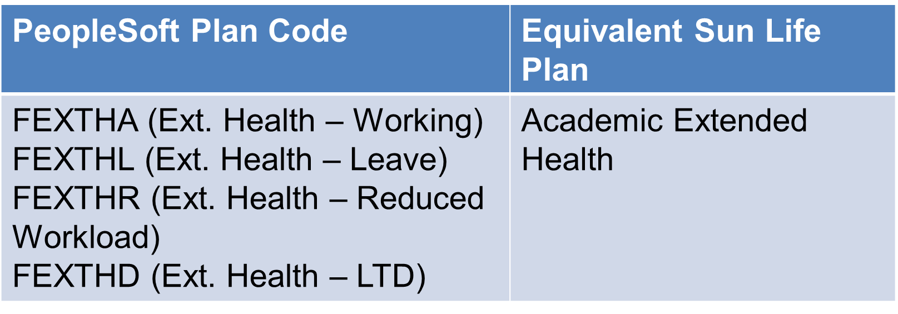
Approach– Interface should be able to…
Determine what is not a Benefit change
Not a Change when an faculty moves from FEXTHA to FEXTHL

Slide 13
Approach– Interface should be able to…
Determine what is a benefit change
Change when Employee moves from FEXTHA to AEXTHA
PeopleSoft Plan Code | Equivalent Sun Life Plan
FEXTHA (Ext. Health – working) to AEXTHA (Ext. Health – working) | Academic Ext. Health to Administrative Staff Ext. Health

Slide 14
Approach– Interface should be able to…
Translate PeopleSoft configuration into Sun Life configuration
PeopleSoft
Sun Life

Slide 15
Solution – What Interface does…
Designed configuration tables to store all eligible benefit plans along with Benefit program.
Benefits that are eligible to be sent to Sun Life and the corresponding Sun Life codes.

Slide 16
Solution – What Interface does…
Configuration of Admin Benefit Plan.

Slide 17
Approach– Interface should be able to…
Determine the data needed for Sun Life to make the change identified
The interface will need to be able to determine the type of change that is occurring.
Is the employee brand new?
Is the employee new to this policy but terminating from another policy?
Is the employee reinstating coverage that they previously had in the same policy?
Does the employee have dependents?
What benefits changed and what benefits stayed the same?
Determine when the data is to be sent
Ability to set parameters of what data should be picked up on the file
No future changes past invoice cut off dates

Slide 18
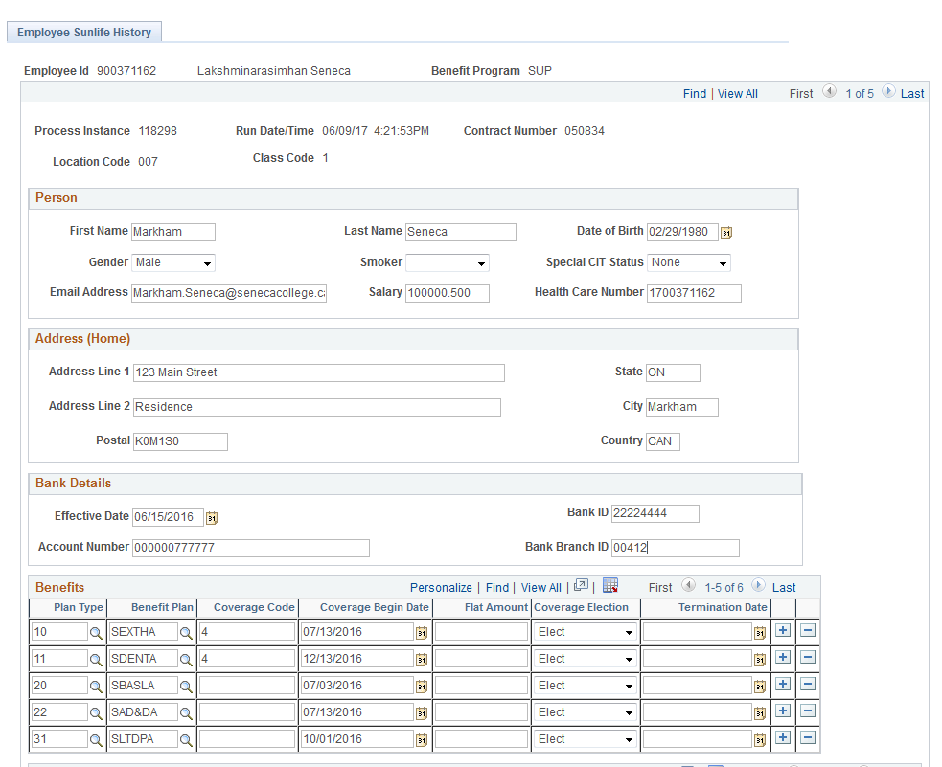
Solution – What Interface does…
Designed Sun Life History page.
This page will contain all information that we sent to Sun Life

Slide 19
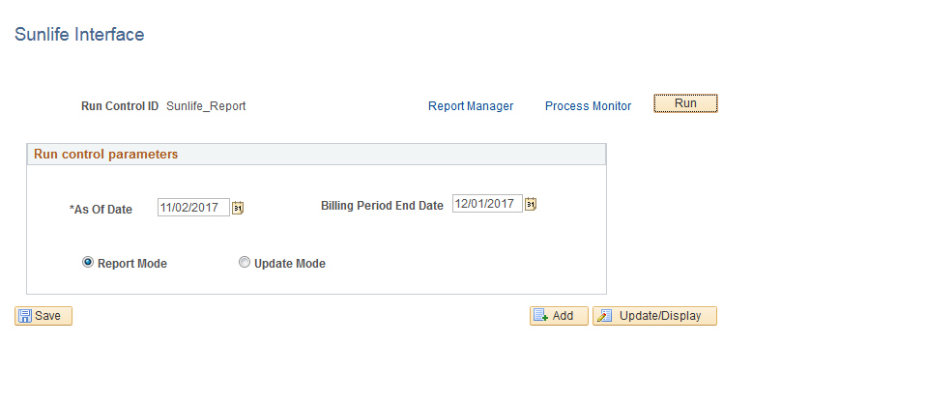
Solution – What Interface does…
The Run Control Page provides Benefit users option to select changes based on the date.
Notes:
Entering Future dated rows in Peoplesoft is still open, but we don’t send that data to sunlife until that date.

Slide 20
Approach– Interface should be able to…
Identify data errors before the data is sent to benefit provider
Provide the opportunity to correct all errors before the data is sent to benefit provider
Ability to do “Real Time” Manual Changes in Sun Life without compromising data cohesion with PeopleSoft.
Archive interface data transaction history for each employee
To send the file in the format required by the vendor – XML file
To send the file whenever we choose
Allow for future Benefit Programs and Plan
Notes:
Identify data errors:
that do not meet the requirements of the interface file like all required fields being completed.
It will identify data that is inconsistent with the benefit program and plan configuration. For example if an employee is over age 65 but is enrolled in a plan for only employees who are under age 65, the error report will report this error.
Missing Information like, Member ID number to identify member
Missing information that is need for the type of transaction,like
Smoker status missing for Critical Illness coverage that requires to know if you smoke in order to bill the correct rate.
Missing Banking information for a new member
Missing date of birth if age rated premium
family coverage with no dependents listed
Ability to run the file as many times as we want before the file is sent to Sun Life. This provides us with the opportunity to fix any data entry errors before producing the final file.
Ability to do Real Time Manual Changes in Sun Life without compromising data cohesion with PeopleSoft.
Person at pharmacy example
If a record was manually updated on the Sun Life Plan Sponsor System, we needed the ability to manually update PeopleSoft data history records to reflect the same manually change.
As a result, the PeopleSoft historical record will always match the Sun Life Plan Sponsor System record.
Gives PeopleSoft the ability to accurately recognize when a change occurs for future benefit transactions when the record is identical to the Sun Life record.
4. Archive data with A time stamped record of every transaction sent to Sun Life.
5. Send the file in required XML format.
6. Send file more often during peak periods when volume is high in order to get coverage activated more efficiently.
Build for Future changes
Collective Bargaining

Slide 21
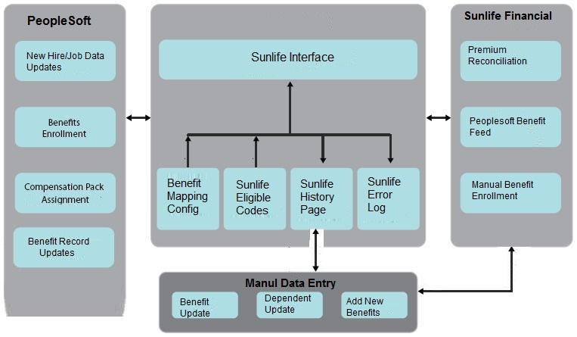
ARCHITECTURE

Slide 22
Thank You!

Slide 23
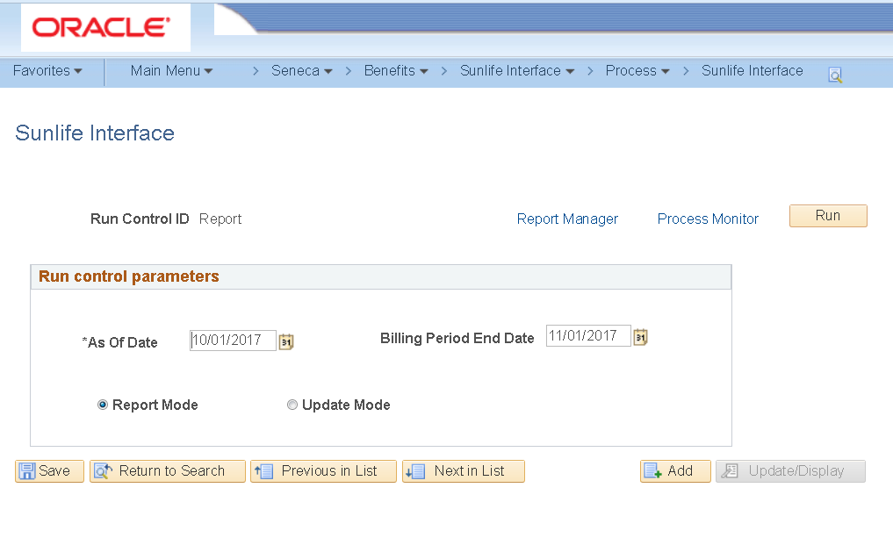
Run Control – Report Mode

Slide 24
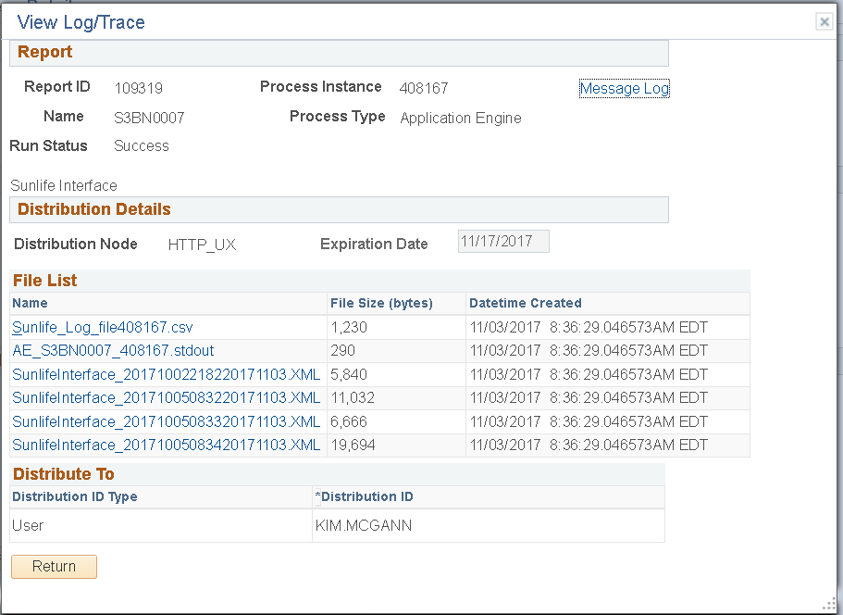
Process Monitor – Review Error Log

Slide 25
Error Log

Slide 26
Re-run in Report Mode

Slide 27
Check Error Log to See if Error has been resolved

Slide 28
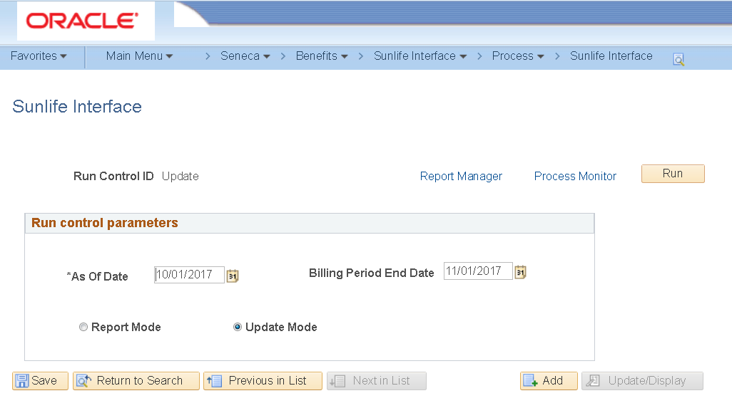
Run File in Update Mode

Slide 29
XML File

Slide 30
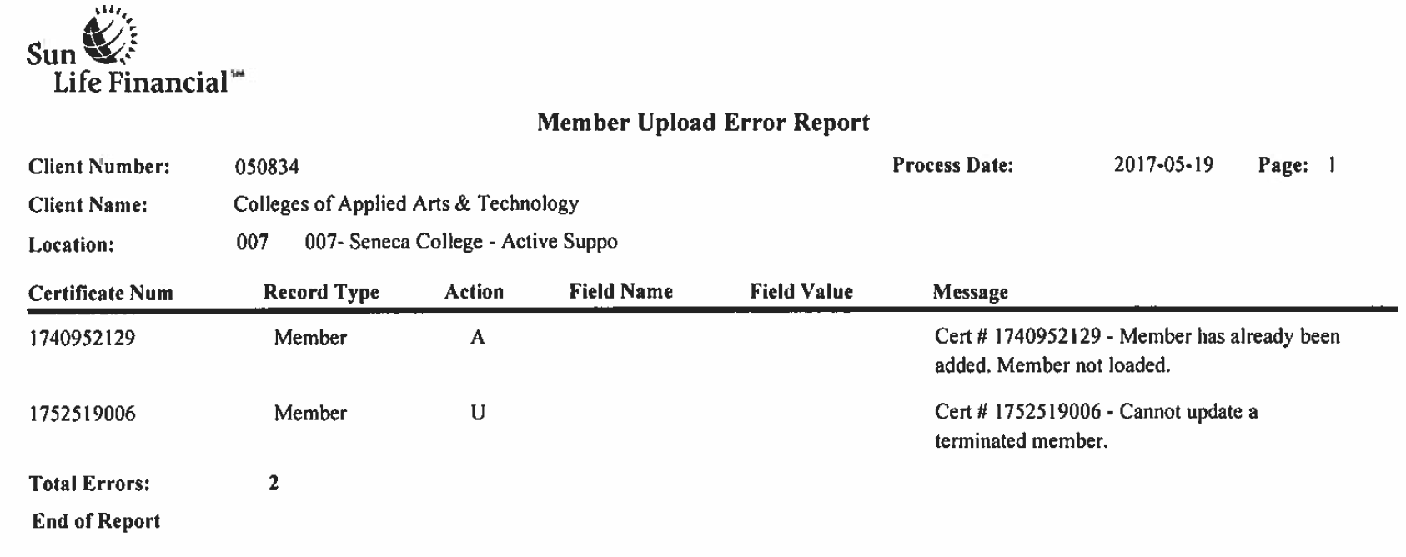
Validation of Successful Integration
Error Report from Benefit Provider
Scheduled file is sent to Sun Life every Saturday
Sun Life provides an error report by Tuesday

Slide 31
Keys to Success– Hind sight is 20/20
Get buy-in at the highest levels
Have a project manager and project plan to keep everyone accountable
Engage the benefit provider months in advance
Understand the benefit providers requirements as it pertains to your policies
Choose an experienced Subject Matter Expert that is familiar with your system configuration.
Dedicated IT resource
Don’t under estimate the complexity.
Create extensive test scripts: try and think of every scenario that may come up
Test, Test, Test.
Just before go-live, do a data clean up by comparing your data with the benefit provider, make sure all data matches, freeze system until go live.
Reconcile after you go live to detect any missed issues.
“Do It. It is worth the effort!”

Slide 32
Lakshminarasimhan Srinivasan Kim Mcgann Senior Functional Analyst Manager, Pension & Benefits, Human Resources lakshminarasimhan.srinivasan@senecacollege.ca kim.mcgann@senecacollege.ca

Slide 33
Thank You!
Notes:
Rubinder

