Slide 1
Using Query to allow easily customisable bolt-ons
SESSION 6510
20 October 2022

Slide 2
presenter
Andrew Morrell
Functional Development Lead
Queen’s University Belfast
a.morrell@qub.ac.uk
Worked with Campus Solutions for 15 years as both a developer and a functional developer on wide range of projects including Admissions, Student Registration, Data Futures and Reporting.

Slide 3
Queen’s University Belfast
Founded in 1845
Approximately 25k students
Russell Group member

Slide 4
ORGANIZATION & ORACLE
Locally branded Qsis
CS 9.2 PUM25
PeopleTools 8.59.07

Slide 5
Overview
1
3
PROBLEM 1
Dealing with Data Futures data collection for Students
PROBLEM 2
Changing data export to new Virtual Learning Environment
2
4
SOLUTION 1
Utilising Query for customisable enrolment and registration
SOLUTION 2
Utilising Query to create customisable data export interface

Slide 6
Data Futures – Statutory data Collection
Keeping on top of ever-changing HESA requirements without having to deal with multiple Requests for Change (RFCs)

Slide 7
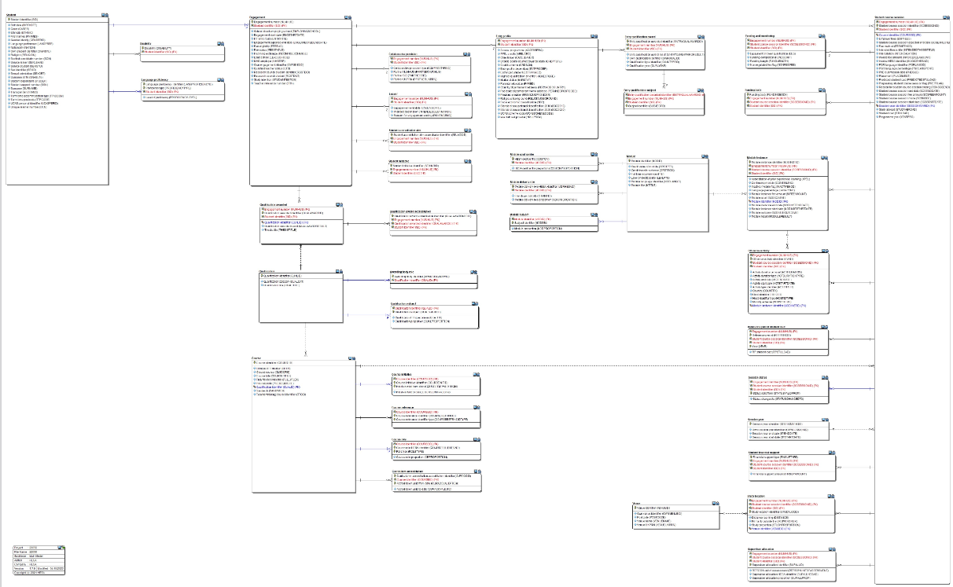
Data Futures data model (umpteenth iteration)
https://hesacodingmanualprod.blob.core.windows.net/strapi-files/assets/56_Data_Model_f_22_6dfcdb3dc0.pdf

Slide 8
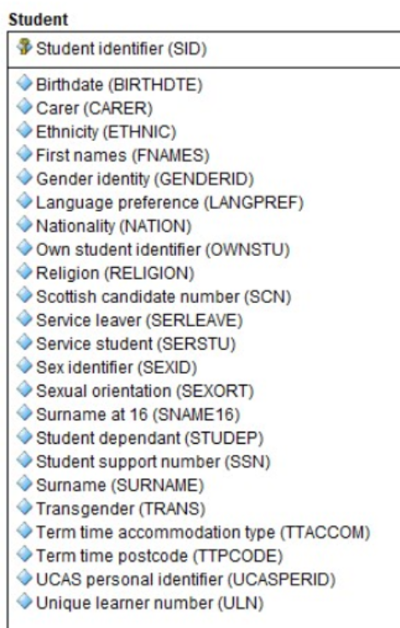
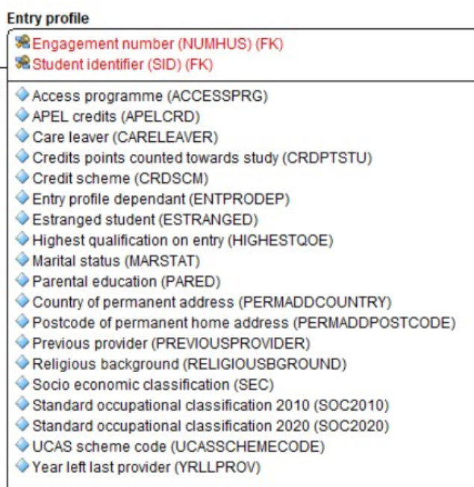
Example Student characteristics
https://hesacodingmanualprod.blob.core.windows.net/strapi-files/assets/56_Data_Model_f_22_6dfcdb3dc0.pdf

Slide 9
Example Student characteristics
https://hesacodingmanualprod.blob.core.windows.net/strapi-files/assets/56_Data_Model_f_22_6dfcdb3dc0.pdf

Slide 10
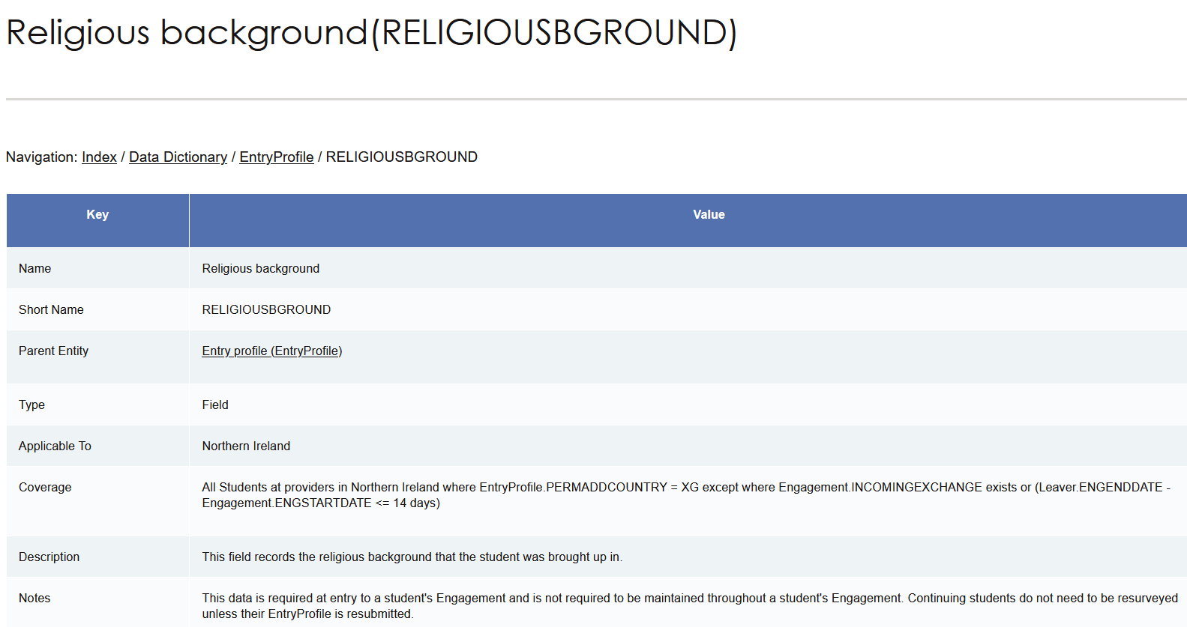
RELIGIOUSBACKGROUND
https://codingmanual.hesa.ac.uk/22056/EntryProfile/field/RELIGIOUSBGROUND

Slide 11
Competing requirements
Maintaining GDPR Principles
Changing HESA Requirements
Customised User Experience
Minimising Development Requirements

Slide 12
CUSTOMISABLE ENROLMENT AND REGISTRATION
Utilising Queries, we developed a solution to meet all the competing requirements.

Slide 13
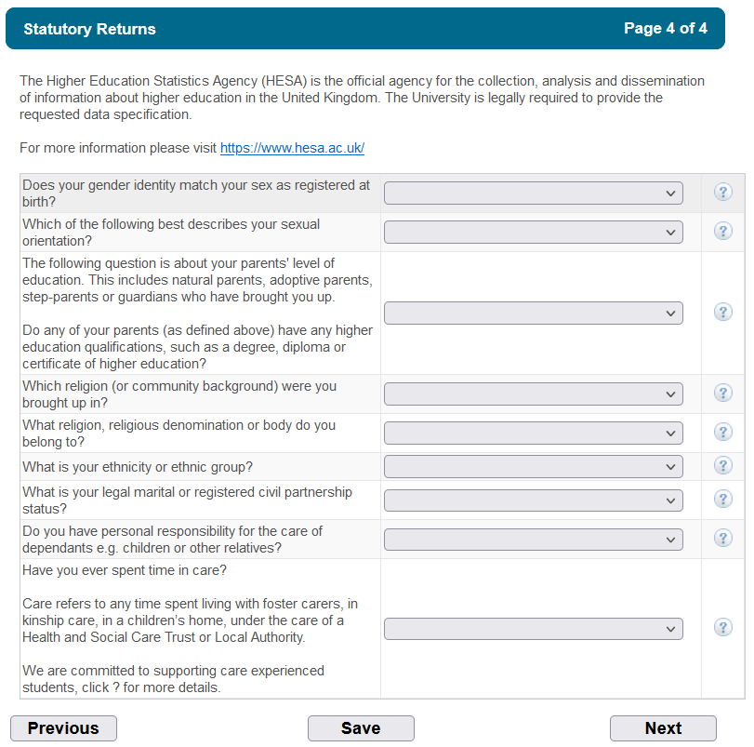
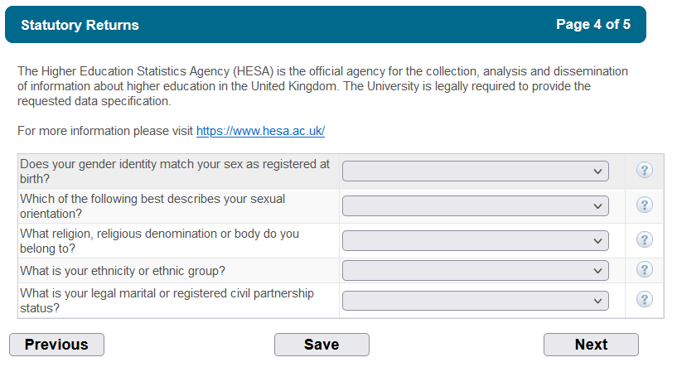
What the individual student sees
International First Year Student
Northern Ireland First Year Student

Slide 14
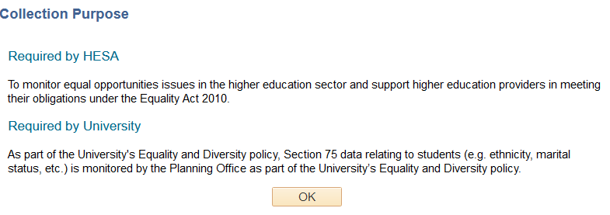
GDPR – Clear Collection Purposes

Slide 15
Configuration COMPONENT - OVERVIEW

Slide 16
CONFIGURATION – DETAIL 1

Slide 17
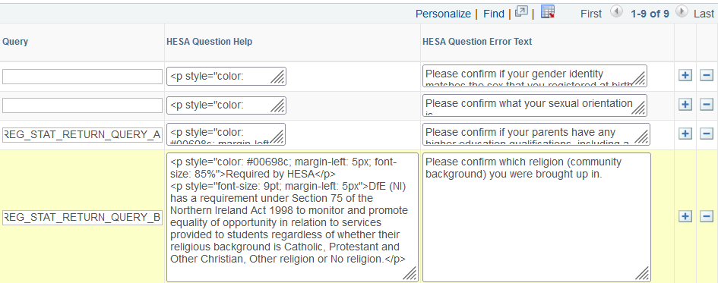
Configuration – Detail 2

Slide 18
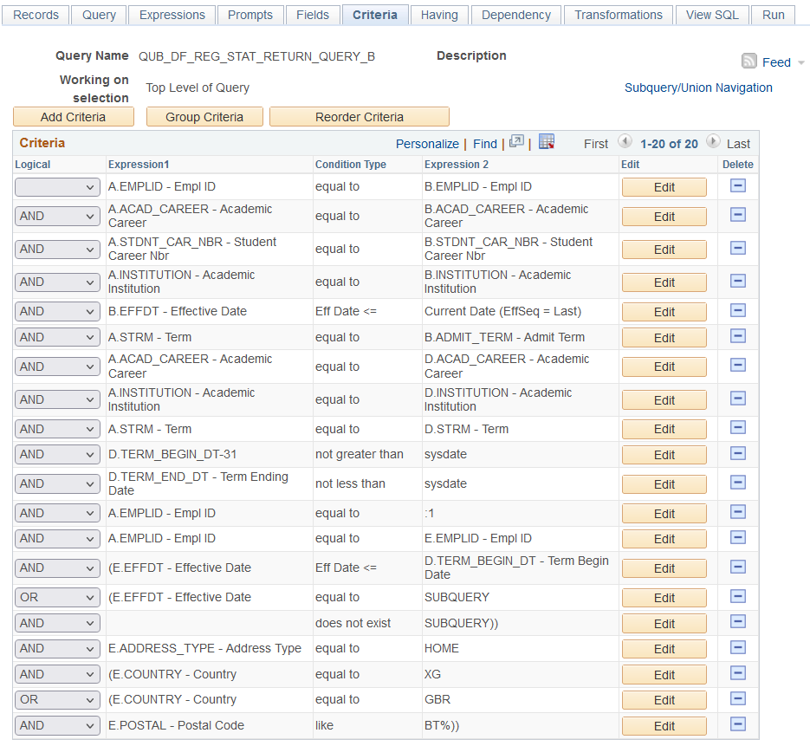
Configuration – QUERY EXAMPLE

Slide 19
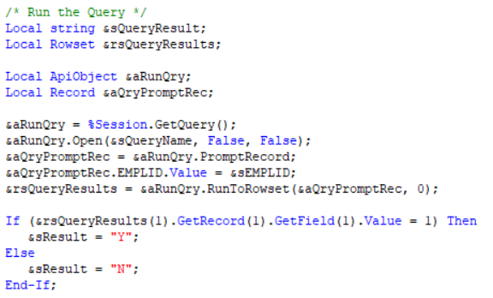
UNDER THE HOOD – Code snippets

Slide 20
Competing requirements
Queries can be (and have been) changed when requirements change
Maintaining GDPR Principles
Changing HESA Requirements
Customised User Experience
Minimising Development Requirements
Clear collection purposes
One configuration page to drive all combinations
Students only fill in necessary questions

Slide 21
New Virtual learning environment interface
How do you provide a solution when you know they’re going to change their mind

Slide 22
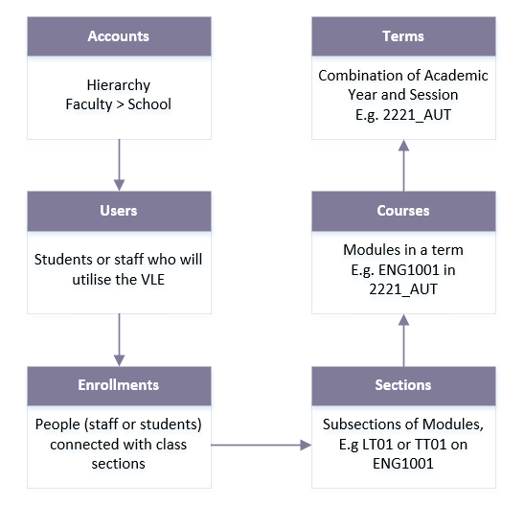
Data model
Daily feed of information from Campus Solutions to Canvas
Each entity requires separate CSV

Slide 23
Identified issues/Opportunities
Not all cohorts will be included in Phase 1
Historically, changes are inevitable in interfaces
Enhance gradually post-pilot review
Desire to create reusable export tool

Slide 24
CUSTOMISABLE DATA export tool
Utilising Queries, we developed a reusable solution to allow gradual enhancement.

Slide 25
Data Export Tool

Slide 26
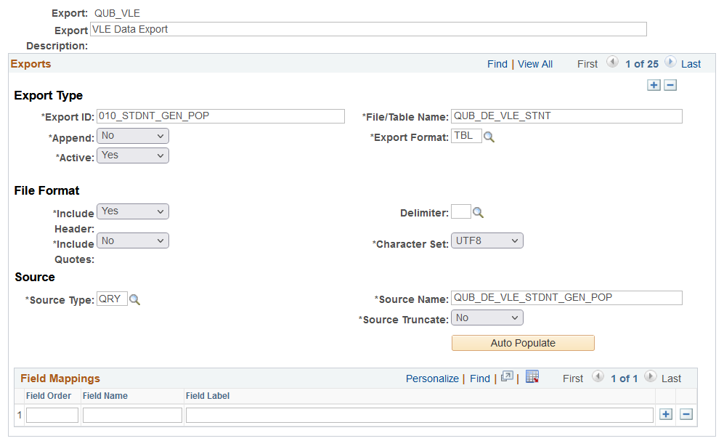

Slide 27
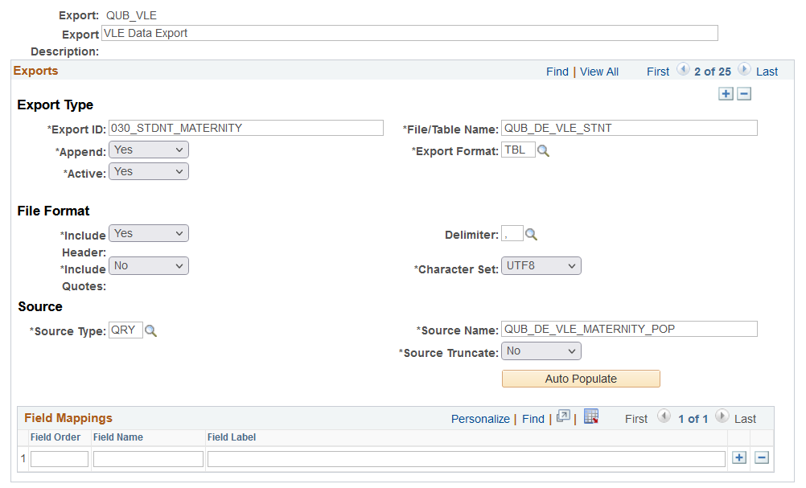

Slide 28
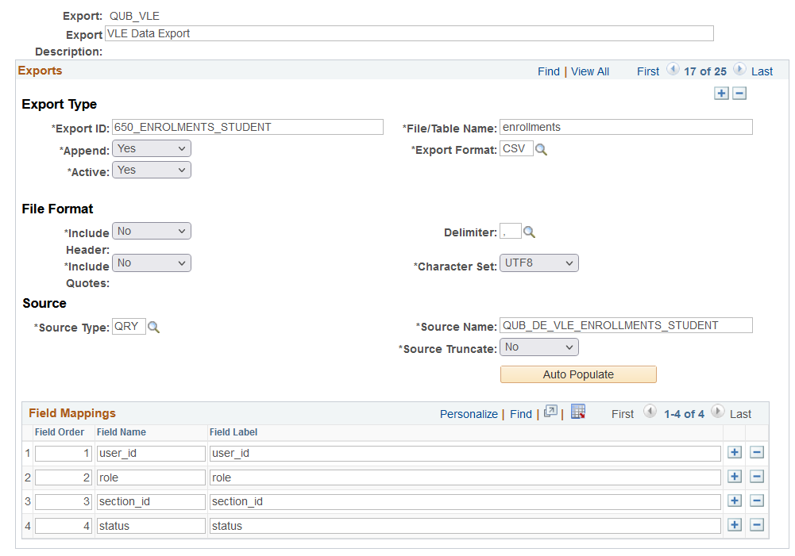

Slide 29
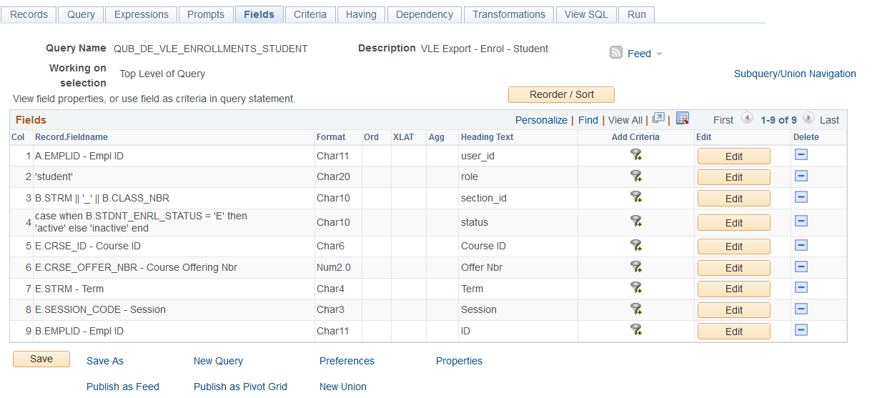
Query provides complete flexibility

Slide 30
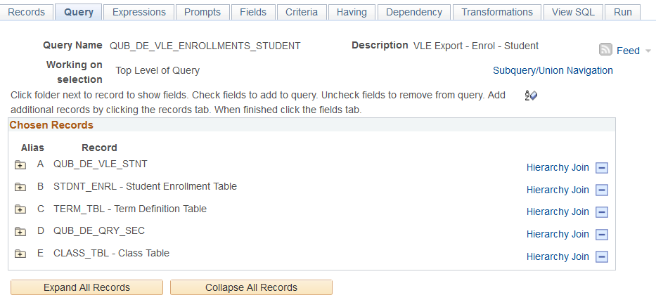
QUERY SECURITY – ADD A DUMMY RECORD

Slide 31
Identified issues/Opportunities
Not all cohorts will be included in Phase 1
Historically, changes are inevitable in interfaces
Enhance gradually post-pilot review
Desire to create reusable export tool
Within a month of going live, a change in definition was required
Query allows easy selection of required cohorts
The tool has been re-used to create other interfaces with improved time for delivery
Amend the queries not the code when new groups required

Slide 32
Concluding thoughts
ANY QUESTIONS?

Slide 33
presenter
Andrew Morrell
Functional Development Lead
Queen’s University Belfast
a.morrell@qub.ac.uk
all Alliance presentations will be available for download from the Conference Site

Slide 34
THANK YOU!

