Slide 1
A reaction to GDPR - securing and auditing sensitive and important data
SESSION 5524
Wed, Oct 23, 2019 (12:05 PM - 12:35 PM)

Slide 2
presenter
Ellen Salway
Head of Service Quality
Student Services, University of Nottingham
ellen.salway@nottingham.ac.uk
Worked for the University of Nottingham for 15 + years across various central and Academic Department roles.
Current role focus on Data Quality and Management, Continual Improvement of people, process and system and Business Operations.
Lead coordinator for Business Acceptance Testing for Oracle Student Record Implementation.

Slide 3
Fair warning
I’m not a GDPR expert or a technical person (but I have had this presentation checked over by one of each)
Organisations on 9.2 and Peopletools 8.56 or later are going to have some new features or enhancements that cover, at least in part, some of the functionality that I’m talking about here.

Slide 4
University of Nottingham
Campuses in UK, China & Malaysia
Gold Teaching Excellence Framework recognition
96 QS World Ranking 2020
19 Complete University Guide Ranking 2020

Slide 5
ORGANIZATION & ORACLE
Campus 9.0
Bundles 52
People tools 8.55.14
OBI 12.2.1.3.0

Slide 6
Overview of the University
Founded as Nottingham College in 1881
1928 moved to University Park
Granted University status in 1948
1970 opened our Medical School
1999 opened the Jubilee Campus
2000 our Malaysia campus was opened
2005 Kings Meadow Campus was purchased
2006 China Ningbo Campus opened
2007 School of Veterinary Medicine and Science opened
Approximately 46,000 students across the three campuses

Slide 7
Overview of the Implementation
Project Transform initiated in 2014
September 2015 UK campus UCAS Admissions Go Live
Restructure of student administration services (Aug 2016)
January 2017 Malaysia campus Go Live
April 2017 China campus Go Live
January 2019 UK campus Student Record Go Live
August 2019 UK campus Student Finance Go Live
Approx. 400 staff in Student Services, 7000 staff in total across the UK campus

Slide 8
Overview of presentation
This session will describe a Process Owners journey through definition, testing and implementation of various customizations in Campus Solutions which sought to support the University of Nottingham's compliance with the General Data Protection Regulations (GDPR) which came into force in 2018.
The University of Nottingham implemented 9.0 version of Campus Solutions within a year of the launch of GDPR. This provided an opportunity prior to implementation to review and customize enhancements to security and audit capabilities. The review covered sensitive and important data, service indicators, comments, checklists and communications, queries and reports. The presentation will outline the journey taken by a GDPR novice and show the end user impact of the customizations.

Slide 9
What will be covered
1
3
THE BASICS
GDPR Important bits, Logic followed and Consultation
WHERE
Where was this information found
2
4
WHAT
Decisions on what to secure (which info)
HOW
The technical bit (which I’m skipping over)

Slide 10
The basics
GDPR – The important bits
Process Steps
Consultation and Buy-In

Slide 11
My take on the important bits from GDPR
Everything is Personal
Technical and organisational controls
Manage your Risk
Don’t Panic
We’re in the business of managing personal information, nearly all non curriculum data in the system is covered by GDPR
It isn’t just about technical controls – people are still responsible for their actions – cross over with the accountability principle below
Privacy by Design
First thought should be “what is the impact on the individual”. Think about the principle of least privilege in terms of access
Accountability Principle
Can you evidence what you have done – policy, procedure, documentation. Given reporting windows think how easily you have these to hand and how definite you can be in your response
Data Protection Impact Assessments – use tools available to you. Consider impact – whilst everything is personal the loss of some data is going to have more on-going impact than other data
GDPR, as with DPA before it, is an enabler supports you to bring in change and improvement. Think about how you want your own data to be handled and apply that threshold
Notes:
GDPR applies to any personal data – i.e. any information relating to an identified or identifiable living person. From a student record perspective this means all data is covered by GDPR.
We, like I’m sure all of you, do our due diligence on granting access and performing reviews on that access periodically to ensure that our colleagues have a legitimate need to have access to the Student Record system and we use user roles and permission lists to vary the access both in terms of the students visible and the types and volume of data seen about those records

Slide 12
Process steps
GDPR Data
Sensitive Data
Location
Securing
Monitoring
Interpreting GDPR ‘special categories’ in terms of the data we hold on our applicants and students
Considering other ‘high risk’ data areas but which do not fall into the above
Locating where this data might be revealed
Securing access on the ‘least privilege principle’ or
Monitoring access to support investigation

Slide 13
Consultation and buy-in
Data and Reporting Working Group
Key sponsors in
Chief Financial Officer
Chief Information Security Officer

Slide 14
Decisions on what to secure
APPLYING GDPR TO OUR DATA

Slide 15
Special Category
UoN Included the following:
Race/Ethnicity
Religion
Health/Disability
Sexual Orientation
Household Income
Stricter conditions apply to the processing (use) of this data. It is information relating to:
racial or ethnic origin;
political opinions;
religious or philosophical beliefs;
trade union membership;
genetic data;
biometric data for the purposes of uniquely identifying a person;
data concerning health; or
data concerning a natural person's sex life or sexual orientation.

Slide 16
Special Category related
UoN Decision to treat as:
Gender
Criminal Conviction
Marital Status
Emergency Contact
One of the surprising things is that Special Category doesn’t cover gender and criminal conviction. On the basis that these are areas where discrimination (like religion, sexual orientation) can arise we have included as in scope.
Marital Status and Emergency Contact are also not strictly speaking covered but both may allow for an intuition of sexual orientation and we therefore included.

Slide 17
Important Category
UoN Defined as:
Emergency Contact
Degree Information
Marks and Grades
Passport and Visa Information
Bank Details
These are areas not specifically called out by GDPR (beyond being personal data) but which we judged to be worth of greater security or monitoring. Judged on:
Potential well meaning but inappropriate use
Potential impact of loss or inappropriate amendment on the student;
Reputational damage to the University in the event of loss;
Value on the market therefore increased potential risk of attempts to extract.

Slide 18
Where is this information found
HOW MIGHT A USER SEE SPECIAL OR IMPORTANT DATA

Slide 19
What might reveal this information
On Screen
SIs and Checklists
Queries
OBI Reporting
Reviewed all fields and made a decision to remove, restrict access or monitor
Reviewed all and used row level security to limit access and added monitoring
Reviewed all that contained field to decide if necessary. Restricted via Query Tree
Reviewed all that contained field to decide if necessary. Restricted by folder and added monitoring

Slide 20
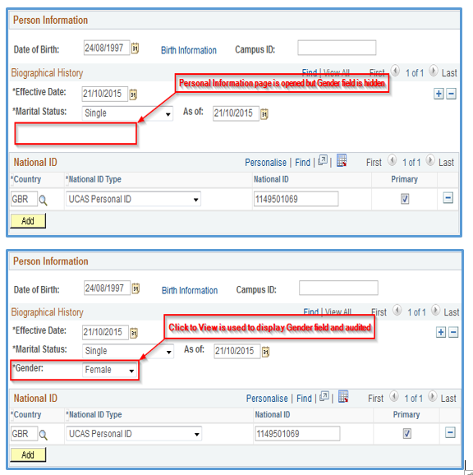
Depending on the data item there were some cases where we were unable to reach consensus on whether the field was necessary for operations.
In the end the agreement was to monitor views. This doesn’t prevent the legitimate access to the data but preserves our ability in the event of an inappropriate use of data investigation.

Slide 21
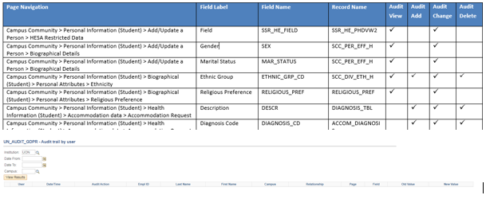
Auditing access
For each field we considered if we need to record view (as in previous slide), add, change or delete. In part these decisions were driven by volumes and the mechanism used to add the data in the first place.

Slide 22
Service Indicators / Checklists
UoN Defined as:
Service Indicators | Appeal in progress
 | Criminal Conviction - UK
 | Criminal Conviction -Course UK
 | Criminal status
 | Dispute Charge Raised-UoN
 | Dispute Charge Raised-Student
 | Complaint Received
 | Disability Assessment Reqd
 | Fraudulent Documents Provided
 | Extenuating Circumstances - UK
 | Health change declaration
 | Block Graduation
 | Sensitive Communications
 | Visa Issue - Do Not Register
 | Termination - No readmit
 | Termination - readmit acceptab
 | Under 18 Applicant
 | Under 18 Applicant - UK
 | WP Applicant - UK
 | WP - Summer School - UK
Checklists | Criminal Conviction (Staff)
 | Under 18 Applicant
Realising that although we had locked down our information on screen and/or added monitoring on view/add/change/delete we might still reveal some of the same information about a student or applicant by the use or visibility of Service Indicators and Checklists we moved on to restrict and monitor these.

Slide 23
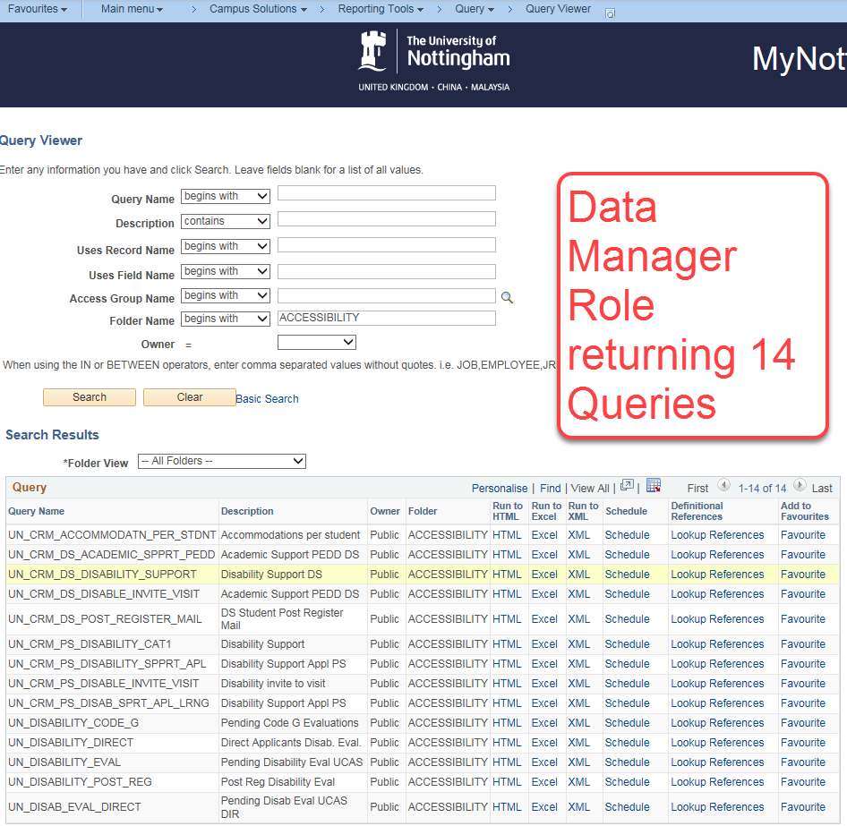
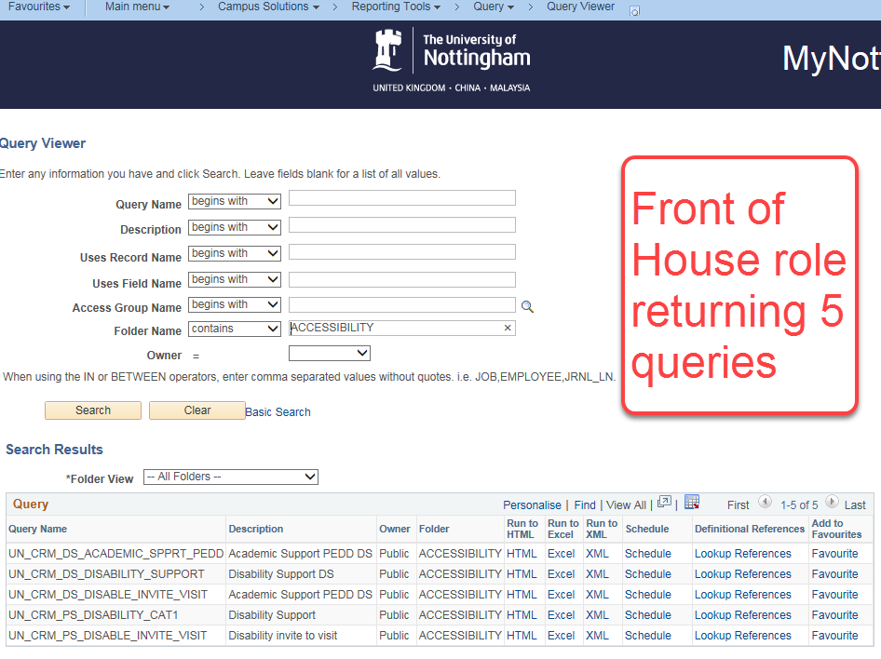
Queries
A query was created to allow us to identify which queries have the restricted fields in them. We reviewed to try to remove the field where it wasn’t necessary for the operation of the query.
After that the Query Tree security kicks in which means that if a query contains info that you are not eligible to see then the query will not appear to you.

Slide 24
OBI Security
All reports were grouped into folders. Those accessing sensitive/important information were isolated by record type. Access was mapped to user roles with permissions to see the data in Campus Solutions. We upgraded to Oracle Business Intelligence 12.2.1.3.0 to support greater audit capabilities.

Slide 25
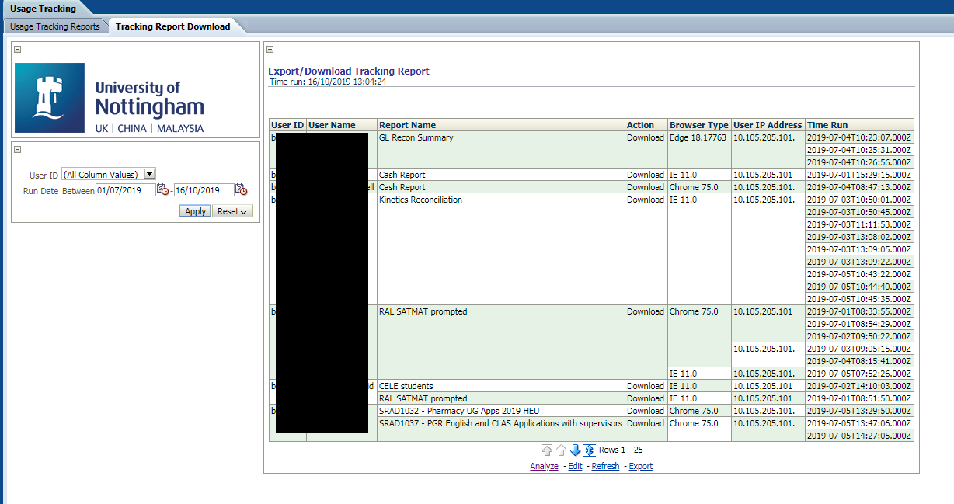
OBI Security
We also placed security on downloads with sensitive information

Slide 26
Quick Video of the hide/show and audit function.

Slide 27
How did we secure it
THE TECHNICAL BIT

Slide 28
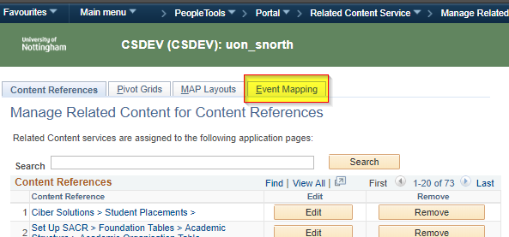
Field display audit solution
This is to be achieved through developing a custom application class which can then be configured through Campus Solutions Related Content Framework.
Using Event Mapping Service

Slide 29
Component Level MapPing
Post Build Event
Save Post Change Event

Slide 30
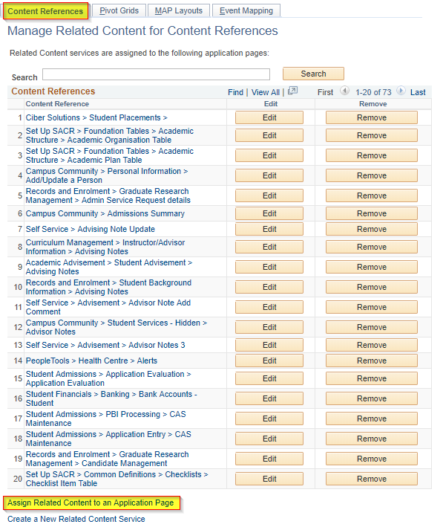
Related Content Service
Using Related Actions
Page Level Related Actions

Slide 31
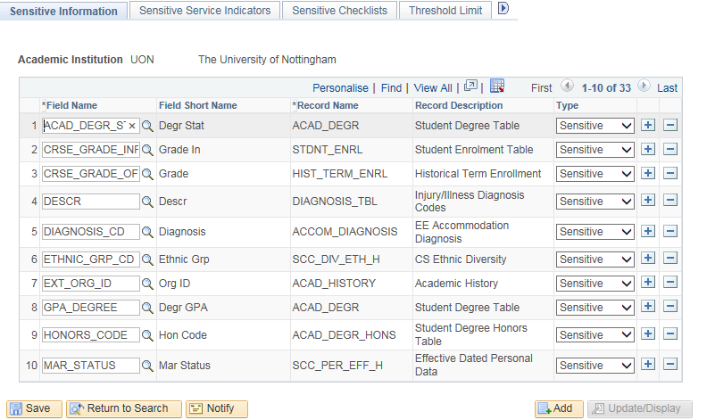
Tagging Fields as sensitive or important

Slide 32
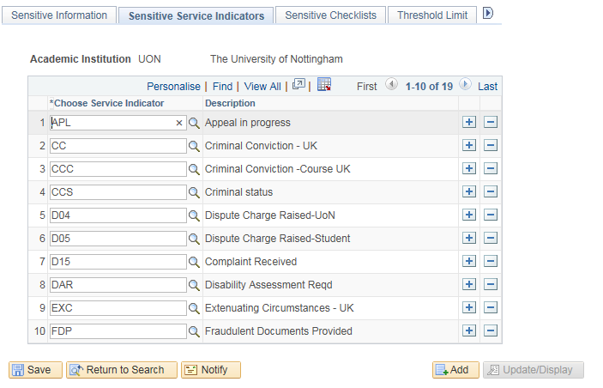
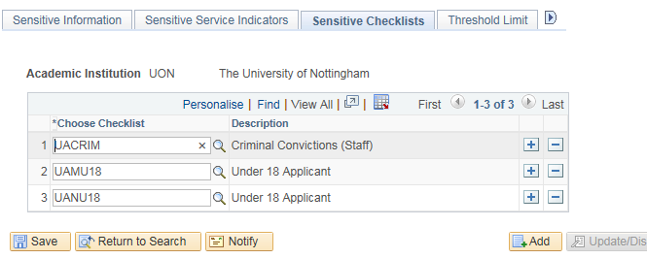
Tagging Service Indicators/Checklists

Slide 33
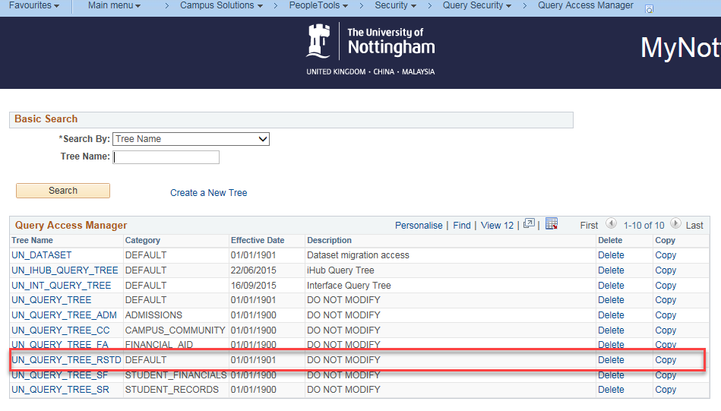
Query Tree
Set up new UoN Custom Query Tree – including one for restricted data items

Slide 34
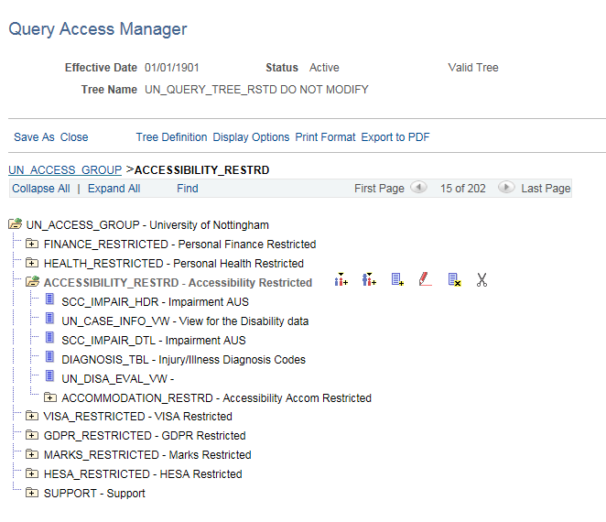
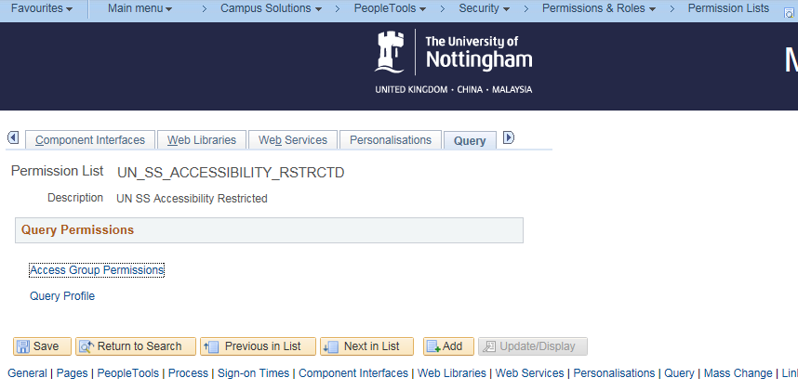
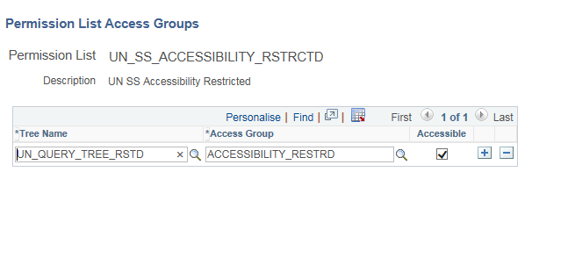
Query Tree
In Query Access Manager this lists the tables that are restricted.
And in Permissions and Roles we mapped these to our User Roles

Slide 35
Other Actions taken
Page Section Level Security – we used this to remove from view certain sections of specific pages depending on your security
Monitoring downloads – we have the ability to monitor downloads over a specified size. This is problematic because of the load that this pulls but the functionality exists and when we make the move to IAAS (or similar) this can be brought to a lower level (aligning to GDPR less than 100 records)
Academic colleagues have a very different view in Campus Solutions than administrative colleagues. Access is restricted by associations built via Advisor, Instructor, Plan or Academic Org. This means that although they can use basic queries (without restricted data in them) to see information about any student, they otherwise have to have an association through one of the above mechanisms to access the Student Record
Download warnings – we’ve placed several download warnings in the system reminding people that they are creating new data assets by downloading information that they must be handled in compliance with GDPR (and pointing to our internal information)

Slide 36
Concluding thoughts and Questions

Slide 37
presenter
Ellen Salway
Head of Service Quality, Student Services
University of Nottingham
ellen.salway@nottingham.ac.uk
all Alliance presentations will be available for download from the Conference Site

Slide 38
THANK YOU!

