Slide 1
Automated Admissions Zero to Hero in a day
SESSION 2004
17 October 2017
Notes:
Tanja Oosthuysen – functional user. Managing admissions communication from a central admissions point-of-view.
Alison and Elmien, re-inforcements from our IT department, more the brains behind the system. I just tell them all my dreams, and then they make my wishes come true.

Slide 2
presenters
Alison Dell
Tanja Oosthuysen
Senior PeopleSoft Analyst Developer
University of Pretoria
Alison.dell@up.ac.za
Manager: Enrolment
University of Pretoria
Tanja.oosthuysen@up.ac.za
Elmien Dippenaar
Senior System Analyst
University of Pretoria
Elmien.dippenaar@up.ac.za
Notes:
Tanja Oosthuysen – functional user. Managing admissions communication from a central admissions point-of-view.
Alison and Elmien, re-inforcements from our IT department, more the brains behind the system. I just tell them all my dreams, and then they make my wishes come true.

Slide 3
University of Pretoria south Africa
109 years old
60 000 students
9 faculties
137 academic departments
5300 staff members
Notes:
A little bit of information regarding the University of Pretoria

Slide 4
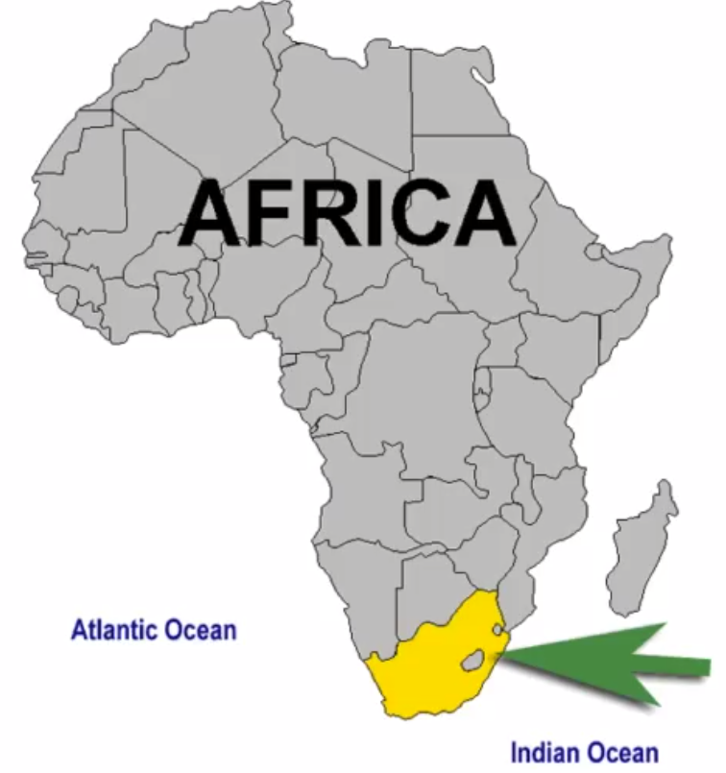
South Africa…
…is here

Slide 5
South AfricA?
not here

Slide 6
The rest of the world thinks…
Notes:
How the rest of the world think we drive to work

Slide 7
The real deal
Notes:
…the reality

Slide 8
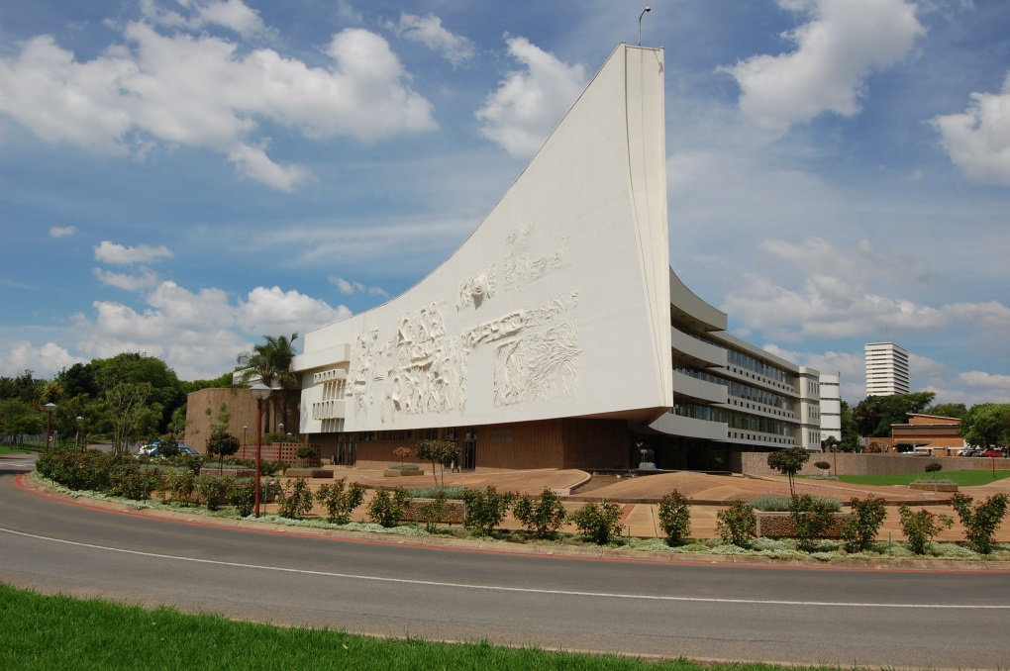
Technology
PeopleTools 8.55
PeopleSoft Campus 9.2

Slide 9
Background information
Academic year runs from January – December (schools and universities)
Government schooling system in South Africa is called the National Senior Certificate (NSC)
Most applicants apply for Undergraduate studies while they are busy with their final school year, known as their Grade 12 year.
They apply with their final Grade 11 results. (pre-final year)
Selection programmes vs Open Programmes
Entry requirements are set per study programme:

Slide 10
New Online application and automated admissions system
WHY?
Identify and process TOP ACHIEVERS, giving them admissions, housing and bursary offer all-in-one
Minimise admin processing on applicants that don’t meet requirements
HOW?
Program plan requirements built into online application process
Auto admit applicants that meet requirements
Auto placement of top achievers in residence (housing)
OUTCOME
Average processing time decreased from 32 days to 3.8 days
(emplid id allocated date – admission date)
Communication generated to admitted student
Notes:
Executive
Previously we had approximately 45 000 applicants (each with 2 study choices) of which we immediately deny at least 17 000 of them, because they do not meet the requirements for university.

Slide 11
Process
APPLICATION
Student applies
REVIEW PROCESS
Student number (emplid) allocated
AUTO ADMISSION
Admitted
LETTER GENERATED
Communication
Notes:
4 step process

Slide 12
application
APPLICATION
Student applies
Student applies for a programme at the University

Slide 13
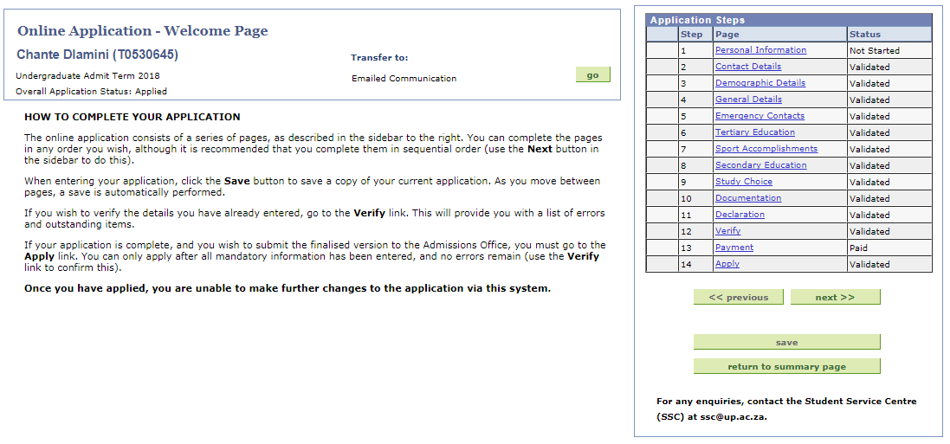
application
APPLICATION
Notes:
14 step process, quit Comprehensive, but easy 2 navigate. This data is stored in staging tables in PeopleSoft

Slide 14
APPLY REQUIREMENTS
Applying
English = 5
ENTRANCE REQUIREMENTS
Registration
English = 5
ADMISSION REQUIREMENTS
Conditional admission
English = 4
Maths = 4
APS = 30
Maths = 5
APS = 32
Maths = 5
APS = 32
Exemption
English = 50%
Maths = 50%
APS = 30
English = 60%
Maths = 60%
APS = 32
English = 60%
Maths = 60%
APS = 32
Exemption
Notes:
In order for us to fulfil the dream of executive – we introduce a 3rd set of requirements. Setup per plan. Apply/comply. Can be the same for some plans, like health sciences/architecture (selection programmes). Or in some cases we can lower the apply requirements to admit students based on NBT? This year we have been quit lenient with the apply requirements – as this is the first year in using these requirements.

Slide 15
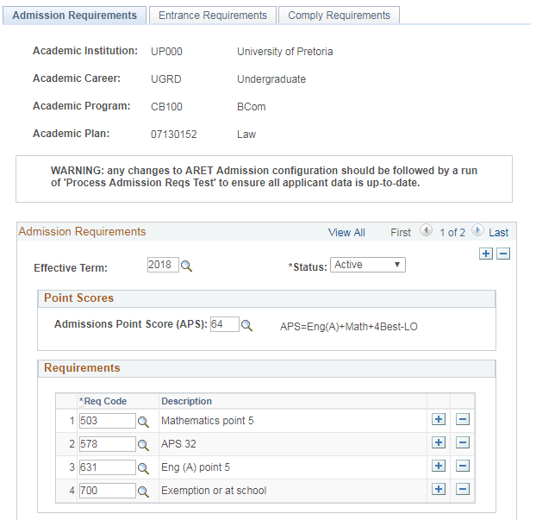
Notes:
Example of the page in PeopleSoft to give a clear idea.

Slide 16
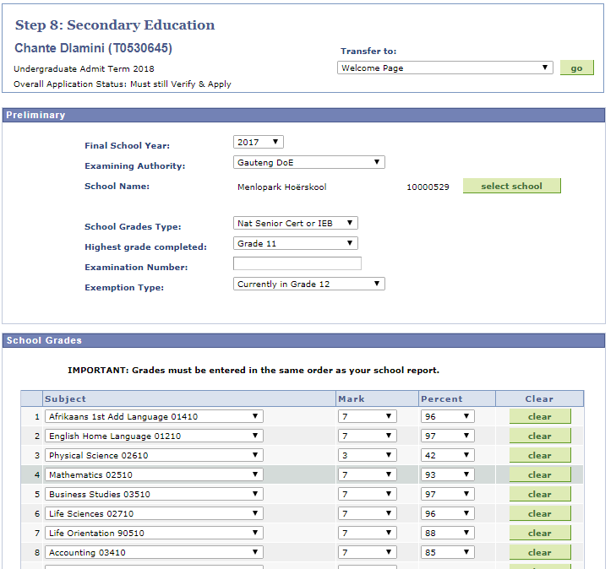
Notes:
NB Page: NSC/IEB or Non NSC, exemption type and Highest Grade completed

Slide 17
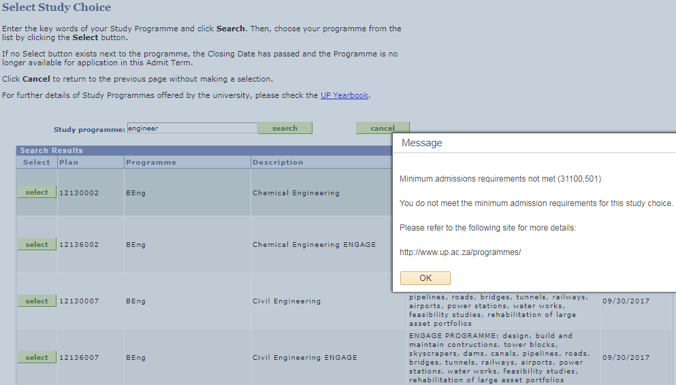
Notes:
Based on what they fill in on step 8, the system will then determine whether or not to test against the ‘apply requirements’. SO this forces an applicant to do some actual research on available study choices and the requirements for the plan.

Slide 18
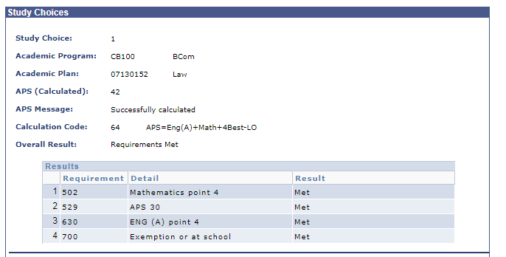
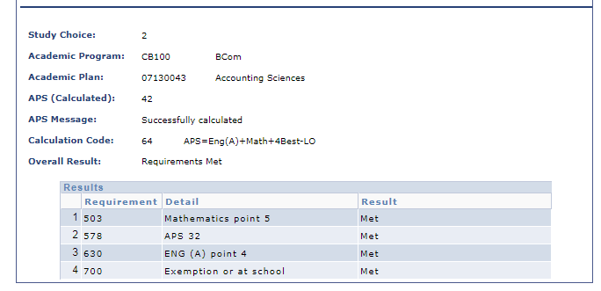
Notes:
Call Centre assisting student struggling to apply. We can check to see if can apply/comply with requirements. Not shown to the student – maybe one day.

Slide 19
Review
REVIEW PROCESS
Student number allocated
The data an applicant enters is verified against uploaded documentation and then a student number (Emplid) is allocated

Slide 20
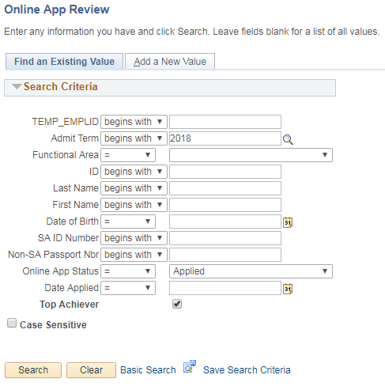
TOPIC TITLE
REVIEW
Top Achievers are identified and reviewed 1st daily (setup)
Data Management Centre ensures the school results correspond with the uploaded documentation
After review a student number is allocated
Email generated with student number and access information to UP Student Centre
Remember to limit your bullet points and text, they should highlight the important details of your presentation, but they are meant to support the speaker(s).
Notes:
Data Management Centre. Top Achievers reviewed first. Look at the screen of where you get your list of applications that still needs to be reviewed. Data is stored on PeopleSoft Tables/records.

Slide 21
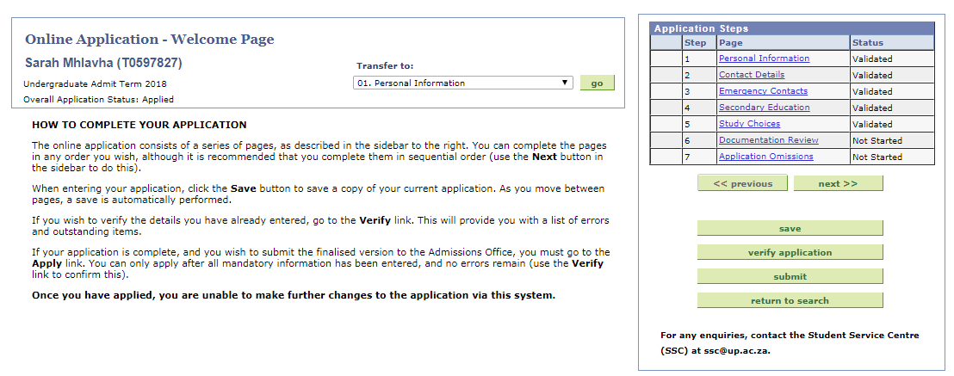
TOPIC TITLE
REVIEW
Review screen
Notes:
If all docs are valid a Search/Match is performed and new emplid is allocated when no match has been found.

Slide 22
Auto admission
AUTO ADMISSION
Admitted
Process where an applicant is admitted automatically to non-selection programmes.
Notes:
Favourite part

Slide 23
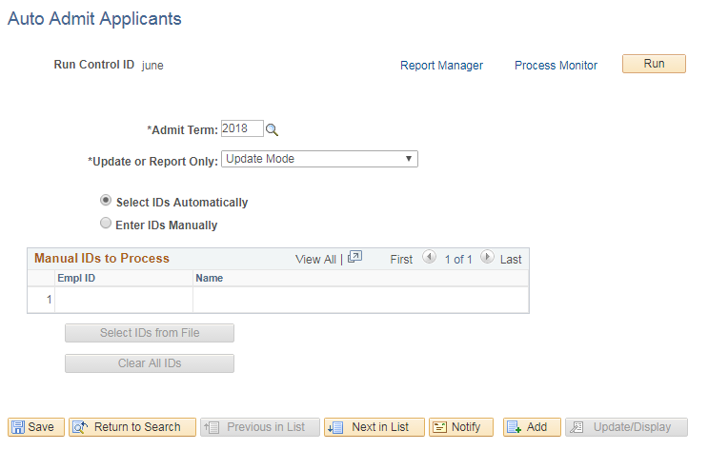
Step 1 example
ADMISSIONS
Notes:
Everybody that received a student number that they and were flagged will go through this process. Flagged is UGRD, NEW Admit Type (no tertiary info), SA citizen, and NSC/IEB examination authority

Slide 24
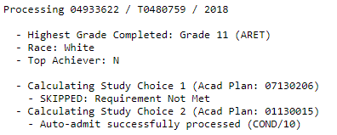
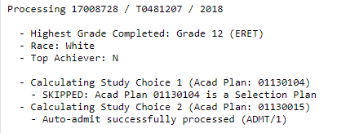
Currently in Gr 12 applicants test against Admission Requirements
Program Action = (COND)
Conditional Admission
Action Reason = 10 (Based on Gr 11 results)
Utilize the Slide Sorter view while setting up your slides to see how the flow is progressing on your presentation
Selection programmes are ‘skipped’ in the process
Completed Gr 12 applicants test against Entrance Requirements
Program Action = (ADMT) Unconditional Admission
Action Reason = 1 (Admitted)
If a 1st choice is admitted, the 2nd choice is not processed and automatically cancelled.
Program Action = (WADM) Administrative Withdrawal
Action Reason = 2 (Admitted for 1st choice)
If a top achiever is processed an automatic email is generated to a designated person (setup)
Notes:
Progress report on what happened and identified all the exceptions

Slide 25
If a student completed Gr 12 longer than 2 years from Admit term – it is also not processed.

Slide 26
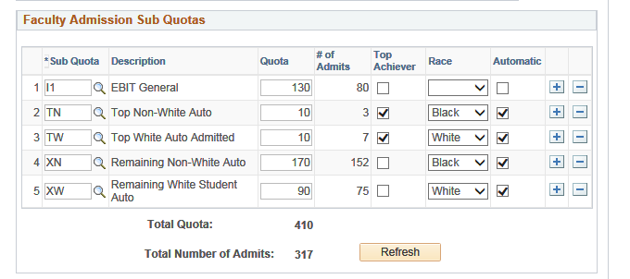
qUOTAS
At least 5 different quota setups exist per plan.
Student is placed in a quota according to Top Achiever or not, and then based on his/her population group.
Top Achiever quotas are usually set high to ensure top achievers are admitted daily.
Notes:
Previously disadvantaged population groups are prioritised and identified.

Slide 27
TOP ACHIEVER AND Residence (HOUSING)
Top Achiever > 85%
Applied for residence
Placed in residence
Admitted / Conditionally admitted to a study choice
If a student is identified as a Top Achiever, Admitted and applied for housing – he/she is automatically placed.

Slide 28
Letter generation
LETTER GENERATION
Communication
Communication is sent to students automatically using the 3C’s component and BI Publisher
Notes:
Customised 3C component

Slide 29
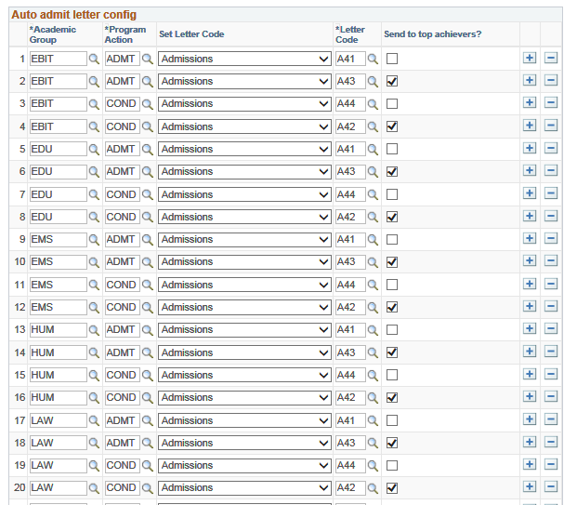
Letter setup
COMMUNICATION
Letters are setup in communication component (3C’s)
Setup available to have different letters for different faculties
Letters are then processed to all admitted students based on the quota
Different letters are generated to the top achievers

Slide 30
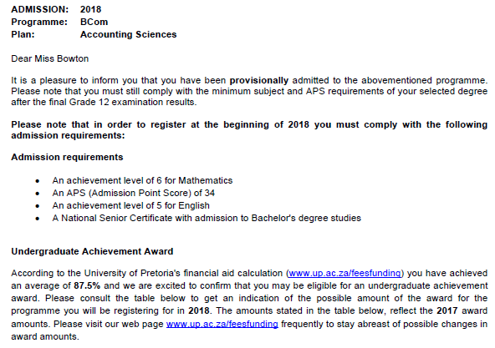
EXAMPLE
COMMUNICATION

Slide 31
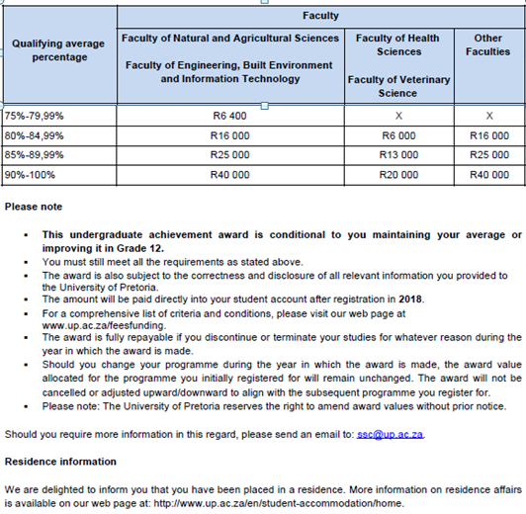
EXAMPLE
COMMUNICATION

Slide 32
negatives
Higher rejection rate where applicants do not comply – bad publicity
No more paper applications – potentially disadvantages rural candidates who do not have internet access
Fewer applicants = Less application fees

Slide 33
positives
Shorter processing time; faster resolution; student receives communication of admissions status, housing placement and bursar offer.
Establishment of the Centralised Admissions Office frees up faculty staff to focus more on International applicants, transfers and applicants with other examination authorities.
Auto Admissions process enables Central Admissions Office to manage quotas and numbers more efficiently.
Admission targets met earlier, with clearer indication of shortfall in programmes.
Applicants make more realistic decisions.

Slide 34
POSITIVES
 | 2016 | 2017
Applications | 34780 | 33578
Admissions | 14442 | 16298
Admissions Target | 82% | 95%
64% of the total number of admissions were automatically admitted (end July)
66% of auto admitted students were admitted within 1 day of them receiving their student number

Slide 35
TECHNICAL NUTS & BOLTS
This project was squeezed in at the end of last year in response to a growing focus at UP on maximizing efficiencies
Growing pressure on existing staff to manage increasing workloads – programmatic intervention required
Two to three months development effort – development primarily done by a consultant with our implementation partner, Bruce Robinson from Visions Consulting

Slide 36
TECHNICAL NUTS & BOLTS
Our bolt on Online Study Application process is an alternative to AAWS – we developed the Online Study Application in 2012, prior to AAWS being widely utilized – first went live 01 March 2013
Uses custom staging tables as a temporary holding area for data, which, on application submission, write to delivered Peoplesoft admissions and biographical records
Nightly automated admit process, residence placement and letter generation accomplished using scheduled processes (three application engines)
Letters sent via email using 3C engine, with a custom calling process hugely simplifying 3C processing – all managed by setup
Notes:
Data stored in staging tables – undergoes stringent validations before the application can be submitted, so that only clean data makes it to PSFT delivered tables.
The original development for online study app was completed within six months, including user acceptance testing (which formed the bulk of the effort)

Slide 37
ANY QUESTIONS?

Slide 38
presenters
Alison Dell
Tanja Oosthuysen
Elmien Dippenaar
Senior PeopleSoft Analyst Developer
Alison.dell@up.ac.za
Enrolment Manager
Tanja.oosthuysen@up.ac.za
Senior System Analyst
Elmien.dippenaar@up.ac.za
all Alliance presentations will be available for download from the Conference Site

Slide 39
THANK YOU!

