Slide 1
PeopleSoft Campus Solutions Upgrade The Devil in the Details
SESSION 4009
29 Apr 2019

Slide 2
presenters
Yvonne Yong
Principal IS Analyst
Singapore Management University
yvonneyong@smu.edu.sg
Application Support for Student Information Systems
Over 13 years of experience with PeopleSoft
11 years of experience with Campus Solutions

Slide 3
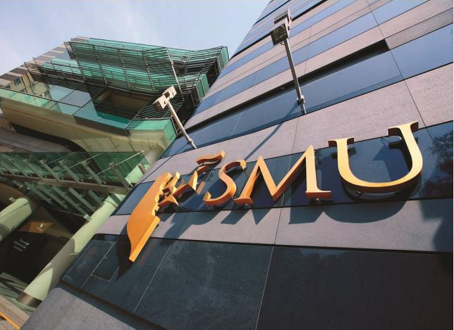
Singapore Management University

Slide 4
Singapore Management University (SMU)
A premier university in Asia, the Singapore Management University (SMU) is internationally recognised for its world-class research and distinguished teaching.
Established in 2000, SMU’s mission is to generate leading-edge research with global impact and produce broad-based, creative and entrepreneurial leaders for the knowledge-based economy.
Home to around 10,000 undergraduate, postgraduate, executive and professional, full- and part-time students.
SMU has six schools: School of Accountancy, Lee Kong Chian School of Business, School of Economics, School of Information Systems, School of Law, and School of Social Sciences.

Slide 5
SMU & ORACLE

Slide 6
SMU & Oracle
PeopleSoft Campus Solutions | Version
Current Version | 9.2
Campus Solutions Modules | Admissions & Recruiting Academic Advisement Student Records Student Financials Campus Community Campus Self Service
PeopleTools | Version
Current Version | 8.55

Slide 7
Content
Project Overview
Project Challenges
Achievements
Concluding Thoughts

Slide 8
Project overview
Background, Scope
Timeline
Scale & Complexity
Risks
Project Organization

Slide 9
Project Background & Objectives
The Integrated Student Information System (ISIS) using PeopleSoft Campus Solutions 8.9 had been implemented more than 10 years ago - aged software version was on limited support
Infrastructure was close to end of support life - opportunity to refresh infrastructure to SMU’s preferred platform and reduce maintenance costs
The system upgrade would provide a platform to implement more attractive functions and features in the future

Slide 10
Project Scope
Technology | Previous | Now
Operating System | Solaris10 | Windows 2012 R2
Database | Oracle 11g | MS SQL 2016
PeopleTools | 8.49 | 8.55
Campus Solutions | 8.9 | 9.2
Retrofit SMU customizations

Slide 11
Project Timeline
30 Nov 2016
23 Apr 2018
Functional
Keep/Drop
Retrofit / Dev
SIT
UAT
Go Live
Performance Security Test
PGP/ Warranty
23 Apr 2018
Initial Pass
Retro-fit1
MTP 2
Retro-fit2
MTP 3
Cut Over
Technical

Slide 12
Scale & Complexity
TECHNICAL OVERHAUL
Application
Database
Servers
MANY BUSINESS PROCESSES
> 40K users/year
21 Process Areas
~1000 test cases
OPERATIONAL
IMPACT
Limited downtime
Critical changes during project
INTEGRATION
40 interfacing systems within and external to SMU

Slide 13
Project RISKs
Underestimated customizations scale and complexity
Limited SMU resources and availability
Concurrent System Changes during Upgrade
Limited Time for Testing

Slide 14
Strong and Committed Project Team
SMU
Project Steering Committee: Registrar, CFO, CIO
9 Project Management Committee Members
>30 reps from 16 departments/schools
Vendors
2 Project Directors
4 Project Management Committee Members
10 Core Team Members (interviewed by SMU for key roles)
50 technical team members

Slide 15
Project Challenges
Delays
Software Differences
Change Control
Technical Considerations

Slide 16
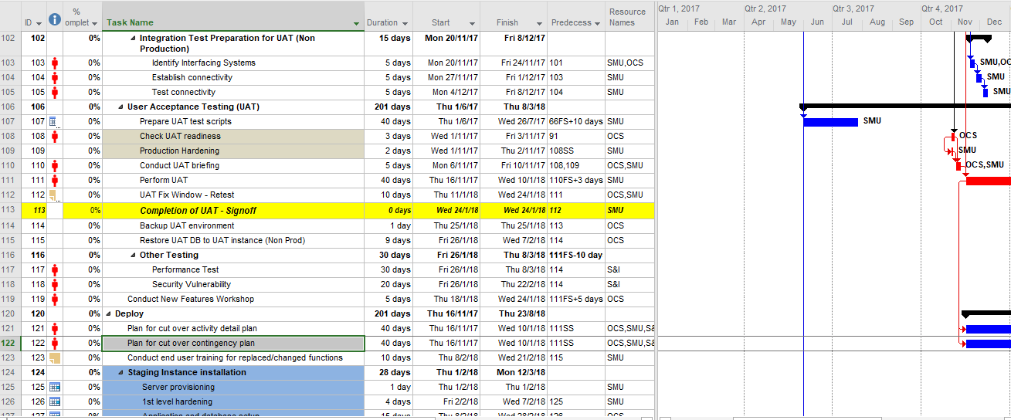
Initial Project Schedule
Tasks were too high-level to predict an accurate master project schedule

Slide 17
Planned Project Timeline
21 Mar 2017
Functional
Keep/Drop
Retrofit / Dev
27 Oct 2017
SIT
24 Jan 2018
UAT
Go Live
Performance Security Test
PGP/ Warranty
23 Apr 2018
Initial Pass
Retro-fit1
MTP 2
Retro-fit2
MTP 3
Cut Over
Technical

Slide 18
Actual Project Timeline
Functional
Keep/Drop
Fit/Gap
Retrofit / Dev
SIT
27 Apr 2018
UAT
Go Live
Performance Security Test
PGP/ Warranty
5 May 2018
Initial Pass
Retro-fit1
MTP 2
Retro-fit2
Retrofit3
MTP 3
MTP 4
Retrofit4
Cut Over
Technical

Slide 19
Causes of Delay
Underestimated extent of customizations
Performance issues took time to resolve
Inadequate SIT scenarios identified
UAT was impacted by SIT delay
UAT had to be phased out by modules based on SIT completion

Slide 20
Fit Gap Blind Spot
Software version changes underestimated
Performance
Maintain Applications
Advisement processing
Student Program/Plan CI
Product Issues
Bugs in Advisement and Enrolment, raised SRs with Oracle Support
Different setup data
Translate Values
Country Table
Address formats
Security permissions
New technical features available to irrelevant users
New fields in delivered pages
Users are unfamiliar and may have impact when used wrongly

Slide 21
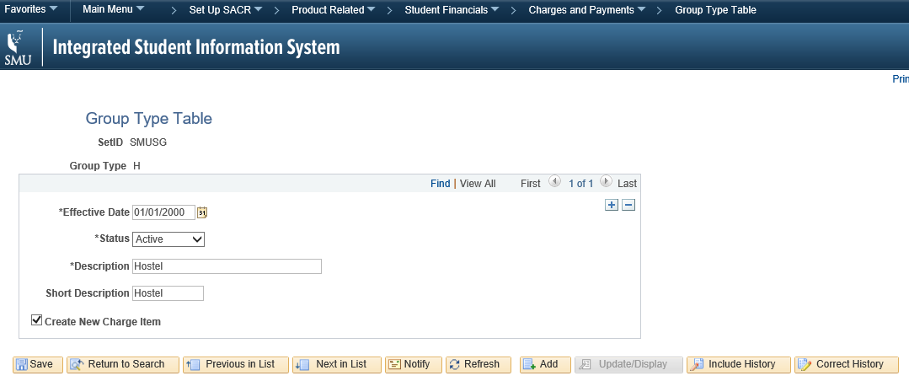
Missed Gap
Example issue due to new field default:
New configuration defaulted as enabled.
Impact: Transactions no longer grouped when posting.
Issue: Automated interface could not process subsequent transaction reversals

Slide 22
Change Control
Out of more than 200 system changes requested, 25 critical fixes and enhancements could not be deferred to after Go-Live, including:
Tuition Grant requirement for Admissions from MOE
University Admissions Score computations
IRAS requirement for external organisation billing
Enhancements for PDPA policies
Security vulnerability fixes

Slide 23
System Code Freeze
Code freeze period reduced from 1 year to 2 months
COP2
COP3
COP4
COP Final
COP1
MTP4
Cut Over
Initial Pass
Retrofit1
Retrofit2
MTP2
Retrofit3
MTP3
Retrofit4
Dev
SIT
UAT
PROD

Slide 24
Environment Planning
89 DEMO
89
Code Ref
89
PRD
92 DEMO
92
DEV
92
SIT
92
PRD
92
UAT
92
STG
Customizations re-application
Development from functional specifications
Oracle to MS SQL Server retrofit
Crystal Reports to XMLP
SIT
UAT
Performance Testing
Security Vulnerability Testing
Dry Run
Final Cutover
Provision after Go-Live

Slide 25
Actual Environments
89 DEMO
89
Code Ref
89
UAT
89
UAT2
89
Dry Run
89
FV
89
DV
89
PRD
92 DEMO
92
DEV
92
DEV2
92
SIT
92
UAT
92
PERF
92
Dry Run
92
STG
92
DV
92
PRD
Customizations re-application
Development from functional specifications
Oracle to MS SQL Server retrofit
Crystal Reports to XMLP
Critical system bug fixes and enhancements
SIT
UAT
(required for UAT with the 40 interfacing systems)
Performance Testing
Security Vulnerability Testing
(required for concurrent activities)
Dry Run
Report and Data Verification
(required for concurrent activities)
Functional Verification
Data Verification
Final Cutover
Graduation Parallel Run

Slide 26
Testing
Limited time and resources for testing
Specific scenarios
Silent issues missed from SIT and UAT scenarios
Datetime handling,
wrong data deletions,
rare scenarios
Performance issues
5 scenarios selected for Performance Testing
Overlooked functions:
Query reports
Batch processes
Infrastructure issues
PRD architecture different from UAT
All file input processes failed
Unsupported filenames

Slide 27
Achievements
Data Intact
Go-Live on Time
Minimal Business Impact

Slide 28
Data Verification Strategy
Data Reconciliation and Verification Approach
Comparison by Scripts
Migrate database
Upgrade Application
Apply Customisations
Functional Data Recon and Verification
Technical Data Recon and Verification
Row Count Recon
Row Count Recon
Query/ Reports
SQL Extract Compare

Slide 29
Automate Data Verification
Issues were found from this, leading to fixes in database migration and upgrade scripts
Technical Verification
Prepare scripts to extract data and compare CS89 ad CS92
Discrepancies, if any, will be flagged out
SELECT CS89.EMPLID, CS89.ACAD_CAREER, CS89.INSTITUTION, CS89.STRM, CS89.CLASS_NBR, CS89.CRSE_CAREER, CS89.SESSION_CODE, CS89.SESSN_ENRL_CNTL, CS89.STDNT_ENRL_STATUS, CS89.ENRL_STATUS_REASON, CS89.ENRL_ACTION_LAST, CS89.ENRL_ACTN_RSN_LAST, CS89.ENRL_ACTN_PRC_LAST, CS89.STATUS_DT, CS89.ENRL_ADD_DT, CS89.ENRL_DROP_DT, CS89.UNT_TAKEN, CS89.UNT_PRGRSS, CS89.UNT_PRGRSS_FA, CS89.UNT_BILLING, CS89.CRSE_COUNT, CS89.GRADING_BASIS_ENRL, CS89.GRADING_BASIS_DT, CS89.OVRD_GRADING_BASIS, CS89.CRSE_GRADE_OFF, CS89.CRSE_GRADE_INPUT, CS89.GRADE_DT, CS89.REPEAT_CODE, CS89.REPEAT_DT from cs89.PS_STDNT_ENRL
EXCEPT
SELECT CS92.EMPLID, CS92.ACAD_CAREER, CS92.INSTITUTION, CS92.STRM, CS92.CLASS_NBR, CS92.CRSE_CAREER, CS92.SESSION_CODE, CS92.SESSN_ENRL_CNTL, CS92.STDNT_ENRL_STATUS, CS92.ENRL_STATUS_REASON, CS92.ENRL_ACTION_LAST, CS92.ENRL_ACTN_RSN_LAST, CS92.ENRL_ACTN_PRC_LAST, CS92.STATUS_DT, CS92.ENRL_ADD_DT, CS92.ENRL_DROP_DT, CS92.UNT_TAKEN, CS92.UNT_PRGRSS, CS92.UNT_PRGRSS_FA, CS92.UNT_BILLING, CS92.CRSE_COUNT, CS92.GRADING_BASIS_ENRL, CS92.GRADING_BASIS_DT, CS92.OVRD_GRADING_BASIS, CS92.CRSE_GRADE_OFF, CS92.CRSE_GRADE_INPUT, CS92.GRADE_DT, CS92.REPEAT_CODE, CS92.REPEAT_DT from CS92.PS_STDNT_ENRL

Slide 30
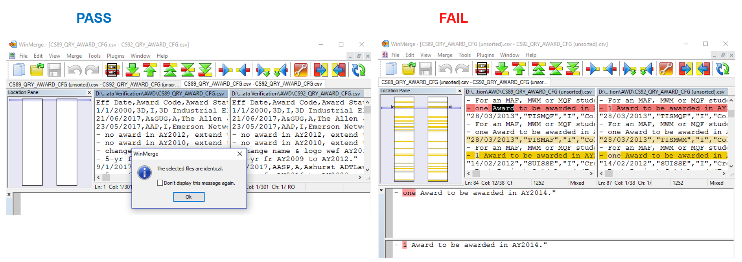
User Verification
More comprehensive than page sampling and eyeballing operational reports

Slide 31
Go-Live
Functional
Keep/Drop
Fit/Gap
Retrofit / Dev
SIT
UAT
Go Live
Performance Security Test
PGP/ Warranty
5 May 2018
Initial Pass
Retro-fit1
MTP 2
Retro-fit2
Retrofit3
MTP 3
MTP 4
Retrofit4
Cut Over
Technical

Slide 32
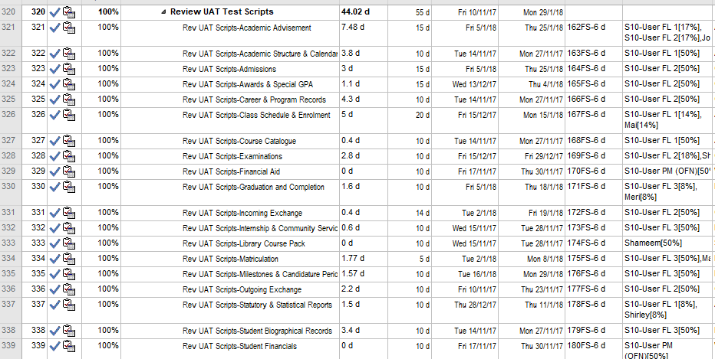
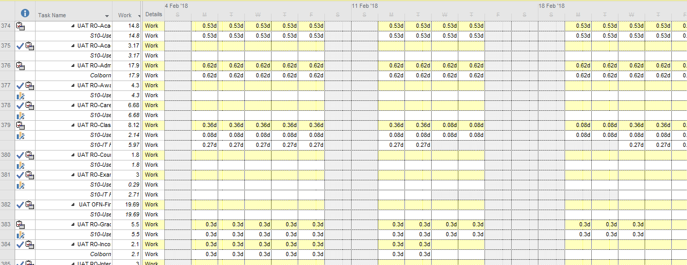
Resource Levelling
Despite additional activities:
Internal SIT by SMU
Detailed UAT Script Review
Regression Testing
Data Verification UAT
Delta Migration UAT
UAT phase was planned with more than 200 tasks defined with estimated efforts based on test cases, phased based on SIT completion, with detailed resource loading and levelling.

Slide 33
Cutover Period
Cutover period reduced from 3 weeks to 8 days.
Initial Pass
4 months
Move To Production 2
Move To Production 3
Move To Production 4
Prep
Dry Run
Prep
Final Cutover
6 days for upgrade
+
2 days for verification and delta migration

Slide 34
Business Operations During Cutover
ISIS - Academic Advisement | ISIS - Interfaces
ISIS - Academic Structure & Calendar | ISIS - Internship & Community Service
ISIS - Admissions | ISIS - Library Course Pack
ISIS - Awards & Special GPA | ISIS - Matriculation
ISIS - Career & Program Records | ISIS - Milestones & Candidature Period
ISIS - Class Schedule & Enrolment (including BOSS) | ISIS - Outgoing Exchange
ISIS - Course Catalogue | ISIS - PeopleTools
ISIS - Examinations | ISIS - Statutory & Statistical Reports
ISIS - Financial Aid | ISIS - Student Biographical Records
ISIS - Graduation and Completion | ISIS - Student Financials
ISIS - Incoming Exchange | ISIS - Student Profiling & Admin Holds
 | ISIS - Transfer Credits & Exemptions
Go-Live period was heavily deliberated to avoid majority of business cycles.
However, it still coincided with the peak periods for postgraduate application submissions, and Undergraduate admissions interview and evaluation.

Slide 35
Careful Cutover Considerations
Cut Over
Go Live
27 Apr 6pm
28 Apr 9am
4 May 6pm
5 May 9pm
Applicant
Downtime
CS8.9 (limited transactions)
Downtime
CS9.2
Migrate Delta
Staff
Downtime
CS8.9 (limited transactions)
CS9.2

Slide 36
Concluding Thoughts
Key Learning Points
Project Benefits

Slide 37
Key Learning Points
Scrutinize the proposed project schedule, tasks and effort
Set detailed expectations and ensure proper quality control and governance from the start of project
Be as detailed as possible early in the project, to identify required tasks, gaps and issues early
Consider opportunities to automate tasks, eg. testing and data verification
Do not take anything for granted

Slide 38
Project Benefits
New software version on full support
Reduced maintenance costs
Support team acquired new and updated skills
Leveraged new delivered features to replace aged bolt-ons e.g.
Interactive Advisement Report
Process Milestones
Process and Mass Release Service Indicators
Potential to improve business processes e.g. Research Tracking
Potential to implement attractive features, e.g.
Fluid UI
Drill-down queries
Work Centres

Slide 39
Q&A

Slide 40
presenters
Yvonne Yong
Principal IS Analyst
Singapore Management University
yvonneyong@smu.edu.sg
all Alliance presentations will be available for download from the Conference Site

Slide 41
THANK YOU!

