Slide 2
Utilizing Jmeter for proper Oracle
Applications Environment Sizing
Presenter Information
Mohamed Ibrahim Khalil
Application and Database Specialist
Abu Dhabi University
Mohamed.Khalil@adu.ac.ae
+971-50-5909919
SESSION ####
DATE OF PRESENTATION

Slide 3
Problem Statement
Peoplesoft Campus with high volume of data and users often complain
about performance glitches such as:
Slowness of the application during peak hours or periods
Poor response time with the application when number of concurrent users increases
Limited number of concurrent user

Slide 4
What is jMeter
JMeter is an Open Source software (Graphical user interface) that can perform load test , regression test and stress test.
It is 100% JAVA application that can run on several platform such as Windows, Linux, Mac.

Slide 5
The tool :jMeter
In order to understand the reason for the performance degradation, we utilized JMeter to stimulate heavy load on servers to analyse application behaviour under heavy load. JMeter used to track application and database response time , which helps us to in identifying the problematic areas in the application to be fine-tuned.
It also can generate a serial of N of virtual users and against several protocols such as:
- Web: HTTP and HTTPS
- Directory: LDAP
- Database : JDBC driver
- Messeging : IMAP ,POP3 and SMTP
- Load Balancer : F5

Slide 6
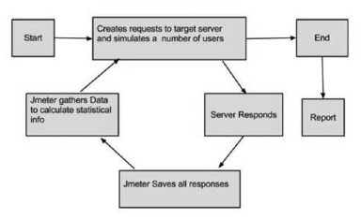
jMeter Process Architecture

Slide 8
Contact information
Mohamed.Khalil@adu.ac.ae
+971-50-5909919

